Slide 1
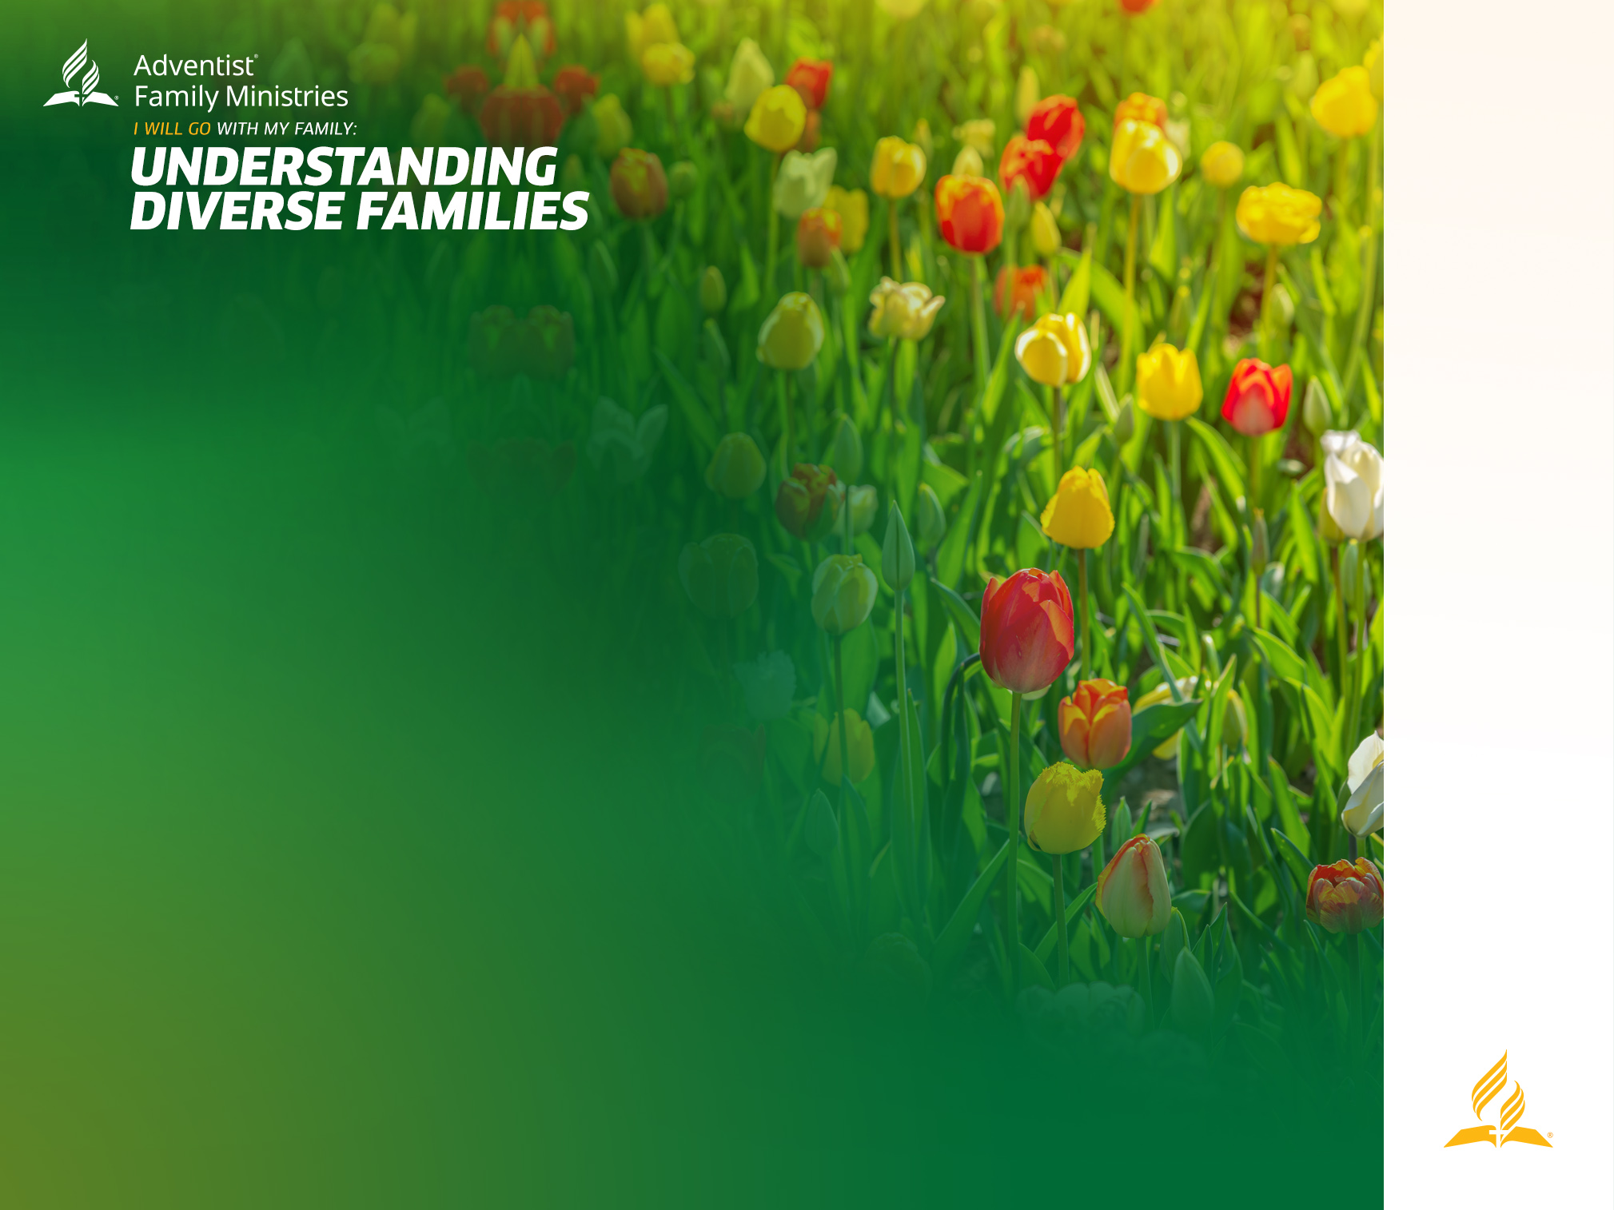
MANAGING DIFFERENCES IN THE FAMILY
Presented by: (add presenter’s name here)
Written by: Alina Baltazar, PhD, MSW, LMSW, CFLE, CCTP-I, CCTP-F is the MSW Program Director & Professor in the School of Social Work and Co-Associate Director for the Institute for the Prevention of Addictions at Andrews University, and also a psychotherapist who treats mental illness in children/adolescents and families in Berrien Springs, MI, USA.

Slide 2

TEXTS:
“So God created man in His own image; in the image of God He created him; male and female He created him.” Genesis 1:27 NKJV
“For by one Spirit we were all baptized into one body – whether Jews or Greeks, whether slaves or free – and have all been made to drink into one Spirit.” I Corinthians 12:13 NKJV
“Where there is neither Greek nor Jew, circumcised nor uncircumcised, barbarian, Scythian, slave nor free, but Christ is all and in all.” Colossians 3:11 NKJV
MANAGING DIFFERENCES IN THE FAMILY

Slide 3
TEXTS:
“Be of the same mind toward one another. Do not set your mind on high things, but associate with the humble. Do not be wise in your own opinion.” Romans 12:16 NKJV
“For all the law if fulfilled in one word, even in this: “You shall love your neighbor as yourself.” Galatians 5:14 NKJV
MANAGING DIFFERENCES IN THE FAMILY

Slide 4
STATEMENT OF PURPOSE:
This seminar aims to help the audience better understand differences within the family and how to manage any conflict that may arise from these differences, especially concerning modern societal issues. This seminar also addresses how to improve empathy and communication skills that may help resolve conflict related to these challenges.
MANAGING DIFFERENCES IN THE FAMILY

Slide 5
DIFFERENCES IN THE FAMILY
Human beings are all different. Everyone was created in the image of God, so our differences reflect the beautiful dimensions of our creator. “So God created man in His own image; in the image of God He created him; male and female He created him.” Genesis 1:27 NKJV. People differ in many ways: personality, age, hair color, eye color, height, hair texture, gender, skin color, interests, abilities, sexual attraction, physical and mental health, limitations, body size/type, opinions, etc. Look around at your family and you will see several of these human variations. Many of these differences are biological, and some can be influenced by the environment and life experiences.
MANAGING DIFFERENCES IN THE FAMILY

Slide 6
CULTURES
Our cultures often value some of these characteristics over others. In some cultures, certain body types are valued over others, whereas another culture could be the opposite in the type of body that is valued. As a result, some children may look down on others and other children internalize those lower opinions of themselves.
This can lead to conflict in the family. We may treat certain members of the family poorly due to their perceived lower value in society. Those who aren’t treated well may act out or withdraw from the family all together, which can reinforce some of those low opinions of the other person.
MANAGING DIFFERENCES IN THE FAMILY

Slide 7
IMPROVE EMPATHY
One of the roles of parents is to talk about these differences to lessen the harm that can happen to a developing child’s self-esteem and to improve empathy for those who are different from themselves. These conversations aren’t always easy. It starts by developing a close relationship when our children are young. When there is a close relationship, kids feel like they can talk to their parents about difficult topics and know they won’t feel judged (Baltazar, Dessie, & McBride, 2020)
MANAGING DIFFERENCES IN THE FAMILY

Slide 8
IMPROVE EMPATHY CONT.
Empathy is a great way to smooth over problematic differences in the family. In a sinful world, empathy does not develop naturally. Parents play a powerful role in children developing empathy. Harvard University (2023) has a Making Caring Common project that has shared the following tips to cultivate empathy in children.
MANAGING DIFFERENCES IN THE FAMILY

Slide 9
IMPROVE EMPATHY CONT.
Tips To Cultivate Empathy In Children:
Empathize with your child and model empathy for others
Make caring for others a priority and set high ethical expectations
Provide opportunities for children to practice empathy
Expand your child’s circle of concern
MANAGING DIFFERENCES IN THE FAMILY

Slide 10
IMPROVE EMPATHY CONT.
Tips To Cultivate Empathy In Children:
Help children develop self-control and manage feelings effectively
  Help child be aware of and identify problematic emotions
  Show child how to slow down breathing to increase calm
  Demonstrate the “pizza breathing” exercise
Harvard University (2023)
MANAGING DIFFERENCES IN THE FAMILY

Slide 11

MANAGING DIFFERENCES IN THE FAMILY
GROUP EXERCISE

Slide 12
GROUP EXERCISE
Discussion Questions
Think back to when you were a teen. What was the best part about that time in your life?
What were some of the challenges you faced during that time?
Was there anything your parents did or said to you that was helpful during your teen years?
MANAGING DIFFERENCES IN THE FAMILY

Slide 13
How to talk so your teen will listen and
listen so your teen will talk
Adolescence can be a challenging time for many parents because this is a time when teens are working on developing their identity. They are deciding what parts of your teachings they will internalize, fitting them into their unique personality in a world different from the ones their parents grew up in.
MANAGING DIFFERENCES IN THE FAMILY

Slide 14
How to talk so your teen will listen and
listen so your teen will talk cont.
This can lead to conflict between parents and teens when a teen starts to experiment with or take on an identity the parent(s) disagree with and are afraid it may lead to a path of destruction physically and/or spiritually. Though teens are increasingly turning to their peers and media for guidance, parents still play a powerful role. Parents often don’t know how to approach their teen, who seems resistant to any guidance, or how to avoid a teen thinking they are being judged or disrespected.
MANAGING DIFFERENCES IN THE FAMILY

Slide 15
MANAGING DIFFERENCES IN THE FAMILY
GROUP EXERCISE

Slide 16
GROUP EXERCISE
Explore and discuss in your groups ways we are almost guaranteed to turn most kids off.
Think of some typical scenarios you have had with your kids and identify ways you have or think you would get a negative response.
MANAGING DIFFERENCES IN THE FAMILY

Slide 17
Six approaches that will help parents communicate with teens.
Deal with feelings
Getting a teenager’s cooperation
To punish or not to punish
Faber & Mazlich, 2005
MANAGING DIFFERENCES IN THE FAMILY

Slide 18
Six approaches that will help parents communicate with teens cont.
Working it out together
Get to know your teen.
Healthy expressions.
Faber & Mazlich, 2005
MANAGING DIFFERENCES IN THE FAMILY

Slide 19
How to talk about difficult issues:
We may often think we have to choose a side that is the opposite of someone else. In reality, both sides may want the same thing, and they just have different ideas on how to get them. We have more in common than we realize.
Generally, all humans want love, acceptance, safety, and freedom. As Christians, we want to show we love and care for others. Based on our culture and personal experience, we develop different ideas on how to get these desires met.
MANAGING DIFFERENCES IN THE FAMILY

Slide 20
How to talk about difficult issues:
When these differences lead to conflict in the family, it helps to really listen to the need or desire behind what the person is saying. Try to avoid taking offense at what is being said, be cordial instead.
There may be times when you genuinely believe the other person is wrong. It helps to state the facts, realizing they may disagree with the reliability of those facts.
It helps to ask questions to understand the other person’s perspective better. Doing so may help them see the error of their thinking without being embarrassed over their erroneous thinking.
MANAGING DIFFERENCES IN THE FAMILY

Slide 21
How to talk about difficult issues:
Look for what you do agree on and build from there. If you still sincerely believe the other person is in the wrong, but they refuse to see it, you don’t need to end the relationship. Continue to pray for the other person and your relationship with them.
Resolving differences without hurting the other person’s feelings can be challenging, thus damaging the relationship. As a result, we often avoid talking about problems, or we just don’t express ourselves directly.
MANAGING DIFFERENCES IN THE FAMILY

Slide 22
How to talk about difficult issues:
There are ways to communicate our needs without making the other person defensive.
Aggressive communication
Passive communication
Passive aggressive communication
Assertive communication
MANAGING DIFFERENCES IN THE FAMILY

Slide 23
How to talk about difficult issues:
Here is an example of an assertive communication script:
  “I feel __________.” First, we need to know what our feelings are. Psychologists vary on what our core emotions are, but generally, when we are upset about something, we are experiencing some variation of disgust, sadness, anger, or fear.
  Do not say, “I feel that __________” That is an opinion, not a feeling. It can cause the person to get defensive, which can then escalate to conflict.
  “About______” Describe what you are concerned about without using the word “you” if possible. The other person isn’t necessarily the problem, but the situation is.
MANAGING DIFFERENCES IN THE FAMILY

Slide 24
How to talk about difficult issues:
Here is an example of an assertive communication script cont:
  “Because _____________” Why is this situation causing you distress? How have childhood or past experiences led to your beliefs about the situation?
  “I need_______” Clearly state what the other person can do to help you with the problematic situation. When you request assistance from the other person, it can lead to a more positive response. The other person may not be able to meet that need the way you are requesting, so then be willing to negotiate where both parties are more likely to get their needs met.
MANAGING DIFFERENCES IN THE FAMILY

Slide 25
How to talk about difficult issues:
Here is an example of an assertive communication script cont:
  In a situation where a wife is upset at her husband for inviting friends over without checking in with her first, an assertive conversation will go like this; “I feel disregarded when friends are brought over without checking with me first because it reminds me when my parents wouldn’t listen to me when I tried telling them I didn’t want to do something. I need you to check in with me before you invite people over.”
MANAGING DIFFERENCES IN THE FAMILY

Slide 26
MANAGING DIFFERENCES IN THE FAMILY
APPLICATION EXERCISE

Slide 27
APPLICATION EXERCISE
Now practice assertive communication. Think of a regular point of conflict with a family member that you would like to improve your communication around. Either write down what you would say using the script presented or practice with the person you came with or someone else you’d feel comfortable with. The other person should try to take on the role of that other person, guessing how someone would react. Work on your negotiation skills. If you aren’t comfortable talking about a personal issue, then choose a more generic point of conflict common within families.
MANAGING DIFFERENCES IN THE FAMILY

Slide 28
What to do when conflict escalates:
Sometimes, conflict escalates very quickly, and both parties are not thinking clearly enough to resolve their conflict without causing harm to the other person and/or the relationship. When individuals get flooded with strong emotions, it can be hard to think clearly enough to be able to resolve the conflict. It is important to recognize that the conflict has gotten out of hand and know when to walk away.
MANAGING DIFFERENCES IN THE FAMILY

Slide 29
What to do when conflict escalates:
Give yourself some time to calm down. Preferably at least 20 minutes, up to 24 hours, but it shouldn’t be longer than that, according to Dr. John Gottman, a well-known couple researcher (Gottman & Gottman, 2014). During that time, avoid thinking about the situation because it can make you even more upset. Think ahead of time about what types of things help you calm down after a fight. Then, when in a calmer mood, come back to resolve the conflict. It helps to realize that according to Dr. Gottman’s research, 70% of couple issues are unresolvable, so most of the time, you will not be able to resolve the issue completely, but you can at least come to some sort of agreement.
MANAGING DIFFERENCES IN THE FAMILY

Slide 30
What to do when conflict escalates:
Christians often think they shouldn’t go to bed angry, so they may feel conflict has to be resolved before going to sleep. The later the fight goes into the night, the harder it will be to resolve the problem. The people involved in the conflict can agree to resolve the problem the next day after getting some rest. It may be harder to sleep, so pray for the Lord’s guidance to resolve the conflict. The main point is not to let anger continue and fester.
MANAGING DIFFERENCES IN THE FAMILY

Slide 31
CONCLUSION
God created humanity in his image. The differences we see in society are a reflection of God in us. We are all His children, part of the family of God. The Bible reminds us,
“For by one Spirit we were all baptized into one body – whether Jews or Greeks, whether slaves or free – and have all been made to drink into one Spirit.”
I Corinthians 12:13 NKJV
MANAGING DIFFERENCES IN THE FAMILY

Slide 32
CONCLUSION
Conflict within the family is inevitable in a sinful world. The Lord has given us guidance in the Bible and direction through others with expertise in these areas.
Remember, we have more in common than we realize.“Where there is neither Greek nor Jew, circumcised nor uncircumcised, barbarian, Scythian, slave nor free, but Christ is all and in all.” Colossians 3:11 NKJV.
MANAGING DIFFERENCES IN THE FAMILY

Slide 33
CONCLUSION
God has called us to share the good news of salvation through His son, Jesus Christ.
Who will listen to that good news if it isn’t shared out of love?
MANAGING DIFFERENCES IN THE FAMILY

Slide 34


