Slide 1

BALANCING THE PRACTICE
OF TIME-OUT AND TIME-IN:
TWO EFFECTIVE DISCIPLINE STRATEGIES FOR PARENTS
Presented by: (add presenter’s name here)
Written by: Bryan Cafferky, PhD, MDiv, LMFT, CFLE is an Associate Professor in the School of Behavioral Health at Loma Linda University, Loma Linda, California, USA.

Slide 2

STATEMENT OF PURPOSE
This parenting workshop aims to explore and equip parents with two effective discipline strategies: Time-Out and Time-In. By understanding the underlying principles, relational benefits, and emotional considerations of each method, parents can develop a balanced approach to discipline that prioritizes self-regulation and then co-regulation, which promotes positive behavioral responses to distress and strengthens the parent-child relationship. Through interactive presentations, discussions, and roleplaying, participants will gain valuable insights and tools to implement Time-Out and Time-In strategies in their parenting journey.
BALANCING THE PRACTICE OF TIME-OUT AND TIME-IN: TWO EFFECTIVE DISCIPLINE STRATEGIES FOR PARENTS

Slide 3
Upon completion of this workshop, participants will:
Understand the similarities/differences, outcomes, and benefits of Time-Out and Time-In responses to a distressed child.
Evaluate which response (Time-Out or Time-In) would be most suited to their child(ren) and their parenting style.
Apply the Time-Out or Time-In Decision Tree to prepare for predictable child dysregulation scenarios.
Internalize the importance of practicing self-regulation techniques and co-regulating with their child.
BALANCING THE PRACTICE OF TIME-OUT AND TIME-IN: TWO EFFECTIVE DISCIPLINE STRATEGIES FOR PARENTS

Slide 4
DEFINITION OF TIME-OUT
Time-Out is a disciplinary technique where a dysregulated child is temporarily separated from a situation or activity in response to their misbehavior/emotional outburst (Morawska & Sanders, 2011)—but hopefully not with the message that they are a “bad” child. Traditional “Time-Out” is when a child has what the parents view as a “negative” emotional outburst (Wong et al., 2008; Wong et al., 2009), and they are punished and sent to a designated space (such as a chair or corner) and are required to sit quietly and alone for a specific period of time. The traditional purpose of a time-out is to provide a consequence for the child's behavior, give them an opportunity to calm down and reflect on their actions, and ultimately learn to self-regulate and make better choices. Yet what often happens is that this punishment of emotional outbursts can result in the child adopting maladaptive coping skills and increased anxiety (Cabecinha‑Alati et al., 2020).
BALANCING THE PRACTICE OF TIME-OUT AND TIME-IN: TWO EFFECTIVE DISCIPLINE STRATEGIES FOR PARENTS

Slide 5
UNDERSTANDING TIME-OUT
QUESTION: What do you know about Time-Out? Please share.
Time-Out is actually best used for parents because we have difficulty handling our own big emotions that are triggered by the child’s big emotions.
The Opportunity: Creating space, boundaries, and clear expectations with the child
  “When you choose to do ‘this,’ you are also choosing ‘this’ consequence.”
  “My first job is to keep you and others safe, so we need to...”
Strategies for effectively communicating and implementing Time-Out while maintaining a positive relationship (including parents who are willing to apologize when upset)
BALANCING THE PRACTICE OF TIME-OUT AND TIME-IN: TWO EFFECTIVE DISCIPLINE STRATEGIES FOR PARENTS

Slide 6

BALANCING THE PRACTICE OF TIME-OUT AND TIME-IN: TWO EFFECTIVE DISCIPLINE STRATEGIES FOR PARENTS
GROUP EXERCISE

Slide 7
GROUP EXERCISE
Role-play different and practical applications of Time-Out. Pay close attention to not only your words, but your facial expressions and body language.
Discuss reflections and observations: What did you notice? What if it were you?
What are some concerns or misconceptions about Time-Out?
What are some advantages of Time-Out?
BALANCING THE PRACTICE OF TIME-OUT AND TIME-IN: TWO EFFECTIVE DISCIPLINE STRATEGIES FOR PARENTS

Slide 8
Advantages of Time-Out in response to a distressed child
  Take the child to a safe place so they can experience a different “sensory palate.”
  The child has a chance to briefly “pause” before they reflect (but are not abandoned by their caregiver(s)/community!)
  Time-Out is not about changing behavior. Instead, it is an opportunity for the parent to calm down before re-engaging the child in order to help the child calm down—then the parent and child can discuss what transpired.
BALANCING THE PRACTICE OF TIME-OUT AND TIME-IN: TWO EFFECTIVE DISCIPLINE STRATEGIES FOR PARENTS

Slide 9
Advantages of Time-Out cont.
  A space for calm
  Clear boundaries
  Consistency
  Importance of pausing
BALANCING THE PRACTICE OF TIME-OUT AND TIME-IN: TWO EFFECTIVE DISCIPLINE STRATEGIES FOR PARENTS

Slide 10
Disadvantages of Time-Out:
  Overuse or misuse
  Limited teaching opportunities
  Potential resentment
  Lack of connection or understanding
BALANCING THE PRACTICE OF TIME-OUT AND TIME-IN: TWO EFFECTIVE DISCIPLINE STRATEGIES FOR PARENTS

Slide 11
DEFINITION OF TIME-IN
Time-In focuses on positive reinforcement, empathetic validation, nurturing understanding, and a parent’s emotional connection with the dysregulated child—rather than punishment or isolation. It involves a calm parent spending emotional energy and quality time co-regulating with the dysregulated child. Co-regulation is one of the most powerful things we can do for our child’s autonomic nervous system (Erdmann & Hertel, 2019). The parent’s calmness provides security for the child (Stelter & Halberstadt, 2011) because if the parent is not scared away by the child’s big emotional outbursts (e.g., “I know that being a kid is difficult sometimes.”), then maybe the child can learn to regulate their own emotions (Cabecinha‑Alati et al., 2020).
BALANCING THE PRACTICE OF TIME-OUT AND TIME-IN: TWO EFFECTIVE DISCIPLINE STRATEGIES FOR PARENTS

Slide 12
UNDERSTANDING TIME-IN
QUESTION: What do you know about Time-IN? Please share.
Time-In is an opportunity for the child to co-regulate with a calm parent so that the parent shares their calmness with the child (anxiety can be shared, just like calmness can be shared) in order to teach the child their big emotions are not too big for the parent.
Frustration/Anger is a shield, a secondary emotion→ Usually some combination of sadness, loneliness, or fear is usually behind that frustration/anger outburst.
“Do you want comfort, or do you want space?” Offer children a chance to decide what they think they need.
BALANCING THE PRACTICE OF TIME-OUT AND TIME-IN: TWO EFFECTIVE DISCIPLINE STRATEGIES FOR PARENTS

Slide 13
UNDERSTANDING TIME-IN CONT.
The Opportunity: Building empathy, co-regulation, validation, and emotional connection
Effective communication techniques during Time-In:
  Calm demeanor, soft voice, non-anxious presence, empathetic facial expression, get down on their level, sit in your lap, phrases like: “Yeah, that makes sense why you were feeling ‘X’ that was disappointing/frustrating/ unfair/hurtful/etc….” and “I believe you, I’m so sorry that happened to you.”
BALANCING THE PRACTICE OF TIME-OUT AND TIME-IN: TWO EFFECTIVE DISCIPLINE STRATEGIES FOR PARENTS

Slide 14
BALANCING THE PRACTICE OF TIME-OUT AND TIME-IN: TWO EFFECTIVE DISCIPLINE STRATEGIES FOR PARENTS
GROUP EXERCISE

Slide 15
GROUP EXERCISE
Role-play different and practical applications of Time-In. Has your posture changed from the Time-Out role-playing?
Discuss reflections and observations: What did you notice? What if it were you?
What are some concerns or misconceptions about Time-In?
What are some advantages of Time-In?
BALANCING THE PRACTICE OF TIME-OUT AND TIME-IN: TWO EFFECTIVE DISCIPLINE STRATEGIES FOR PARENTS

Slide 16
Advantages of Time-In in response to a distressed child
  Teaching emotional regulation (instead of suppression).
  Sense their feelings are validated and that they are valuable.
  Time-In is not about changing behavior. Instead, it is an opportunity for the parent to provide calm so that the child can learn to regulate (through co-regulation) their emotional experience. Then, the parent and child can discuss what happened.
BALANCING THE PRACTICE OF TIME-OUT AND TIME-IN: TWO EFFECTIVE DISCIPLINE STRATEGIES FOR PARENTS

Slide 17
Advantages of Time-In cont.
  Emotional connection
  Teaching opportunities
  Positive reinforcement
  Communication skills
  Long-Term Relationship Building
BALANCING THE PRACTICE OF TIME-OUT AND TIME-IN: TWO EFFECTIVE DISCIPLINE STRATEGIES FOR PARENTS

Slide 18
Disadvantages of Time-In:
  Time-consuming
  Lack of immediate resolution
  Emotional strain
  Difficulty identifying root causes of the child’s distress
BALANCING THE PRACTICE OF TIME-OUT AND TIME-IN: TWO EFFECTIVE DISCIPLINE STRATEGIES FOR PARENTS

Slide 19
Preparing Yourself for Time-Out and Time-In
Recognizing the strengths and limitations of each approach in different scenarios
Navigate and apply the “Time-Out or Time-In Decision Tree” to common situations (see Figure 1)
Awareness of the child's temperament, neurodivergence, and developmental considerations
Adapting these techniques to fit current parenting styles and underlying values
Survey of self-regulation techniques (with the child during the Time-In or by yourself during the Time-Out—meant to help you regulate yourself before returning to the child)
BALANCING THE PRACTICE OF TIME-OUT AND TIME-IN: TWO EFFECTIVE DISCIPLINE STRATEGIES FOR PARENTS

Slide 20
Preparing Yourself for Time-Out and Time-In Cont.
Modeling self-regulation and self-reflection for children (includes parent apologizing when the parent got too loud or demonstrative)
The Time-Out and Time-In responses to a dysregulated child are techniques primarily focused on learning and practicing emotional regulation (for the parent and for the child).
Share personal experiences
BALANCING THE PRACTICE OF TIME-OUT AND TIME-IN: TWO EFFECTIVE DISCIPLINE STRATEGIES FOR PARENTS

Slide 21
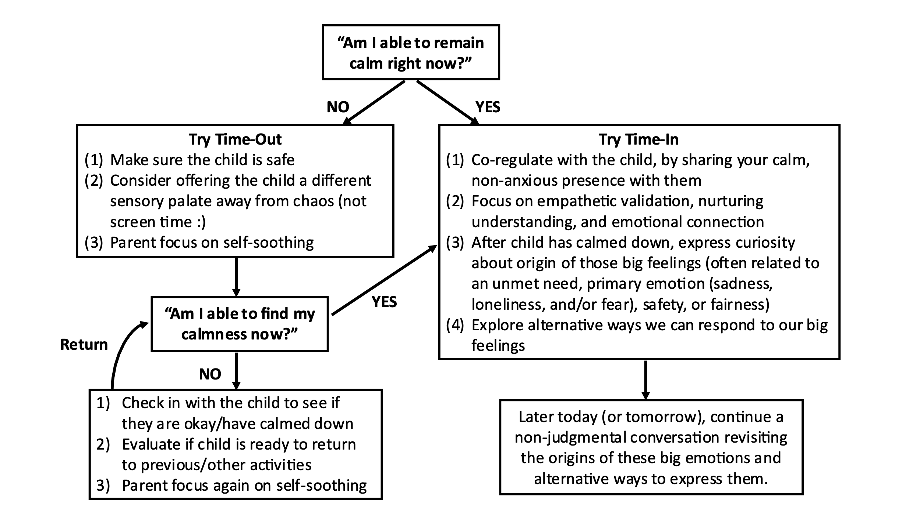
Figure 1
BALANCING THE PRACTICE OF TIME-OUT AND TIME-IN: TWO EFFECTIVE DISCIPLINE STRATEGIES FOR PARENTS

Slide 22
BIBLE VERSES
What can we learn from these bible verses in the context of what we have been discussing today regarding how a parent should respond to a dysregulated child:
Luke 6:38
“Give, and it will be given to you: good measure, pressed down, shaken together, and running over will be put into your bosom. For with the same measure that you use, it will be measured back to you.”
BALANCING THE PRACTICE OF TIME-OUT AND TIME-IN: TWO EFFECTIVE DISCIPLINE STRATEGIES FOR PARENTS

Slide 23
BIBLE VERSES
Philippians 4:6
“Be anxious for nothing, but in everything by prayer and supplication, with thanksgiving, let your requests be made known to God.”
Proverbs 22:6
“Train up a child in the way he should go,
And when he is old he will not depart from it.”
Psalm 103:13
“As a father pities his children,
So the Lord pities those who fear Him.”
BALANCING THE PRACTICE OF TIME-OUT AND TIME-IN: TWO EFFECTIVE DISCIPLINE STRATEGIES FOR PARENTS

Slide 24
BIBLE VERSES
Galatians 5:22-23
“But the fruit of the Spirit is love, joy, peace, longsuffering, kindness, goodness, faithfulness, gentleness, self-control. Against such there is no law.”
1 Peter 5:2-3
“Shepherd the flock of God which is among you, serving as overseers, not by compulsion but willingly, not for dishonest gain but eagerly; nor as being lords over those entrusted to you, but being examples to the flock.”
Proverbs 25:15
“By long forbearance a ruler is persuaded,
And a gentle tongue breaks a bone.”
BALANCING THE PRACTICE OF TIME-OUT AND TIME-IN: TWO EFFECTIVE DISCIPLINE STRATEGIES FOR PARENTS

Slide 25
Recap Discussion Questions
What are some of the key concepts or insights regarding Time-Out and Time-In?
How could these approaches (especially Time-In) benefit other familial relationships?
How can the scripture verses we just read guide us in how we respond to a dysregulated child?
BALANCING THE PRACTICE OF TIME-OUT AND TIME-IN: TWO EFFECTIVE DISCIPLINE STRATEGIES FOR PARENTS

Slide 26
ONLINE RESOURCES
https://www.parenthelp.org.nz/time-in/
https://hes-extraordinary.com/time-in-vs-time-out
https://www.traumaresourceinstitute.com/ichill
https://nurtureandthriveblog.com/feeling-break-time-in/
https://onetimethrough.com/time-in-a-positive-alternative-to-time-out/
http://ndl.ethernet.edu.et/bitstream/123456789/22728/1/172.pdf#page=64
https://time.com/5700473/time-outs-science/#:~:text=Unlike%20a%20time%2Dout%2C%20which,same%20room%20with%20a%20parent
BALANCING THE PRACTICE OF TIME-OUT AND TIME-IN: TWO EFFECTIVE DISCIPLINE STRATEGIES FOR PARENTS

Slide 27


