Slide 1

Notes:
Introduction of the Topic:
Presenter:
Welcome to the Empowered Life series devotional. Today we will be discussing about Hope and Optimism.

Slide 2
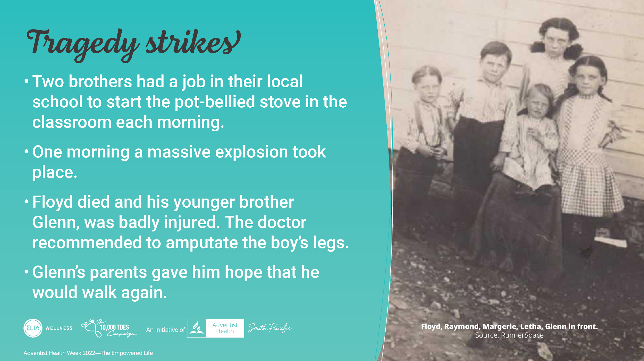
Notes:
Two brothers had a job in their local school to start the potbellied stove in the classroom each morning.
The boys would run to their school, clean out the stove and load the firewood. The older brother, Floyd grabbed the kerosene to light the fire. A massive explosion took place as someone had mistakenly filled the kerosene container with gasoline.
Floyd died and his younger brother, aged 7 was badly injured. The doctor recommended to amputate the boy’s legs, but the parents asked to delayed the amputation for two months and prayed for their son’s legs and that he would walk again.
This faith instilled in the boy gave him hope that he would walk again.

Slide 3
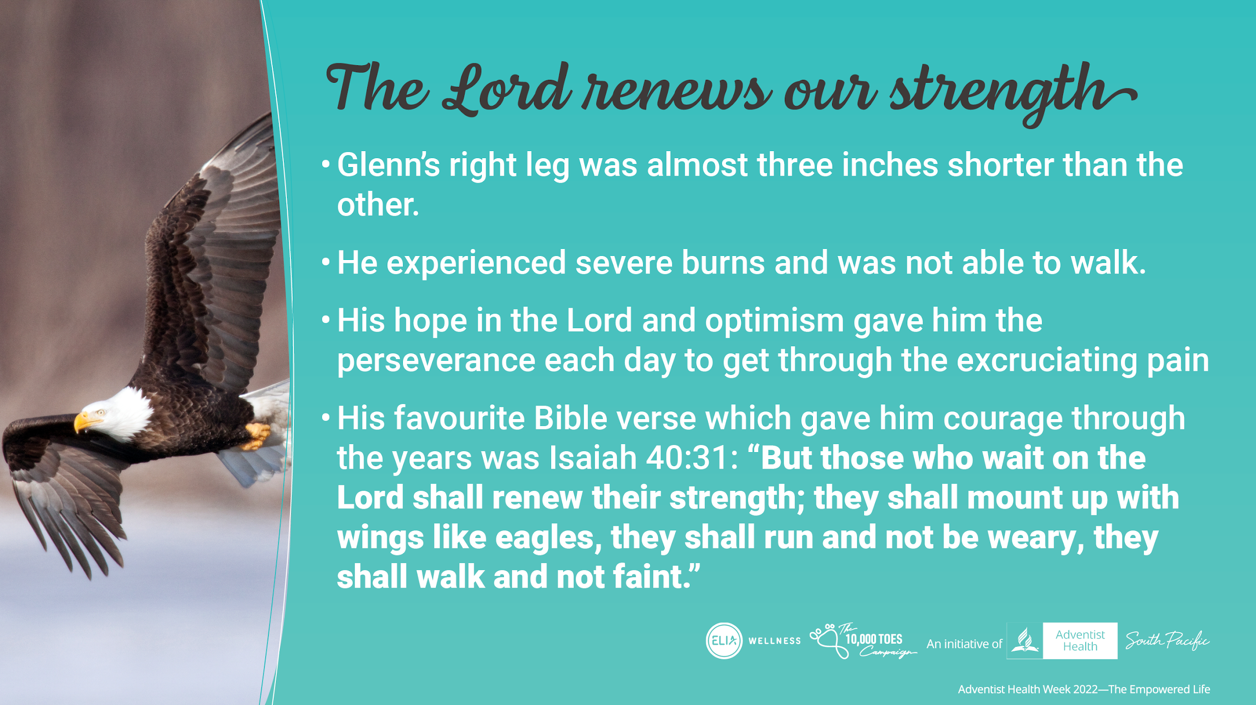
Notes:
When the bandages finally came off, the right leg was almost three inches shorter than the other.
His toes were almost completely burnt off on his left foot, and his knees and shins has lost all flesh. He was not able to walk. However, his hope to walk again, his optimism and perseverance each day through the excruciating pain was amazing.
His favourite Bible verse which gave him courage through the years was Isaiah 40:31: "But those who wait on the Lord shall renew their strength; they shall mount up with wings like eagles, they shall run and not be weary, they shall walk and not faint."

Slide 4
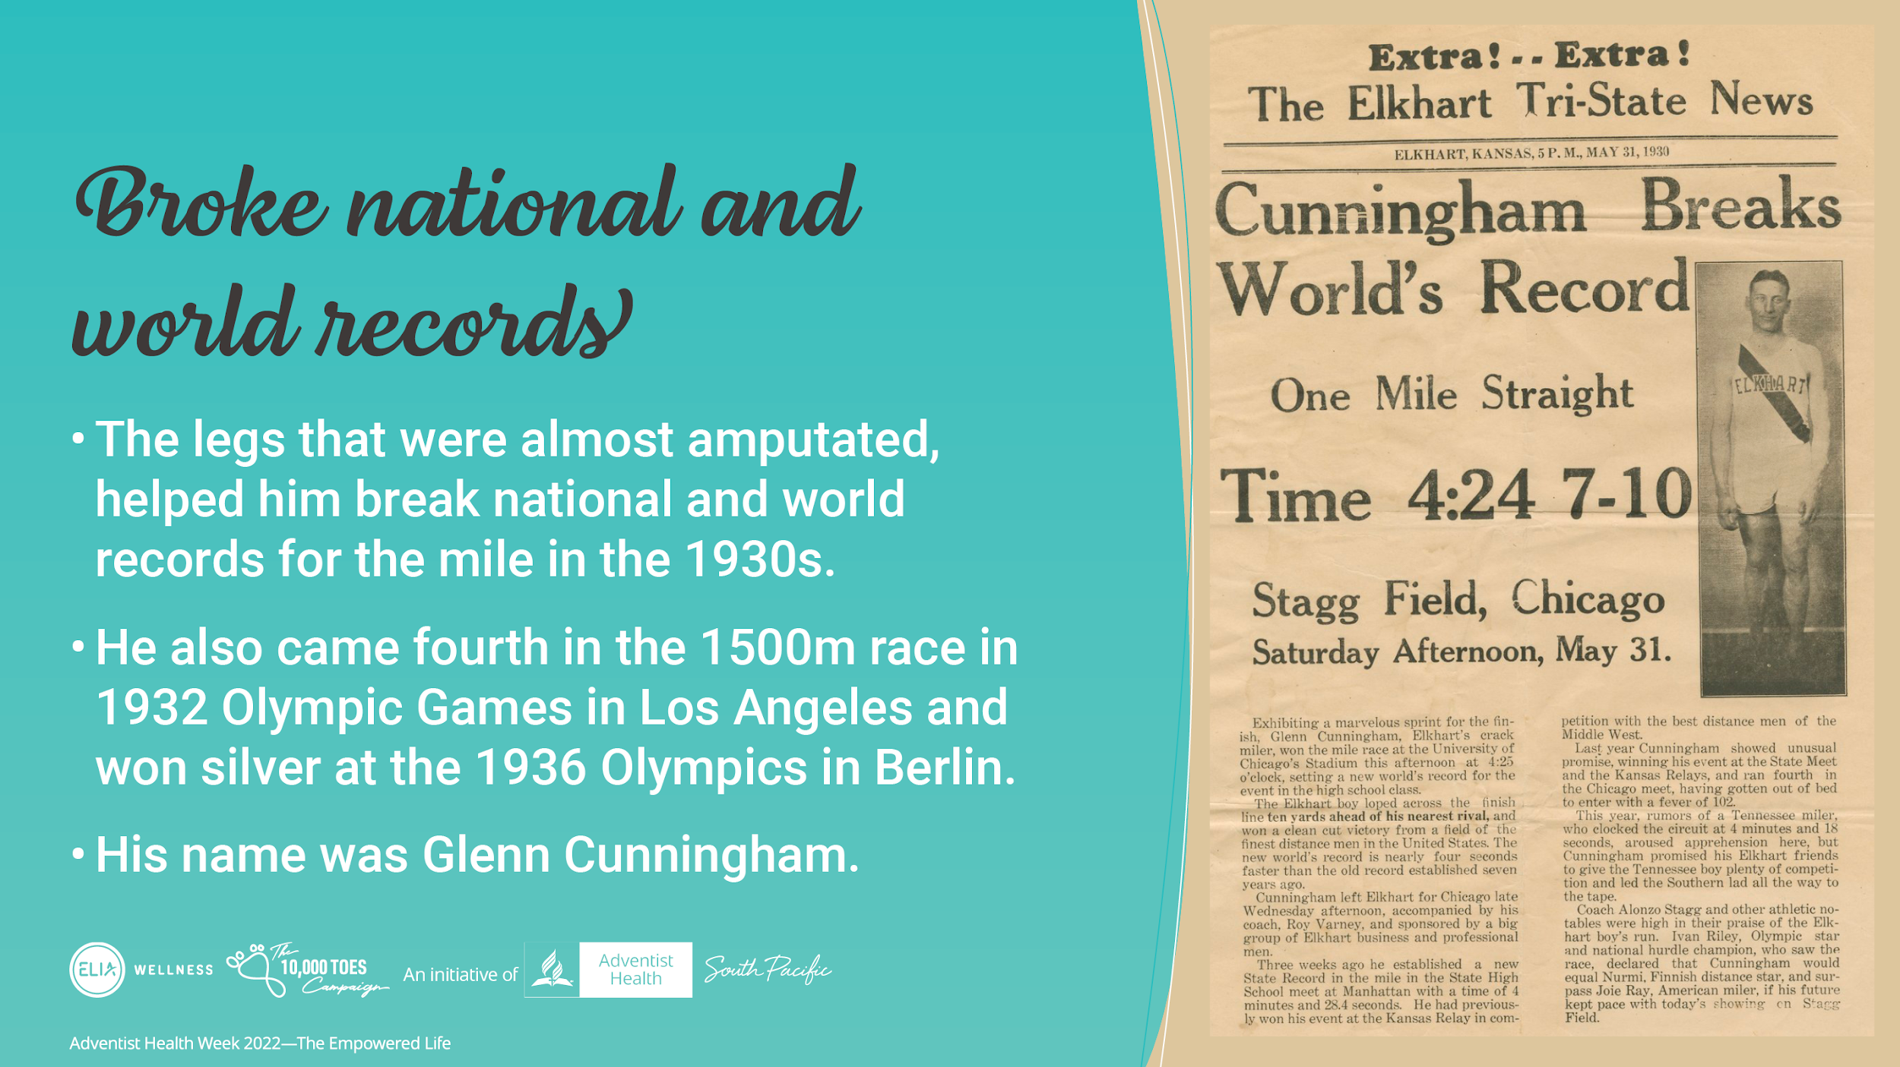
Notes:
The legs that were almost amputated, helped him break national and world records for the mile in the 1930s.
He also came fourth in the 1500m race in 1932 Olympic Games in Los Angeles and won silver at the 1936 Olympics in Berlin.
His name was Glenn Cunningham

Slide 5
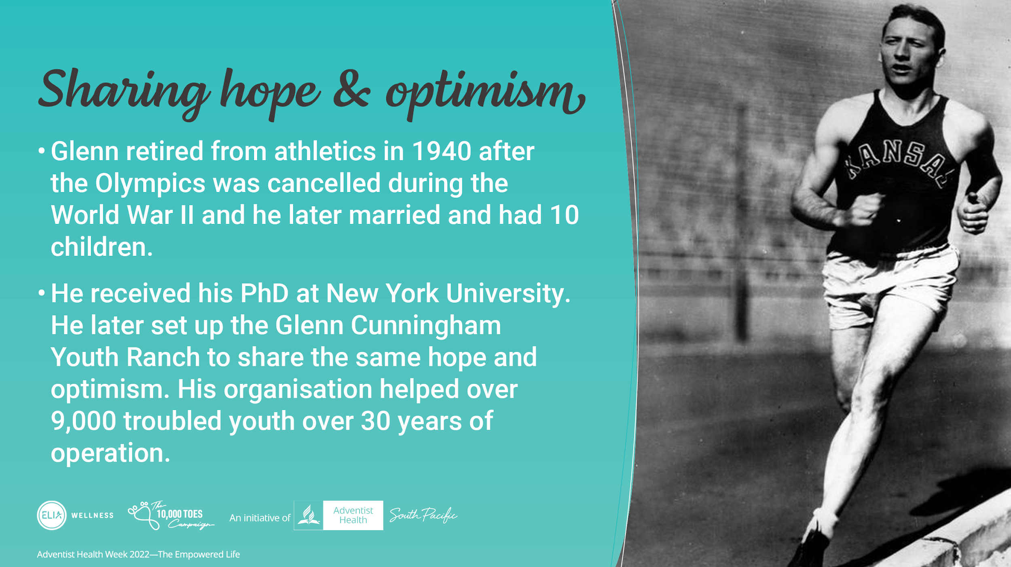
Notes:
Glenn retired from athletics in 1940 after the Olympics was cancelled during the World War II and he later married and had 10 children. He then focussed on his studies and received his PhD at New York University.
Glenn later set up the Glenn Cunningham Youth Ranch to share the same hope and optimism that he had learned to help over 9,000 troubled youth over 30 years.
So what is hope and optimism all about?

Slide 6
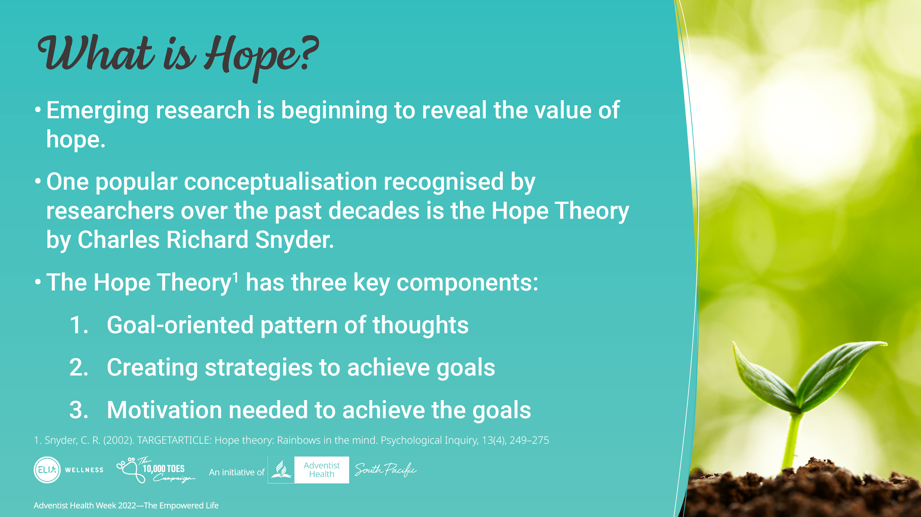
Notes:
Interestingly, there is emerging research that is beginning to reveal the value of hope.
The conceptualisation of hope and measurement has been difficult.
One popular conceptualisation that has received attention by researchers over the past 30 years is the Hope Theory by Charles Richard Snyder.
The hope theory is based on three elements
1. Goal-oriented pattern of thoughts
2. Creating strategies to achieve goals
3. Motivation needed to achieve the goals

Slide 7
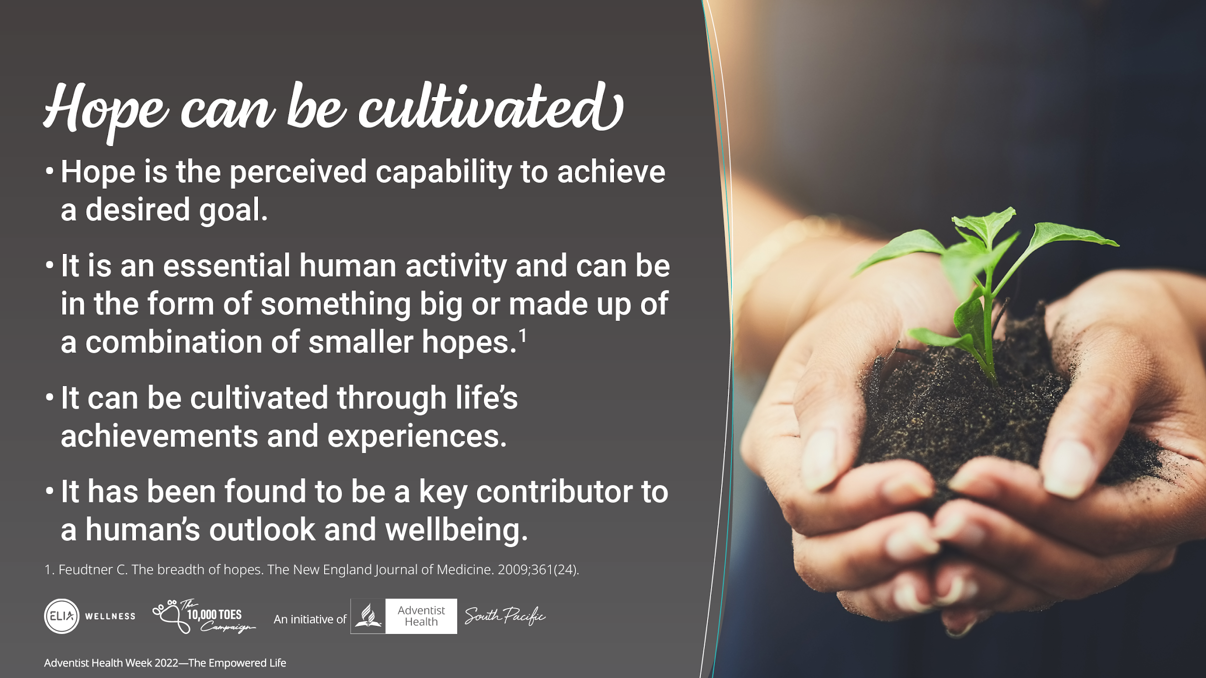
Notes:
Hope is the perceived capability to achieve a desired goal.
It is active and process orientated.
It is suggested that hope is an essential human activity and can be in the form of something big or made up of a combination of smaller hopes
It can be cultivated through life’s achievements and experiences.
It has been found to be a key contributor to a human’s outlook and wellbeing.

Slide 8
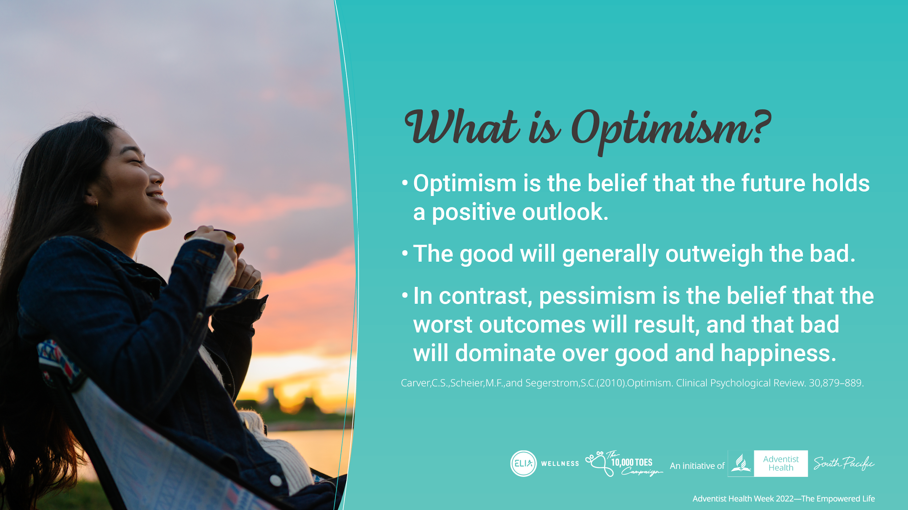
Notes:
So what is Optimism?
Optimism is the belief that the future holds a positive outlook.
The good will generally outweigh the bad.
In contrast, pessimism is the belief that the worst outcomes will result, and that bad will dominate over good and happiness.
Research has shown that individuals who are optimistic tend to adopt health promoting behaviours that protect their health.
In contrast, pessimism tends to result in adverse behaviours and outcomes.

Slide 9
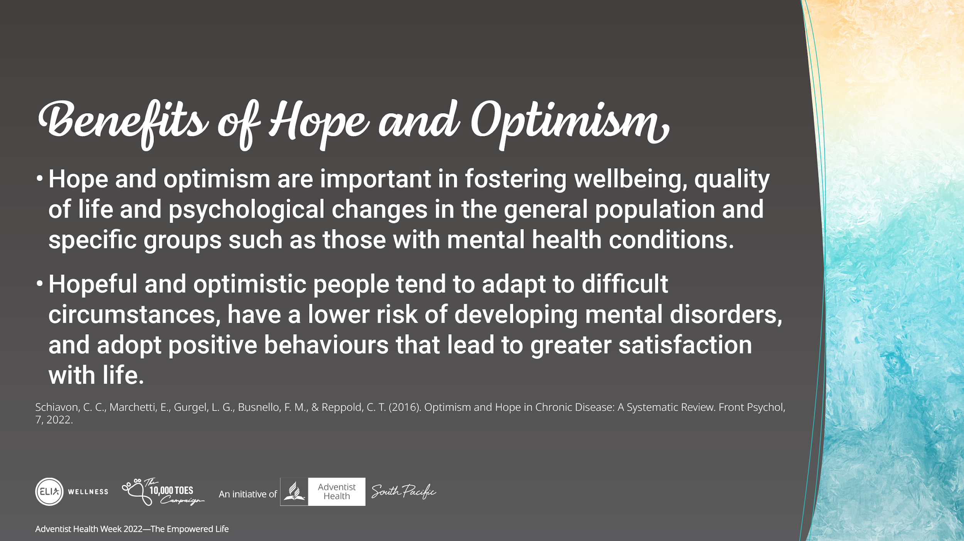
Notes:
Hope and optimism are important in fostering wellbeing, quality of life and psychological changes in the general population and specific groups.
Hopeful and optimistic people tend to adapt to difficult circumstances, have a lower risk of developing mental disorders, and adopt positive behaviours that lead to greater satisfaction with life.

Slide 10
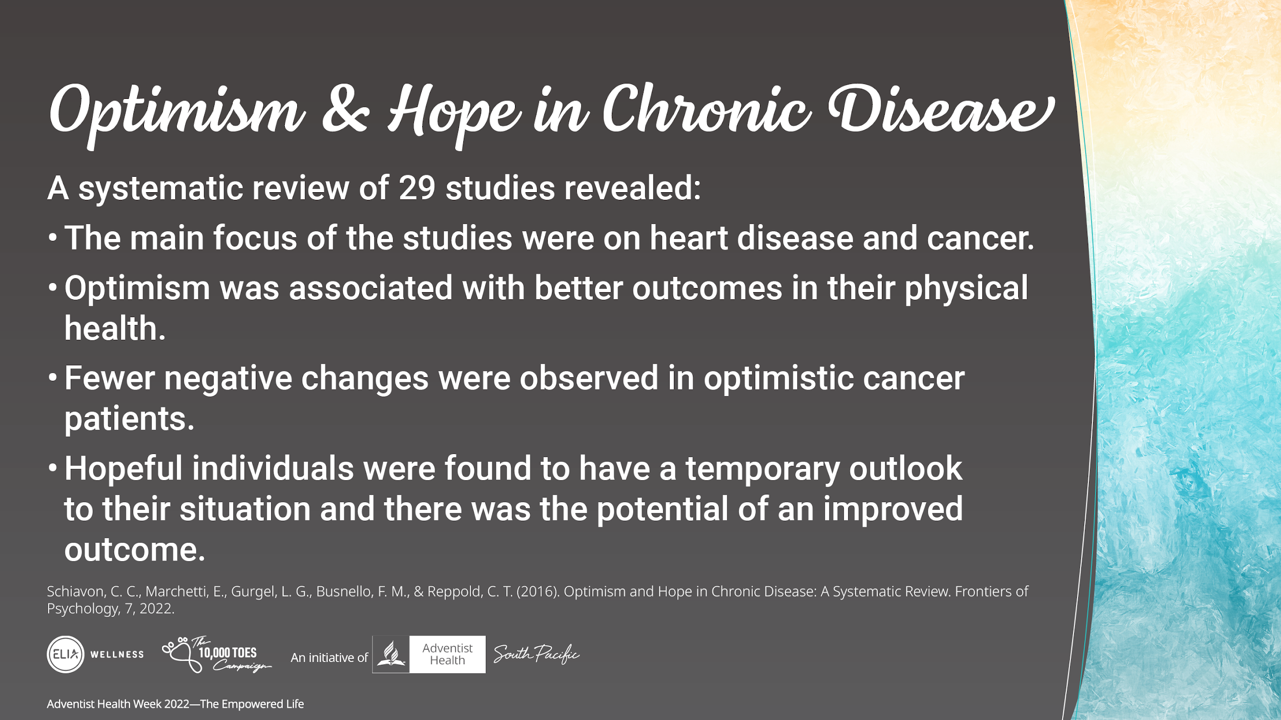
Notes:
A systematic review of Optimism and Hope in Chronic disease including 29 studies revealed:
Main focus of studies were on heart disease and cancer.
Cardiac patients with high levels of optimism was associated with better outcomes in their physical health. They were found to have reduced re-hospitalisation, lower risk of heart disease and lower mortality in the elderly population.
Fewer negative changes were observed in cancer patients who reported they were optimistic. Cancer patients where better able to manage stressors than those who were less optimistic who experienced poorer psychological, physical health and higher mortality rates.
Hopeful individuals were found to have an outlook that their circumstance was temporary and had the potential to result in a better outcome. They were found to have a higher life quality and satisfaction.
The authors acknowledged that further research was needed to understand the effect of hope and optimism on different diseases and more interventions were warranted.

Slide 11
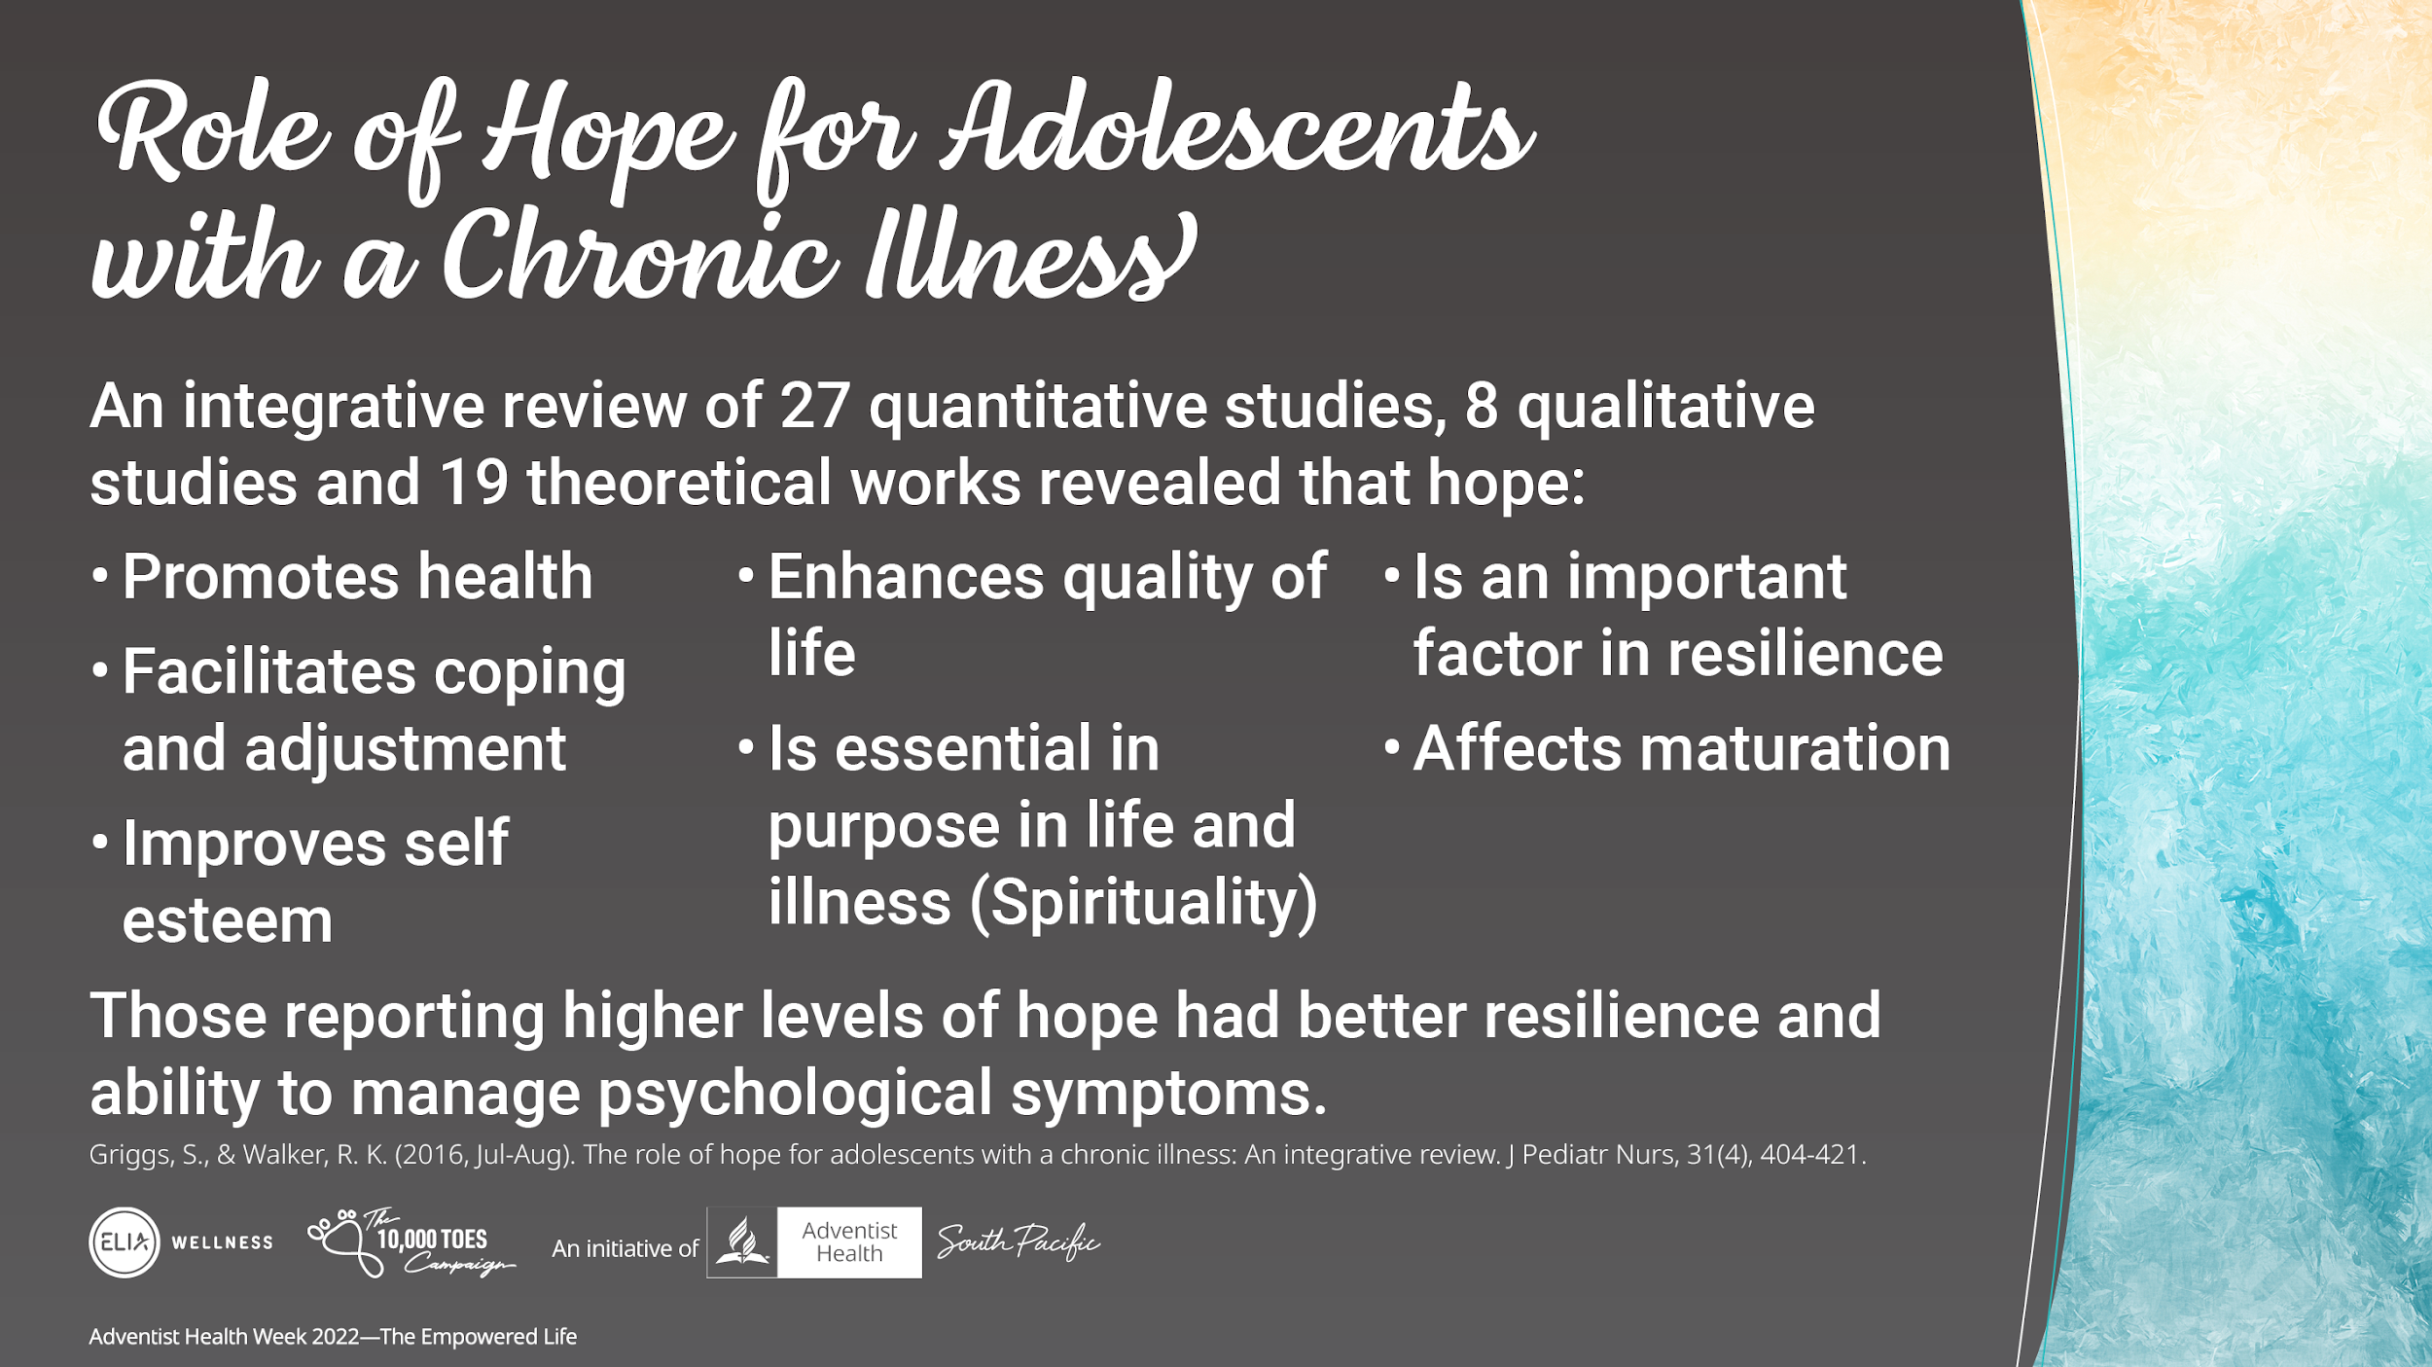
Notes:
An integrative review of 27 quantitative studies, 8 qualitative studies and 19 theoretical works revealed that hope:
Promotes health
Improves self-esteem (considered essential factor to psychological wellness -being
Is essential in purpose in life and Illness (Spirituality) – hope influences how people derive meaning. Spirituality nurtures a sense of wholeness.
Is an important factor in resilience – where an adolescent adjusts to their illness
Facilitates coping and adjustment
Enhances quality of life – helping people to cope with pain and functional limitations.
Affects maturation – where stress and chronic illness can and adolescent’s development
Interestingly, those reporting higher levels of hope had better resilience and ability to manage psychological symptoms

Slide 12
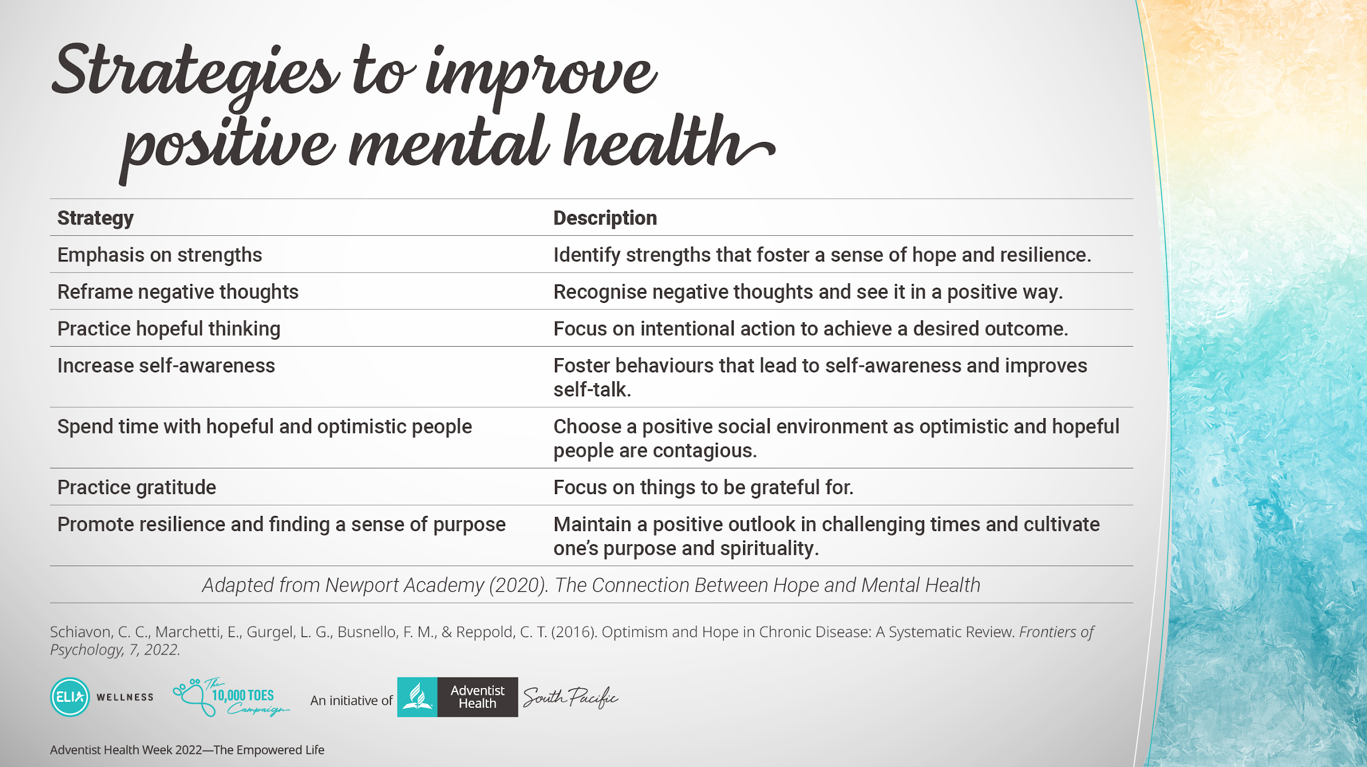
Notes:
Here are some strategies to improve positive mental health.

Slide 13
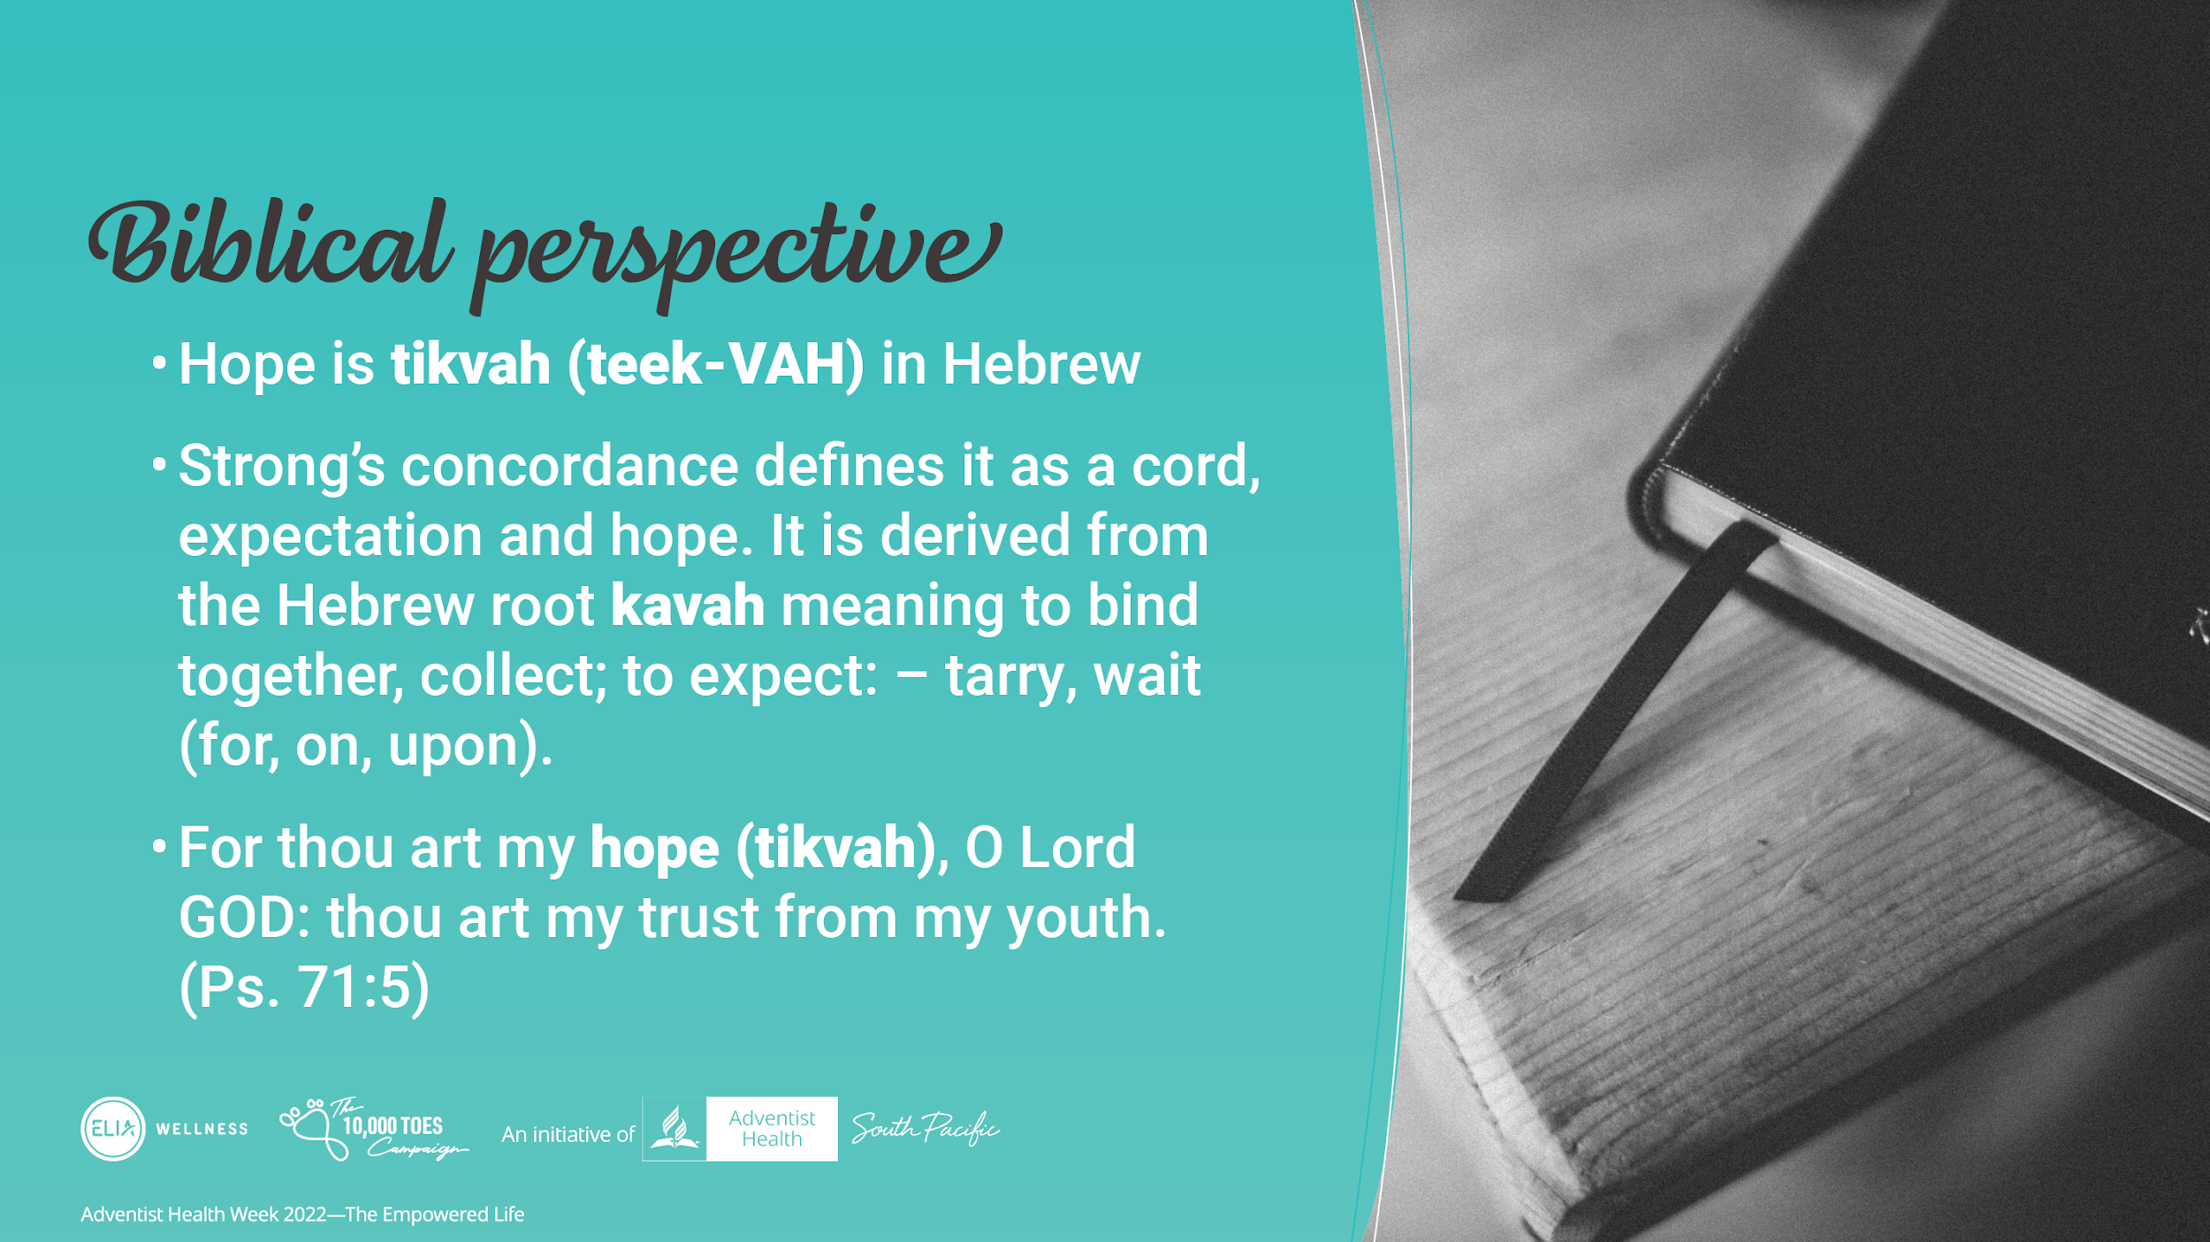
Notes:
Looking at it from the Biblical perspective.
Hope is tikvah (teek-VAH) in Hebrew.
Strong’s concordance defines it as a cord, expectation and hope. It is derived from the Hebrew root kavah meaning to bind together, collect; to expect: – tarry, wait (for, on, upon).
For thou art my hope (tikvah), O Lord GOD: thou art my trust from my youth. (Ps. 71:5)

Slide 14
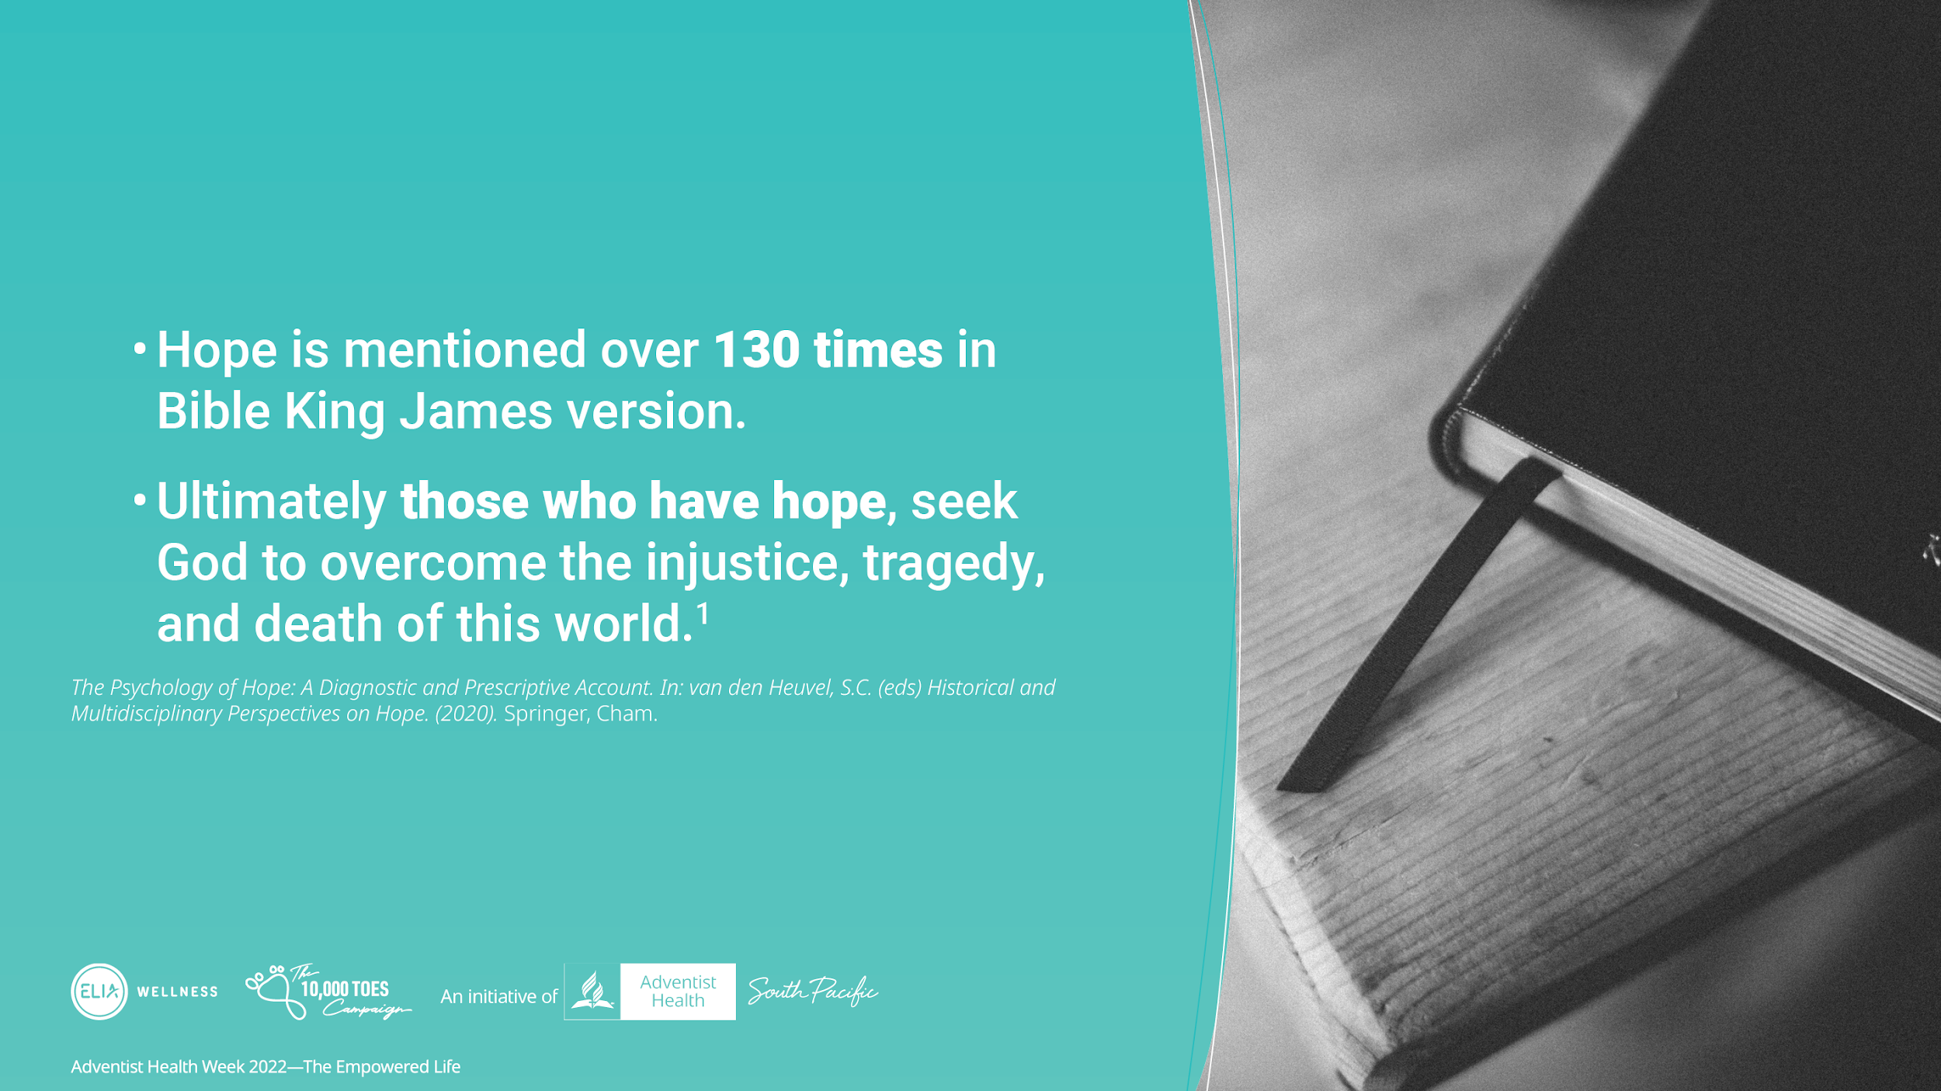
Notes:
Hope is mentioned in the Bible over 130 times in King James Version and is one of the key virtues of the Christian with faith and love.
Ultimately those who have hope, seek God to overcome the injustice, tragedy, and death of this world.¹

Slide 15
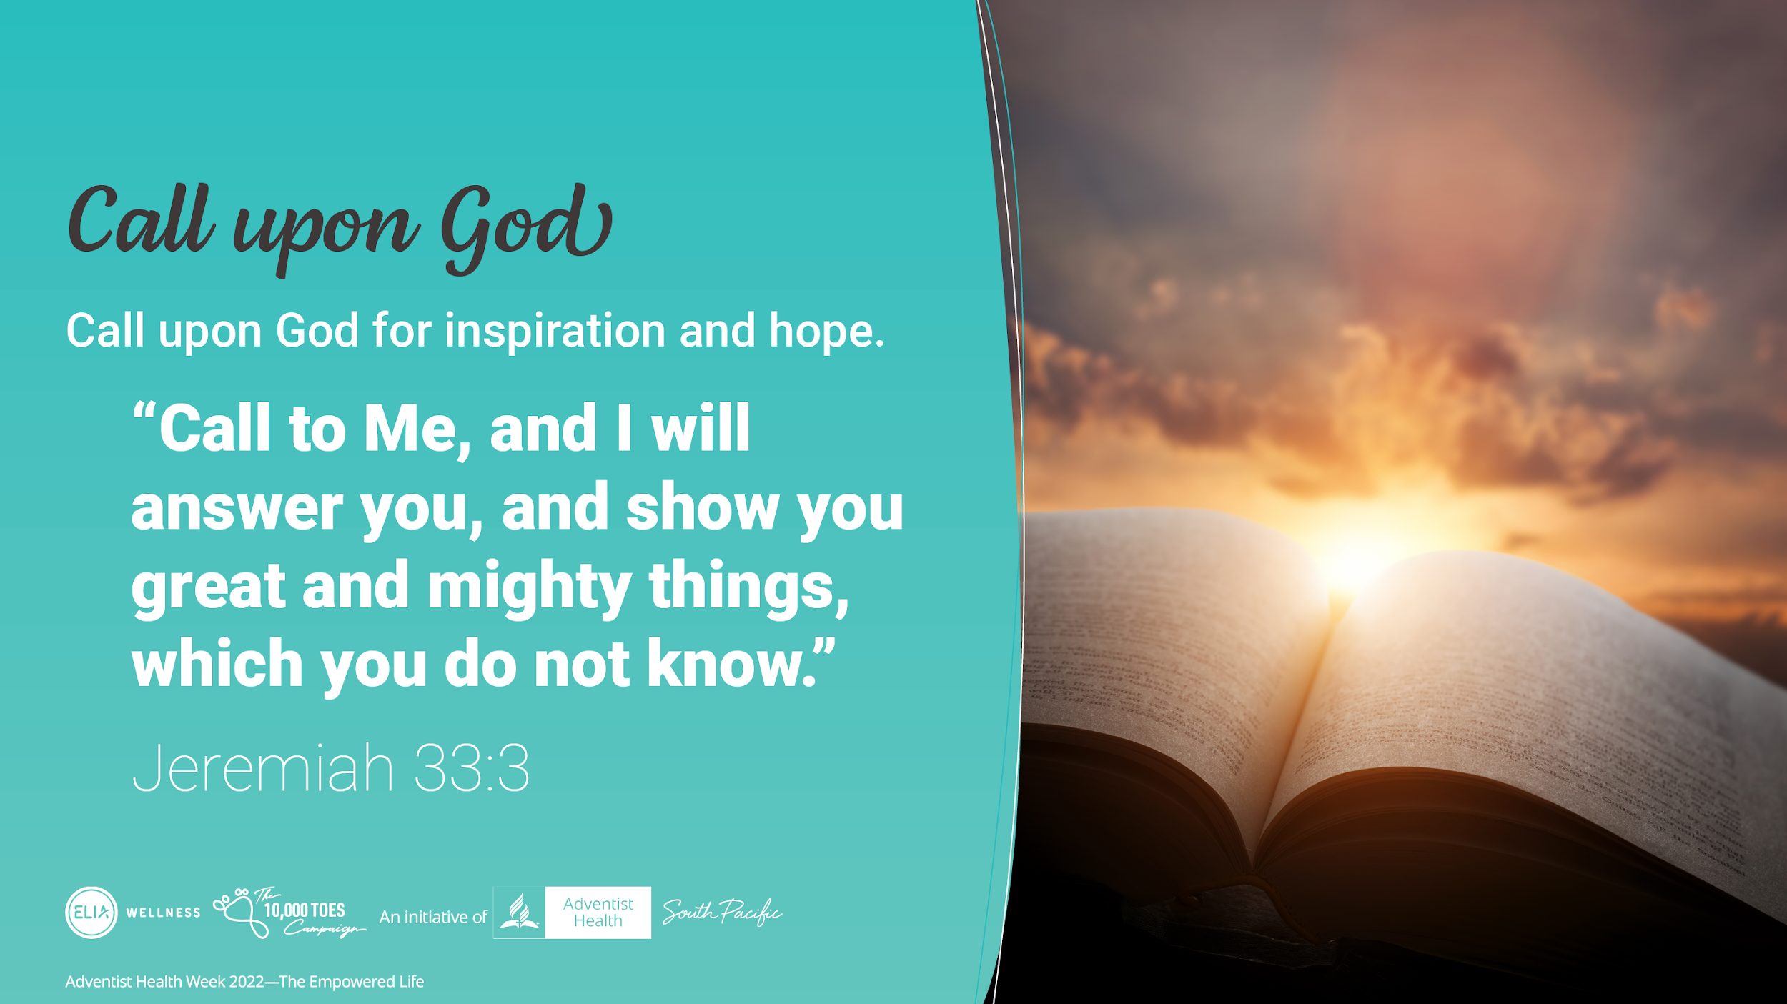
Notes:
Call upon God for hope and inspiration
Jeremiah 33:3
Call to Me, and I will answer you, and show you great and mighty things, which you do not know.’
We see God’s people call upon Him to seek wisdom and solve problems in their life such as Moses, Daniel, Joseph, Queen Esther and Paul.
We too are invited to call upon the God of Heaven to seek His wisdom, when we have no answer. God will renew our spirit and show mighty things!

Slide 16

Notes:
We can trust that God has a plan for our life
Jeremiah 29:11 says,
For I know the thoughts that I think toward you, says the Lord, thoughts of peace and not of evil, to give you a future and a hope.
No matter what we face in our life, we can trust that God wants to bless us
He desires our good and will give us hope and the means to achieve this
He inspires us with His vision for our life

Slide 17
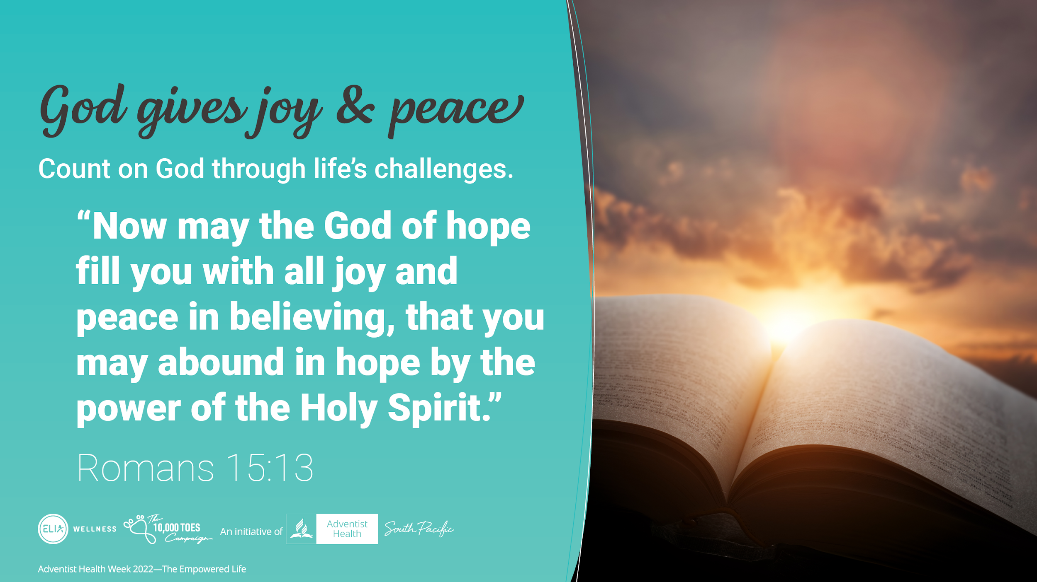
Notes:
We can count on God through life’s biggest challenges
Romans 15:13
“Now may the God of hope fill you with all joy and peace in believing, that you may abound in hope by the power of the Holy Spirit.”
The term "the God of hope” inspires joy, peace and power that only comes from God. It gives comfort to God’s children, to know that no matter what they go through, God can give power for them to once again to have joy and peace. Even in sickness and in loss.

Slide 18

Notes:
Sydney McLauglin was 21 years of age when she won the gold medal for 400m at the 2020 Tokyo Olympics.
Her current world record is 51.46 seconds.

Slide 19

Notes:
Read the blurb above.
Sydney Mclaughlin:
Was going through the hardest times in her life, both emotionally, physically and spiritually
She called upon God, He gave her reassurance
And the God of Hope not only gave her joy and peace.. But a gold medal!
We may not be a world athlete, but we are important in God’s eyes and He is here to bring you hope in your life.

Slide 20
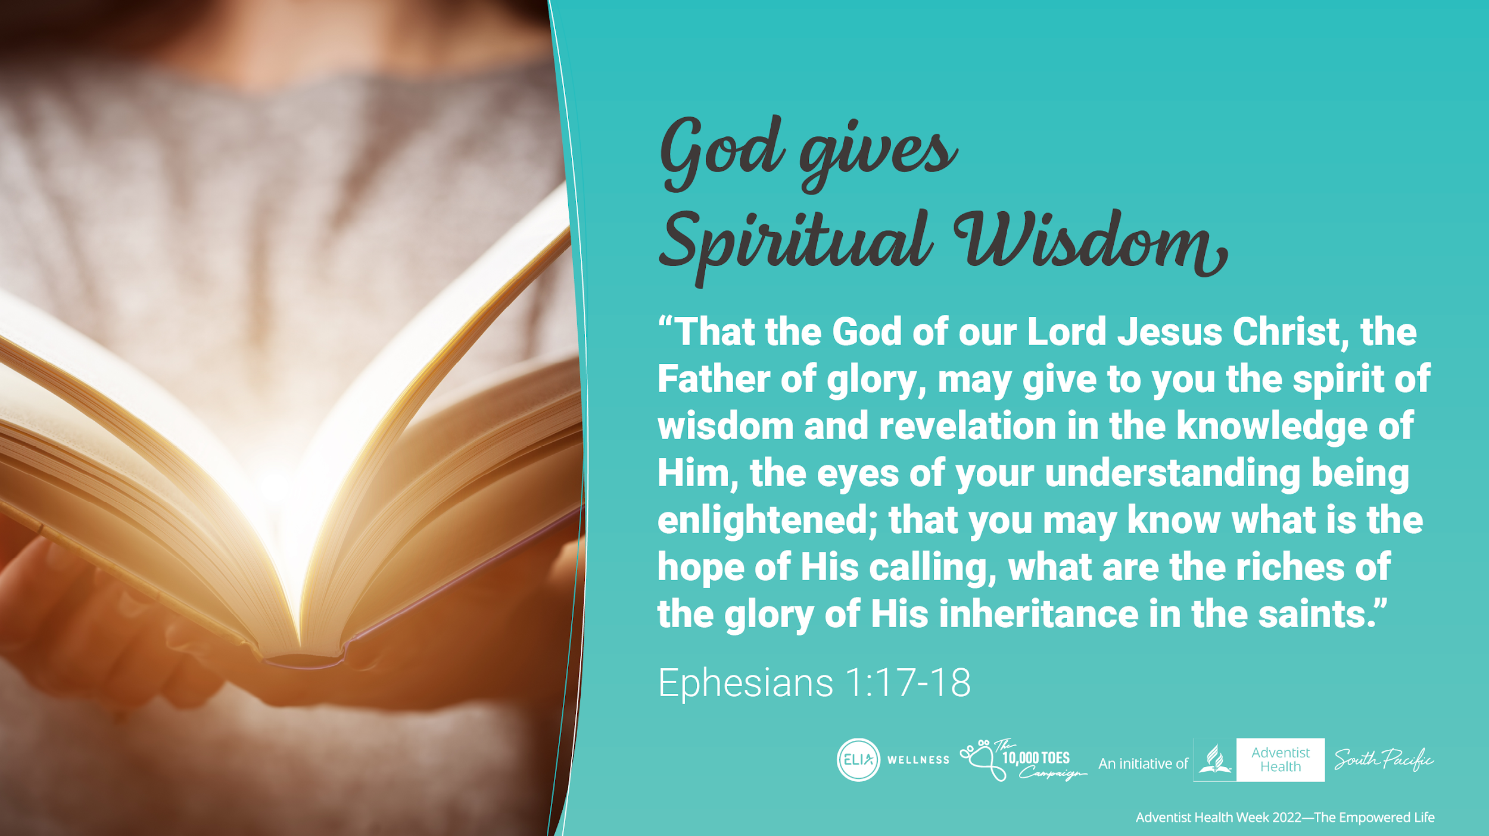
Notes:
We can count on God through life’s biggest challenges
Romans 15:13
“Now may the God of hope fill you with all joy and peace in believing, that you may abound in hope by the power of the Holy Spirit.”
The term "the God of hope” inspires joy, peace and power that only comes from God. It gives comfort to God’s children, to know that no matter what they go through, God can give power for them to once again have joy and peace. Even in sickness and in loss.

Slide 21
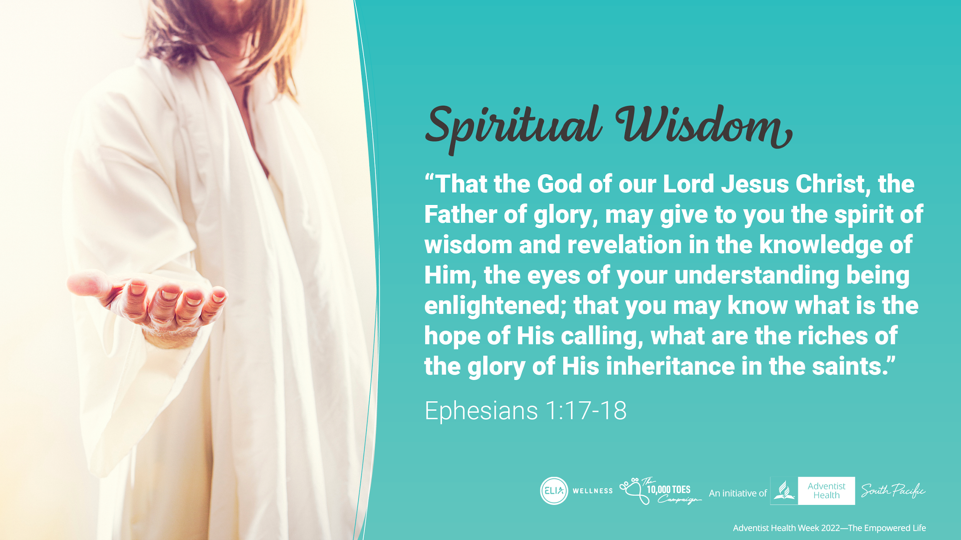
Notes:
Like Sydney, God is calling us to seek his wisdom and understanding so we can know the plans and hope that he has for us, so we can inherit the riches of the glory that God.

Slide 22
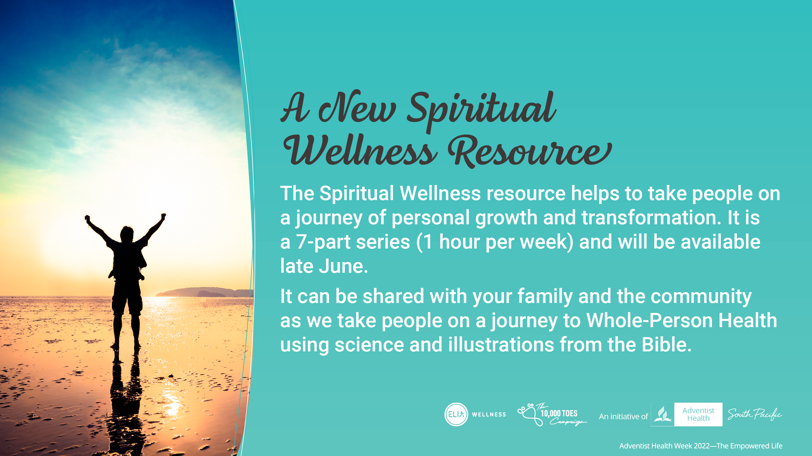
Notes:
A new resource focusing on Spiritual Wellness and will be available in late June 2022. is a 7-week series. 1hr per week.
It aims to take people on a journey of personal growth and transformation. It can be shared with your family and the community as we take people on a journey to Whole-Person Health using science and illustrations from the Bible.
It covers the following topics:
Gratitude
Values
Emotional Intelligence
Resilience
Kindness & Generosity
Meaning and Purpose
Hope & Optimism
This resource provides the latest science on each of the topics and uses illustrations from the Bible for discussion.

Slide 23
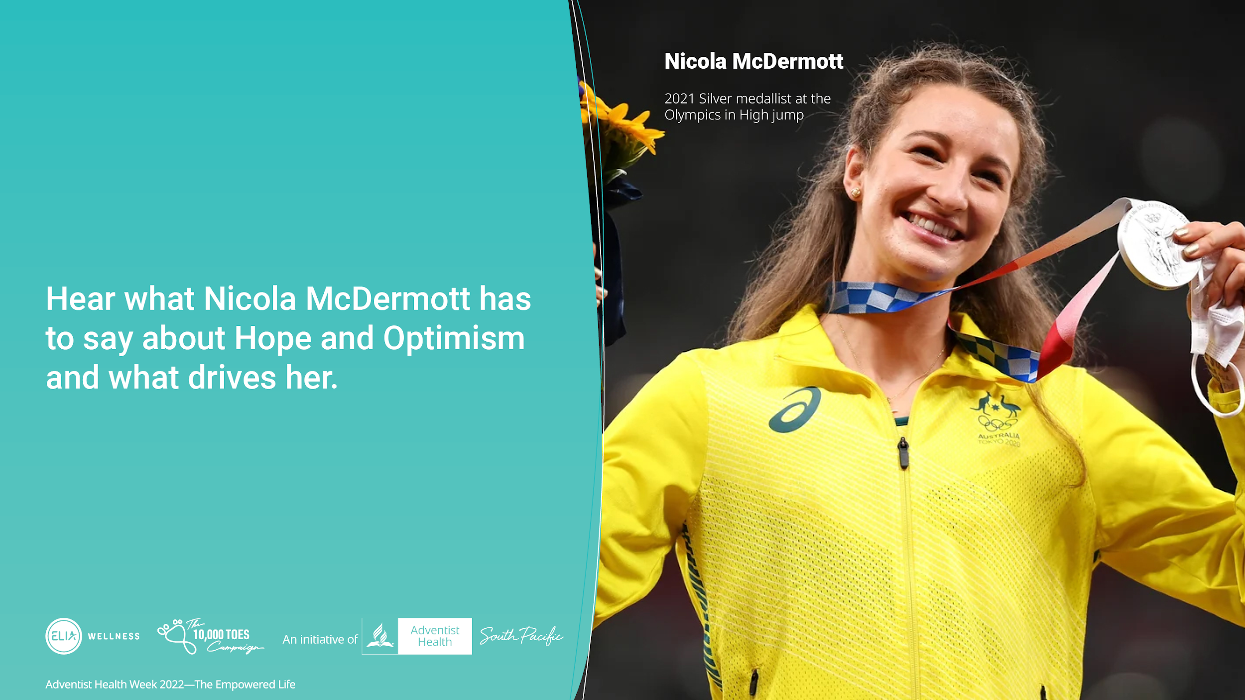
Notes:
We are excited to have Nicola Mc Dermott, who was a Silver medalist at the Olympics last year in High Jump.
She shares her story in the spiritual wellness program in the topic Hope and Optimism session.

Slide 24

Notes:
Our hope is that you will share this resource with your family, friends and the community so they can live an empowered life with the blessed hope of Jesus second coming.
Is it your desire, to call upon God and live the life that God intended you to, one of hope for the future?

