Slide 1

Notes:
This presentation is part of the Empowered Life series and it explores into the understanding of Service and Generosity, its significance, its benefits and the principles from Scripture.

Slide 2
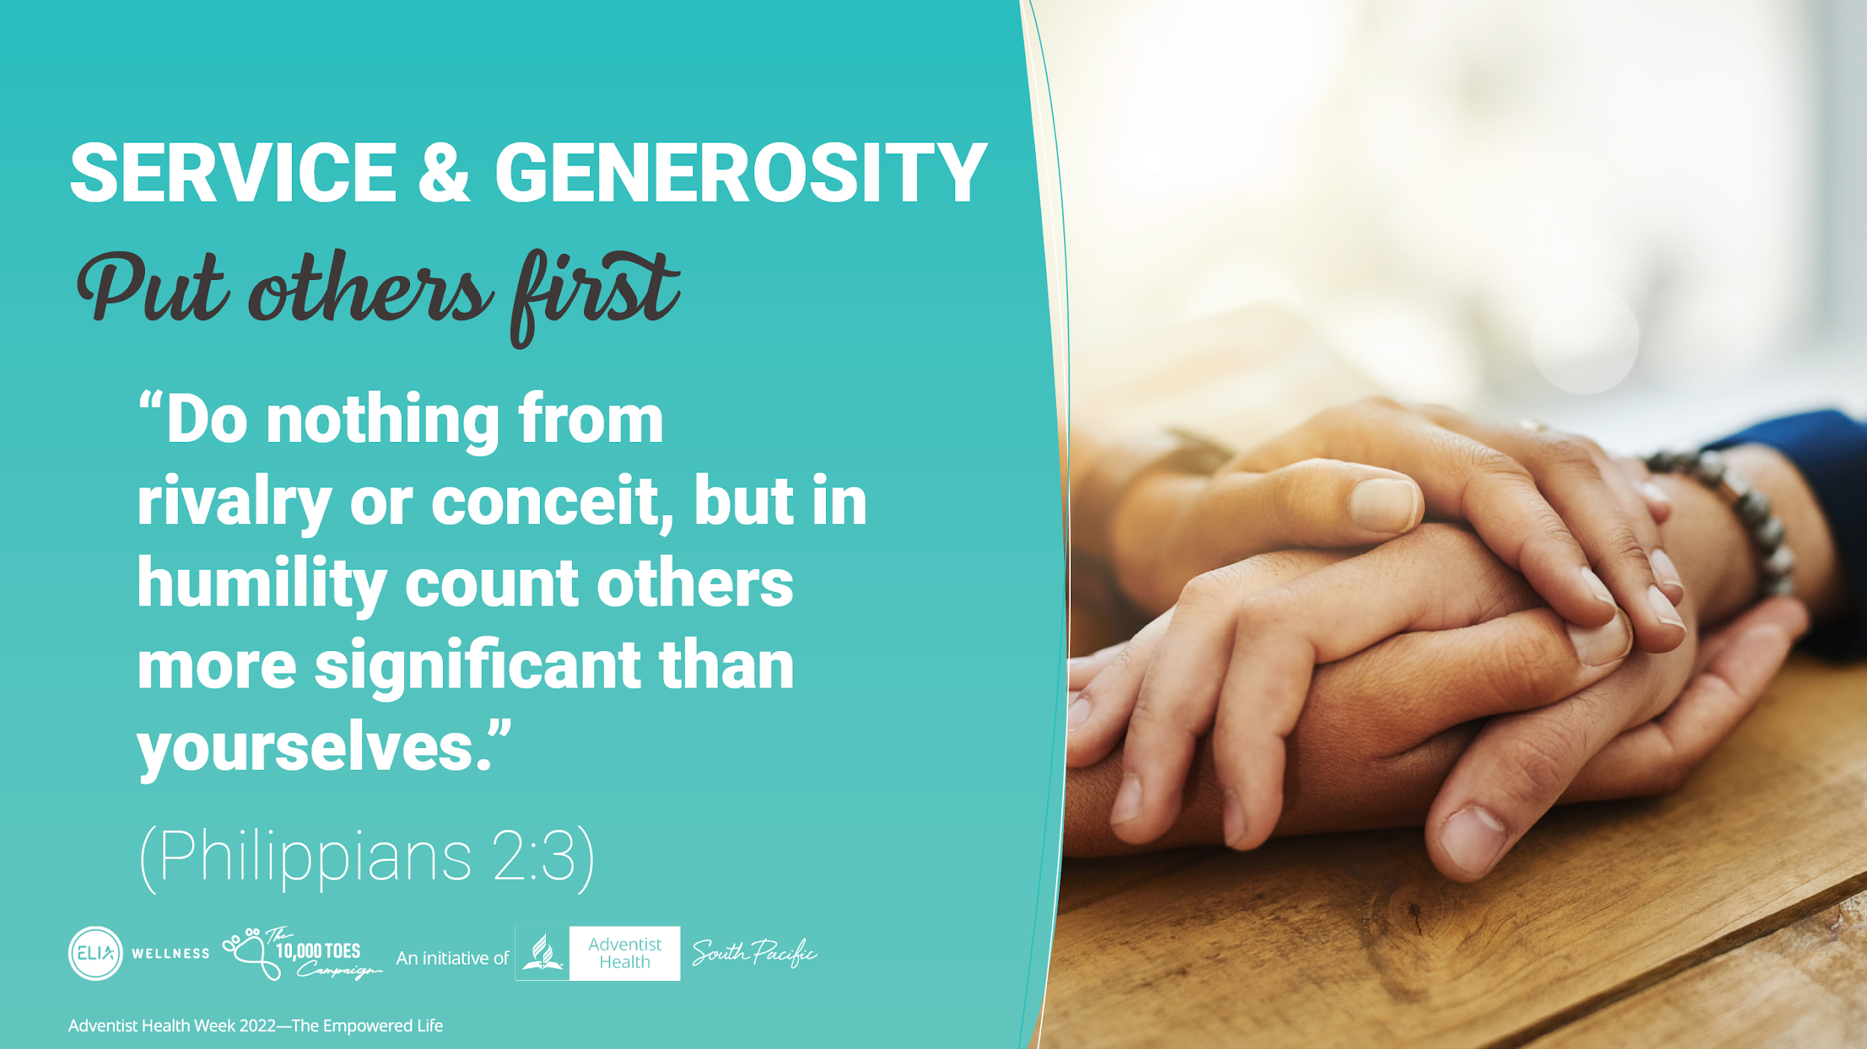
Notes:
Putting others first is the underlying principle when it comes to Service and Generosity and the bible urges us to put others first, “Do nothing from rivalry or conceit, but in humility count others more significant than yourselves.” (Philippians 2:3).

Slide 3
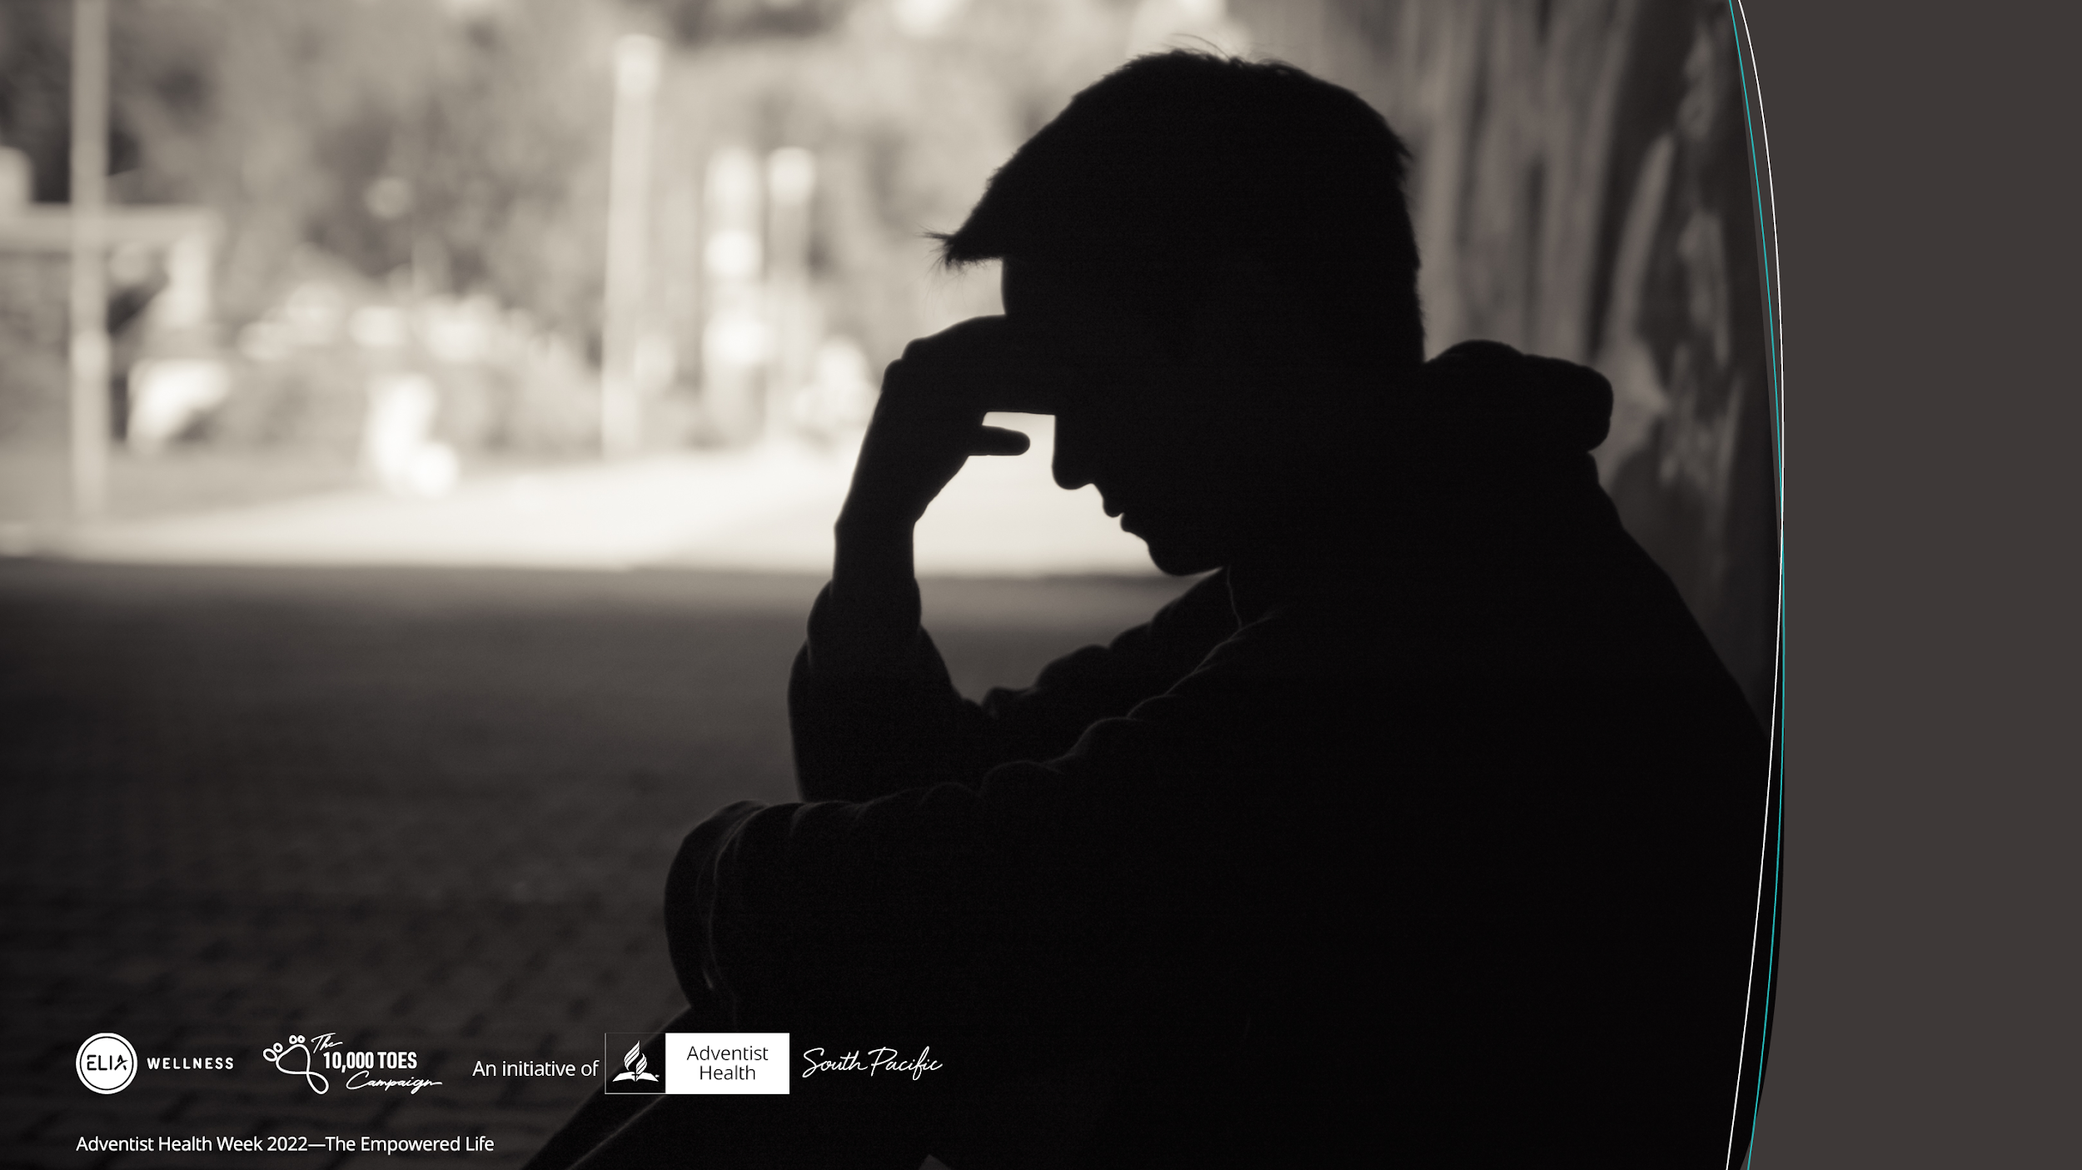
Notes:
Sadly, life on earth is not easy for everyone and we live in a world where life is becoming more difficult to live.

Slide 4
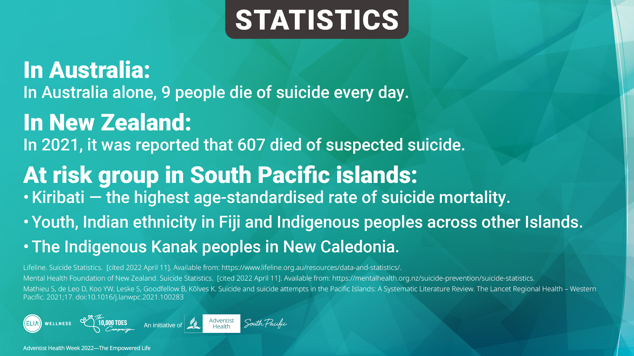
Notes:
Mental health issues such as depression and anxiety are becoming more common, thus robbing us the quality of the lives we live. In Australia alone 9 people die of suicide every day and in 2021 it was reported that 607 died of suspected suicide in New Zealand. The South Pacific islands have a number of at risk group

Slide 5

Notes:
People are constantly looking for meaning and purpose in life. Everyone would love to live a life that has meaning and fulfillment, a life that is empowered. Everybody is in search of Happiness.
So what does it take to live an empowered life?

Slide 6
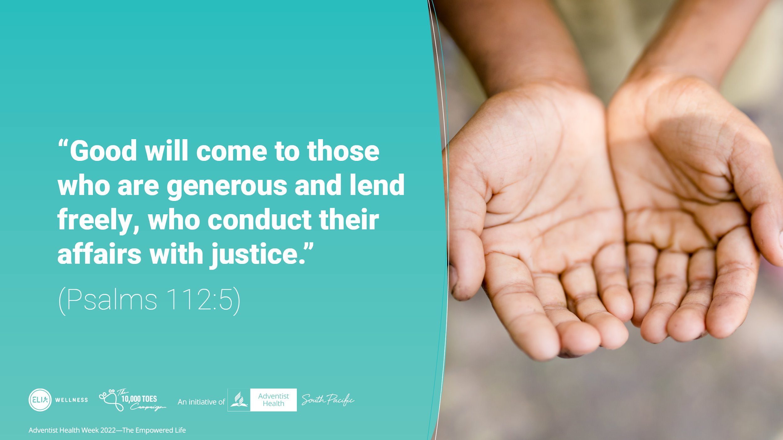
Notes:
The Bible tells us in Psalms 112:5, “Good will come to those who are generous and lend freely, who conduct their affairs with justice.” So what kind of good are we talking about? What good does serving others and giving to others do to me? How am I blessed when I give my time and efforts in service to others? What good does it do to me when I give what I own to others?

Slide 7
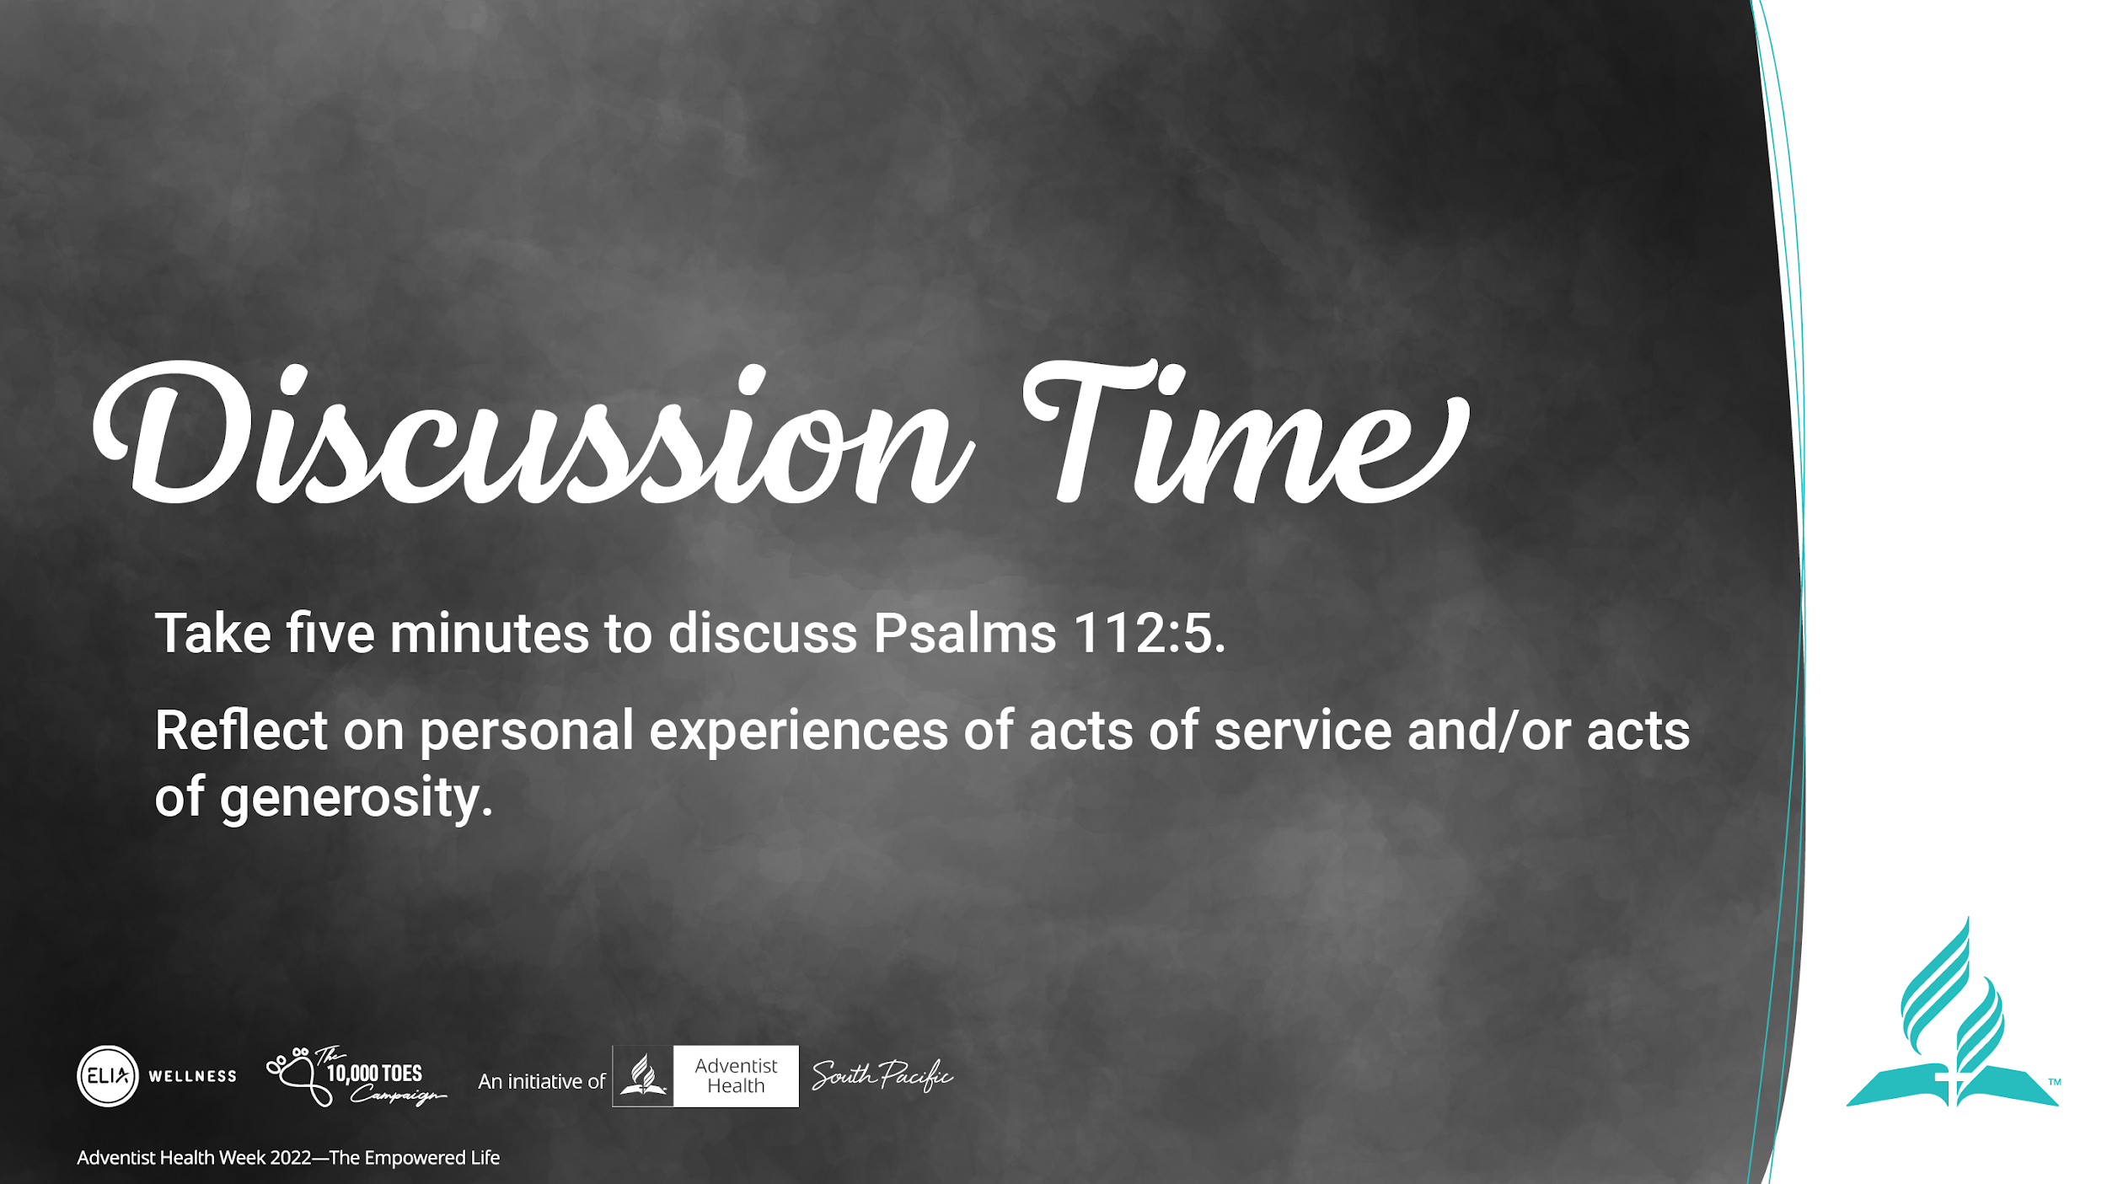
Notes:
Let us take a few minutes to discuss this verse from Psalms and look into your personal experience of acts of service and generosity.

Slide 8
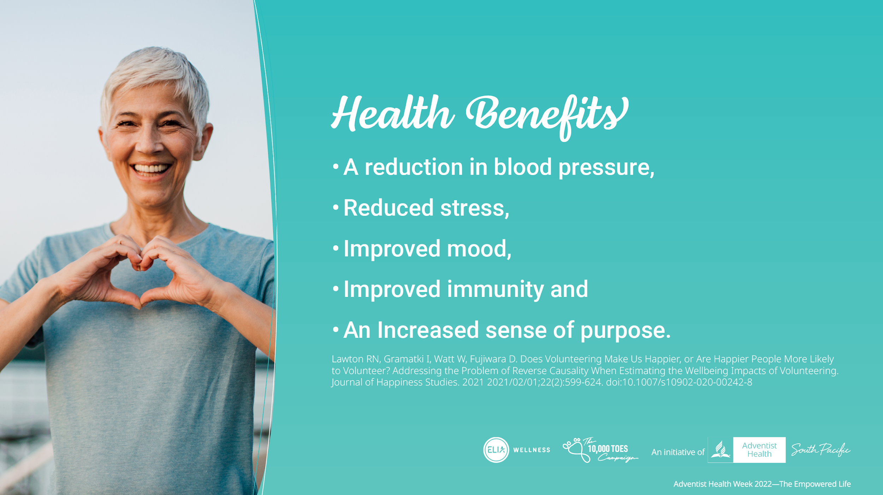
Notes:
Scientific studies have shown that giving to others either in the form of service or kind, can have major positive impacts on our mental and physical health, such as,
A reduction in blood pressure,
Reduced stress,
Improved mood,
Improved immunity and
An Increased sense of purpose

Slide 9
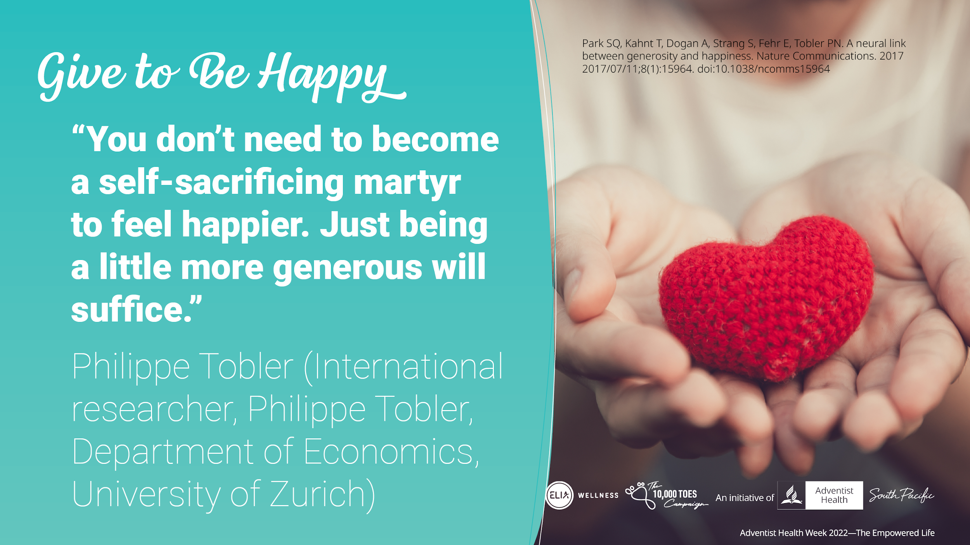
Notes:
A study done at the University of Zurich, found that generous people live happier lives. They looked at the changes that took place in the brain when one performed an act of generosity. They found that not only the physical act of giving sparked the part of the brain that gives us the happy feels but also even just the intent or the decision to do good for someone triggered the happy vibes. "You don't need to become a self-sacrificing martyr to feel happier. Just being a little more generous will suffice," says Philippe Tobler (International researcher, Philippe Tobler, Department of Economics, University of Zurich)

Slide 10
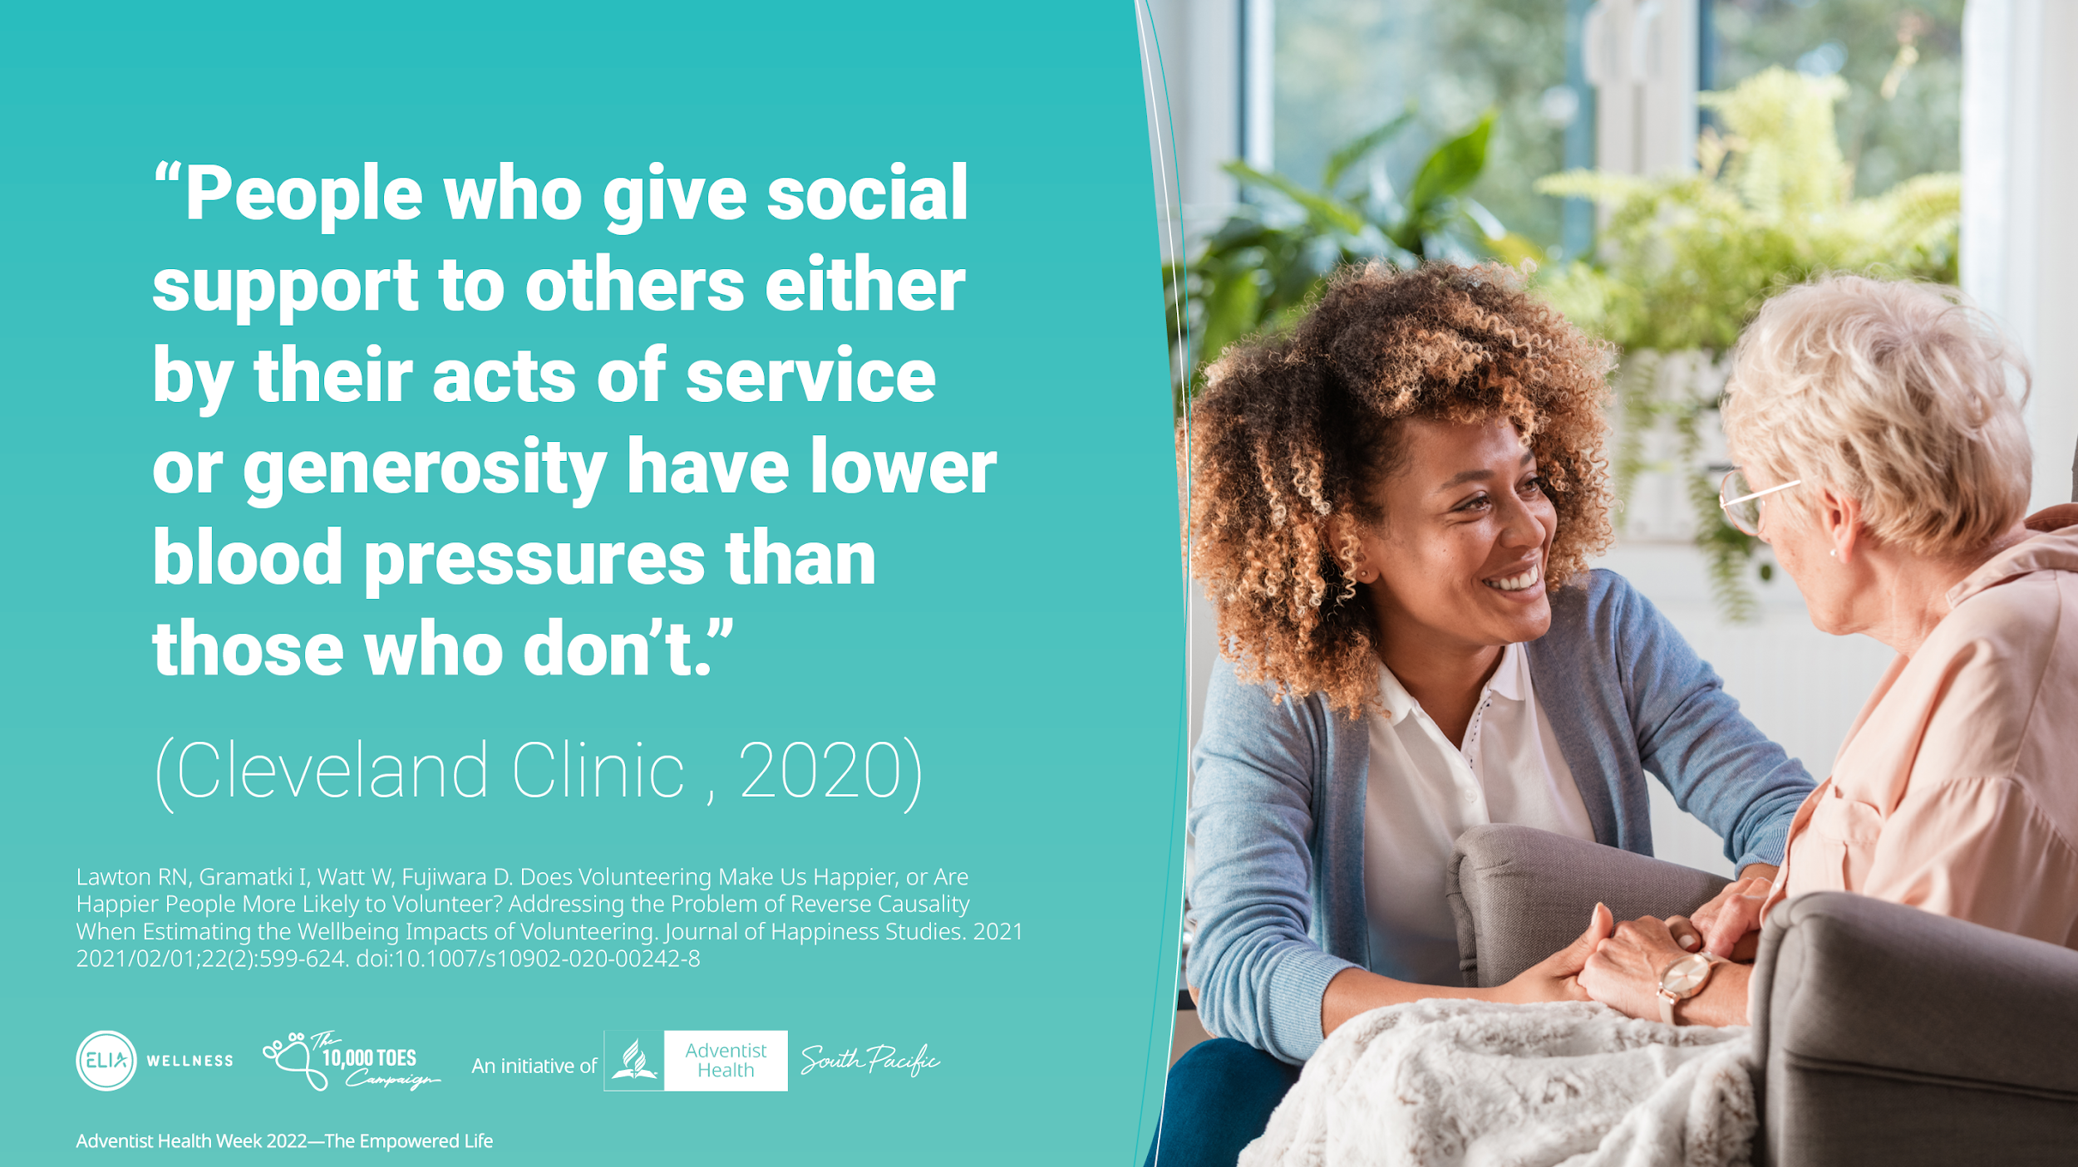
Notes:
A study by the Cleveland clinic in 2020 stated that, people who give social support to others either by their acts of service or generosity have lower blood pressures than those who don’t. It also stated that, supportive interaction with other helps people recover from coronary related events.

Slide 11
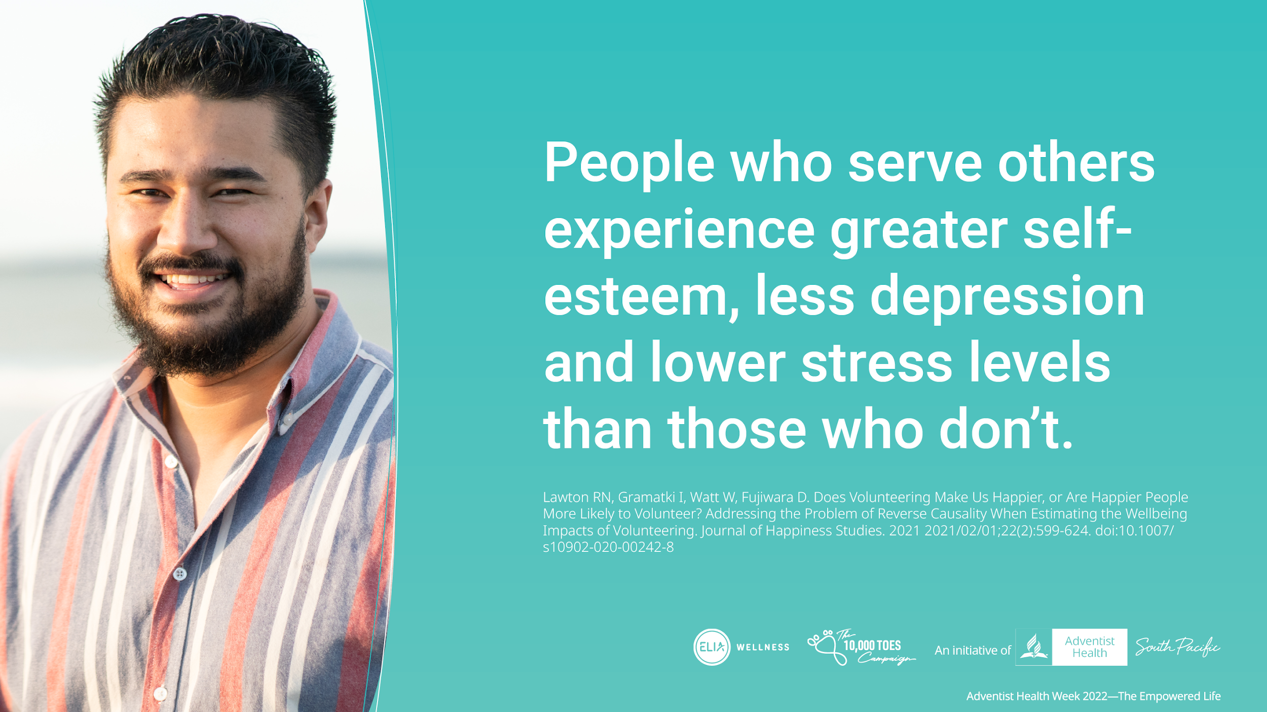
Notes:
Researchers also say that people who give their time to help others through community and organizational involvement have greater self-esteem, less depression and lower stress levels than those who don’t.

Slide 12
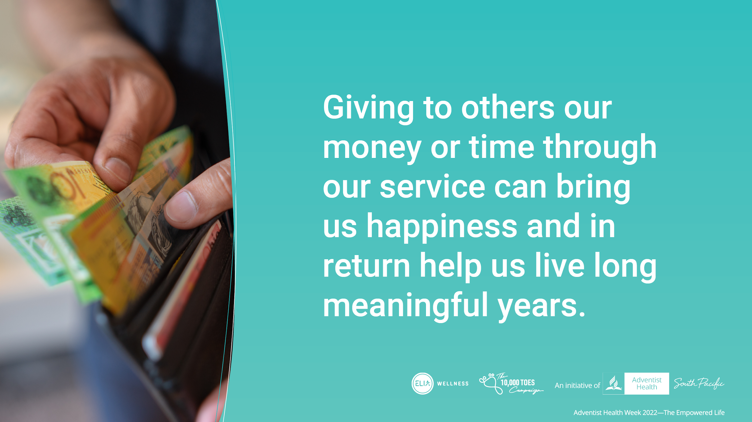
Notes:
So, when the Bible says, “Good will come to those who are generous” … it really does come in the form of better mental and physical health. Giving to others our money or time through our service can bring us happiness and in return help us live long meaningful years.
So, if you have been feeling a bit down and need a boost in your spirit try helping someone in need. Either by generously giving or serving someone who needs your help.

Slide 13
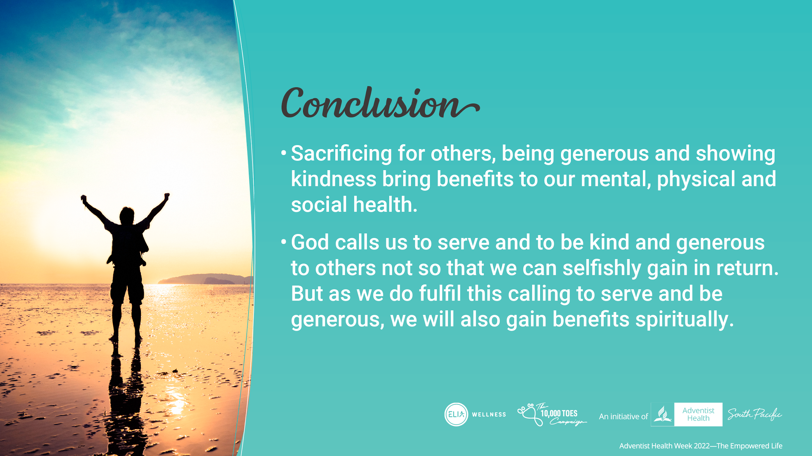
Notes:
In summary,
Sacrificing for others and being generous bring benefits to our health
God calls us to serve and be kind and generous regardless of repayment of kindness.
Being kind and generous is a calling.
There are plenty opportunities for Service and generosity.
Let us pray and ask God to help us put others first. Let us ask God help us to become a Cheerful givers and He will open doors for us to experience the blessing of Service and Generosity.

