Slide 1
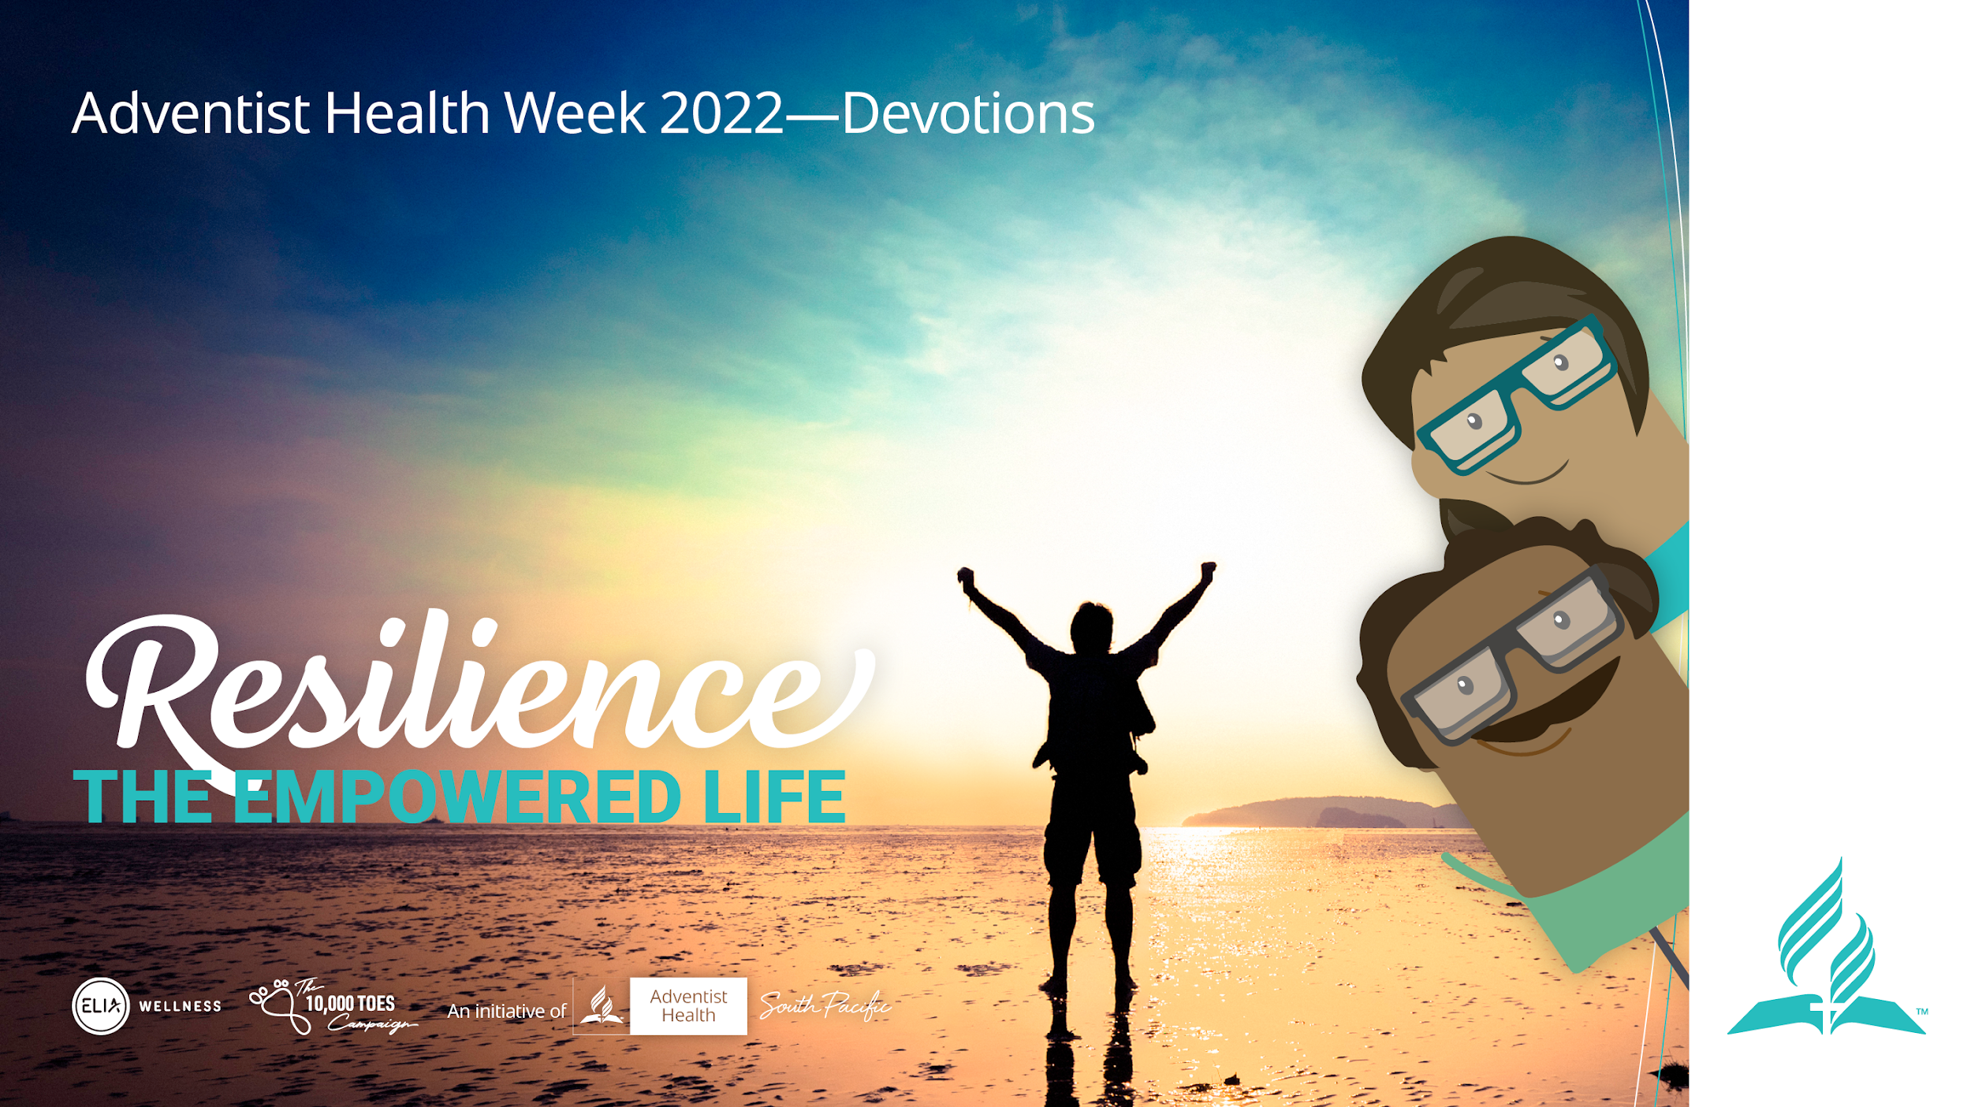
Notes:
Introduction of the Topic:
Presenter:
Welcome to the Empowered Life series devotional. Today we will be discussing about how to have Resilience

Slide 2
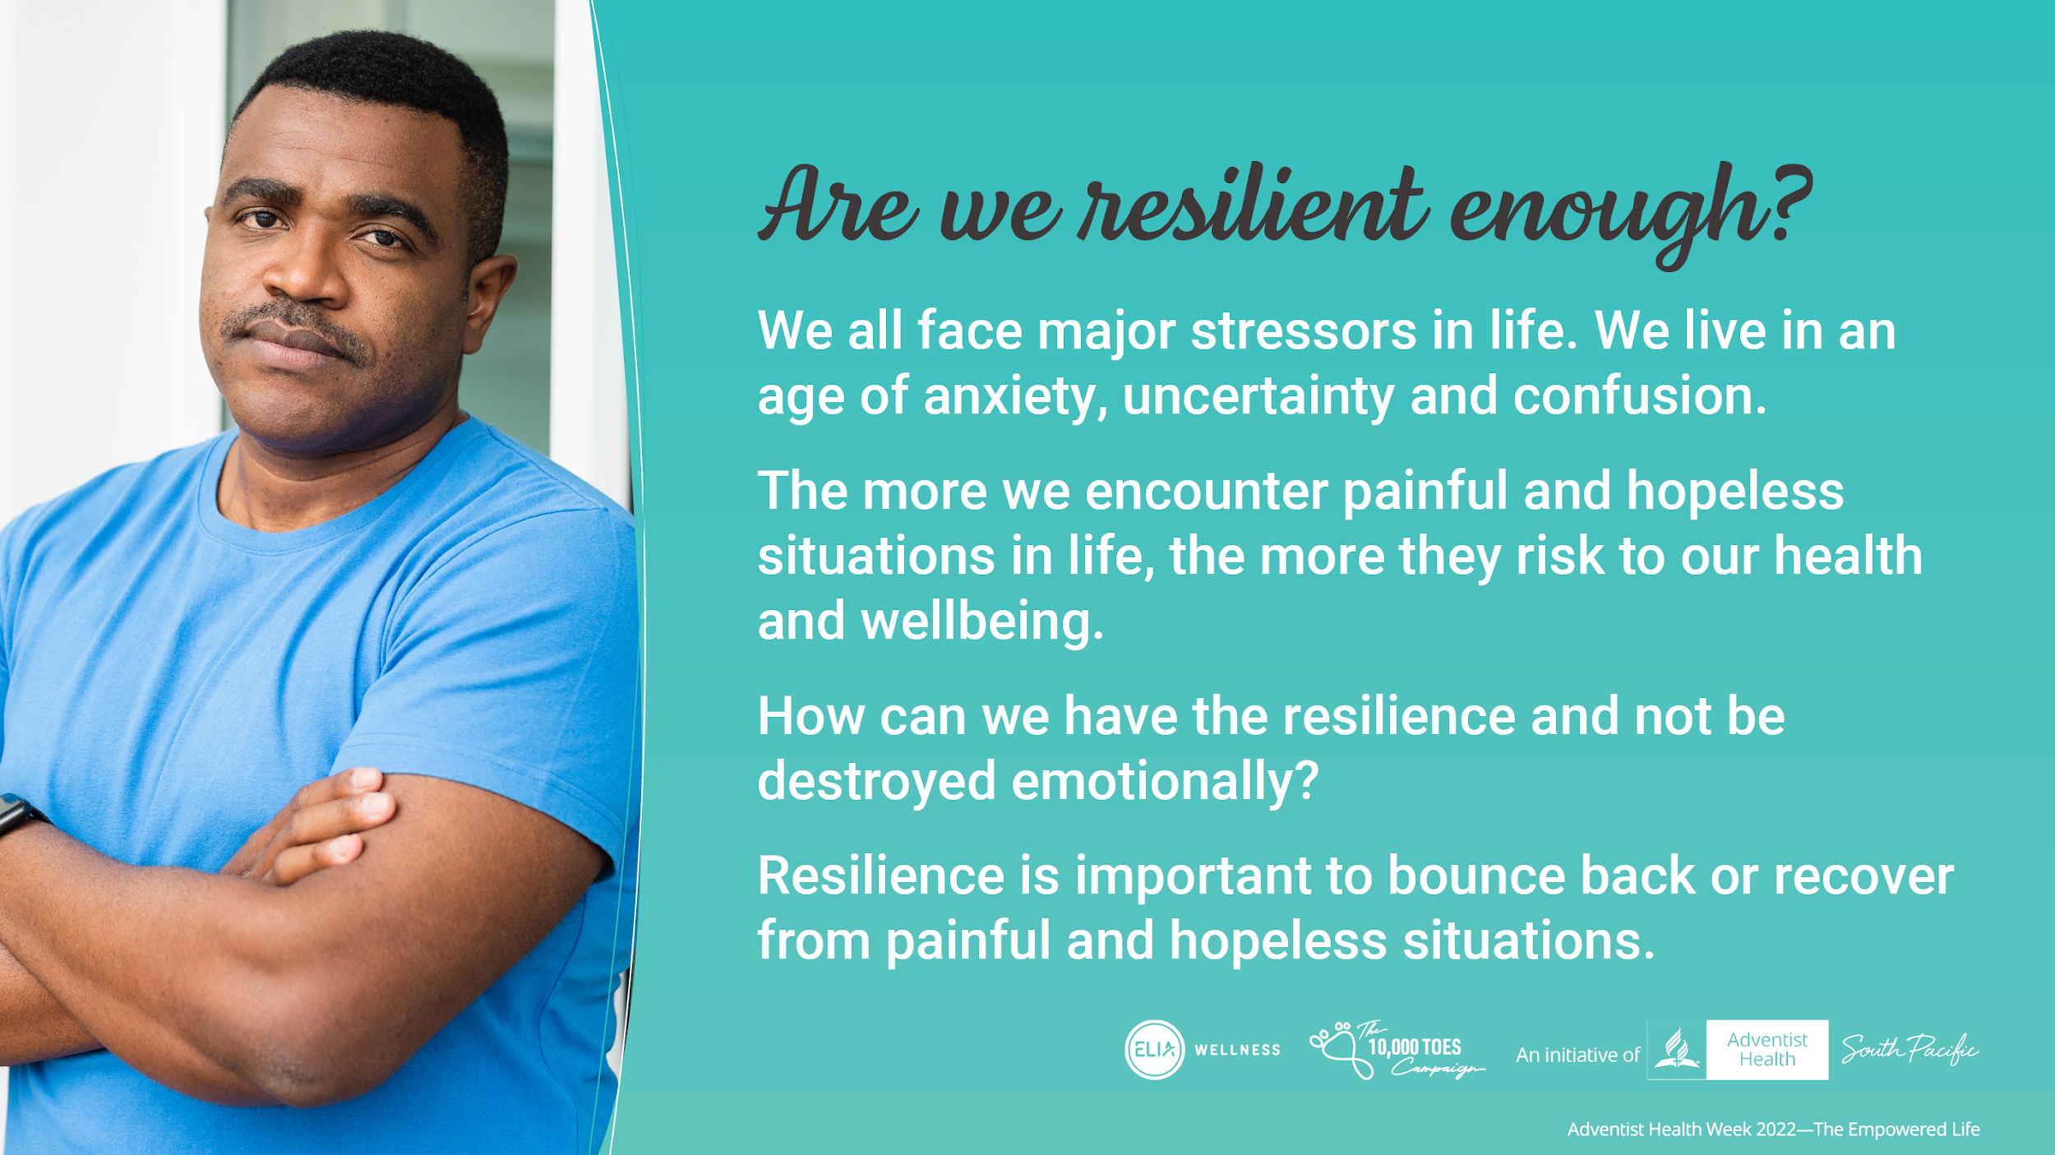
Notes:
Are we resilient enough?
We all face major stressors, in one form or another?
How can we have the resilience to deal with what happens and not be destroyed emotionally in the process?
It is very important that we are resilient so that we are able to bounce back or recover from painful and hopeless situations in life

Slide 3
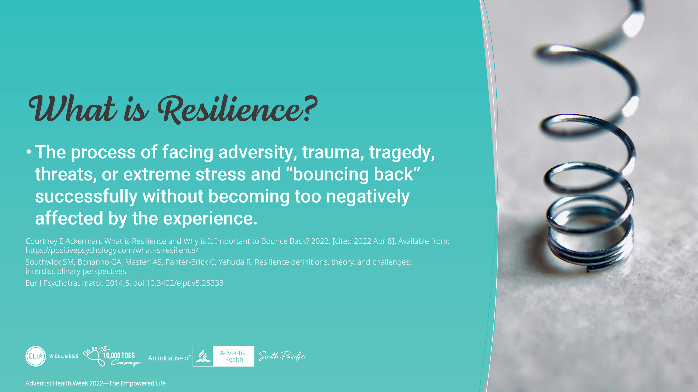
Notes:
What is resilience?
Resilience is the process of facing adversity, trauma, tragedy, threats, or extreme stress and “bouncing back” successfully without becoming too negatively affected by the experience

Slide 4
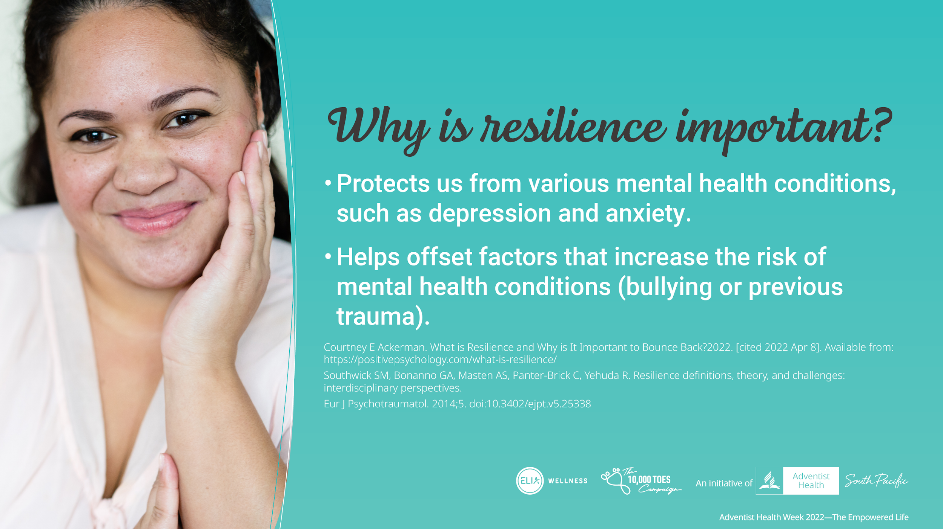
Notes:
Why is resilience important?
Helps to protect us from various mental health conditions, such as depression and anxiety
Helps offset factors that increase the risk of mental health conditions, such as bullying or previous trauma

Slide 5
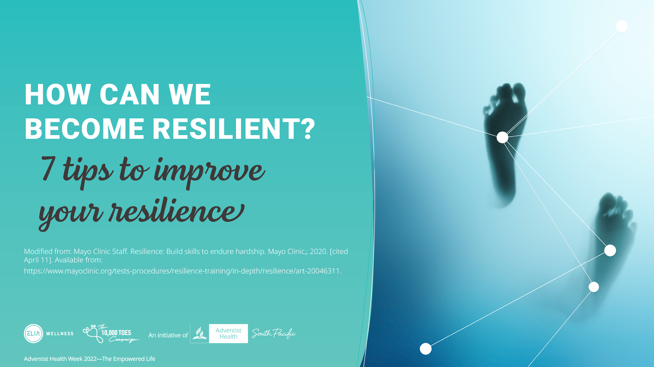
Notes:
Note for the presenter: Make each of this tips your discussion points. Keep it brief.
Since being resilient helps us to cope with stressors and trauma, Mayo Clinic has 7 tips to improve your resilience.

Slide 6
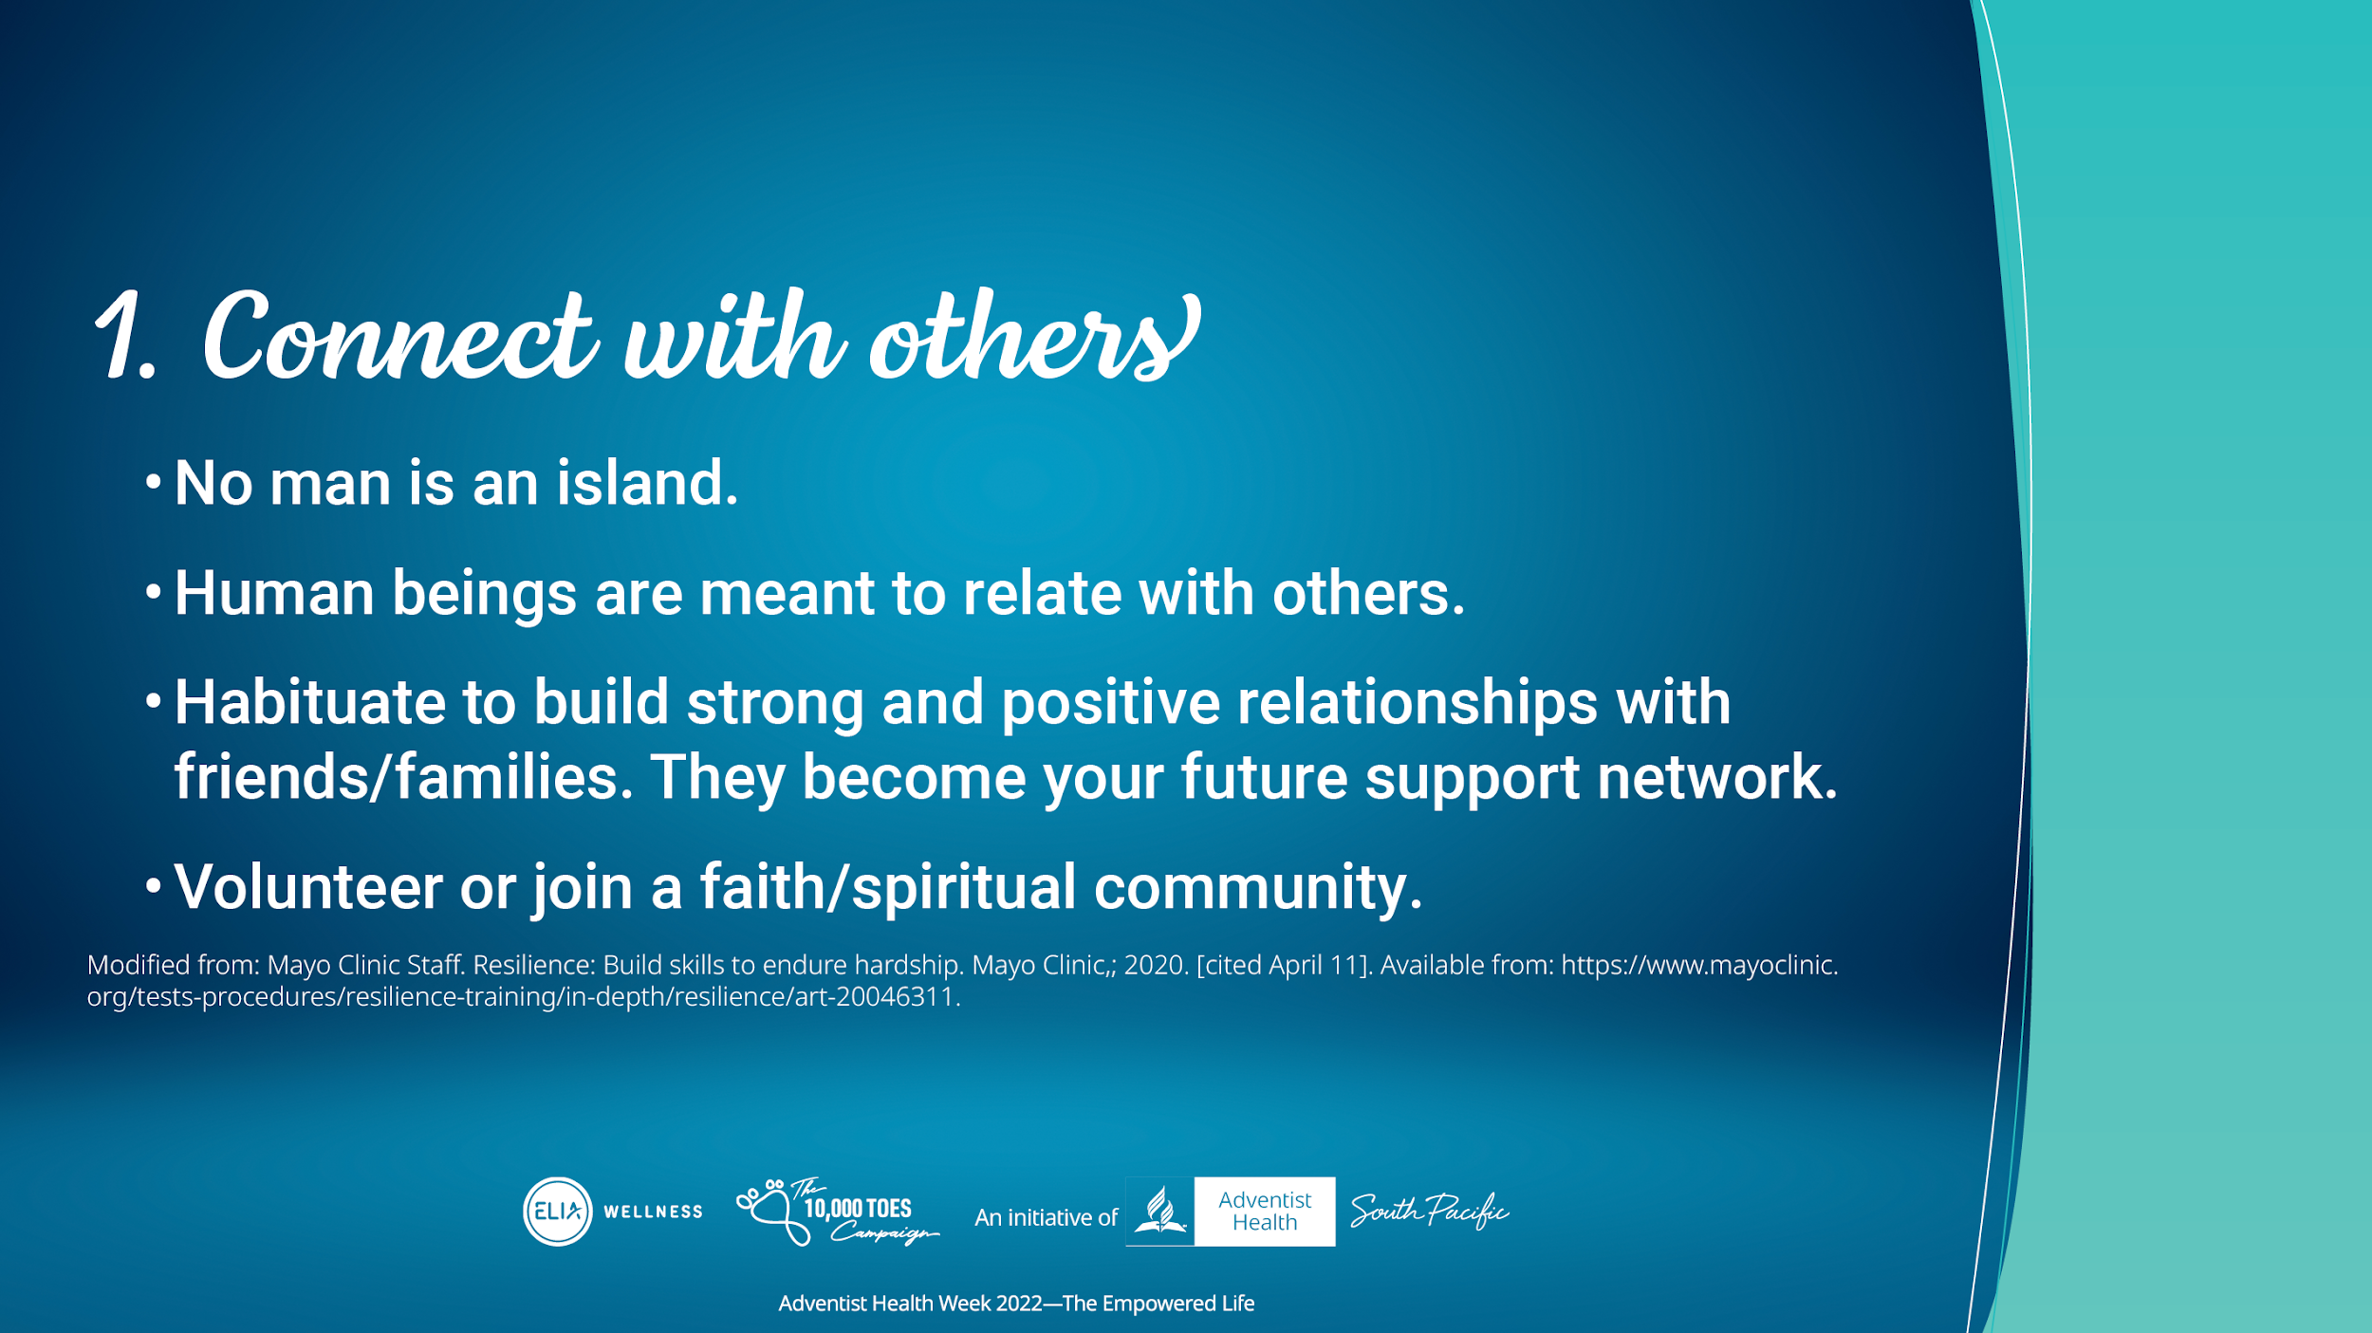
Notes:
First is Connectedness.
Go through the points.
Having a sense of belonging to a particular group makes it easy to get support when in times of desperate need. In fact, in the Pacific, we are a communal society, whereby we support one another in the event of desperate needs. Connectedness is the strength in the Pacific. This helps us become resilient when faced with challenges in life.

Slide 7
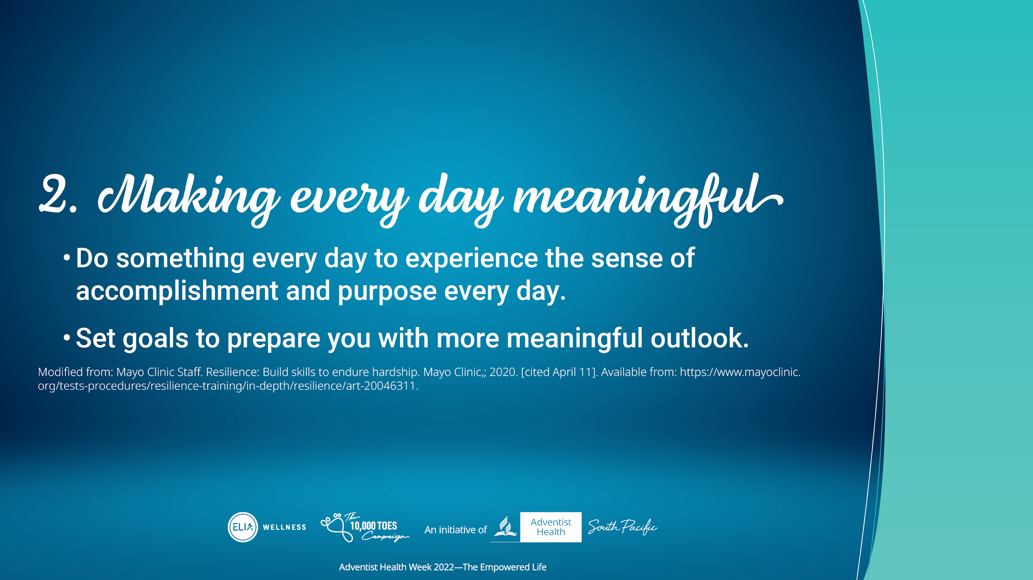
Notes:
Second: Make everyday meaningful.
Do something that gives you a sense of accomplishment and purpose every day. Set goals to help you look toward the future with meaning.

Slide 8
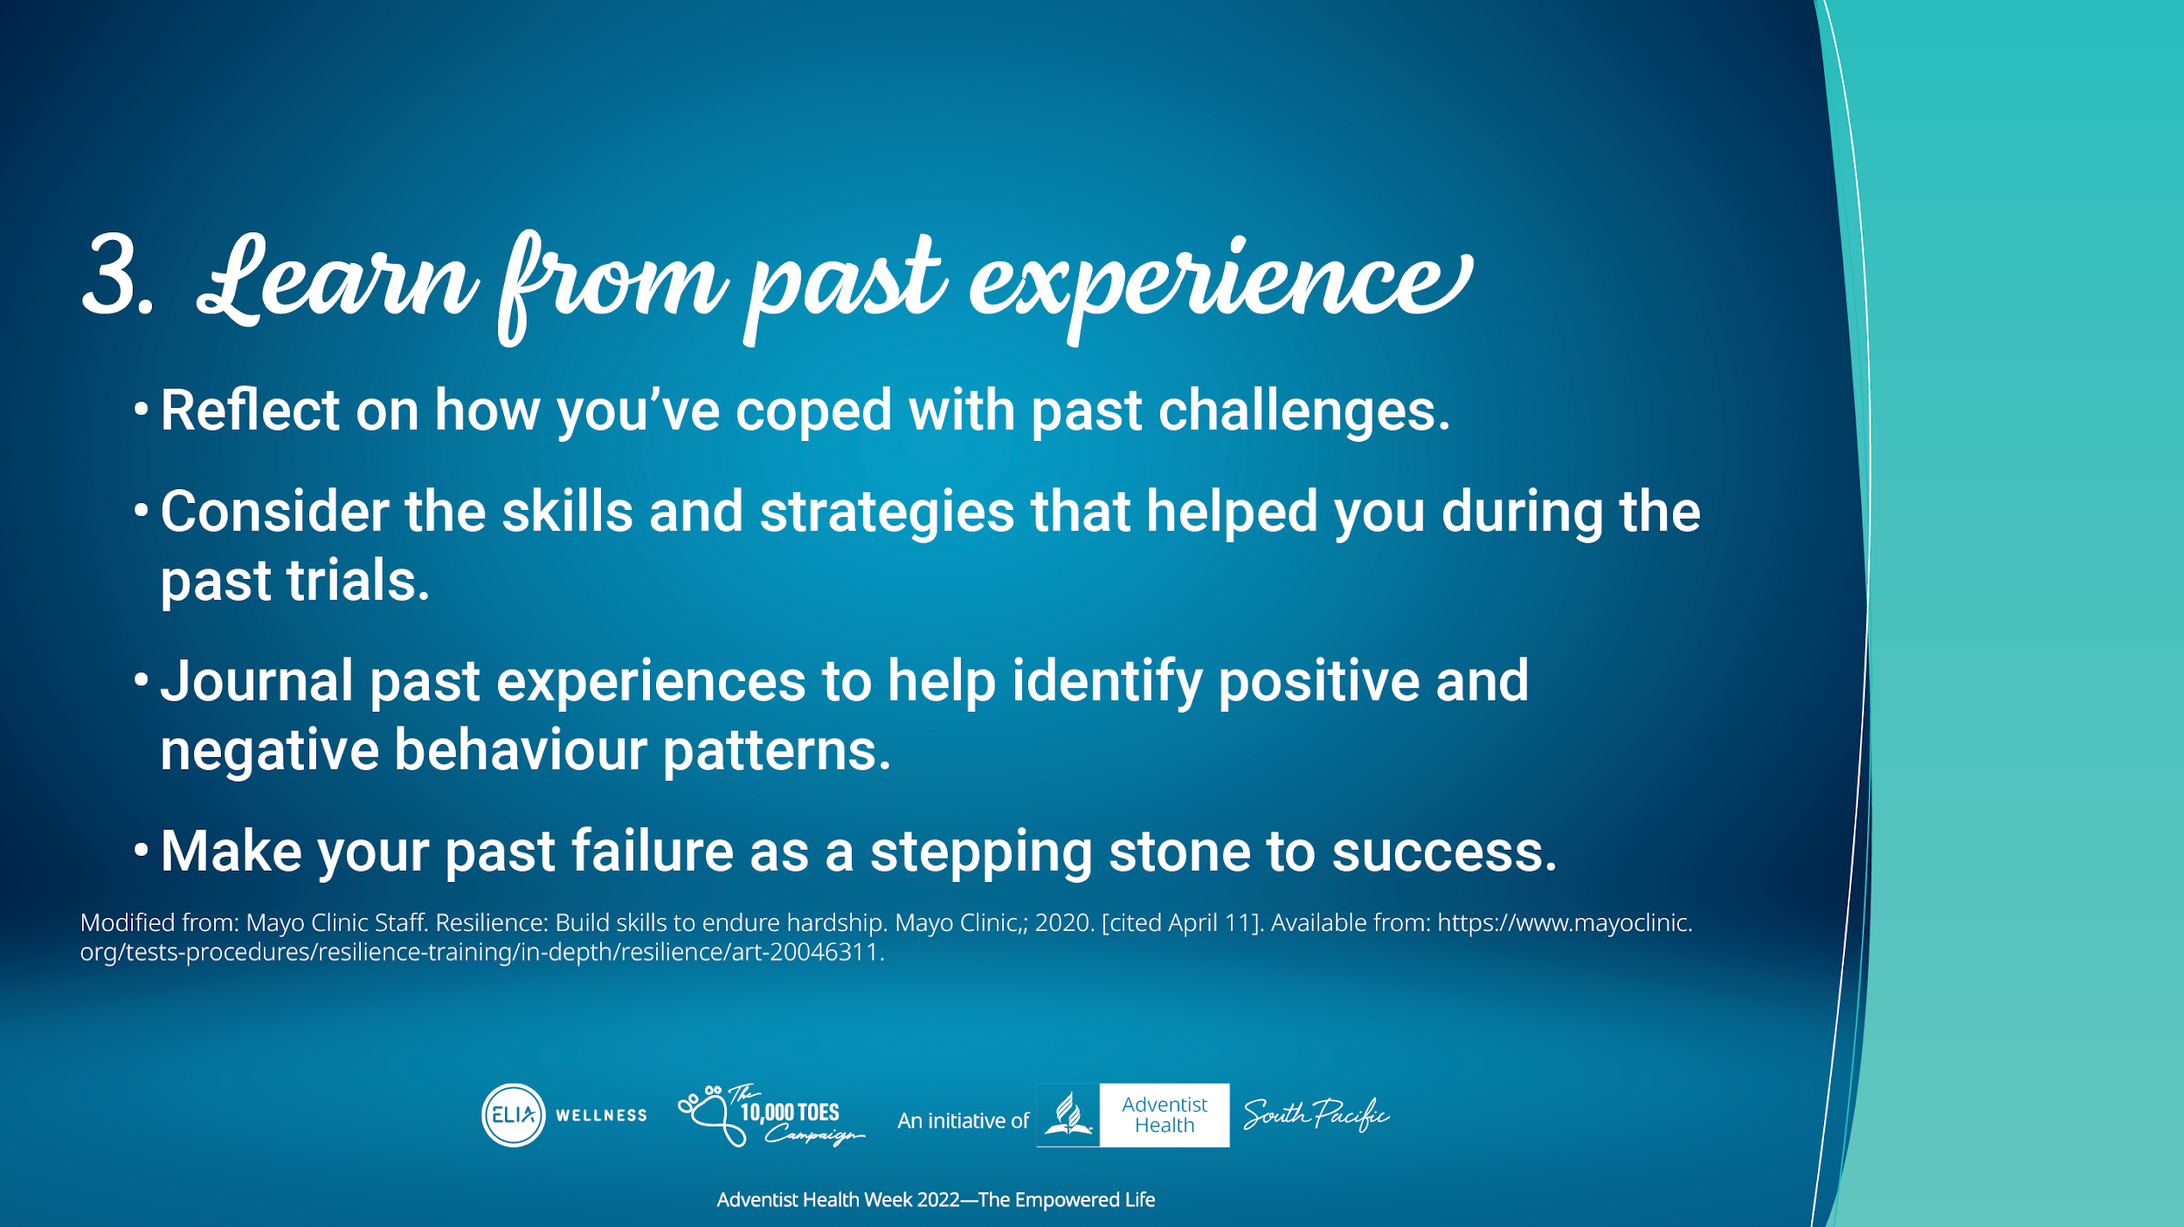
Notes:
Third, Learn from past personal experience, including others.
Learning from the past experience is very important to help build our resilience.
Go through the points.

Slide 9
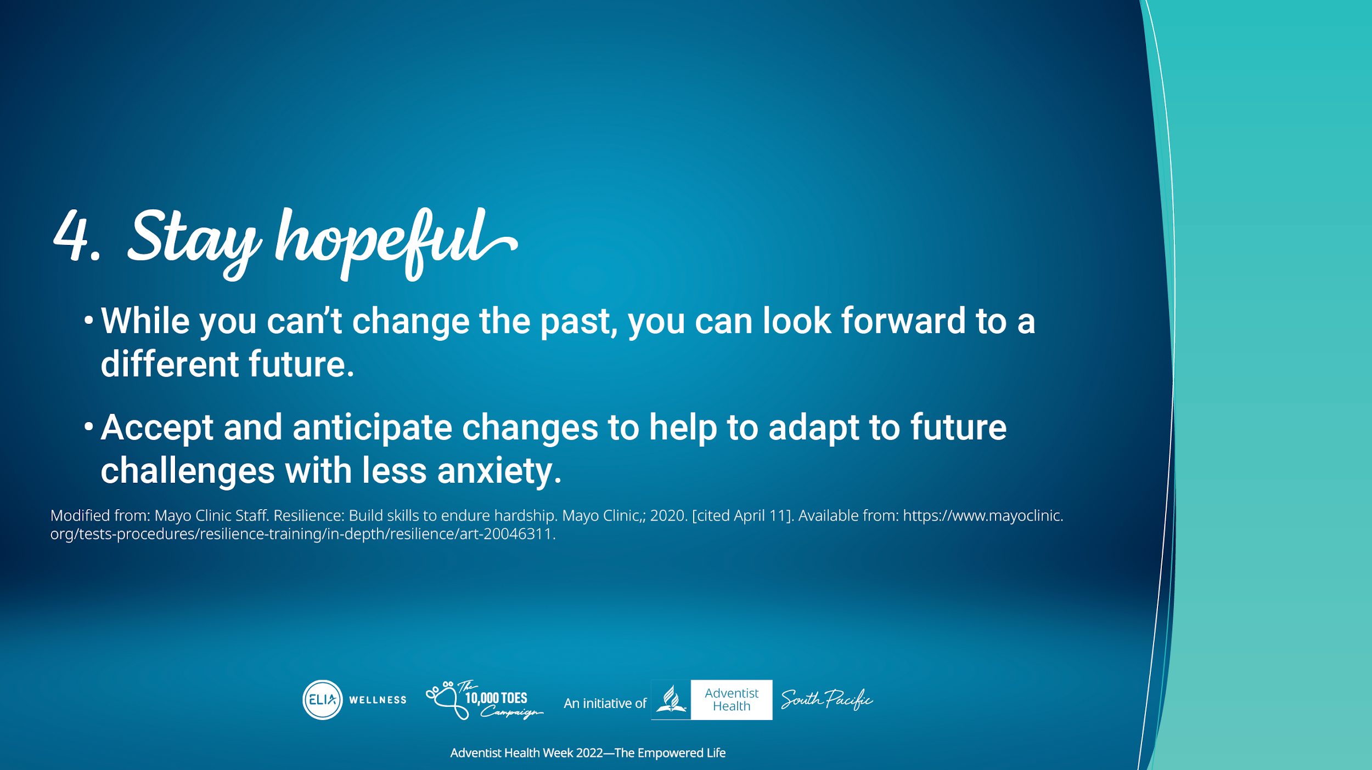
Notes:
Fourth. Remain hopeful.
You can't change the past, but you can always look toward the future.
Accepting and even anticipating change makes it easier to adapt and view new challenges with less anxiety.

Slide 10
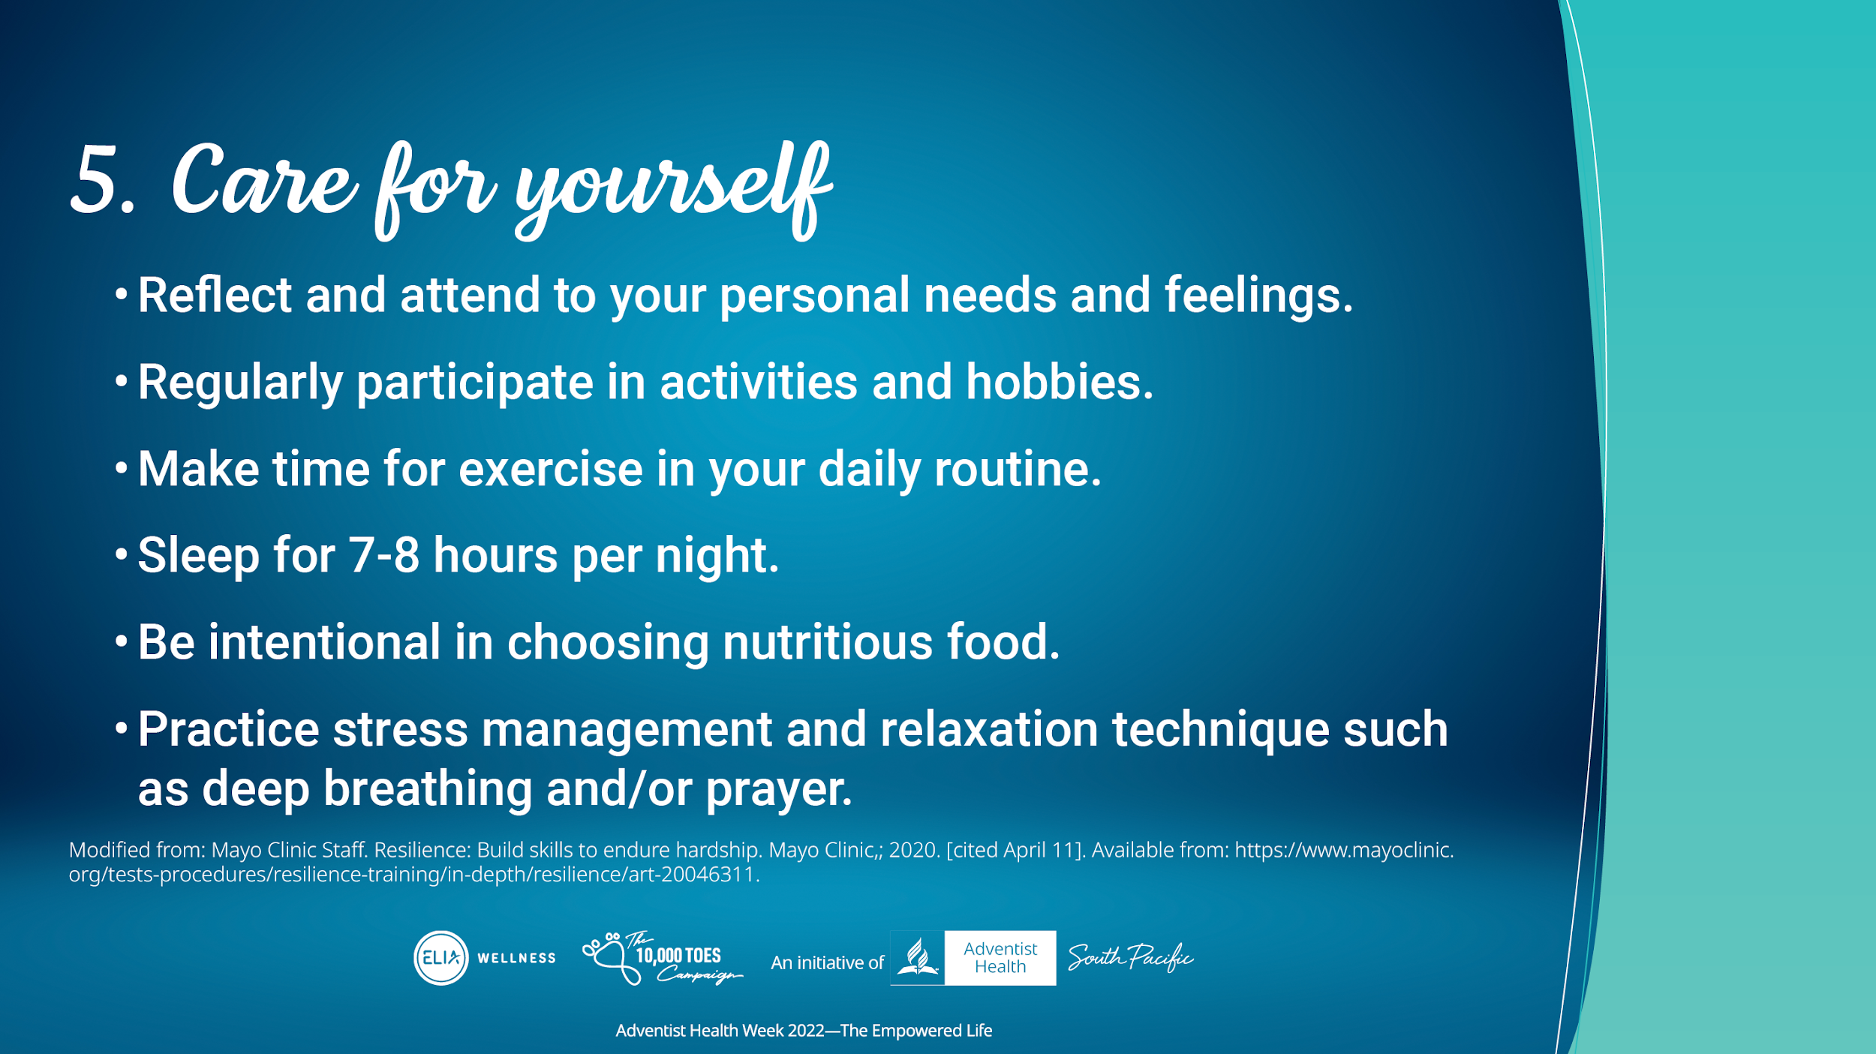
Notes:
The fifth tip: Take care of yourself.
Reflect and attend to your own needs and feelings
Regularly participate in activities and hobbies you enjoy
Make time for exercise in your daily routine
Sleep 7-8 hours per night
Be intentional to choose nutritious foods
Practice stress management and relaxation techniques: deep breathing and/or prayer

Slide 11
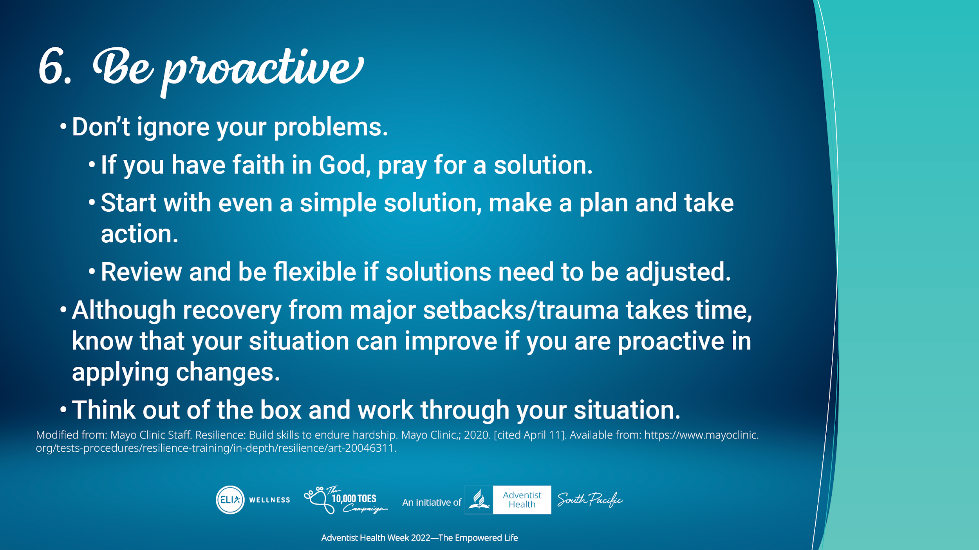
Notes:
The sixth tip: Be Proactive.
Don't ignore your problems
Instead, pray on what needs to be done. Start with a simple solution, make a plan, and take action.
Review and be flexible if solutions need to be adjusted
Although it can take time to recover from a major setback, traumatic event or loss, know that your situation can improve if you work at it
Think out of the box and work through your situation

Slide 12
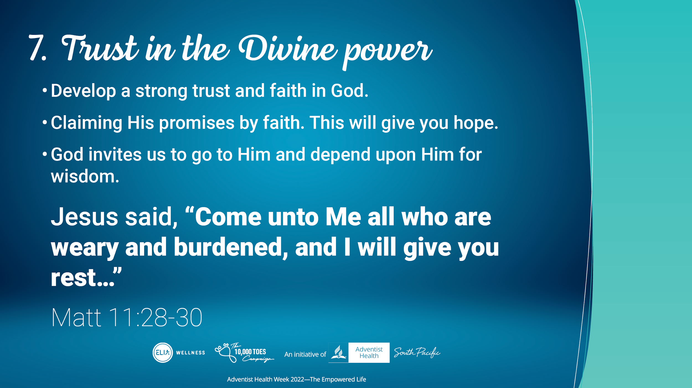
Notes:
For the 7th, trust in the divine power.
Develop a strong trust and faith in God
Claiming His promises by faith. This will give you hope
God invites us to go to Him and depend upon Him for wisdom
Jesus said,
“Come unto Me all who are weary and burdened, and I will give you rest. (Matt 11:28-30)

Slide 13
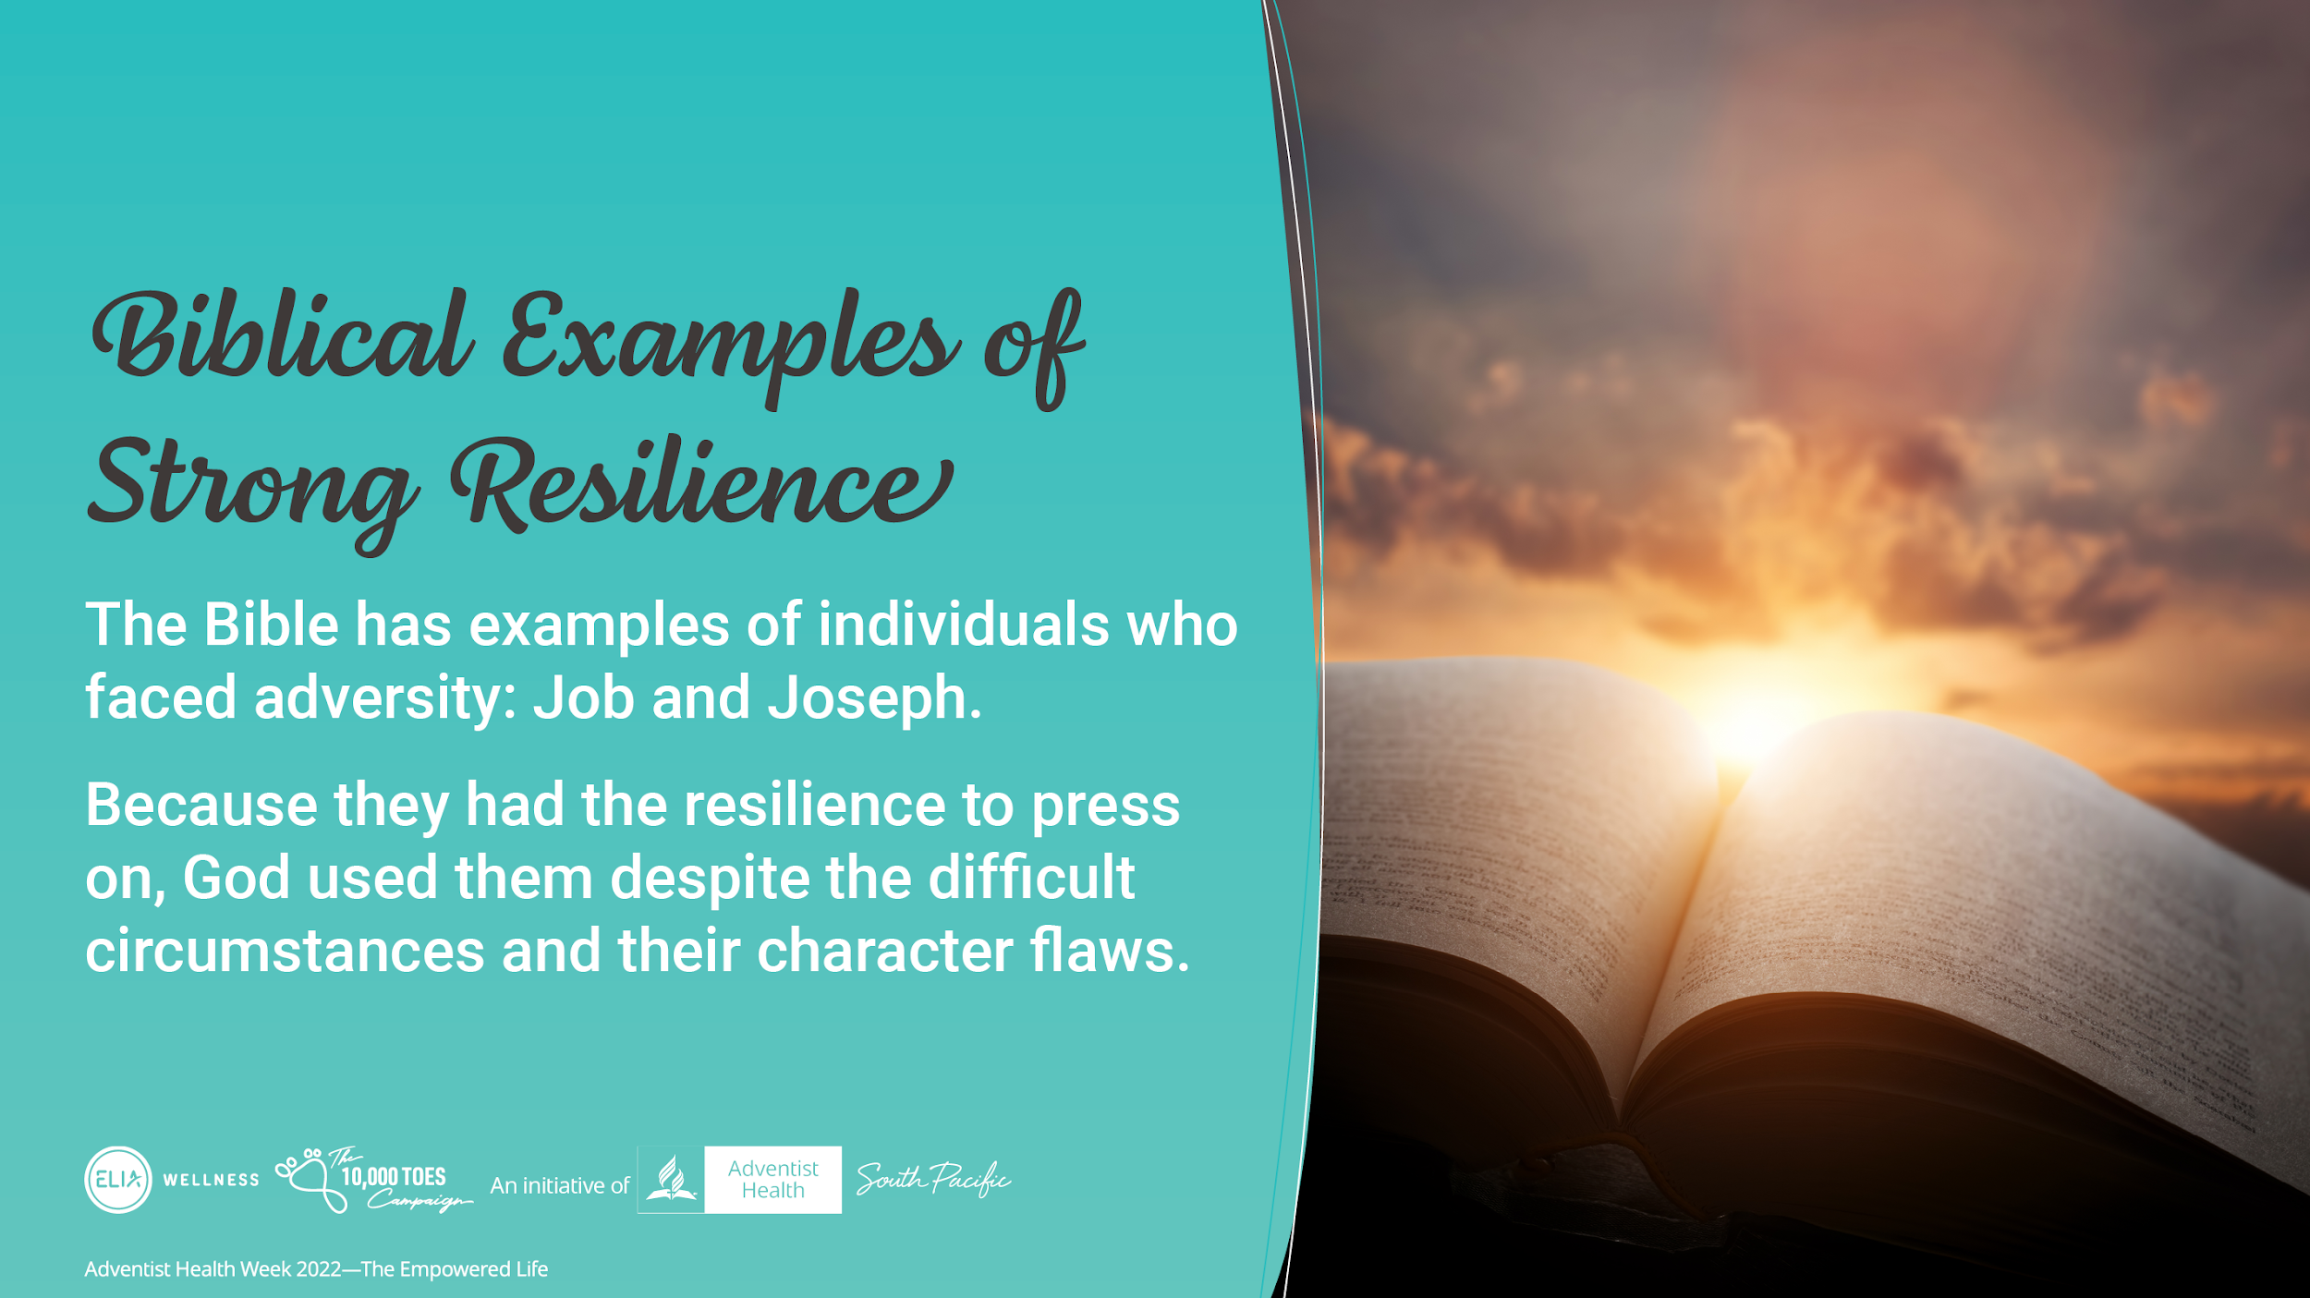
Notes:
The Bible has many examples of individuals who had resilience when facing with adversity.
Despite difficult circumstances and character flaws they were able to be used by God because they had the resilience to press on, even amid adverse circumstances
There are many, but we will look at 2 individuals in the Bible who had the resilience and bounced back because they leaned on God.

Slide 14
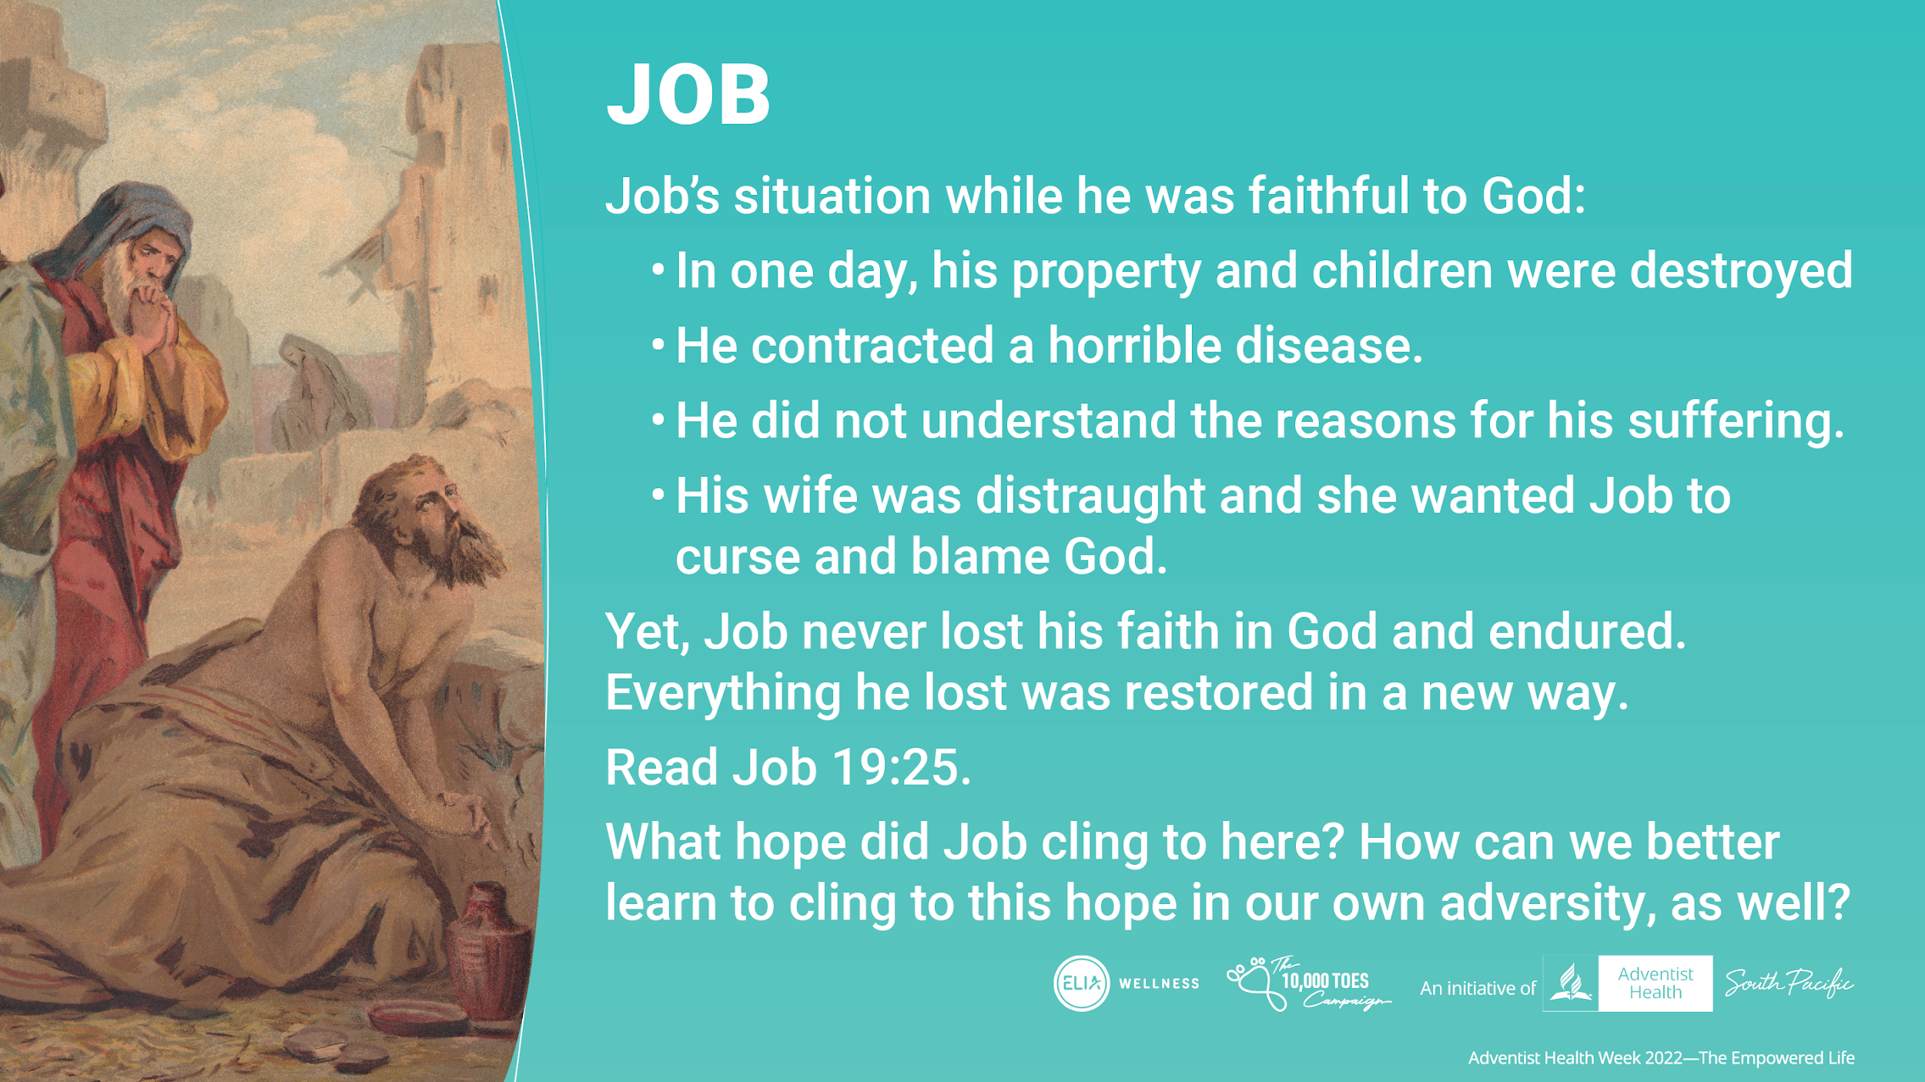
Notes:
The story of Job offers a supreme example of resilience.
Earlier in his life, Job had a strong relationship with God and understood that God is merciful and righteous. He did not understand the reasons for his suffering; his property and children were destroyed in one day, and then he contracted a horrible disease. Job did not find support from his wife; And yet, somehow amid it all, he never lost his faith in God and endured until the tragedy ended.
Read Job 19:25. For I know that my Redeemer lives, and He shall stand at last on the earth;
What hope did Job cling to here? How can we better learn to cling to this hope in our own adversity, as well?
Note to the presenter.
Please discuss in detail the experience of Job, emphasising his resilience strength.

Slide 15
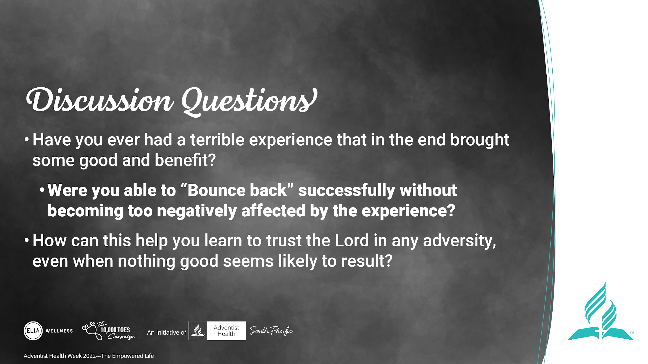
Notes:
Have you ever had a terrible experience that in the end brought some good and benefit? “Bouncing back” successfully without becoming too negatively affected by the experience.
How can this help you learn to trust the Lord in any adversity, even when nothing good seems likely to result?

Slide 16
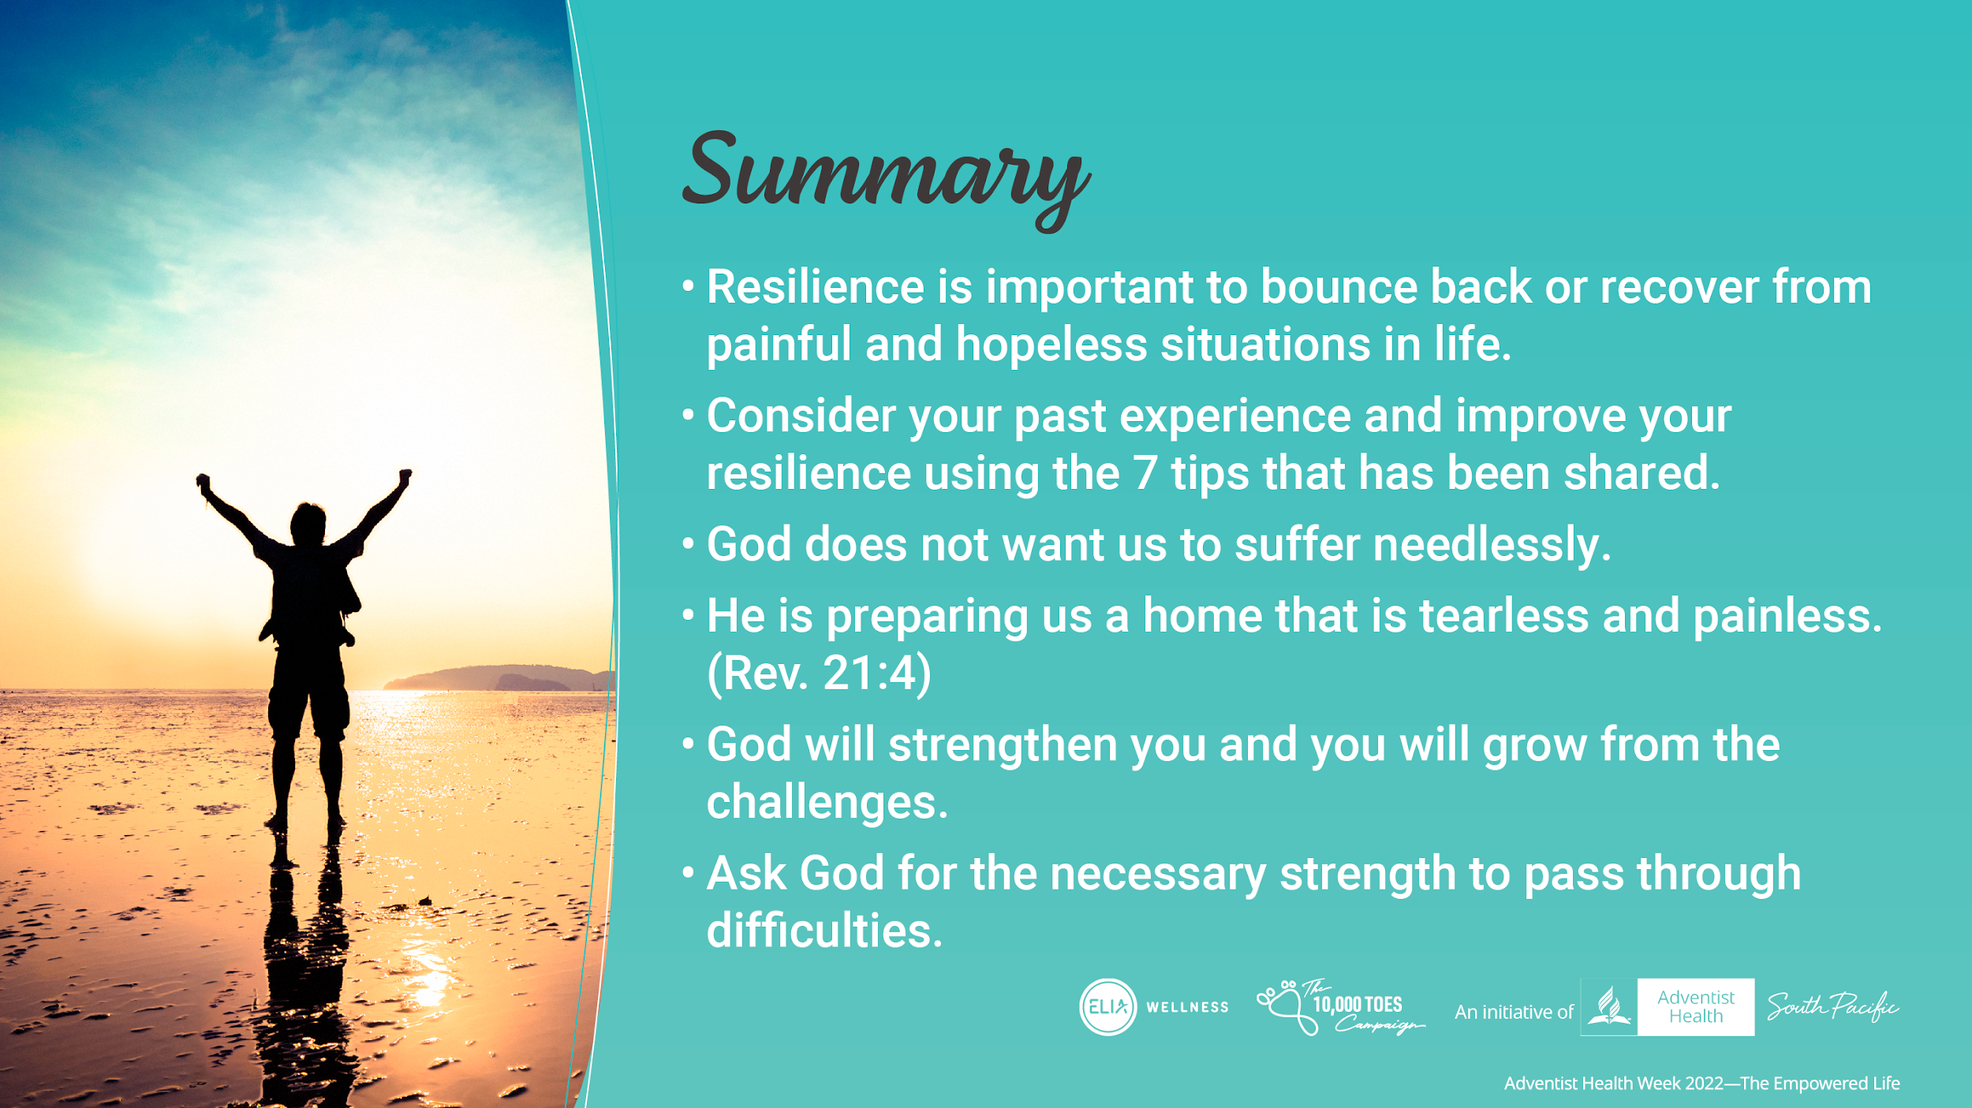
Notes:
Resilience is important to bounce back or recover from painful and hopeless situations in life
Consider your past experience and improve your resilience using the 7 tips that has been shared:
Connecting with the community
Making everyday meaningful
Learning from experiences
Remain hopeful
Take care of yourself
Be Proactive
Trust in Divine power
God does not want us to suffer needlessly. In fact, the environment Jesus has prepared for us in heaven is tearless and painless (Rev. 21:4). But as we wait for that promise to be fulfilled, it seems certain that pain is the path to learn certain lessons. Character development, empathy, humility, discipleship, understanding of good and evil— these are some of the lessons we can learn. Although it is difficult to think of the benefits of suffering, especially in the midst of trial, we can ask God for the necessary strength to pass through difficulties.

