Slide 1

Notes:
Welcome to the Empowered Life series devotional. Today we will be discussing the understanding of having emotional intelligence

Slide 2
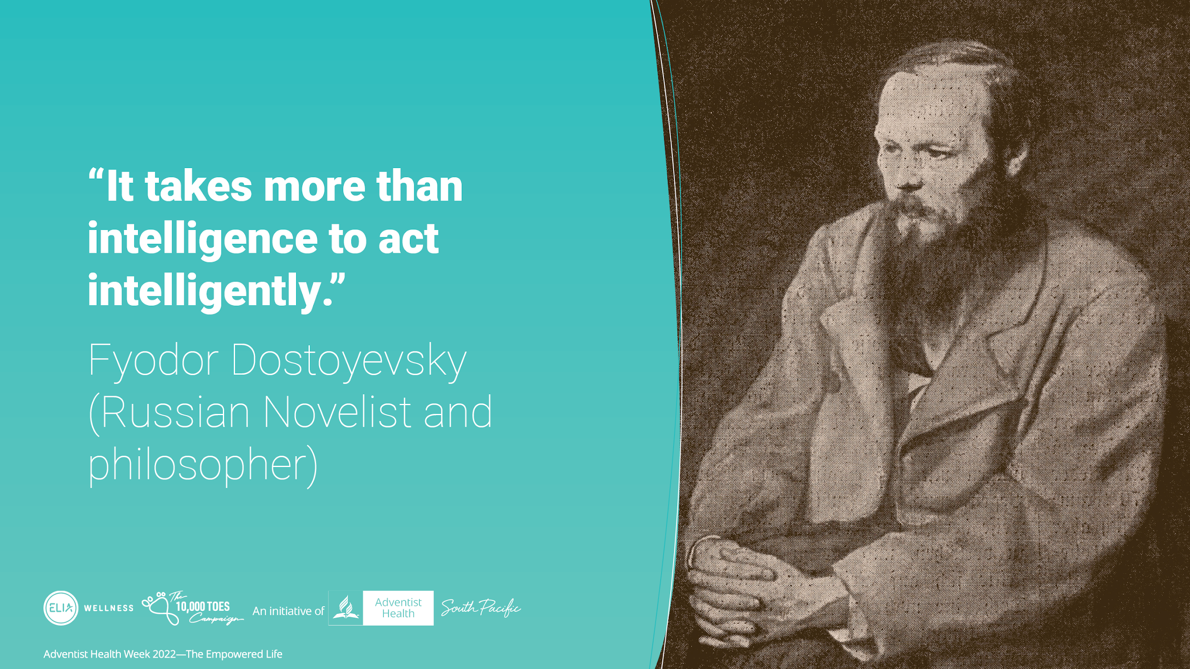
Notes:
Here’s an interesting quote by Fyodor Dostoyevsky (a Russian Novelist and philosopher), “It takes more than intelligence to act intelligently”

Slide 3
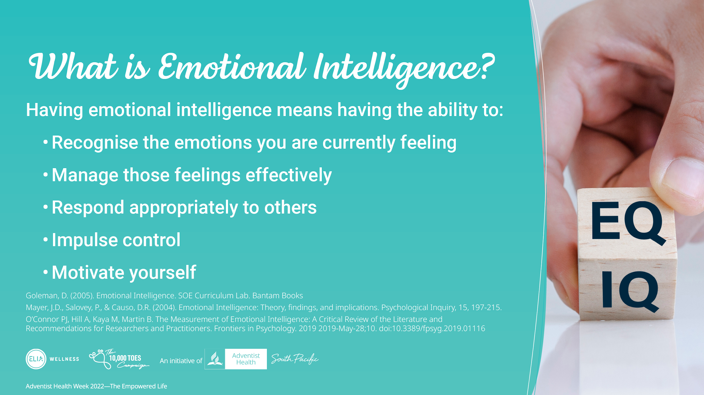
Notes:
Emotional Intelligence or EI results from the interaction of intelligence and emotion. EI refers to an individual’s capacity to understand, manage and express emotions.
What is Emotional Intelligence? Being emotionally intelligent means having the ability to:
Recognize your emotions when you are having them for example, you can feel yourself becoming agitated which may lead to anger, or you are overcome with finding something amusing – even if the situation isn’t very funny. Being able to recognize your feelings takes practice.
Managing feelings effectively when they happen can mean, for example, being able to recognize when you become agitated and putting something in place so that your agitation doesn’t become full blown anger. You can recognize that certain emotions can lead to other “bigger emotions” or responses.
Responding appropriately to others means offering a response to someone that fits the situation they are in, for example, someone who has just lost a loved one will elicit a different response to someone who has lost their wallet. Being emotionally intelligent in this situation is helped when you can recognize the emotion and empathize with the person you are interacting with.
Impulse control is when you are able to “circuit break” a hasty reaction, which invariably may stop an inappropriate response like losing your temper or answering without using tact. Impulse control is difficult to master as it is linked to an automatic response of emotion we have when something new or unexpected happens.
Motivating yourself means having a deep understanding of what is it that stimulates you to do something? When we are intrinsically motivated, i.e.. Motivation from within, based on our values. We are able to achieve almost anything we set our mind on.
Imbedded within the points are the 5 components of Emotional Intelligence – Self-awareness, Self-regulation, Social Skills, Empathy, Motivation.
[*continue}

Slide 4
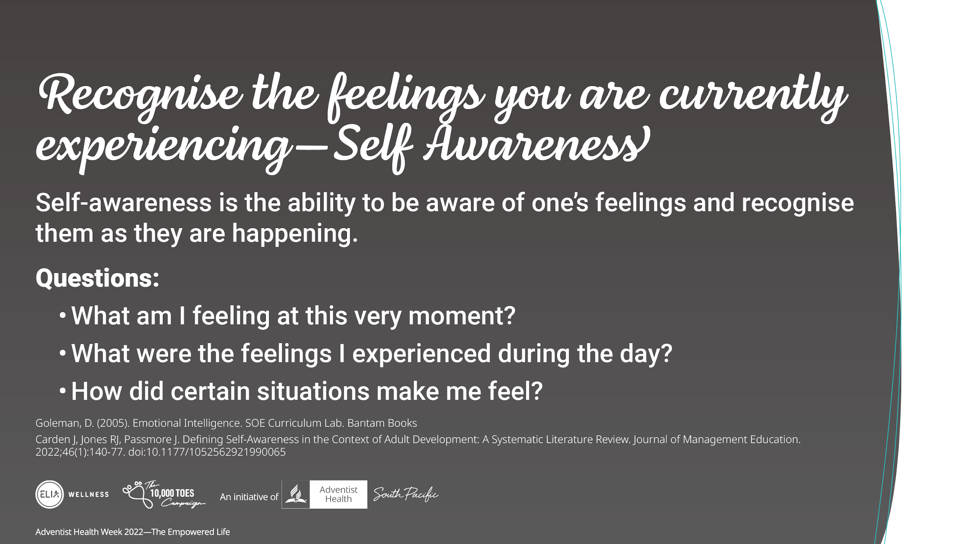
Notes:
Having self-awareness is an indication of having emotional intelligence.
When we are aware of our feelings and recognize them as they are happening to us, we have the choice on how to respond to what feel.
Recognizing a feeling as it happens is the first step in being emotionally intelligent or emotionally agile – at this point we need to understand that how we feel and how we respond are related. Think about this:
What am I feeling at this very moment?
What were the feelings I experienced during the day?
How did certain situations make me feel?
[* take a few seconds for them to think about these questions]
[*with time limit, ask the main group for quick responses. With more time, get people to split into small groups/partner and ask a few to share].
You can share your answers with the people around you, how well were you able to recall your feelings?
The point of this exercise is to encourage us to be more mindful or our emotions as they happen. This is the first step to becoming more emotionally intelligent.

Slide 5
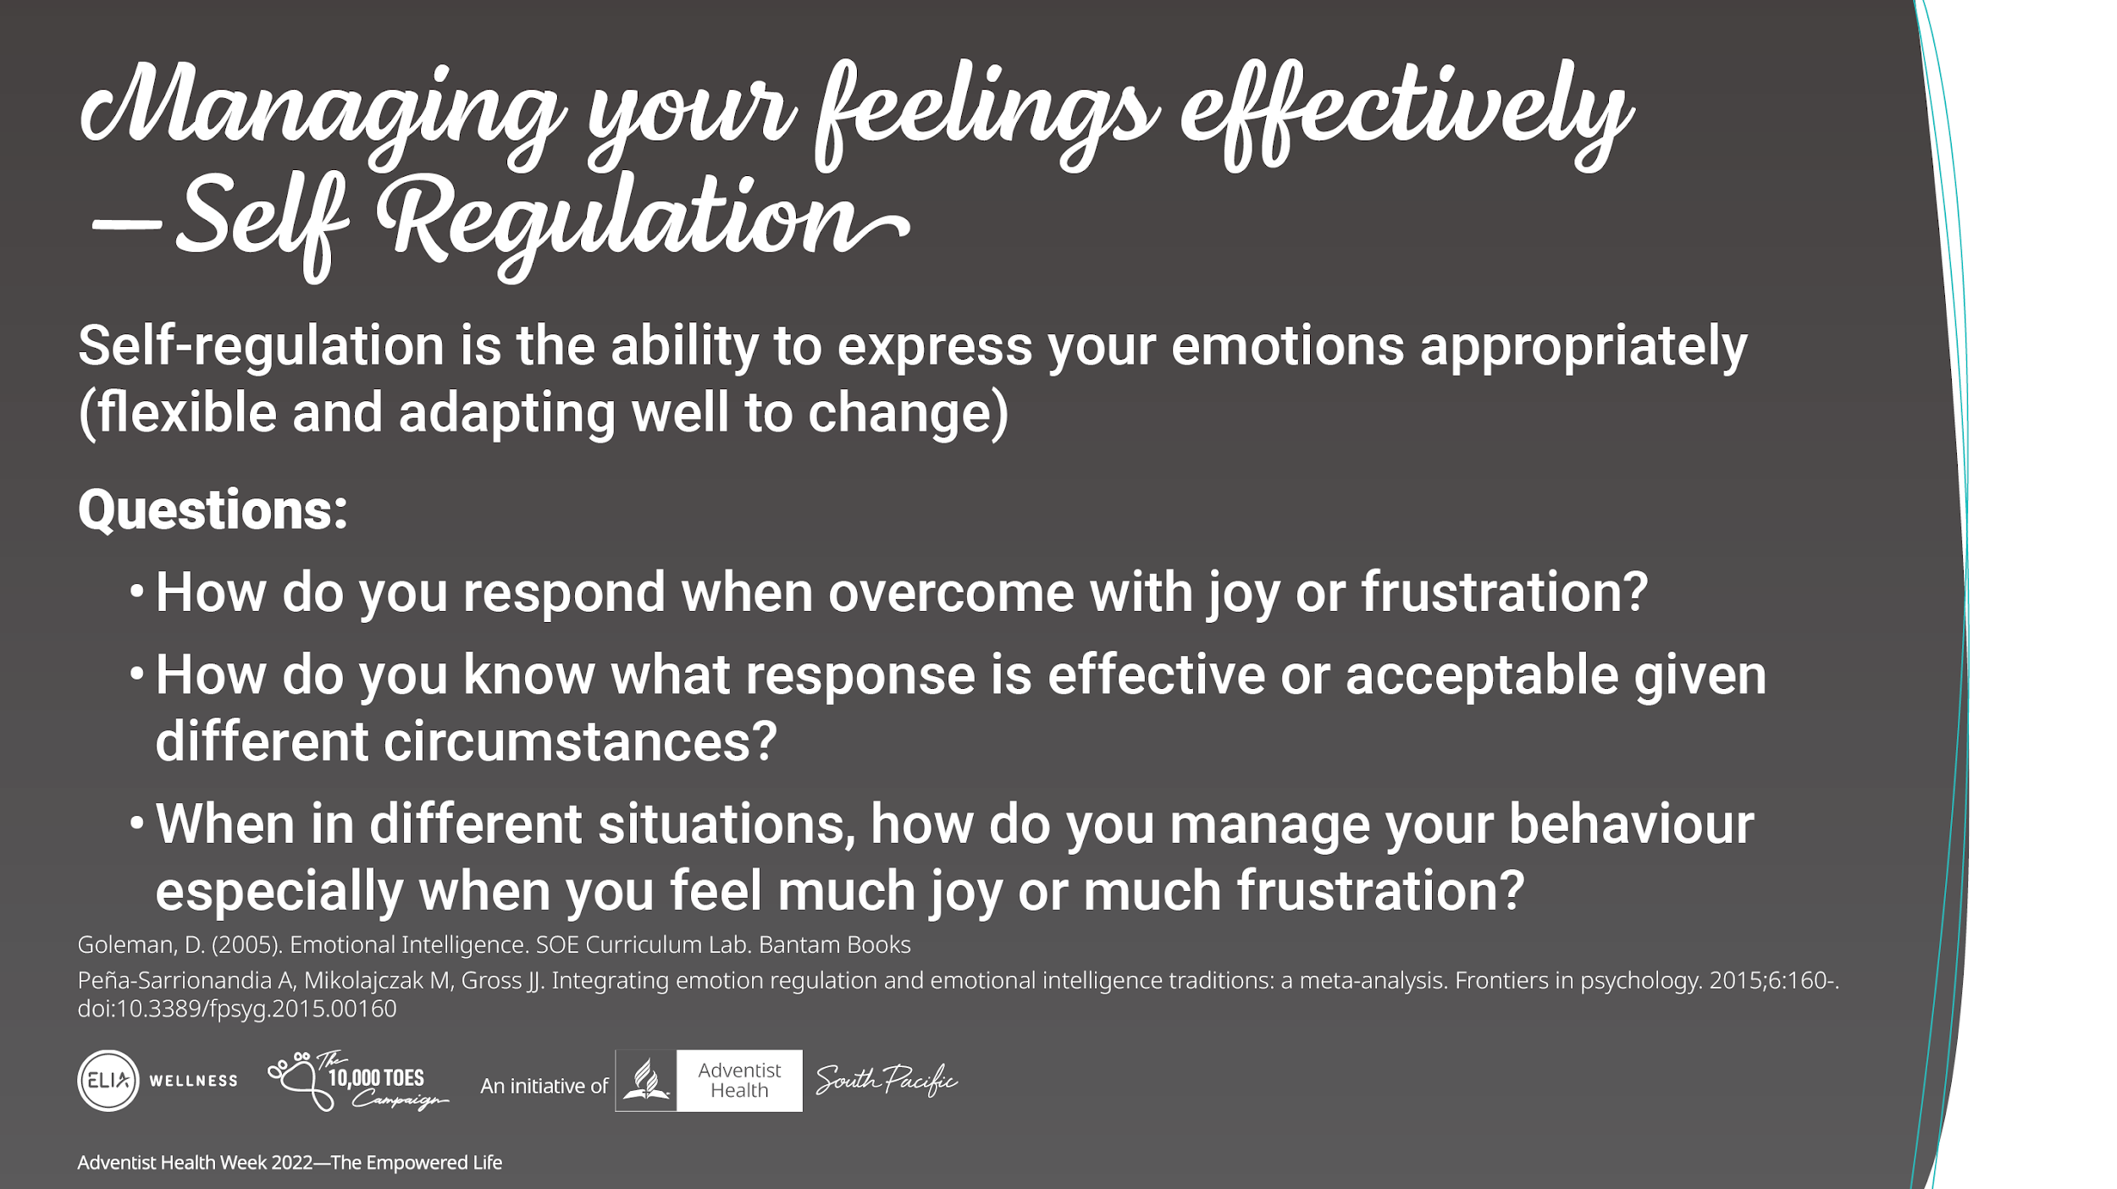
Notes:
Self-regulation is the ability to express your emotions appropriately.
In certain situations, we may be overcome with emotion. This is not uncommon especially in situations that arouse deep emotional responses. In some circumstances responding with a lot of emotion can be a joyful expression, like when our favorite team wins. Yet, in other circumstances a response of explosive anger may not be the best choice and may cause more harm to yourself and those around you. Being able to self regulate your emotions in these circumstances is an important aspect of being emotionally intelligent.
Take this time to think and answer the following questions:
How to you respond when overcome with joy or frustration?
How do you know what response is effective or acceptable given different circumstances? What are the signs you look for when responding to someone?
When in different situations, how do you manage your behavior especially when you feel much joy or much frustration, two examples could be, when your favorite sports team wins a game/tournament and your friends are going for the opposite team, or when someone cuts you off on the road but there are young children in the car with you.
[*with time limit, ask the main group for quick responses. With more time, split people into the same group and ask a few to share].

Slide 6
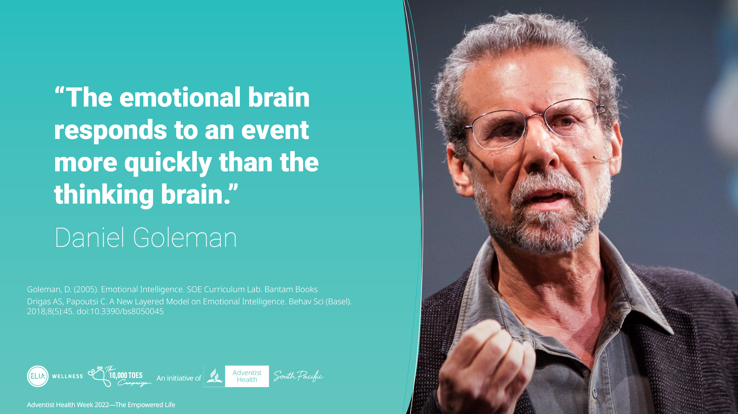
Notes:
Consider this quote by Dr Daniel Goleman. Our emotions are naturally more reactive than our logical processing. Having emotional intelligence is being able to pause before we react to certain situations. Thinking before speaking or acting.

Slide 7
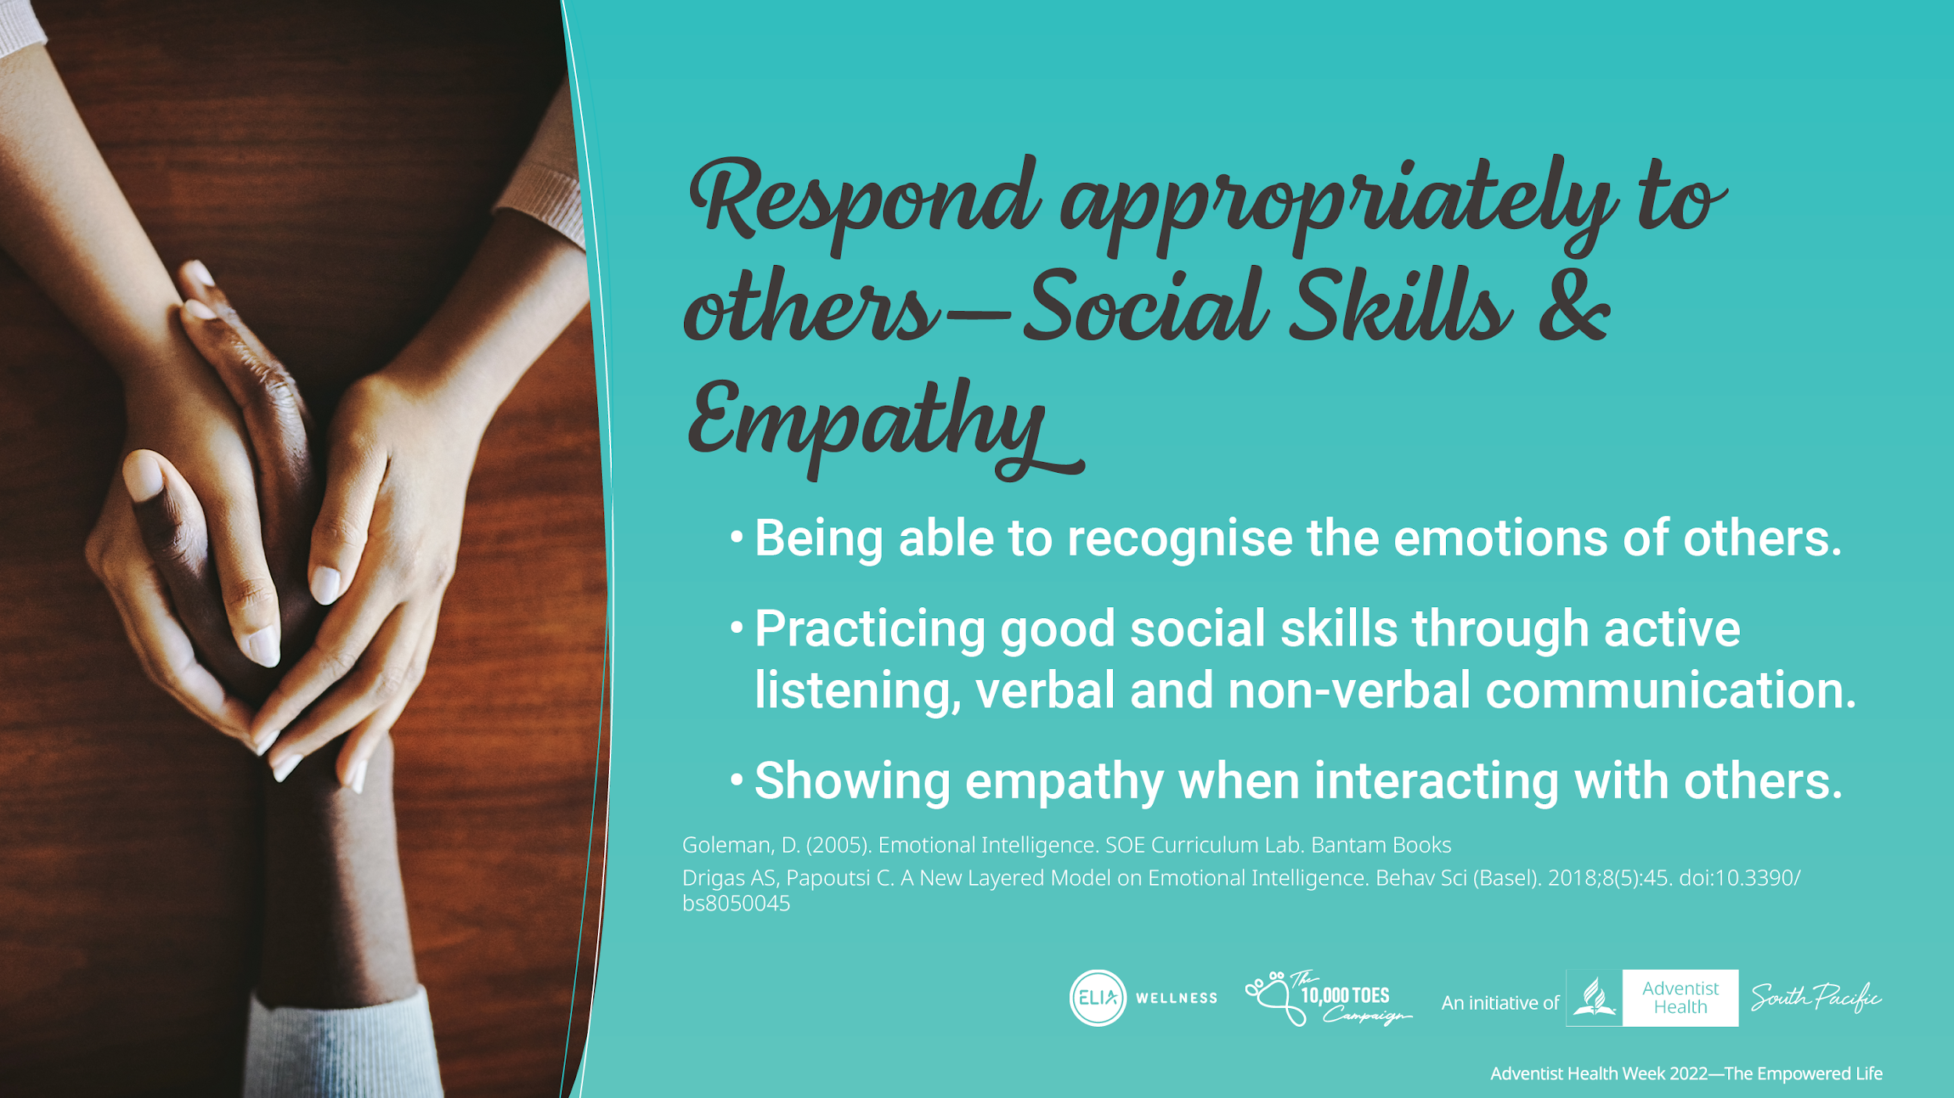
Notes:
Being emotionally intelligent means being able to, not only, recognize your emotions but also others' emotions as they are happening. This is especially helpful when interacting with others, at home, at work, or just in the community in general. Our ability to recognize emotions aids us in developing good social skills. When we recognise someone going through emotional turmoil or joy we can practice different social skills, according to their need. Sometimes people just need us to listen to what they are going through or experience, active listening, which in turn helps us to verbally respond appropriately to what they are saying (when needed). We can also learn communication through non-verbal interaction – this takes practice but shows great emotional intelligence when mastered well.
Showing empathy means being able to recognize how others are feeling and responding in a way that let’s the other person know you understand what they are going through.
Let’s practice with the following images (not required for them to separate into groups)

Slide 8
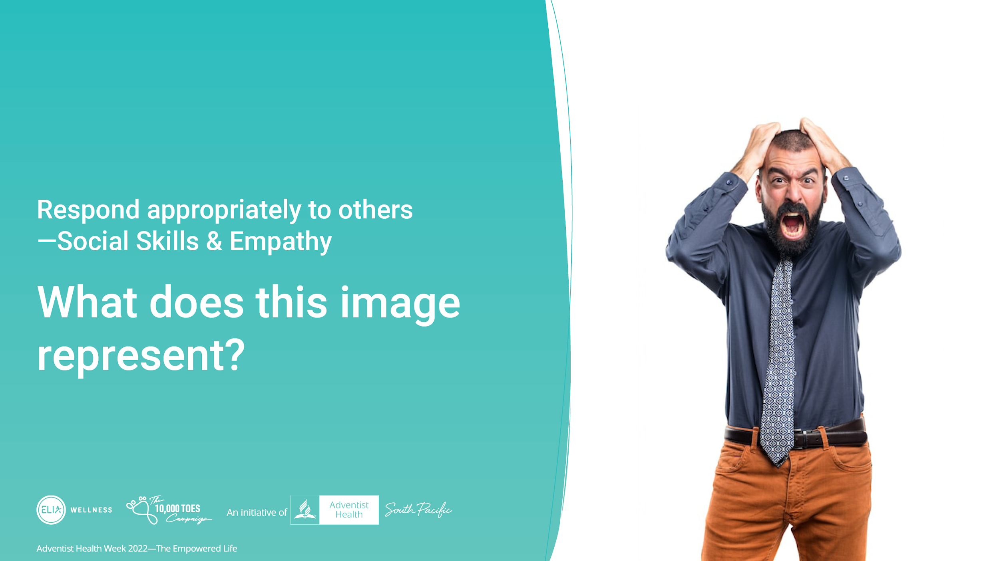
Notes:
(not required for them to separate into groups. 1-2 responses are sufficient)
What does this image reflect about the emotions the person is experiencing? What could an appropriate response be?

Slide 9
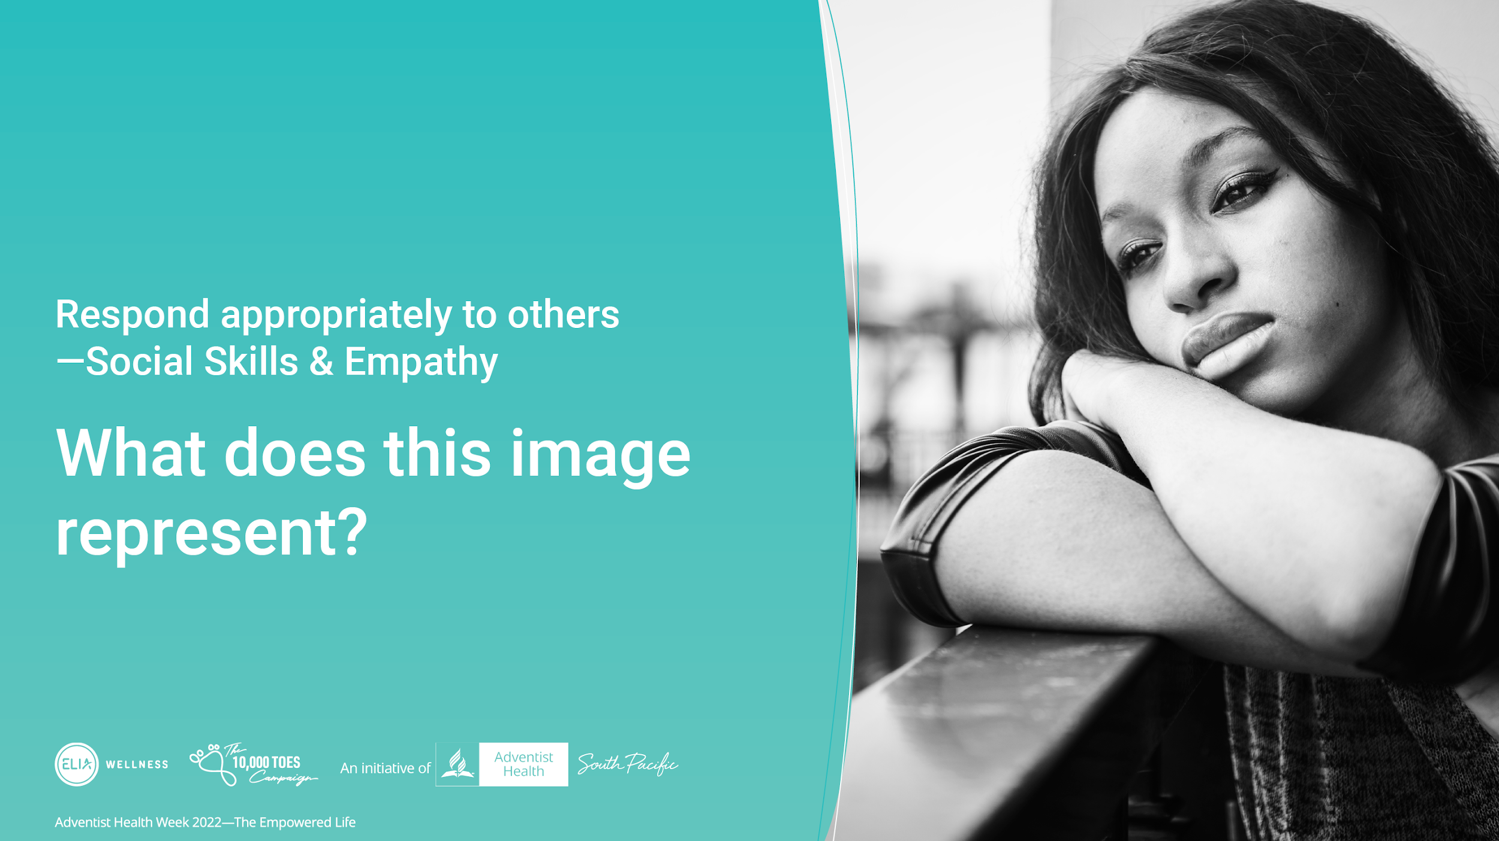
Notes:
(not required for them to separate into groups. 1-2 responses are sufficient)
What does this image reflect about the emotions the person is experiencing? What could an appropriate response be?

Slide 10

Notes:
(not required for them to separate into groups. 1-2 responses are sufficient)
What does this image reflect about the emotions the person is experiencing? What could an appropriate response be?

Slide 11
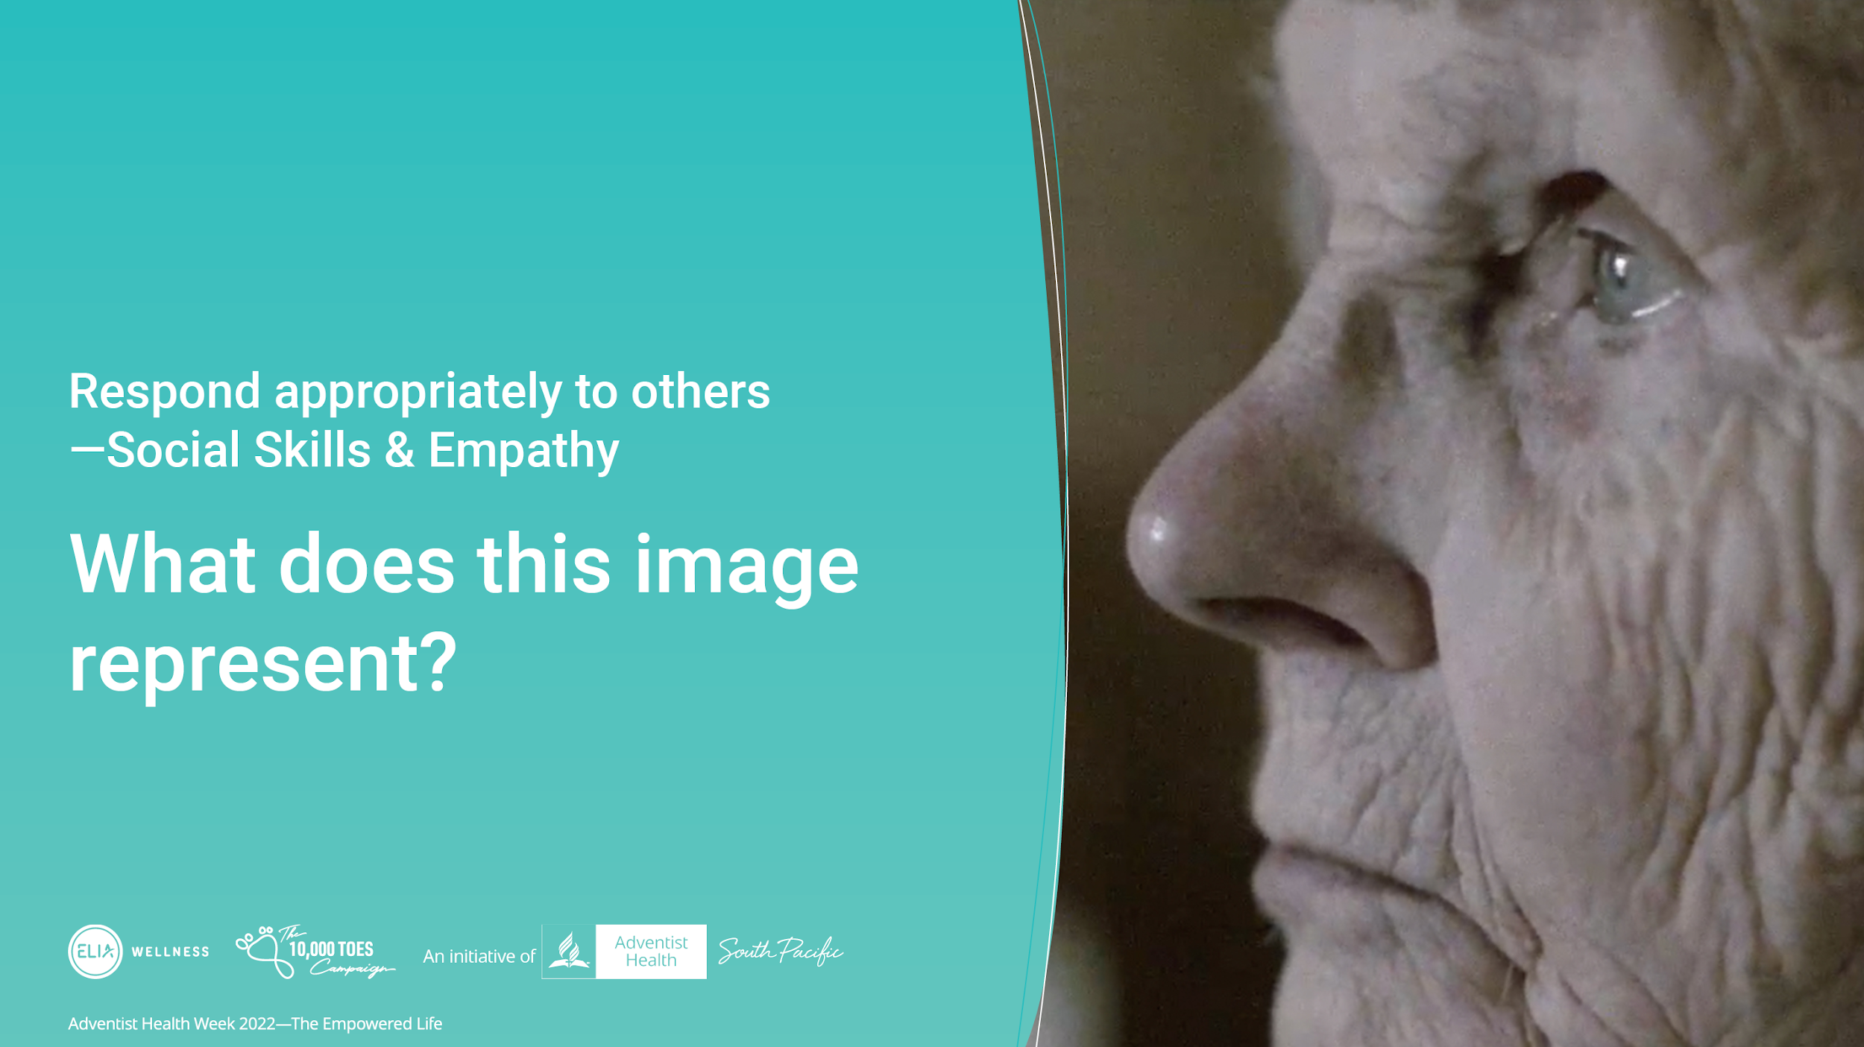
Notes:
(not required for them to separate into groups. 1-2 responses are sufficient)
What does this image reflect about the emotions the person is experiencing? What could an appropriate response be?

Slide 12
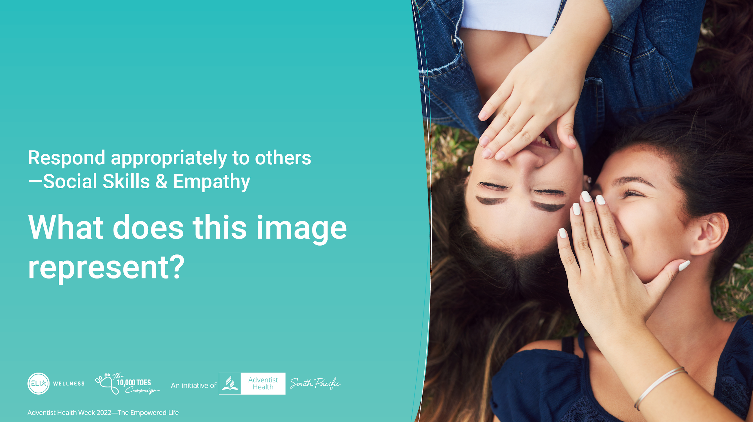
Notes:
(not required for them to separate into groups. 1-2 responses are sufficient)
What does this image reflect about the emotions the person is experiencing? What could an appropriate response be?

Slide 13
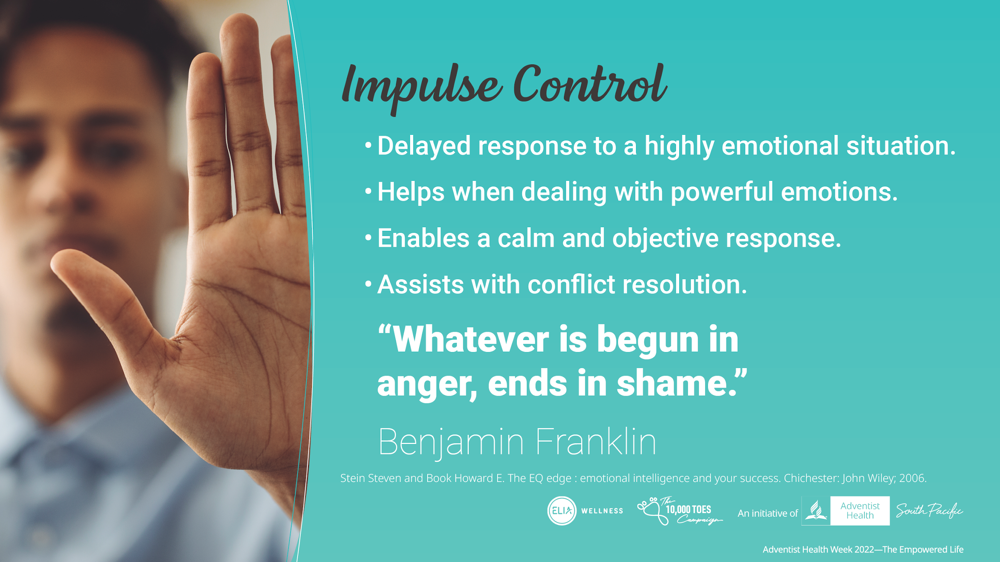
Notes:
Impulse control relates to the immediate autonomic response we all have when something evokes in us very strong emotions. Having the ability to delay a response, is a good tool to have in our emotional intelligence kit. This is especially important when confronted with powerful emotions such as hurt and anger that can lead to aggression, hostility, or irresponsible responses. Being able to delay your response will allow you to look at a situation objectively, then respond in a less confrontational manner and allow you to view the facts objectively and calmly. Practicing impulse control is important, it takes a lot of effort to master but if done well can avoid unnecessary argument and assist in unwanted conflict resolution.

Slide 14
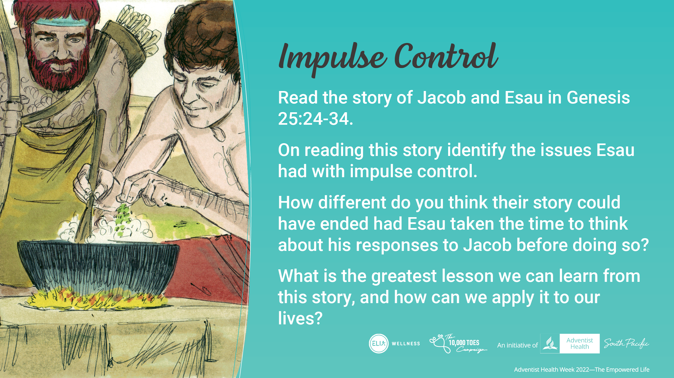
Notes:
Read the story of Jacob and Esau in Genesis 25:24-34.
[*with time limit, ask the main group for quick responses. With more time, split people into the same group and ask a few to share].

Slide 15
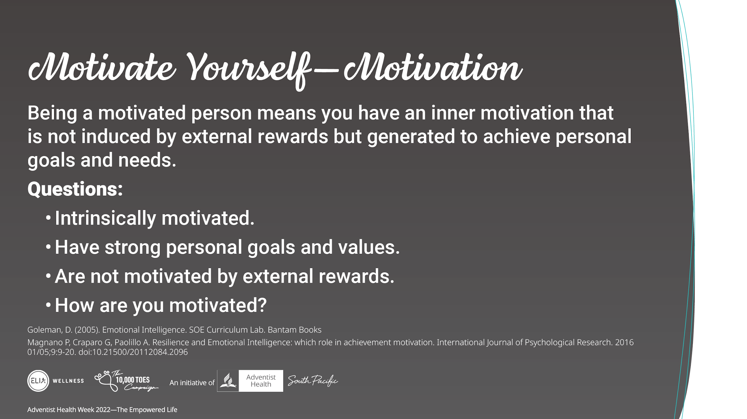
Notes:
A highly motivated person, usually has a high level of emotional intelligence. Intrinsic motivation (motivation that comes from within) is seen when we have set ourselves, and are able to achieve personal goals and needs. This motivation goes deep into our values and what we see as our purpose in life, coming from within. People with high emotional intelligence find motivation from within, are not motivated by external rewards, and are competent, passionate, and action oriented in achieving what they set out to do.
[*with time limit, ask the main group for quick responses. With more time, split people into the same group and ask a few to share].
Discussion Q:
How does being intrinsically motivated helps with becoming a successful person? What are the things that motivate you from within?

Slide 16
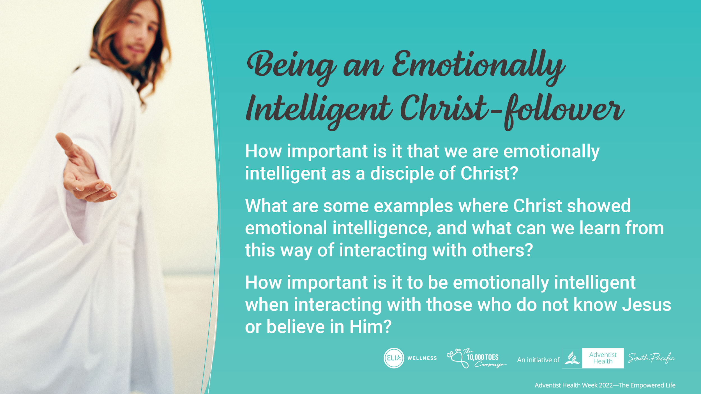
Notes:
[*You can finish with the following questions or just choose one if running out of time]
How important is it that we are emotionally intelligent as a disciple of Christ?
What are some examples where Christ showed emotional intelligence. What can we learn from this way of interacting with others?
Thinking of what we have discussed and when we think of our walk with God how important is it to be emotionally intelligent when interacting with those who do not know Him or believe in Him?

Slide 17
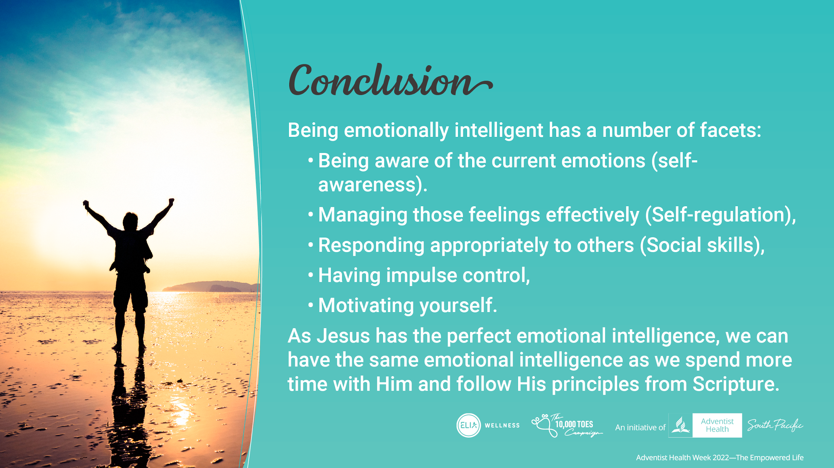
Notes:
In conclusion:
Being emotionally intelligent has a number of facets:
Being aware of the current emotions (self-awareness)
Managing those feelings effectively (Self-regulation),
Responding appropriately to others (Social skills),
Having impulse control
Motivating yourself
As Jesus has the perfect emotional intelligence, we can have the same emotional intelligence as we spend more time with Him and follow His principles from Scripture

Slide 18
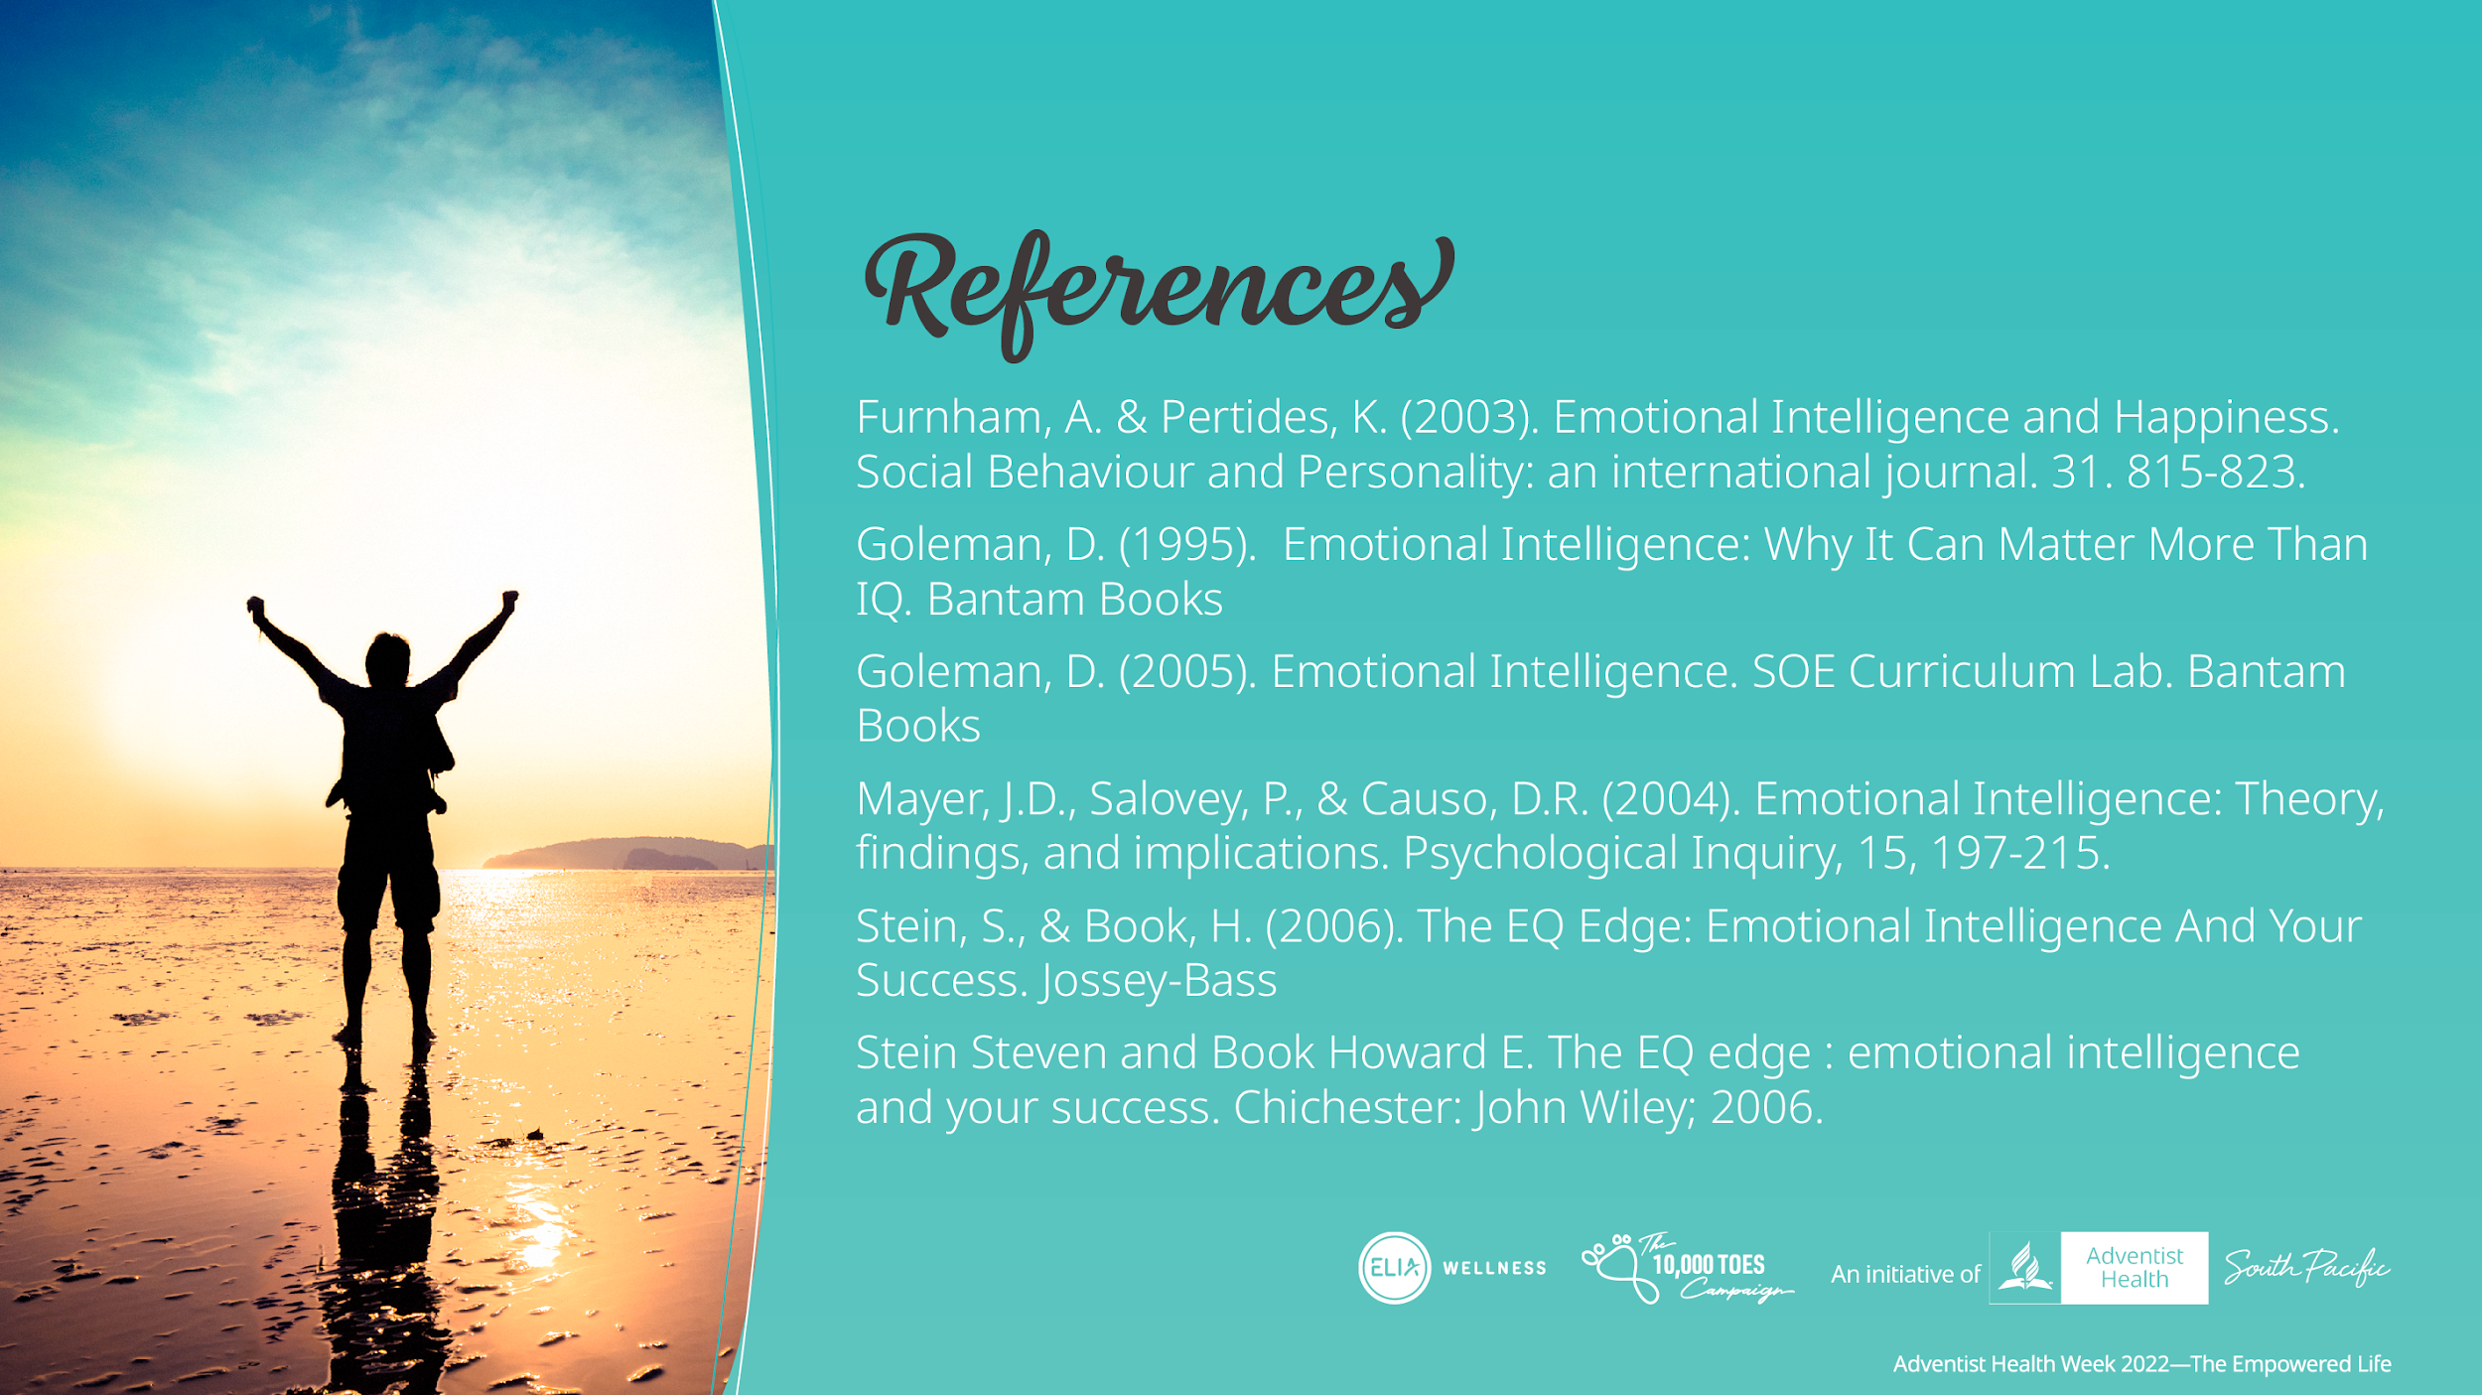
Notes:
[*You can finish with the following questions or just choose one if running out of time]
How important is it that we are emotionally intelligent as a disciple of Christ?
What are some examples where Christ showed emotional intelligence. What can we learn from this way of interacting with others?
Thinking of what we have discussed and when we think of our walk with God how important is it to be emotionally intelligent when interacting with those who do not know Him or believe in Him?

