Slide 1

Notes:
Introduction of the Topic:
Presenter:
Welcome to the Empowered Life series devotional. Today we will be discussing values in view of honesty and integrity.

Slide 2
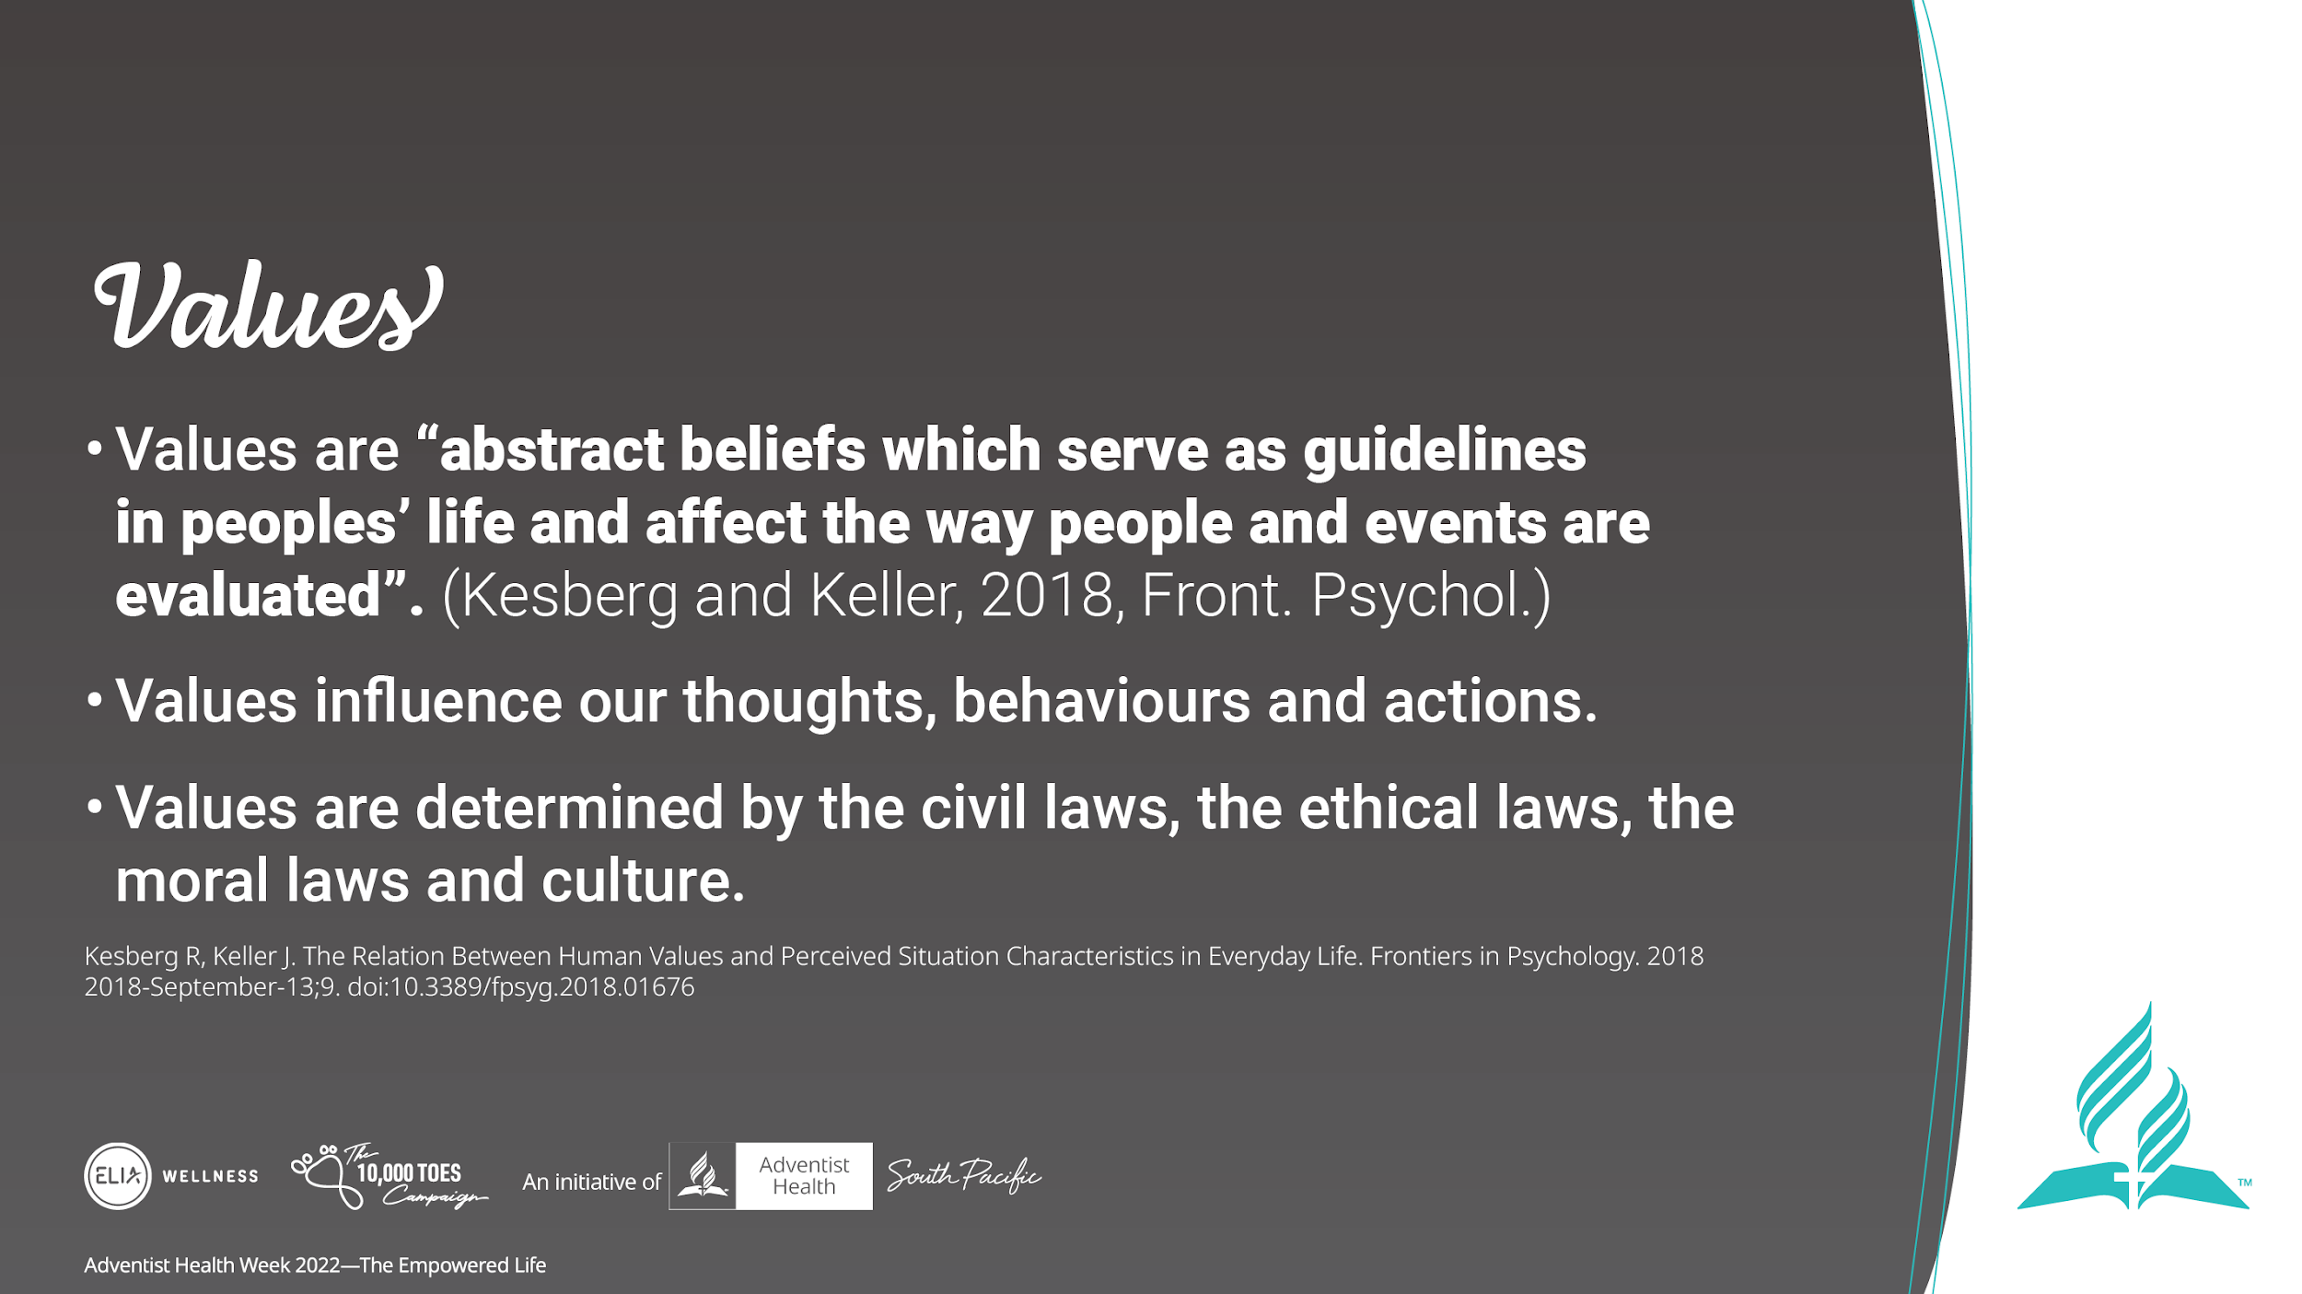
Notes:
Kesberg and Keller defined Values as:
“abstract beliefs which serve as guidelines in peoples’ life and affect the way people and events are evaluated.”
Values influence our thoughts, behaviours and actions
They are determined by the civil laws, the ethical laws, the moral laws and culture

Slide 3
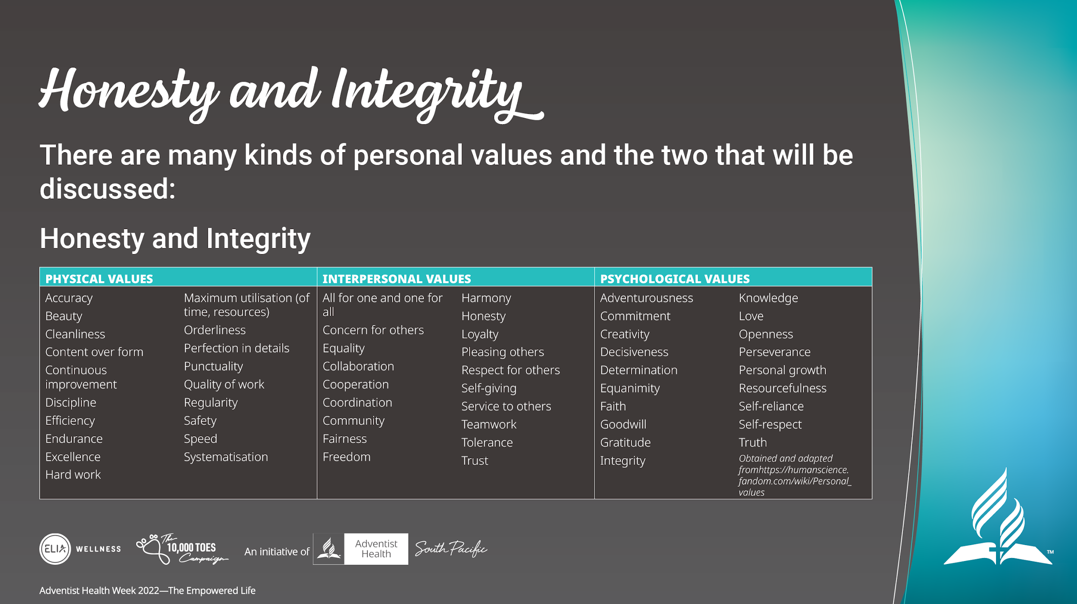
Notes:
There are many kinds of personal values and today we will focus on 2 which are Honesty and Integrity.
Honesty and integrity are ingredients for an empowered life. Honesty and integrity bring out success. Having integrity is like avoiding unnecessary traits like stress, anxiety and confusion. To understand the qualities of honesty and integrity; first we need to understand the meaning of the two words.

Slide 4
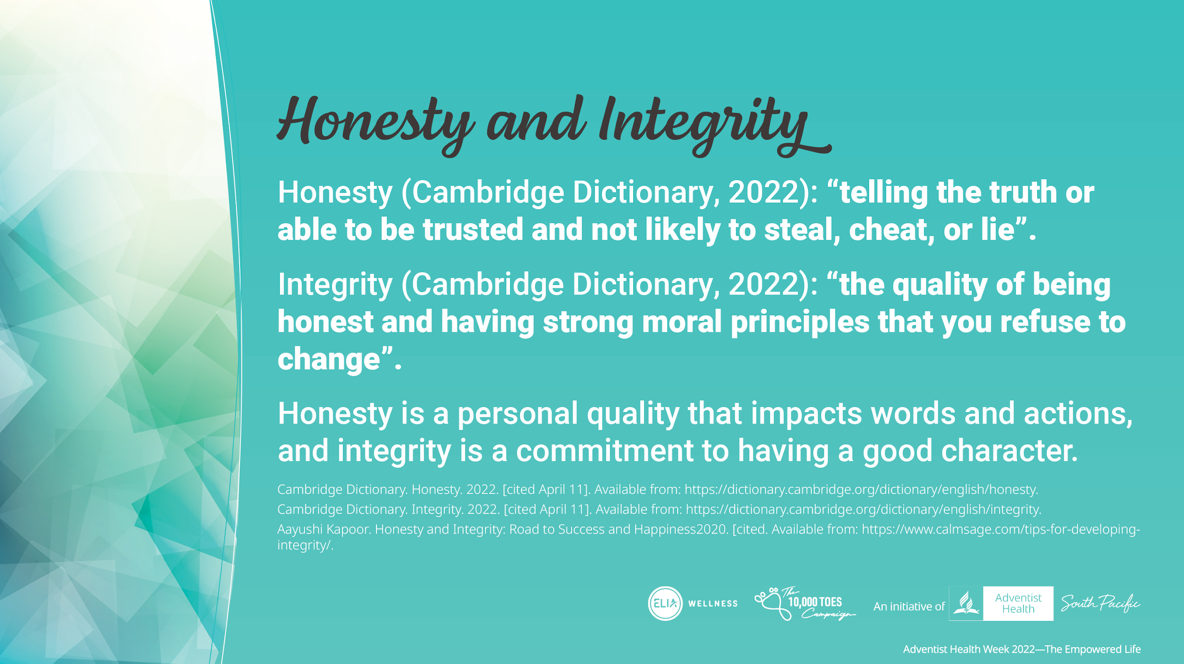
Notes:
According to Cambridge Dictionary, honesty means: “telling the truth or able to be trusted and not likely to steal, cheat, or lie”
Integrity is very similar to honesty but it takes it further.
Cambridge Dictionary says of integrity: ”the quality of being honest and having strong moral principles that you refuse to change”
Honesty is a personal quality that impacts words and actions, and integrity is a commitment to having a good character

Slide 5
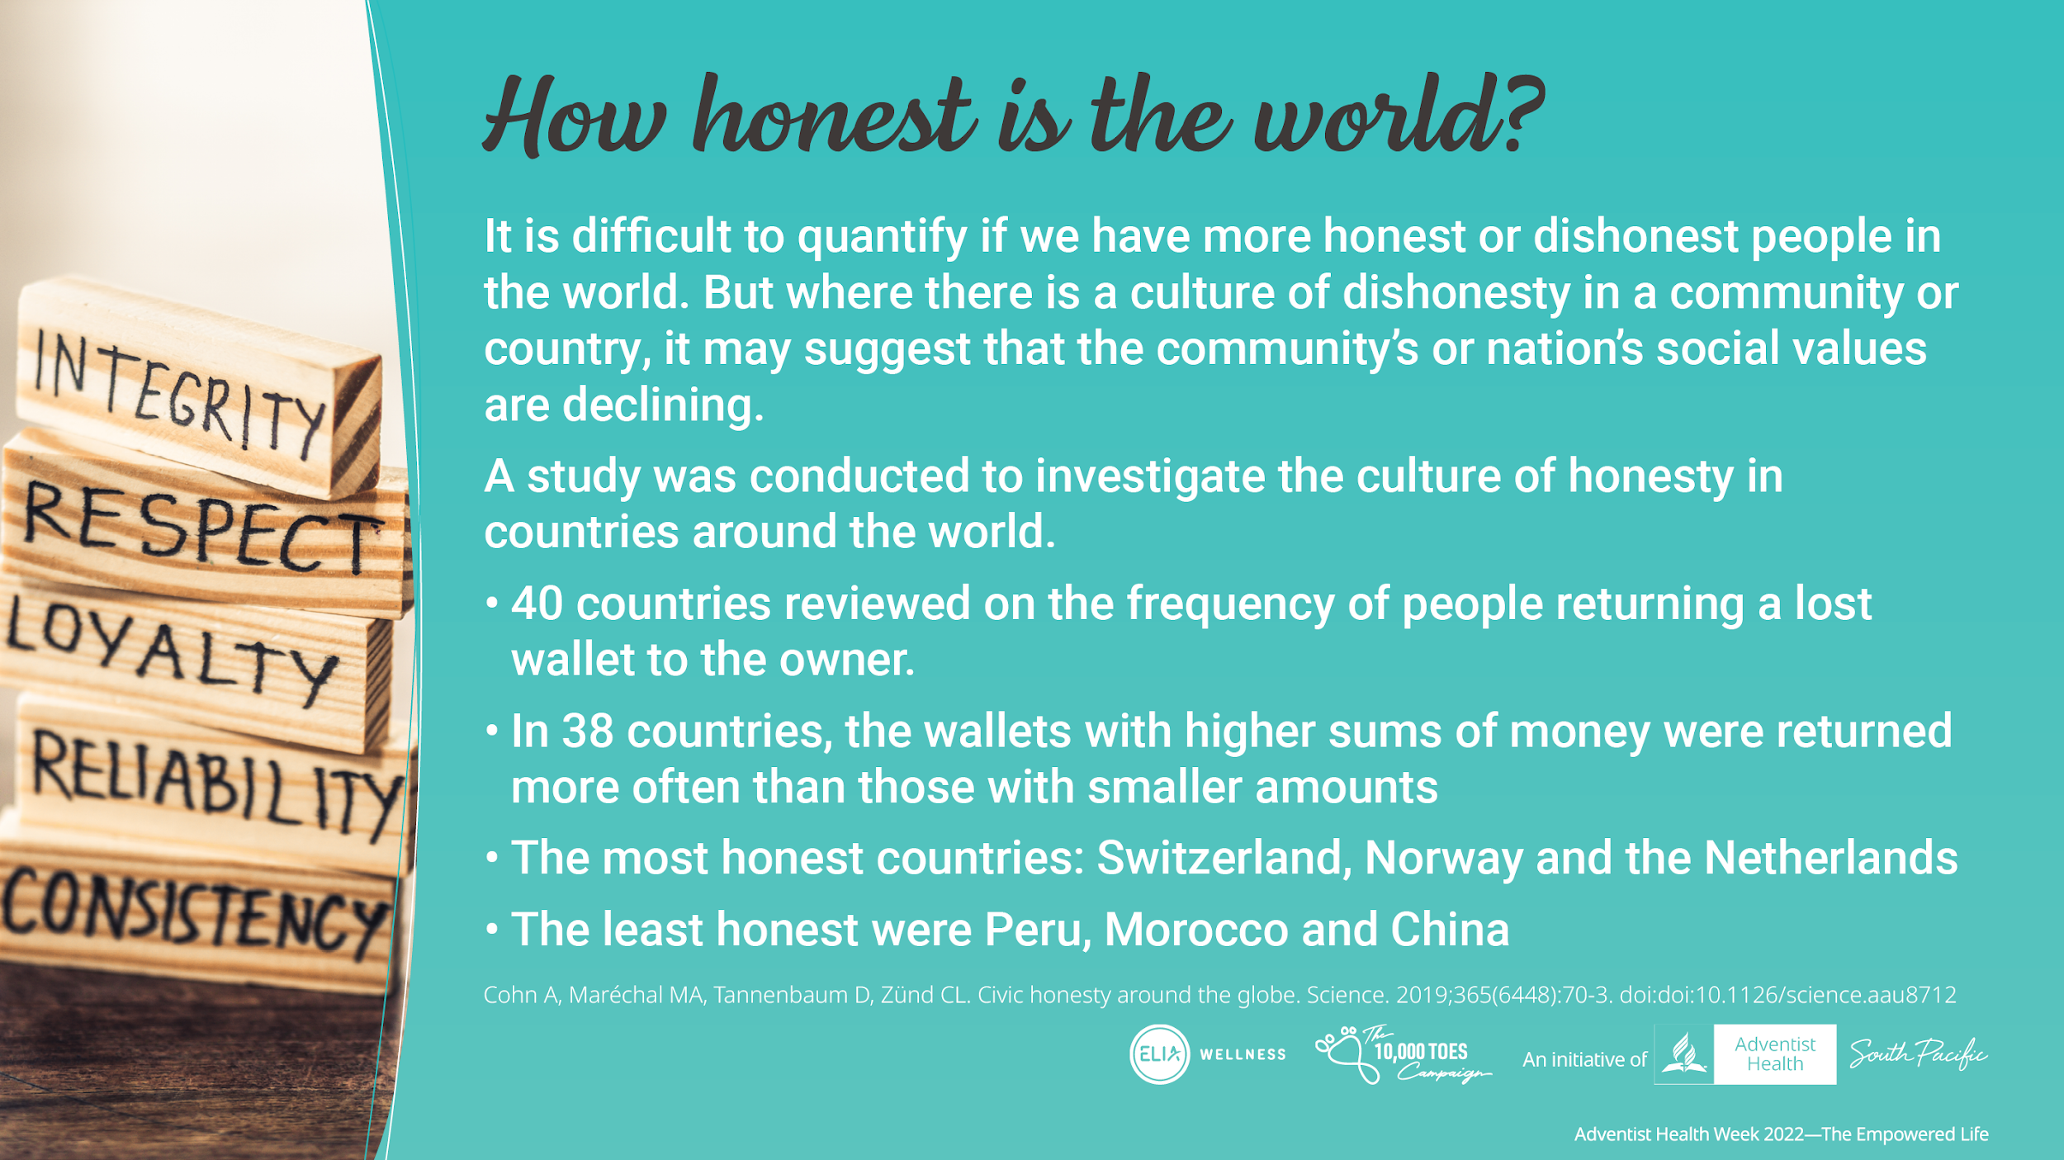
Notes:
There are many dishonest and deceitful people in the world and to say there are more of them than the honest people, is hard to judge.
Where there is a lack of honesty in a community or a nation, it shows that the community’s or nation’s social values are declining.
There was a study, published in Science, that gave a glimpse on the possible culture of honesty in countries in the world. They reviewed 40 different countries and checked how often people in these countries decided to return a lost wallet to the owner.
In 38 countries, the wallets with higher sums of money were returned more often than those with smaller amounts. This was the opposite of what the researchers had expected, they thought there would be a minimum dollar value at which participants would begin to keep the money.
The most honest countries were Switzerland, Norway and the Netherlands whereas the least honest were Peru, Morocco and China.

Slide 6
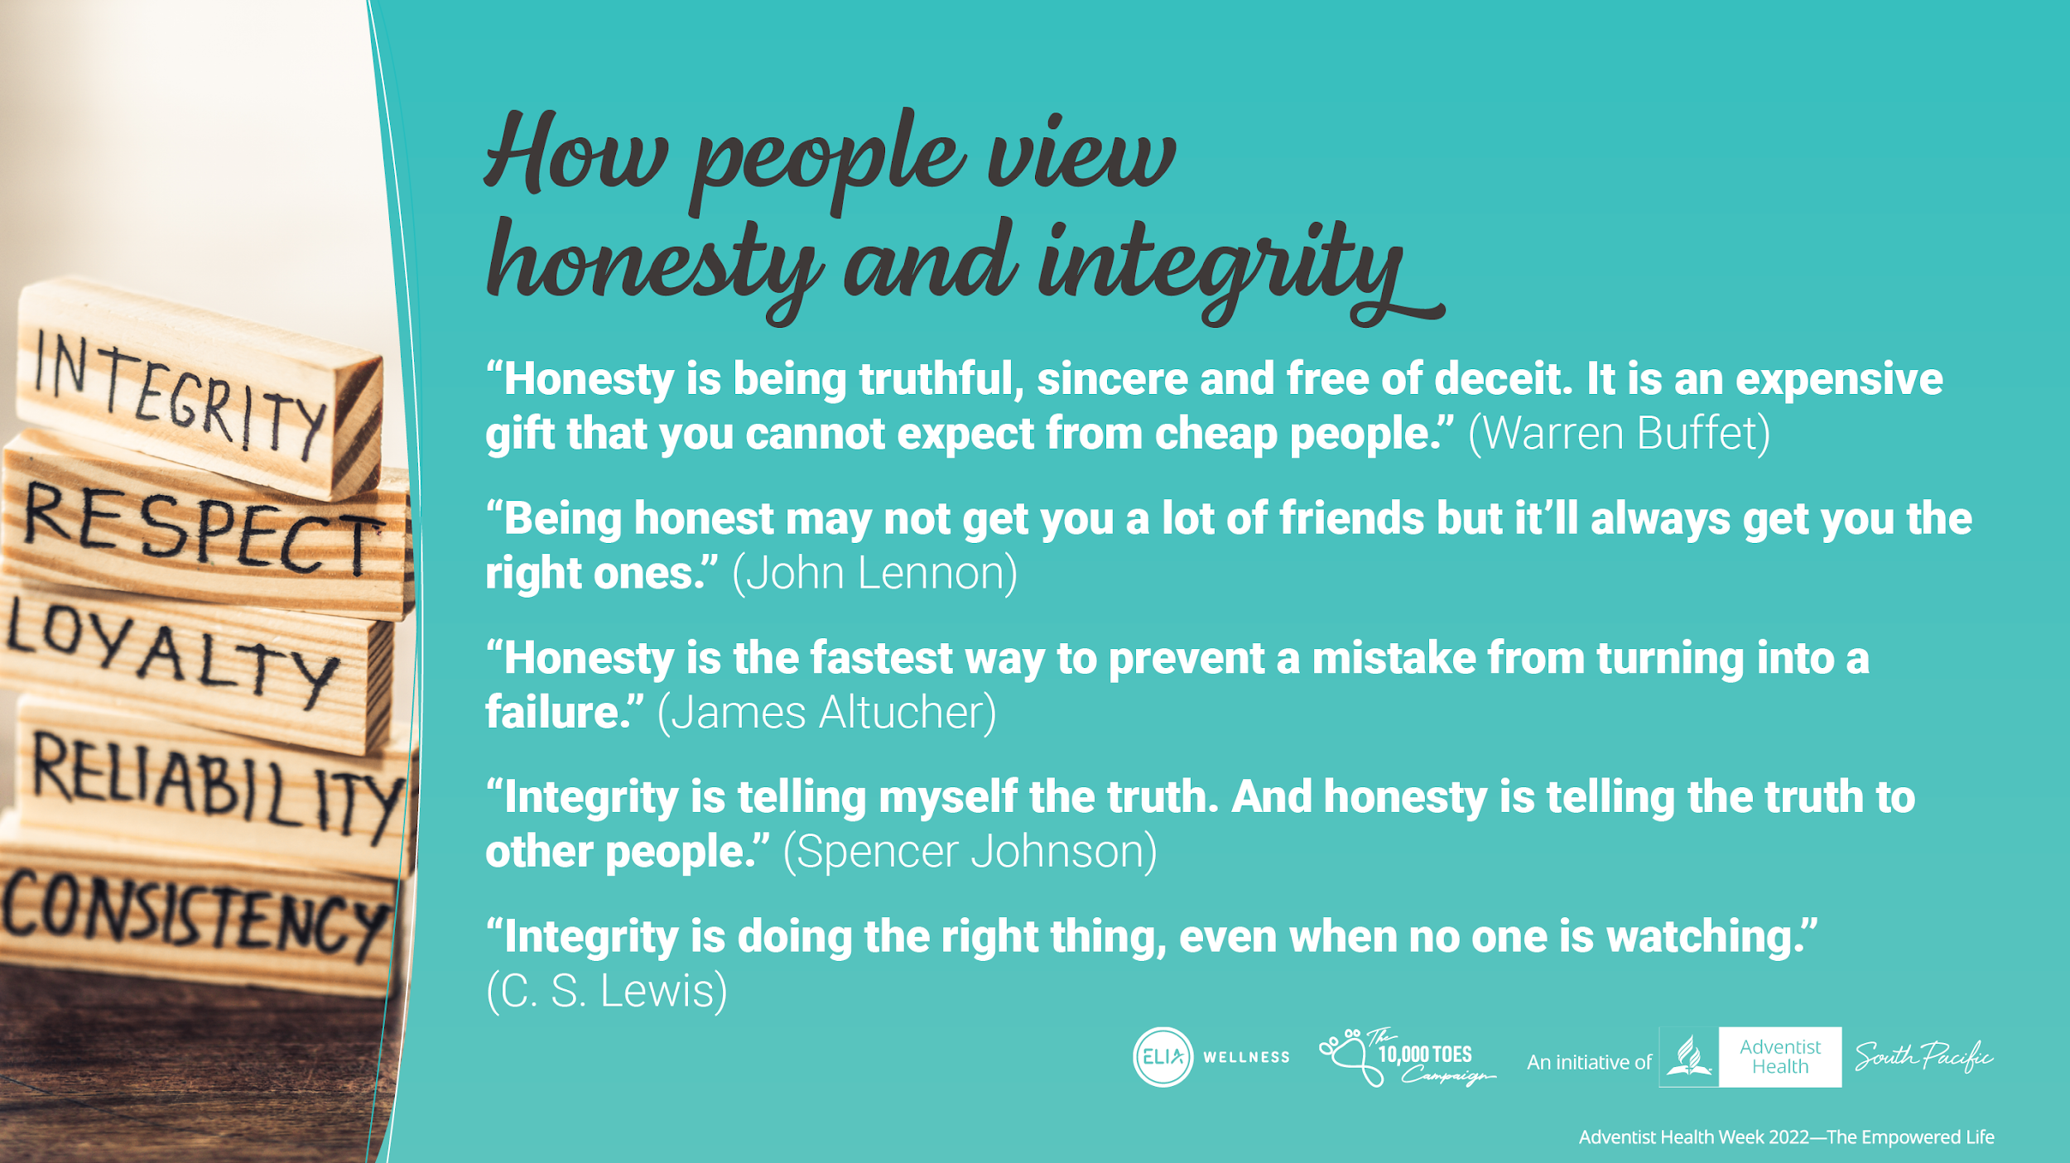
Notes:
Regardless of people’s moral and religious background, or lack thereof, people view honesty and integrity as important values.
Warren Buffet, one of the richest man in the world, said of honesty as “being truthful, sincere and free of deceit. It is an expensive gift that you cannot expect from cheap people.”
Others have said:
“Being honest may not get you a lot of friends but it’ll always get you the right ones.” (John Lennon)
“Honesty is the fastest way to prevent a mistake from turning into a failure”. (James Altucher)
“Integrity is telling myself the truth. And honesty is telling the truth to other people.” (Spencer Johnson)
“Integrity is doing the right thing, even when no one is watching.” (C. S. Lewis)

Slide 7
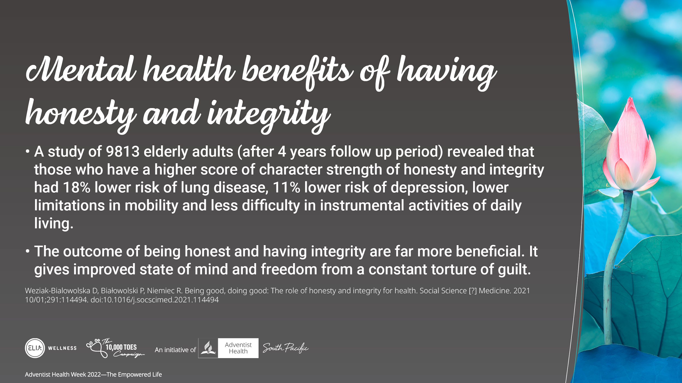
Notes:
There are minimal publications on the mental/physical health benefits in being honest or having integrity
A study of 9813 elderly adults (after 4 years follow up period), revealed that those who have a higher score of character strength of honesty and integrity had 18% lower risk of lung disease, 11% lower risk of depression, lower limitations in mobility and less difficulty in instrumental activities of daily living.
Therefore, the outcome of being honest and having integrity are far more beneficial. Gives improved state of mind and freedom from a constant torture of guilt.

Slide 8
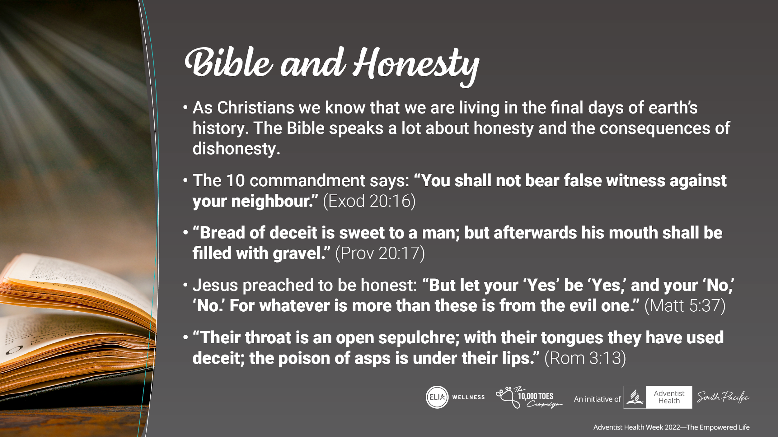
Notes:
As Christians we know that we are living in the final days of earth’s history. The Bible speaks a lot about honesty and the consequences of dishonesty.
The first is what the 10 commandment says: “You shall not bear false witness against your neighbor. (Exod 20:16)
Bread of deceit is sweet to a man; but afterwards his mouth shall be filled with gravel. (Prov 20:17)
Jesus preached to be honest: “But let your ‘Yes’ be ‘Yes,’ and your ‘No,’ ‘No.’ For whatever is more than these is from the evil one.” (Matt 5:37)
Their throat is an open sepulcher; with their tongues they have used deceit; the poison of asps is under their lips. (Rom 3:13)

Slide 9
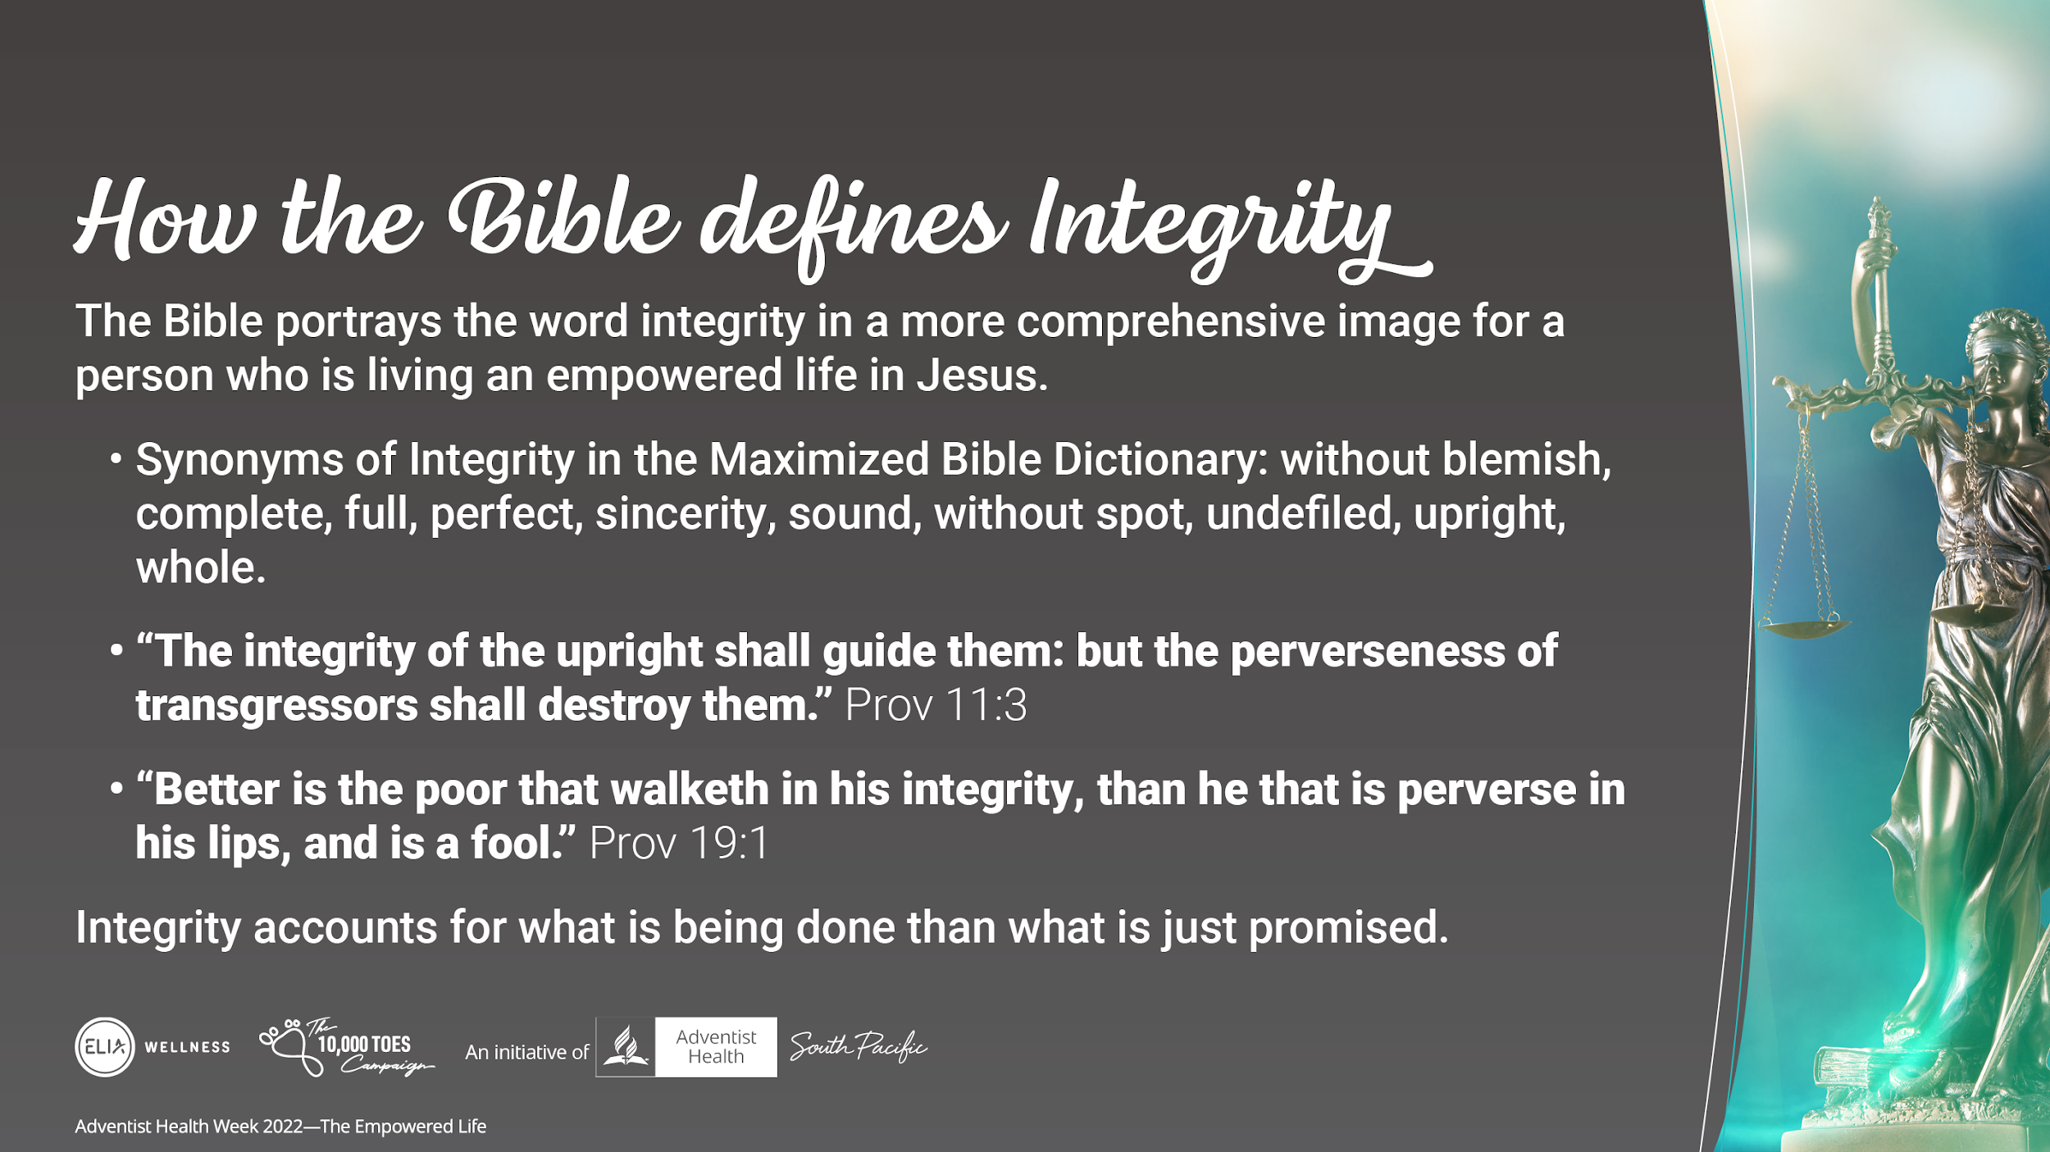
Notes:
The Bible portrays the word integrity in a more comprehensive image for a person who is living an empowered life in Jesus. (The Maximized Bible Dictionary gives several synonyms of the word: integrity, truth: - without blemish, complete, full, perfect, sincerity, sound, without spot, undefiled, upright, whole).
The integrity of the upright shall guide them: but the perverseness of transgressors shall destroy them. (The use of the word in this passage portrays this scenario. The integrity of the upright person will guide them to live the kind of life “the empowered life”.
Better is the poor that walketh in his integrity, than he that is perverse in his lips, and is a fool. (Pro 19:1).
It is far better to do the little things that are in our reach to do than to talk big without action (lip service only). Integrity accounts for what is being done than what is said.

Slide 10
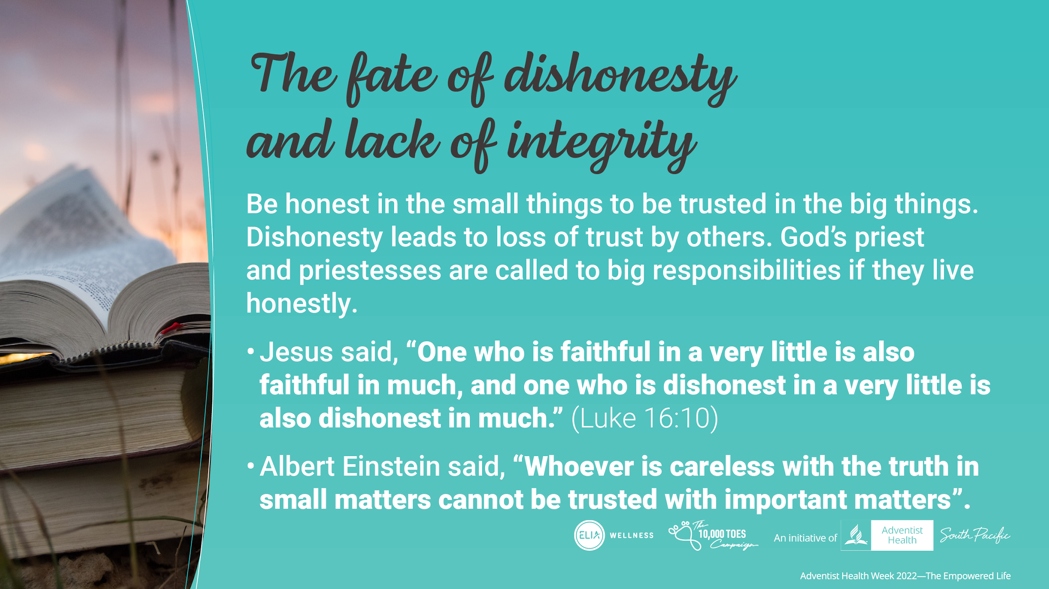
Notes:
The Bible also speaks about the consequence of dishonesty and lack of integrity in this lifetime and the consequence for the eternal life.
Be honest in small things to be trusted with responsibilities to do big things. Dishonesty leads to loss of trust by others. God’s priest and priestesses are called to big responsibilities if they live honestly
Jesus said, “One who is faithful in a very little is also faithful in much, and one who is dishonest in a very little is also dishonest in much. (Luke 16:10)
Albert Einstein said, “Whoever is careless with the truth in small matters cannot be trusted with important matters”.
If we cannot be honest in the small things, we cannot be trusted with responsibilities to do big things.

Slide 11
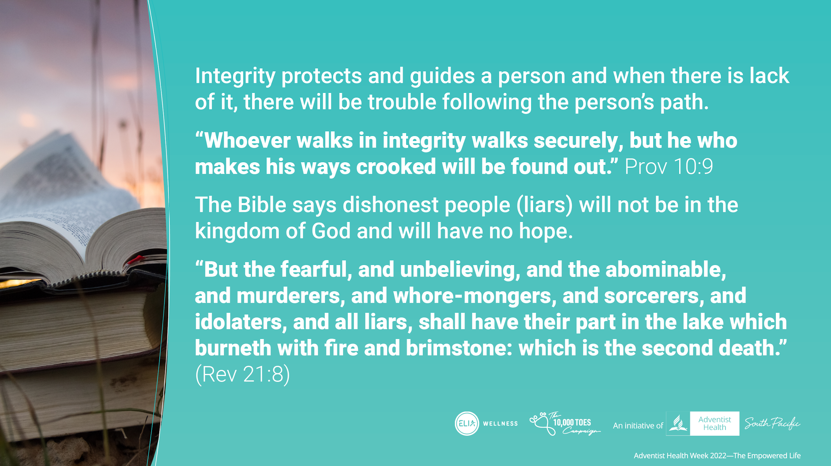
Notes:
Integrity protects and guides a person and when there is lack of it, there will be trouble following the person’s path
“Whoever walks in integrity walks securely, but he who makes his ways crooked will be found out.” Prov 10:9
The Bible says dishonest people (liars) will not be in the kingdom of God and will have no hope.
“But the fearful, and unbelieving, and the abominable, and murderers, and whoremongers, and sorcerers, and idolaters, and all liars, shall have their part in the lake which burneth with fire and brimstone: which is the second death.” (Rev 21:8)

Slide 12
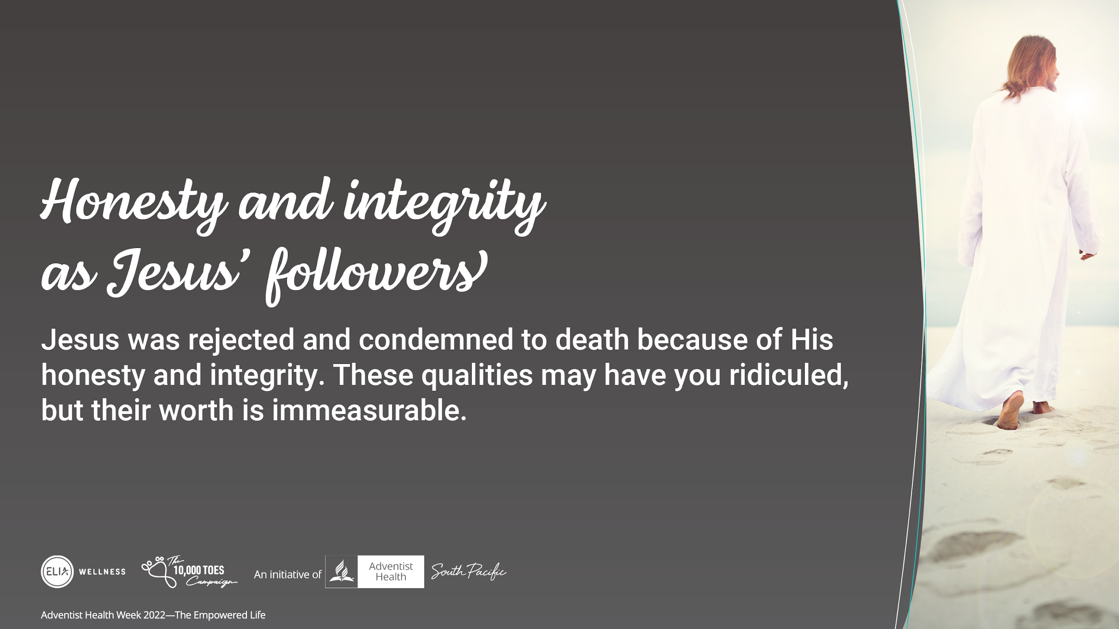
Notes:
Jesus lived a life of honesty and integrity. But unfortunately people who had other agenda had Him ridiculed and condemned to death. But the worth of these qualities are immeasurable.
As followers of Jesus, we are also called to follow in having His honesty and integrity.

Slide 13
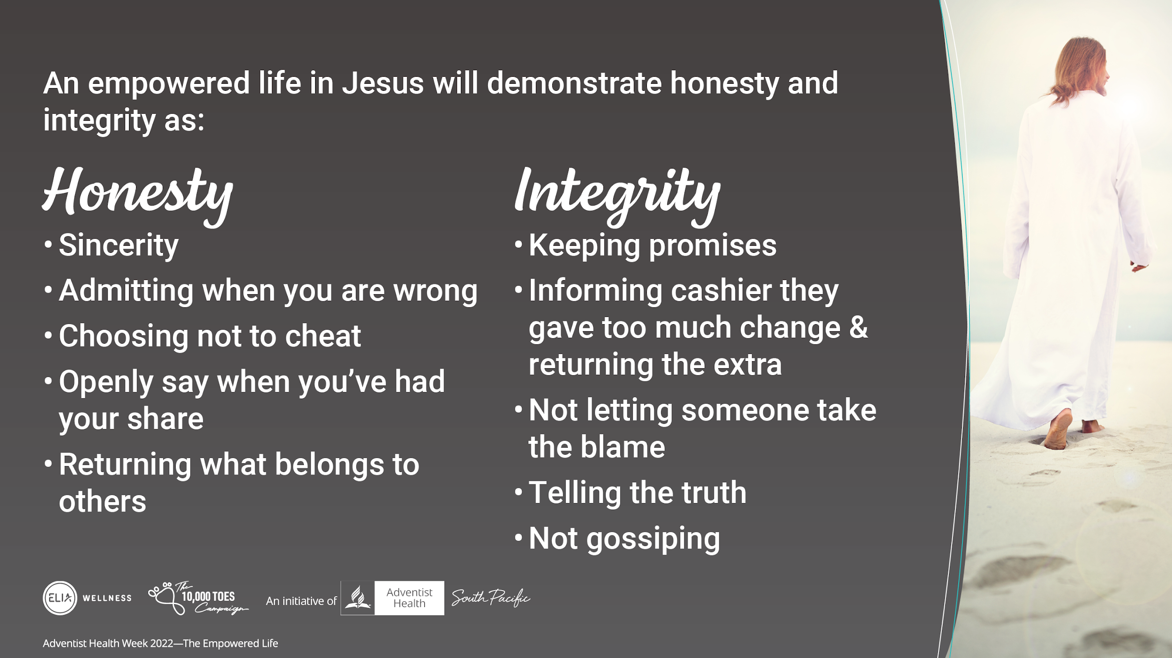
Notes:
An empowered life in Jesus will demonstrate honest actions as:
sincerity
admitting when you are wrong
choosing not to cheat
openly say when you’ve had your share
returning what belongs to others
An empowered life in Jesus will demonstrate integrity actions as:
Keeping promises
Informing cashier they gave too much change & returning the extra
not letting someone take the blame
telling the truth
Not gossiping

Slide 14
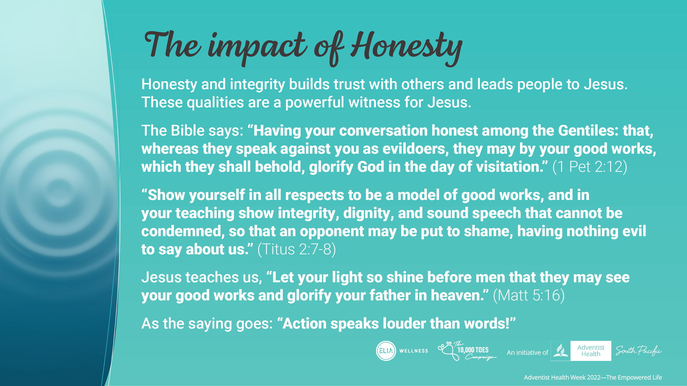
Notes:
I think we all will agree that there is a positive impact in being honest and having integrity. But how does this impact our witness for Jesus?
Honesty and integrity builds trust with others and leads people to Jesus. These qualities are a powerful witness for Jesus.
The Bible says: Having your conversation honest among the Gentiles: that, whereas they speak against you as evildoers, they may by your good works, which they shall behold, glorify God in the day of visitation. (1Pet 2:12)
Show yourself in all respects to be a model of good works, and in your teaching show integrity, dignity, and sound speech that cannot be condemned, so that an opponent may be put to shame, having nothing evil to say about us. (Titus 2:7-8)
Jesus teaches us, “Let your light so shine before men that they may see your good works and glorify your father in heaven.”(Matt 5:16)
As the saying goes: “Action speaks louder than words!”

Slide 15
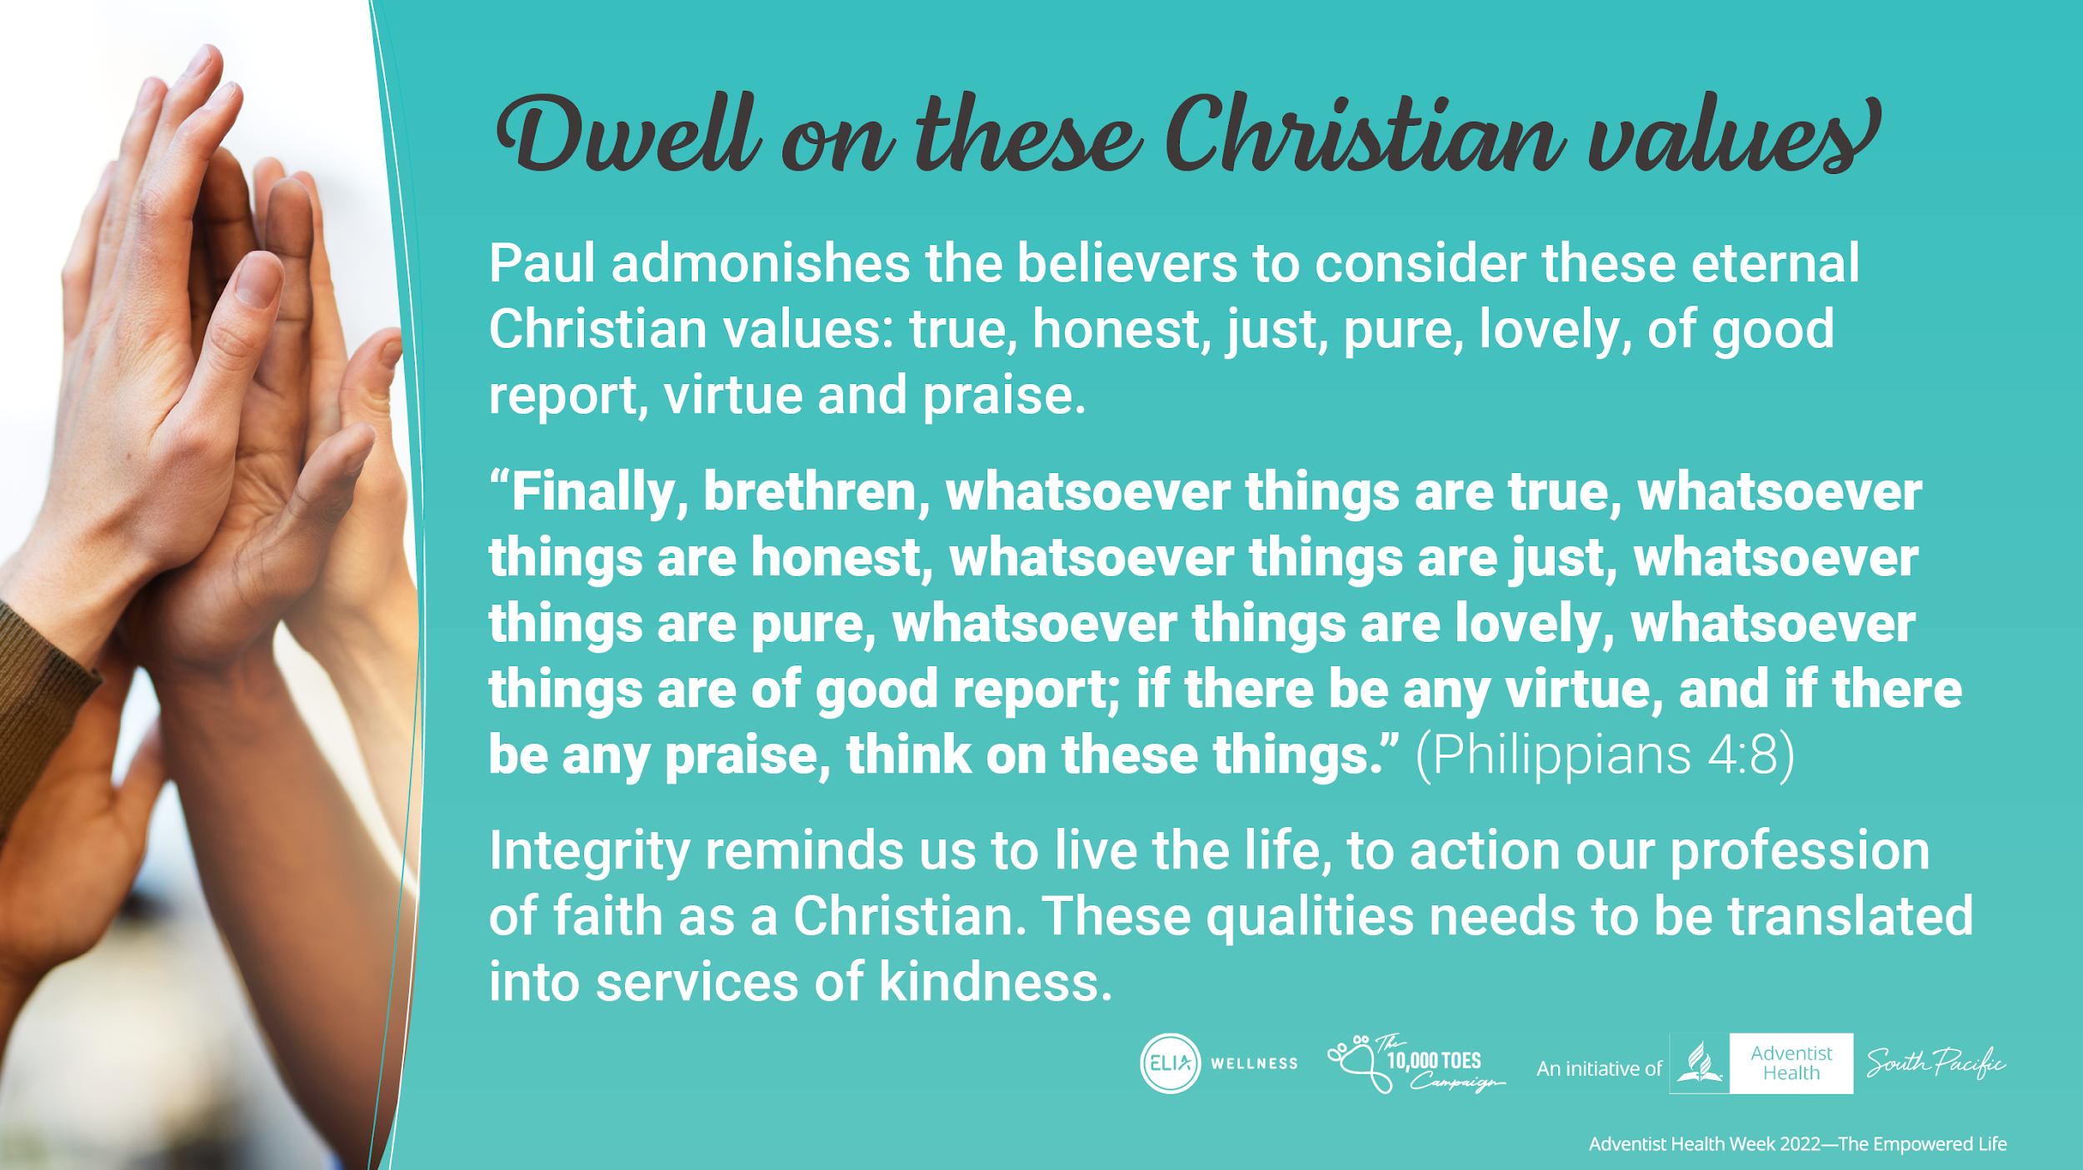
Notes:
Paul admonishes the believers in Philippi to seriously consider these eternal Christian values: true, honest, just, pure, lovely, of good report, virtue and praise.
“Finally, brethren, whatsoever things are true, whatsoever things are honest, whatsoever things are just, whatsoever things are pure, whatsoever things are lovely, whatsoever things are of good report; if there be any virtue, and if there be any praise, think on these things.” (Philippians 4:8)
Integrity reminds us to live the life, to action our profession of faith as a Christian. These qualities needs to be translated into services of kindness.

Slide 16
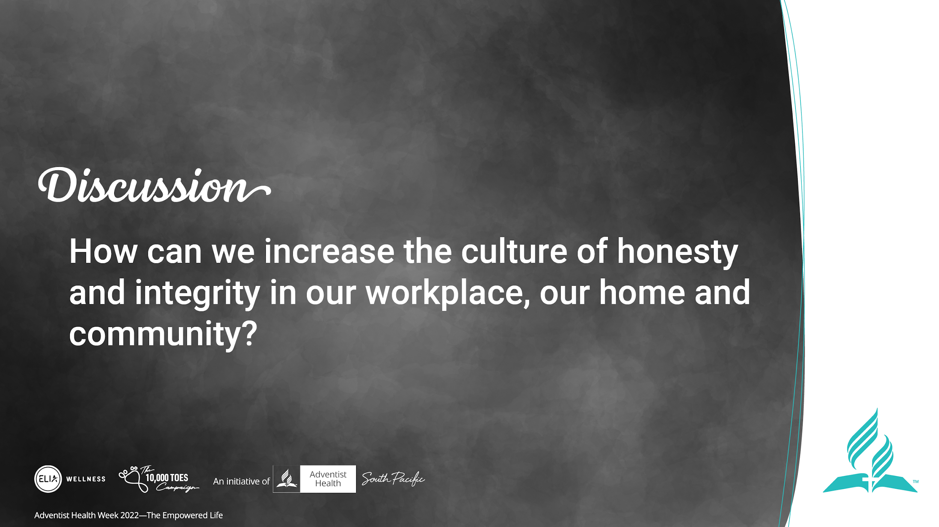
Notes:
Presenter: Note to open up a 2 minute discussion.
Discussion:
How can we increase the culture of honesty and integrity in our workplace, our home and community?

Slide 17
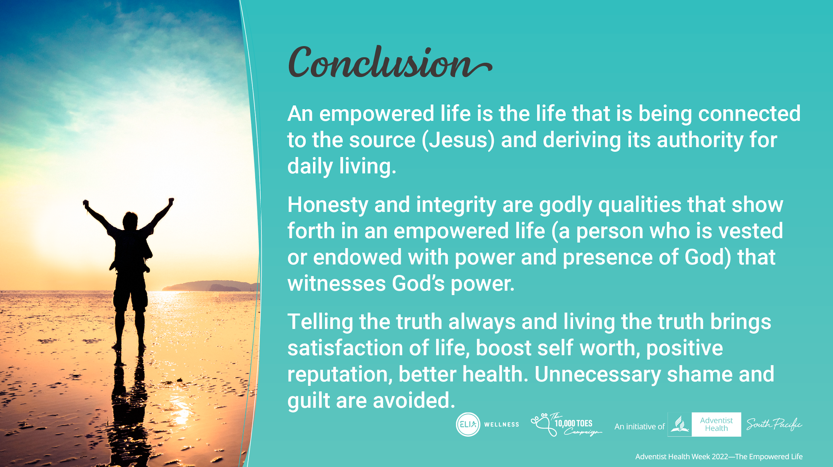
Notes:
The law of the LORD is perfect, converting the soul.
The testimony of an empowered life is the life that is being connected to the source (Jesus) and deriving its authority for daily living.
Honesty in word and integrity in action are godly qualities that show forth in an empowered life (a person who is vested or endowed with power and presence of God).
Telling the truth always and living the truth brings satisfaction of life. Unnecessary shame and guilt are avoided. At the same time, honesty and integrity builds and boosts self worth, integrity and reputation. Gain confidence and trust.

Slide 18
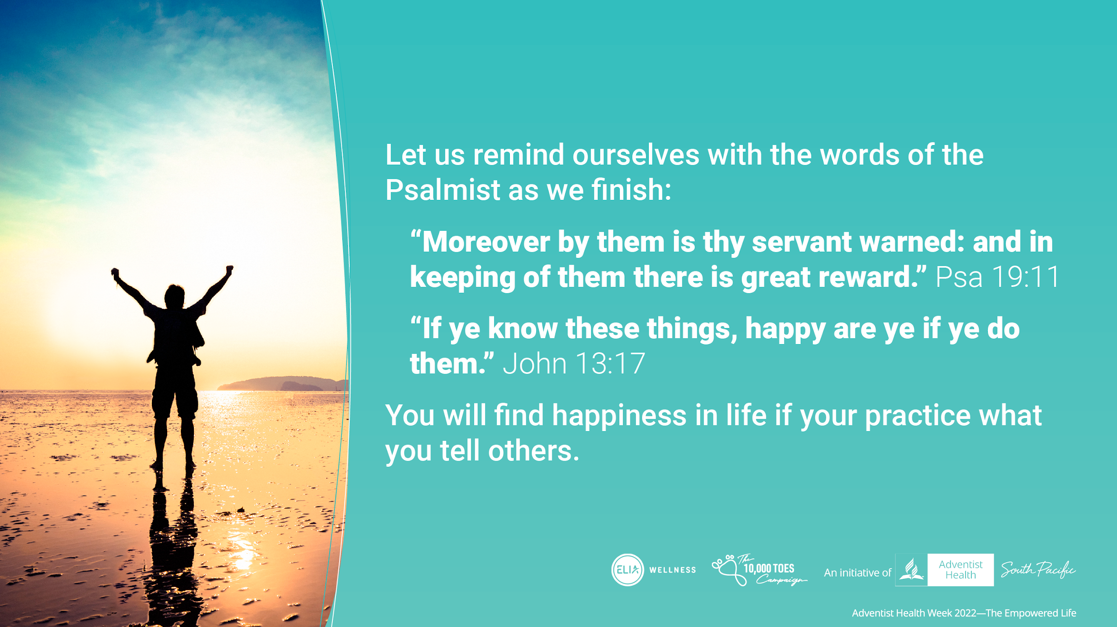
Notes:
“Let us remind ourselves with the words of the Psalmist as we finish: Moreover by them is thy servant warned: and in keeping of them there is great reward.” (Psa 19:11)
“If ye know these things, happy are ye if ye do them”. John 13:17
You will find happiness in life if your practice what you tell others

