Slide 1
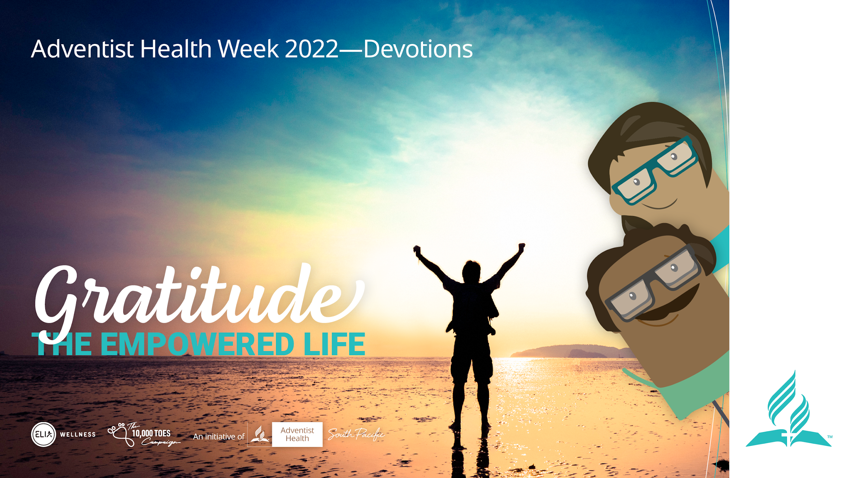
Notes:
Welcome to the Empowered Life series devotional. Today we will be discussing the understanding of having gratitude.

Slide 2
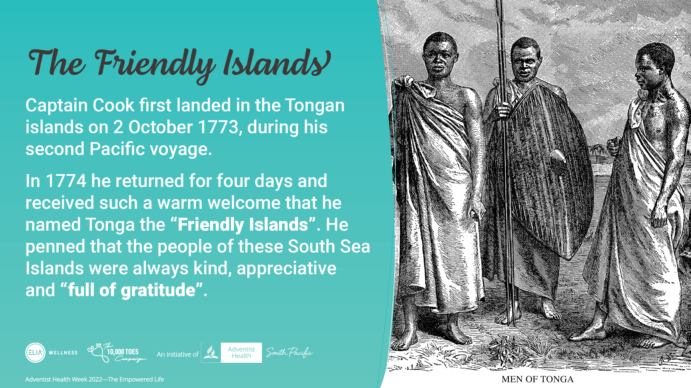
Notes:
One of the Pacific islands has been the friendly island. It started from Captain Cook experiencing the warm hospitality.
Captain Cook first landed in the Tongan islands on 2 October 1773, during his second Pacific voyage.
In 1774 he returned for four days and received such a warm welcome that he named Tonga the “Friendly Islands”. He penned that the people of these South Sea Islands were always kind, appreciative and “full of gratitude”.

Slide 3
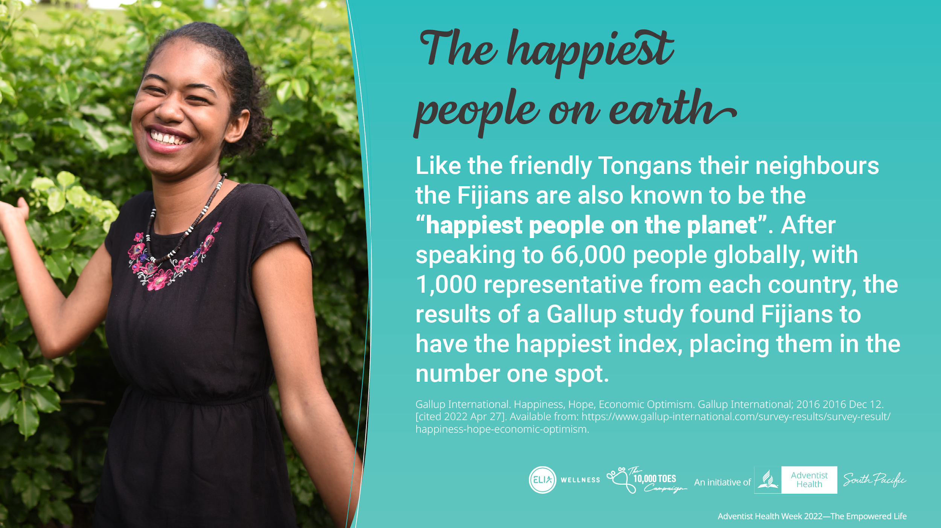
Notes:
But it seems it’s not only The Tongans who are friendly.
Like the friendly Tongans their neighbours the Fijians are also known to be the “happiest people on the planet”. After speaking to 66,000 people globally, with 1000 representatives from each country, the results of a Gallup study found Fijians to have the happiest index, placing them in the number one spot.

Slide 4
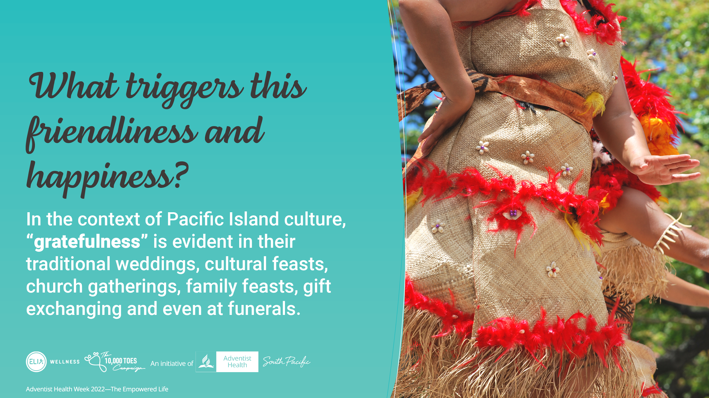
Notes:
In the context of Pacific Island culture, “gratefulness” is evident in the traditional weddings, cultural feasts, church gatherings, family feasts, gift exchanging and even in funerals.

Slide 5
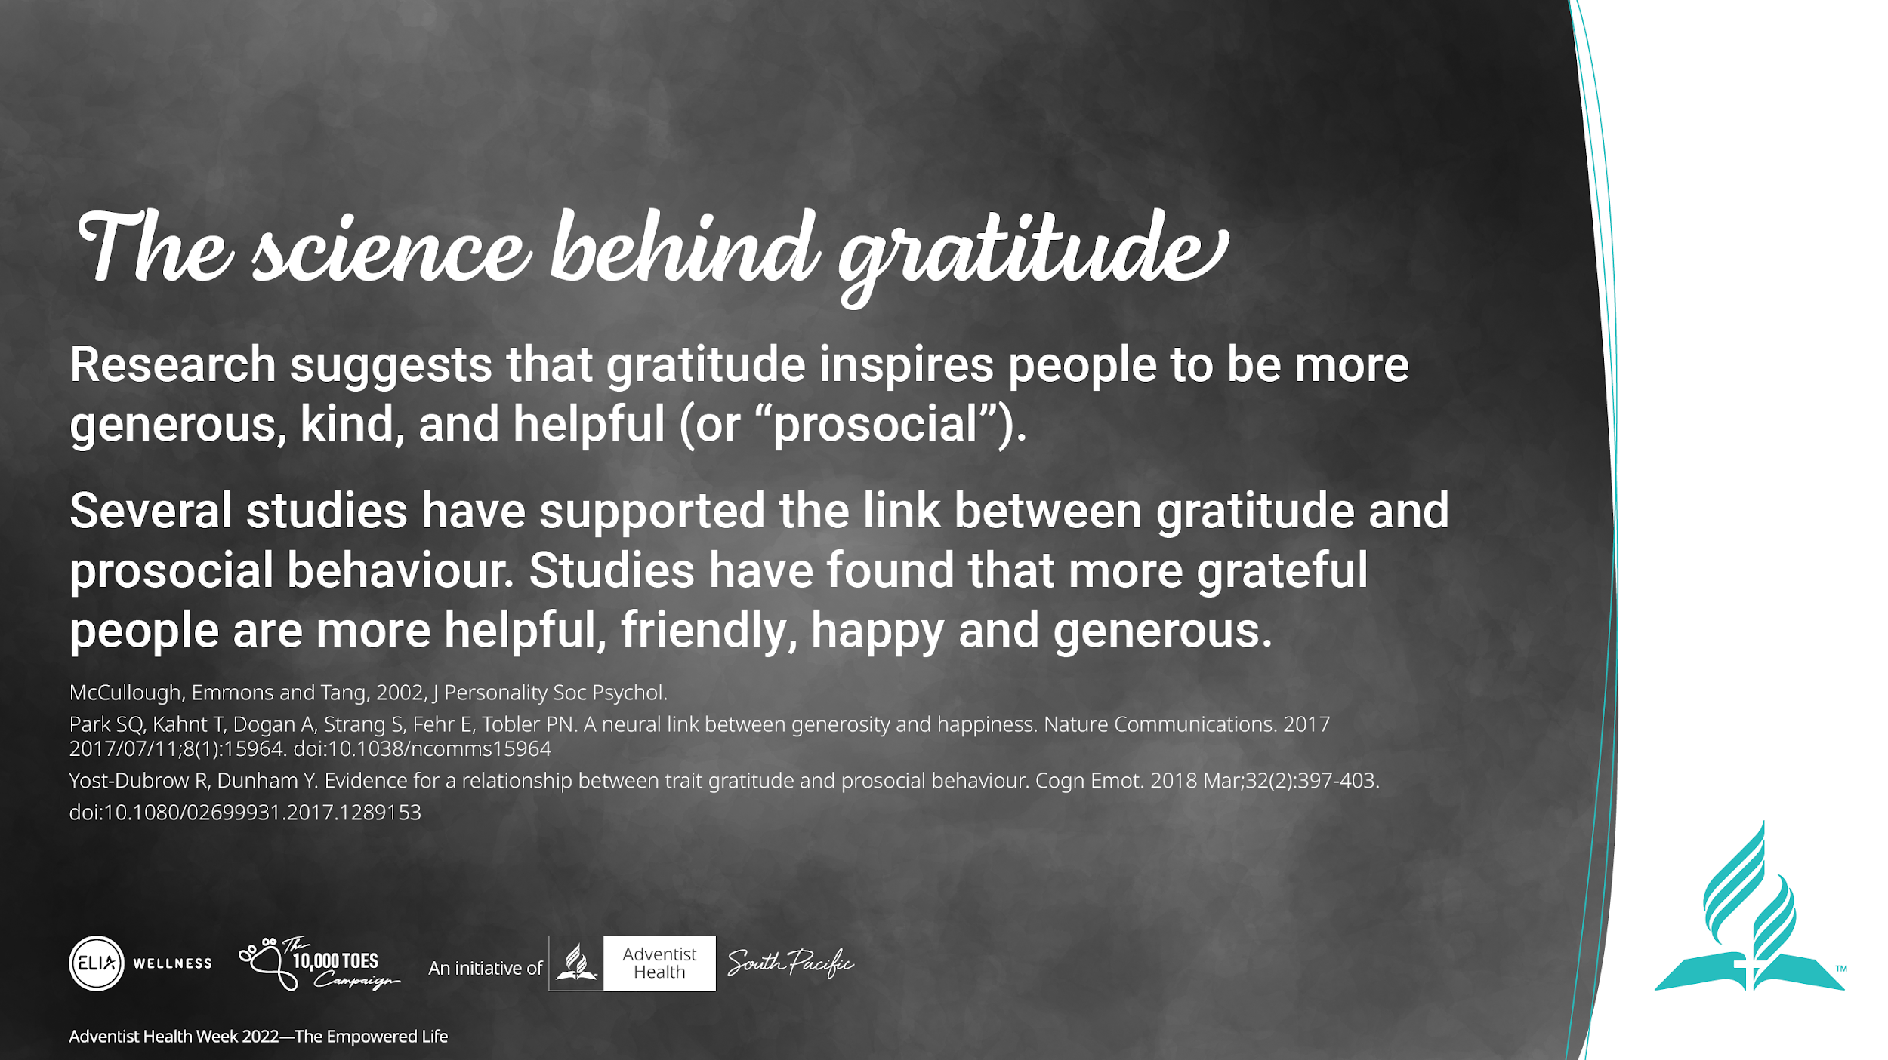
Notes:
Here is some research that suggests that gratitude inspires people to be more generous, kind, and helpful (or “prosocial”).
Several studies have supported the link between gratitude and prosocial behaviour. Studies have found that more grateful people are more helpful, friendly, happy and generous.

Slide 6
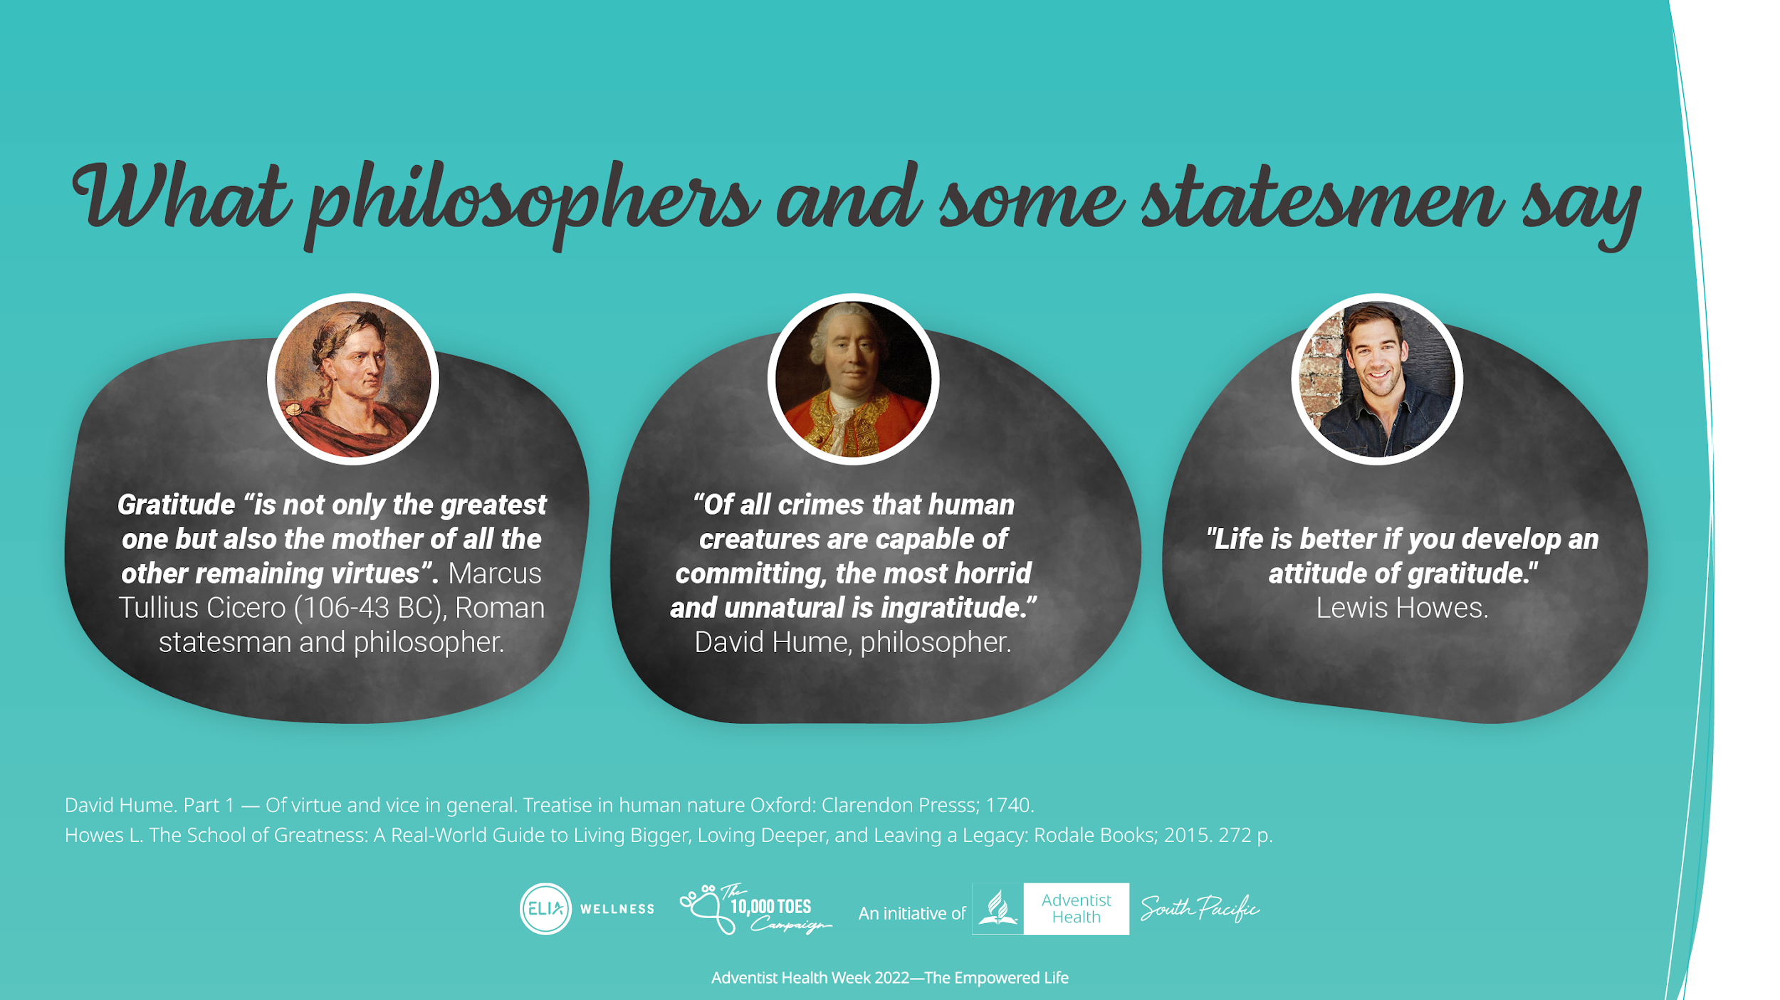
Notes:
Here are what philosophers and some statesmen said about gratitude

Slide 7
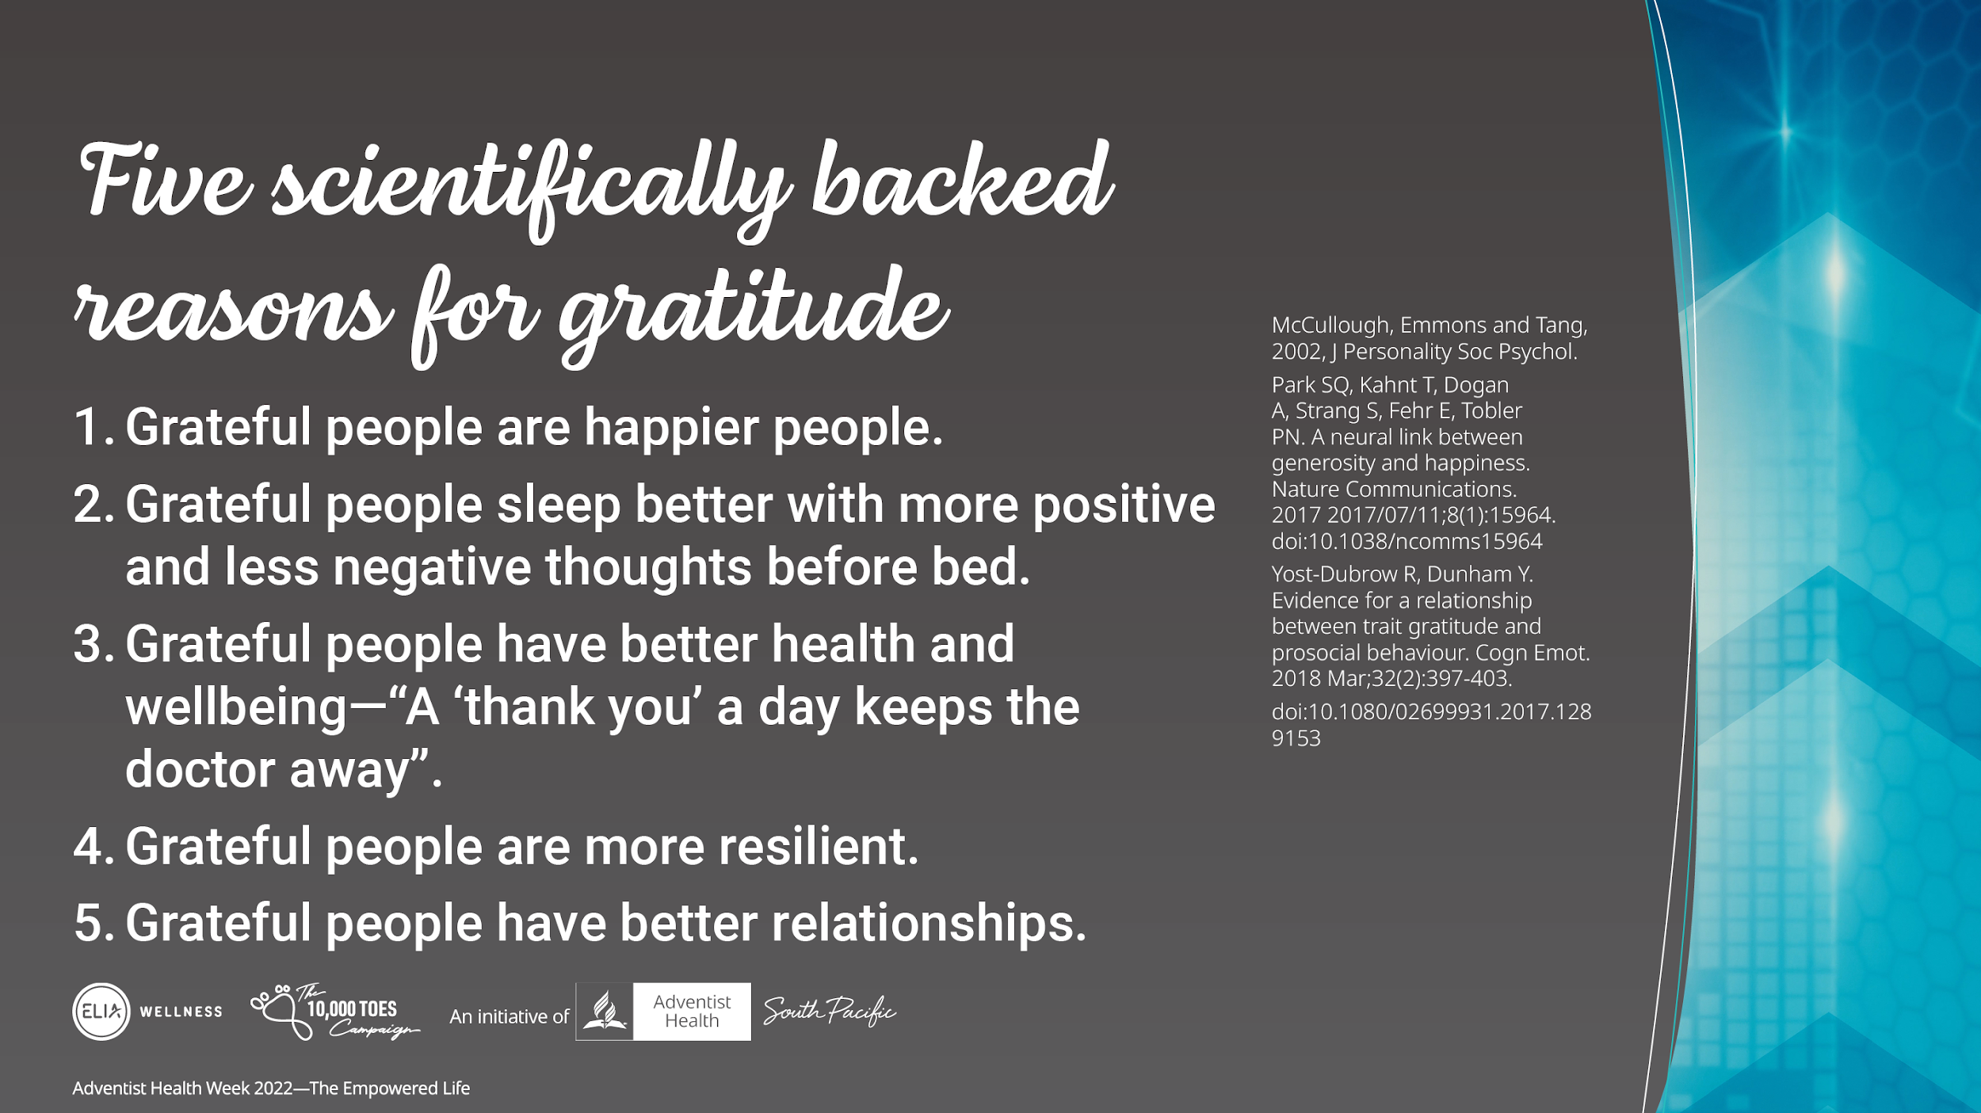
Notes:
Here are 5 scientifically backed reasons to be grateful.
(go through the list)

Slide 8
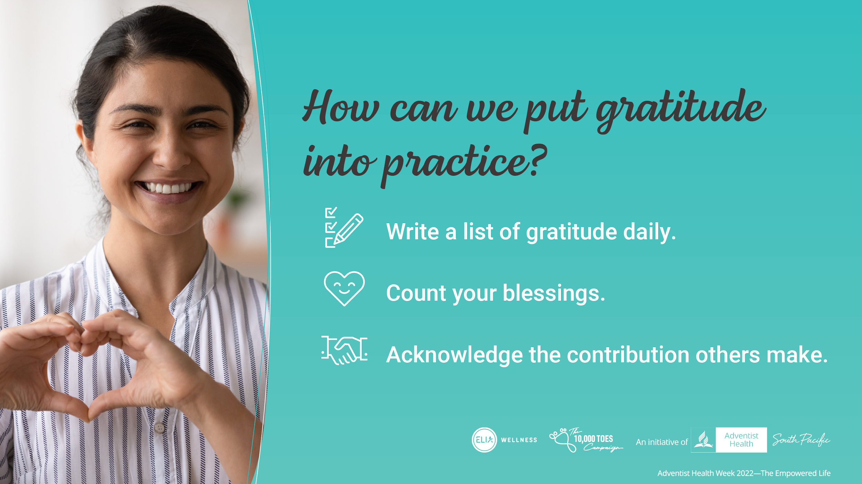
Notes:
So how can we put gratitude practically into practice?
Here are 3 steps to consider:
Write a list of gratitude daily
Count your blessings
Acknowledge the contribution others make

Slide 9
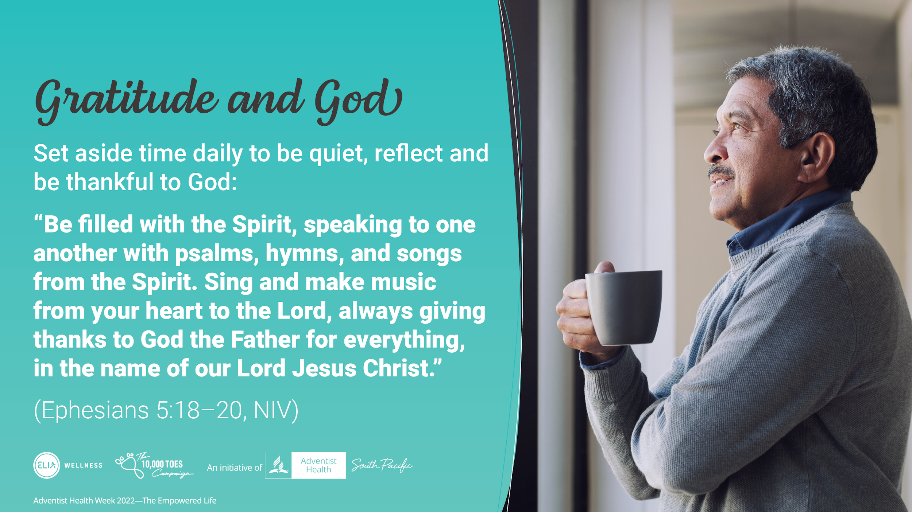
Notes:
Never miss this. Set aside time daily to be quiet, reflect and be thankful to God:
“Be filled with the Spirit, speaking to one another with psalms, hymns, and songs from the Spirit. Sing and make music from your heart to the Lord, always giving thanks to God the Father for everything, in the name of our Lord Jesus Christ.” (Ephesians 5:18–20, NIV)

Slide 10
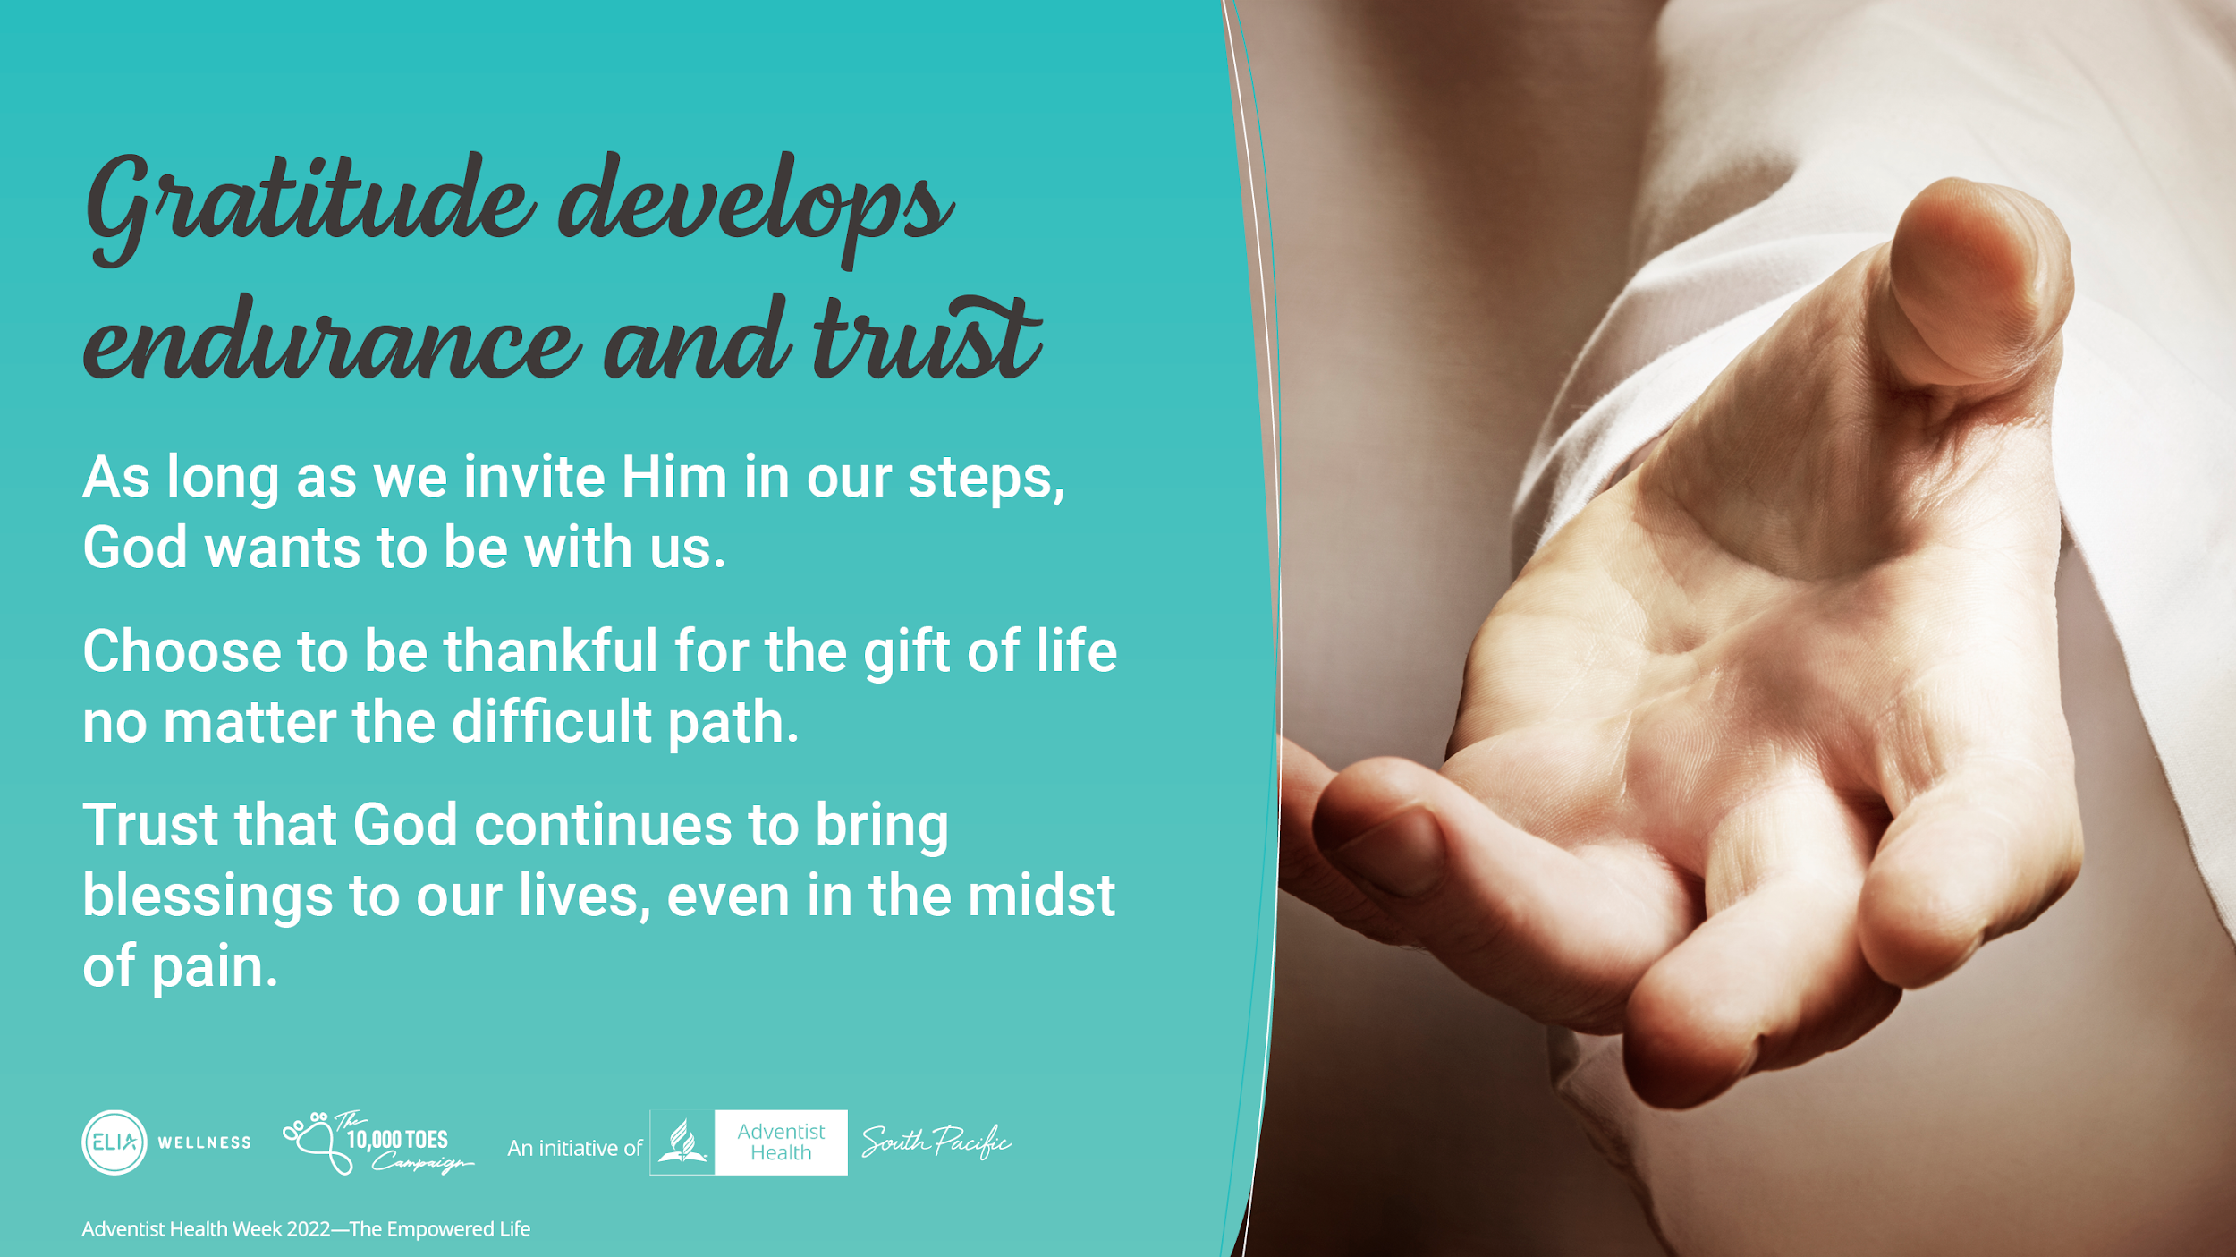
Notes:
The more we practice gratitude, we develop endurance and deeper trust in God.
We can choose to be thankful for the gift of life no matter how difficult our path is because we are assured that
God is with us.
We know that He continues to bring blessings to our lives, even in our most painful moments.
Gratitude helps to remind and reinforce in us God’s goodness and God’s power.

Slide 11
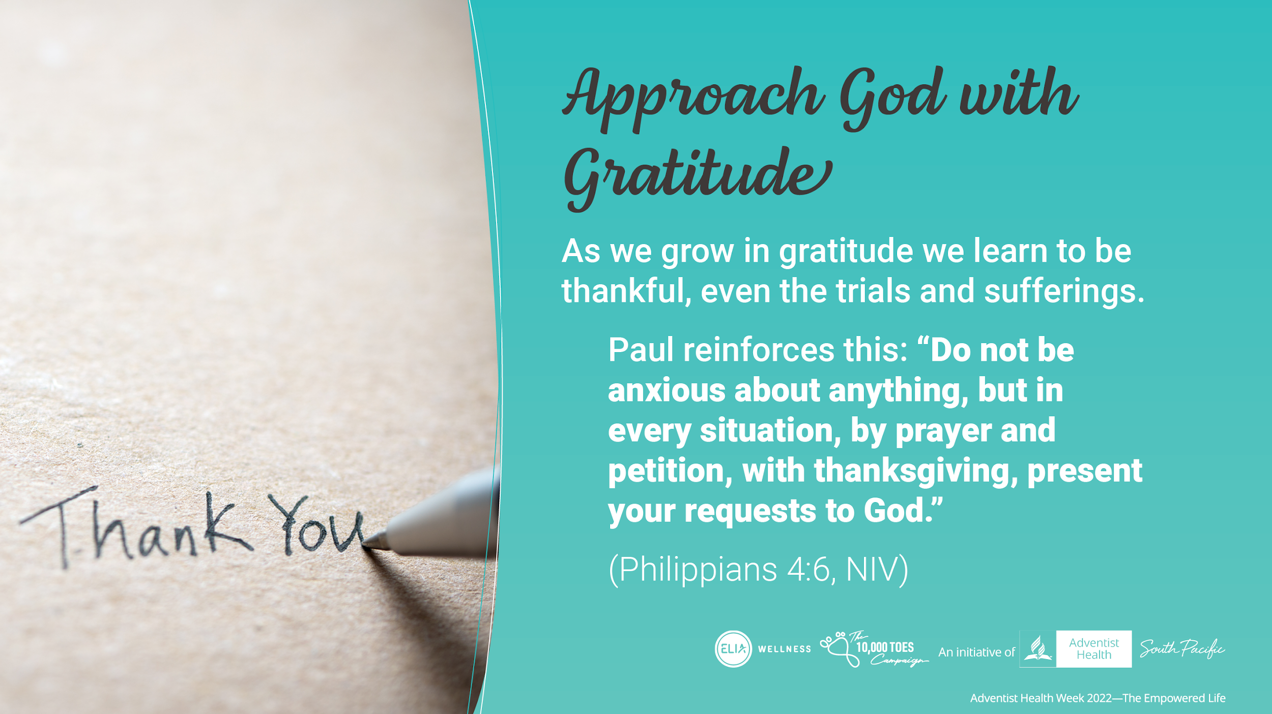
Notes:
When we come to God, we can approach Him with a sense of gratitude. That’s an act of faith.
As we grow in gratitude we learn to be thankful not only for the good gifts but for everything in our lives, including the trials and sufferings.
Paul reinforces the importance of this when in his letter to the Philippians he says:
“Do not be anxious about anything, but in every situation, by prayer and petition, with thanksgiving, present your requests to God.“ (Philippians 4:6, NIV)

Slide 12
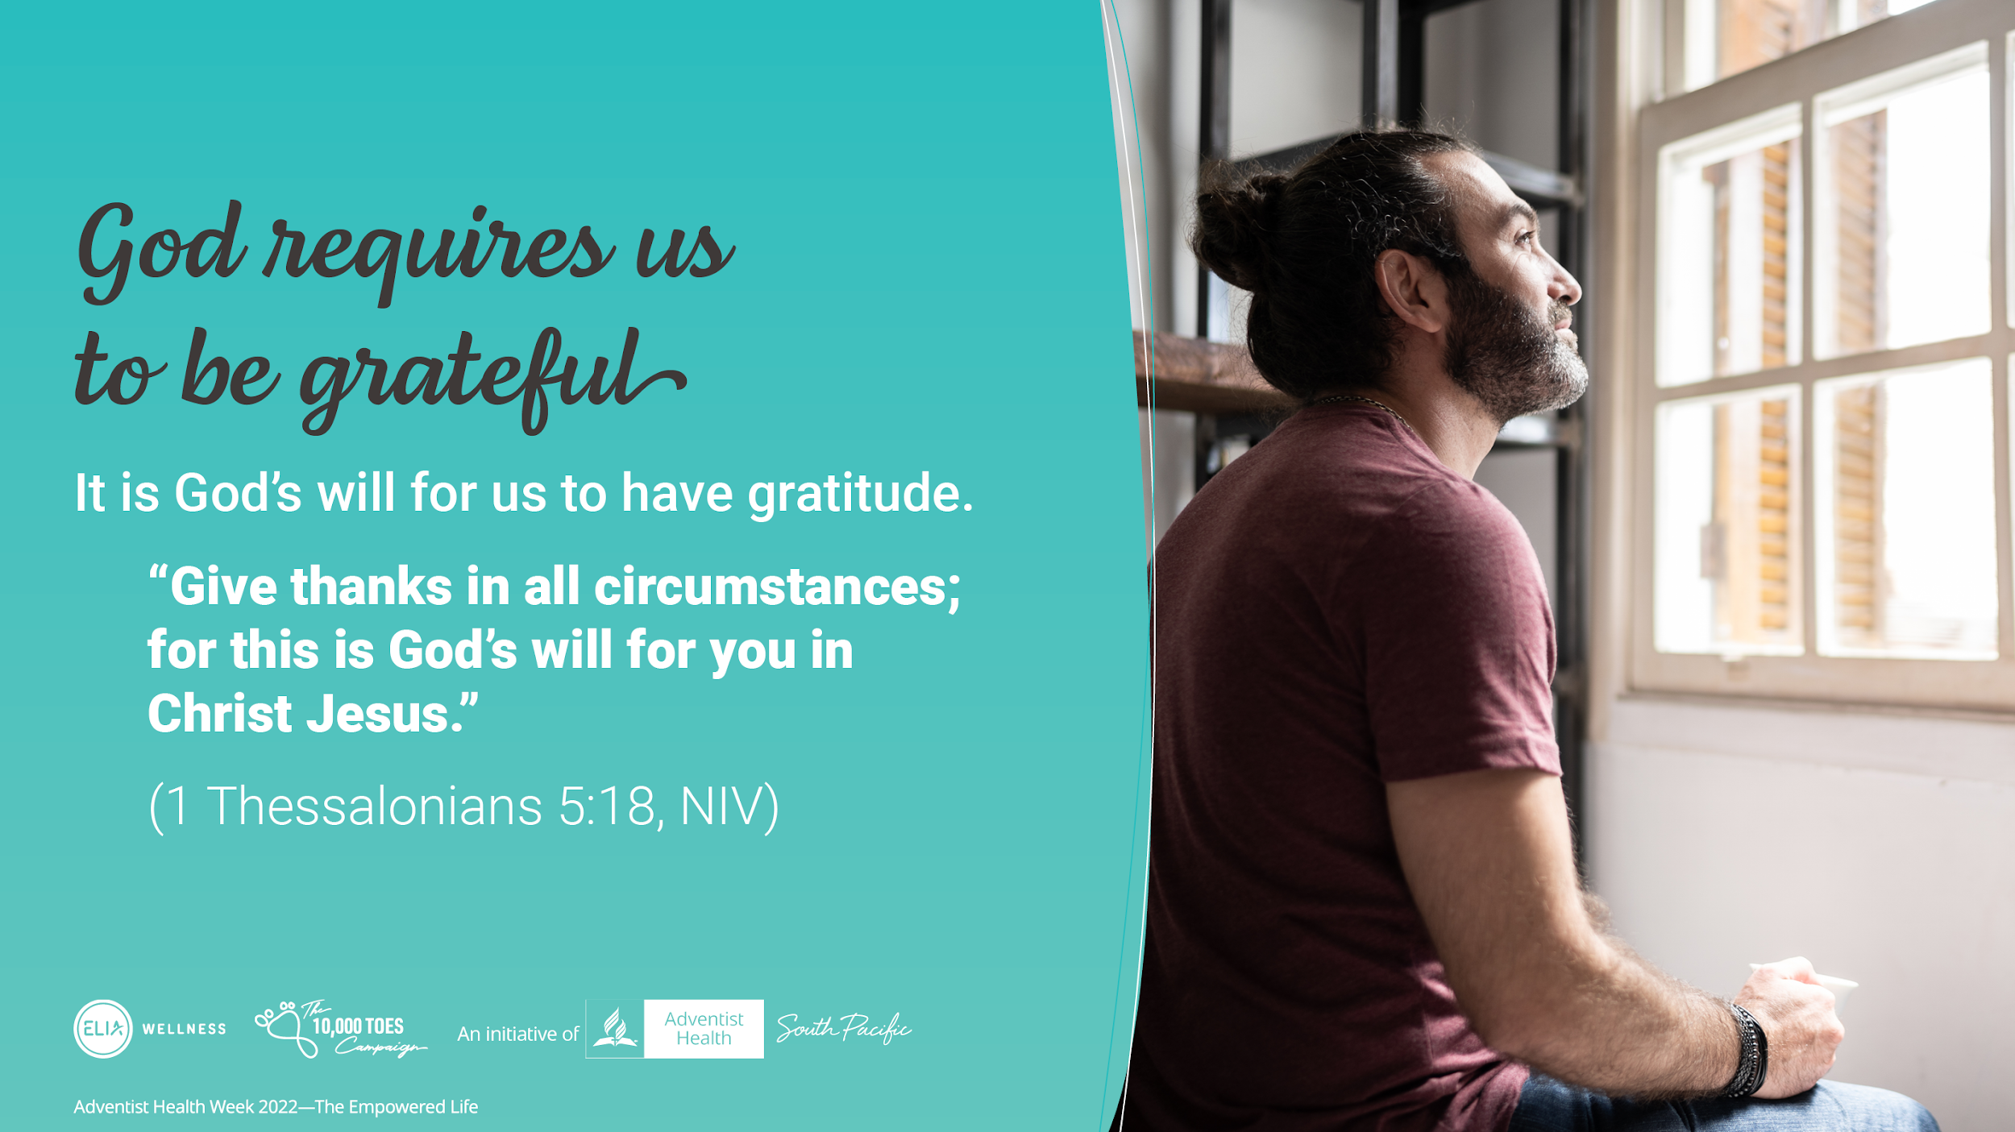
Notes:
God desires us to be grateful.
It is good to thank God for what He has given us, as it’s actually God’s will for us to be grateful and therefore thankful.
Paul tells us to:
“Give thanks in all circumstances; for this is God’s will for you in Christ Jesus.” (1 Thessalonians 5:18, NIV)

Slide 13
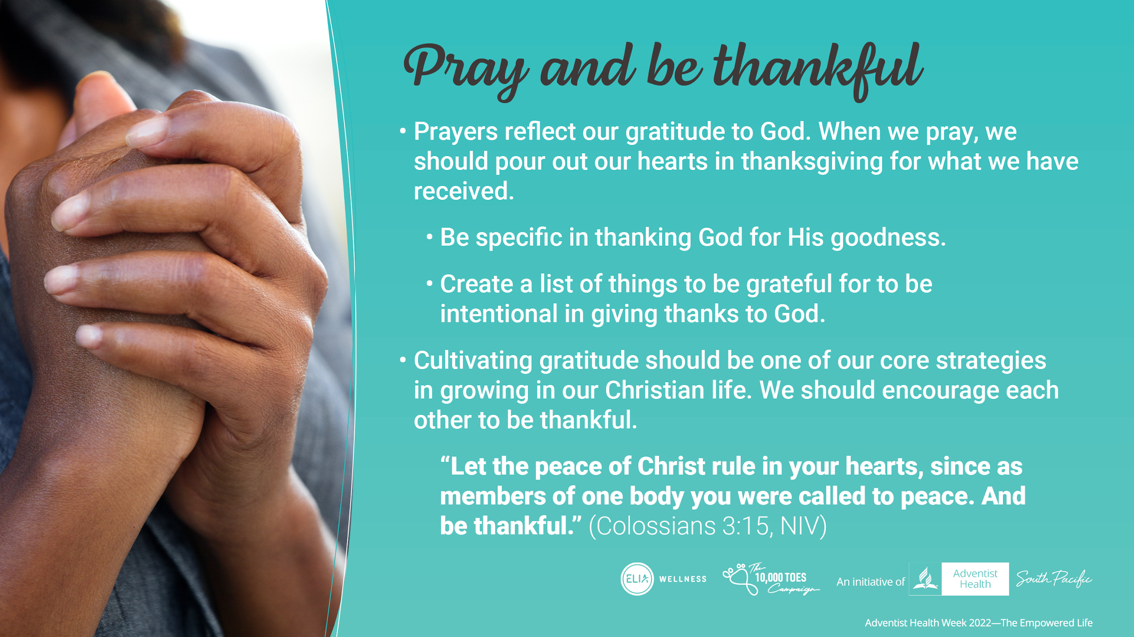
Notes:
Prayers reflect our gratitude to God. When we pray we should pour out our hearts in thanks for the many blessings we have received. We should be specific in thanking God for His goodness; for our family; for friends; and for his son Jesus. We can even keep a list of things to be grateful for, so we can thank God for specific things each day.
Cultivating gratitude should be one of our core strategies in growing in our Christian life. We should encourage each other to be thankful.
“Let the peace of Christ rule in your hearts, since as members of one body you were called to peace. And be thankful.” (Colossians 3:15, NIV)

Slide 14
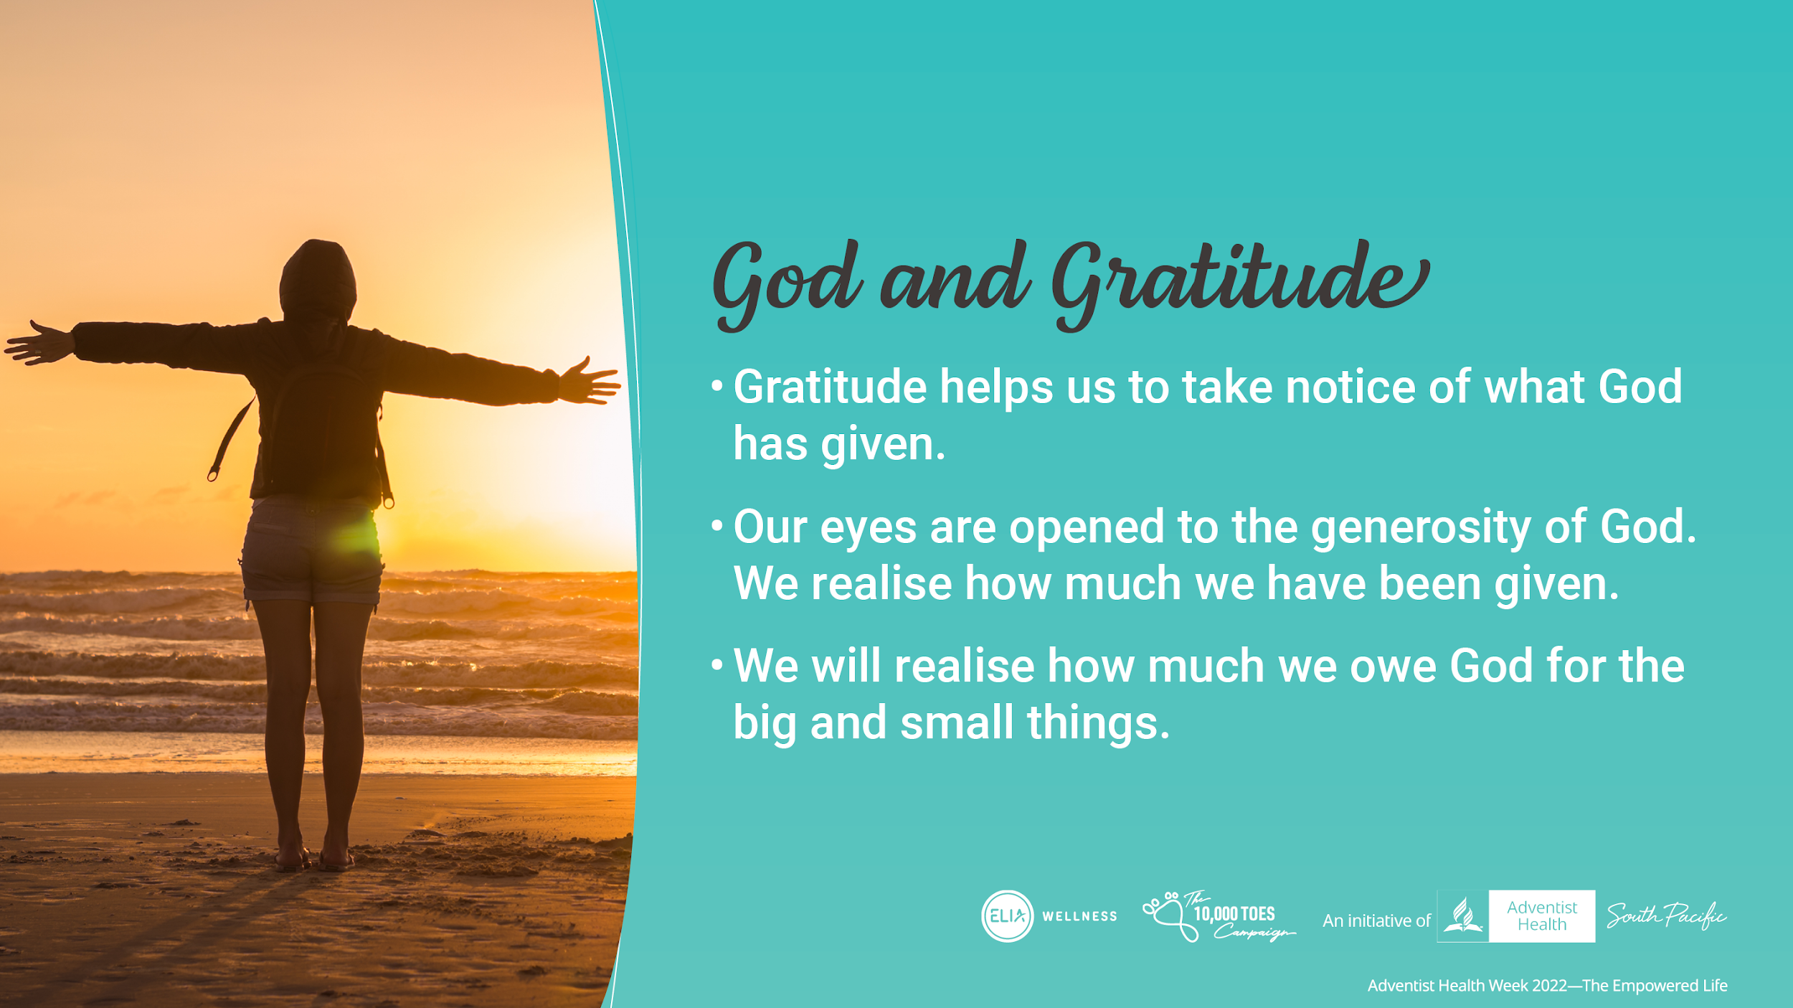
Notes:
Gratitude makes us take notice of what God has given us. When we think about what we should be grateful for, our eyes are opened to the generosity of God. We realise how much we are given. We see how much we owe God. And it’s not just about the big stuff. When we train our hearts to look for God’s grace we see it in the small things as well.

Slide 15
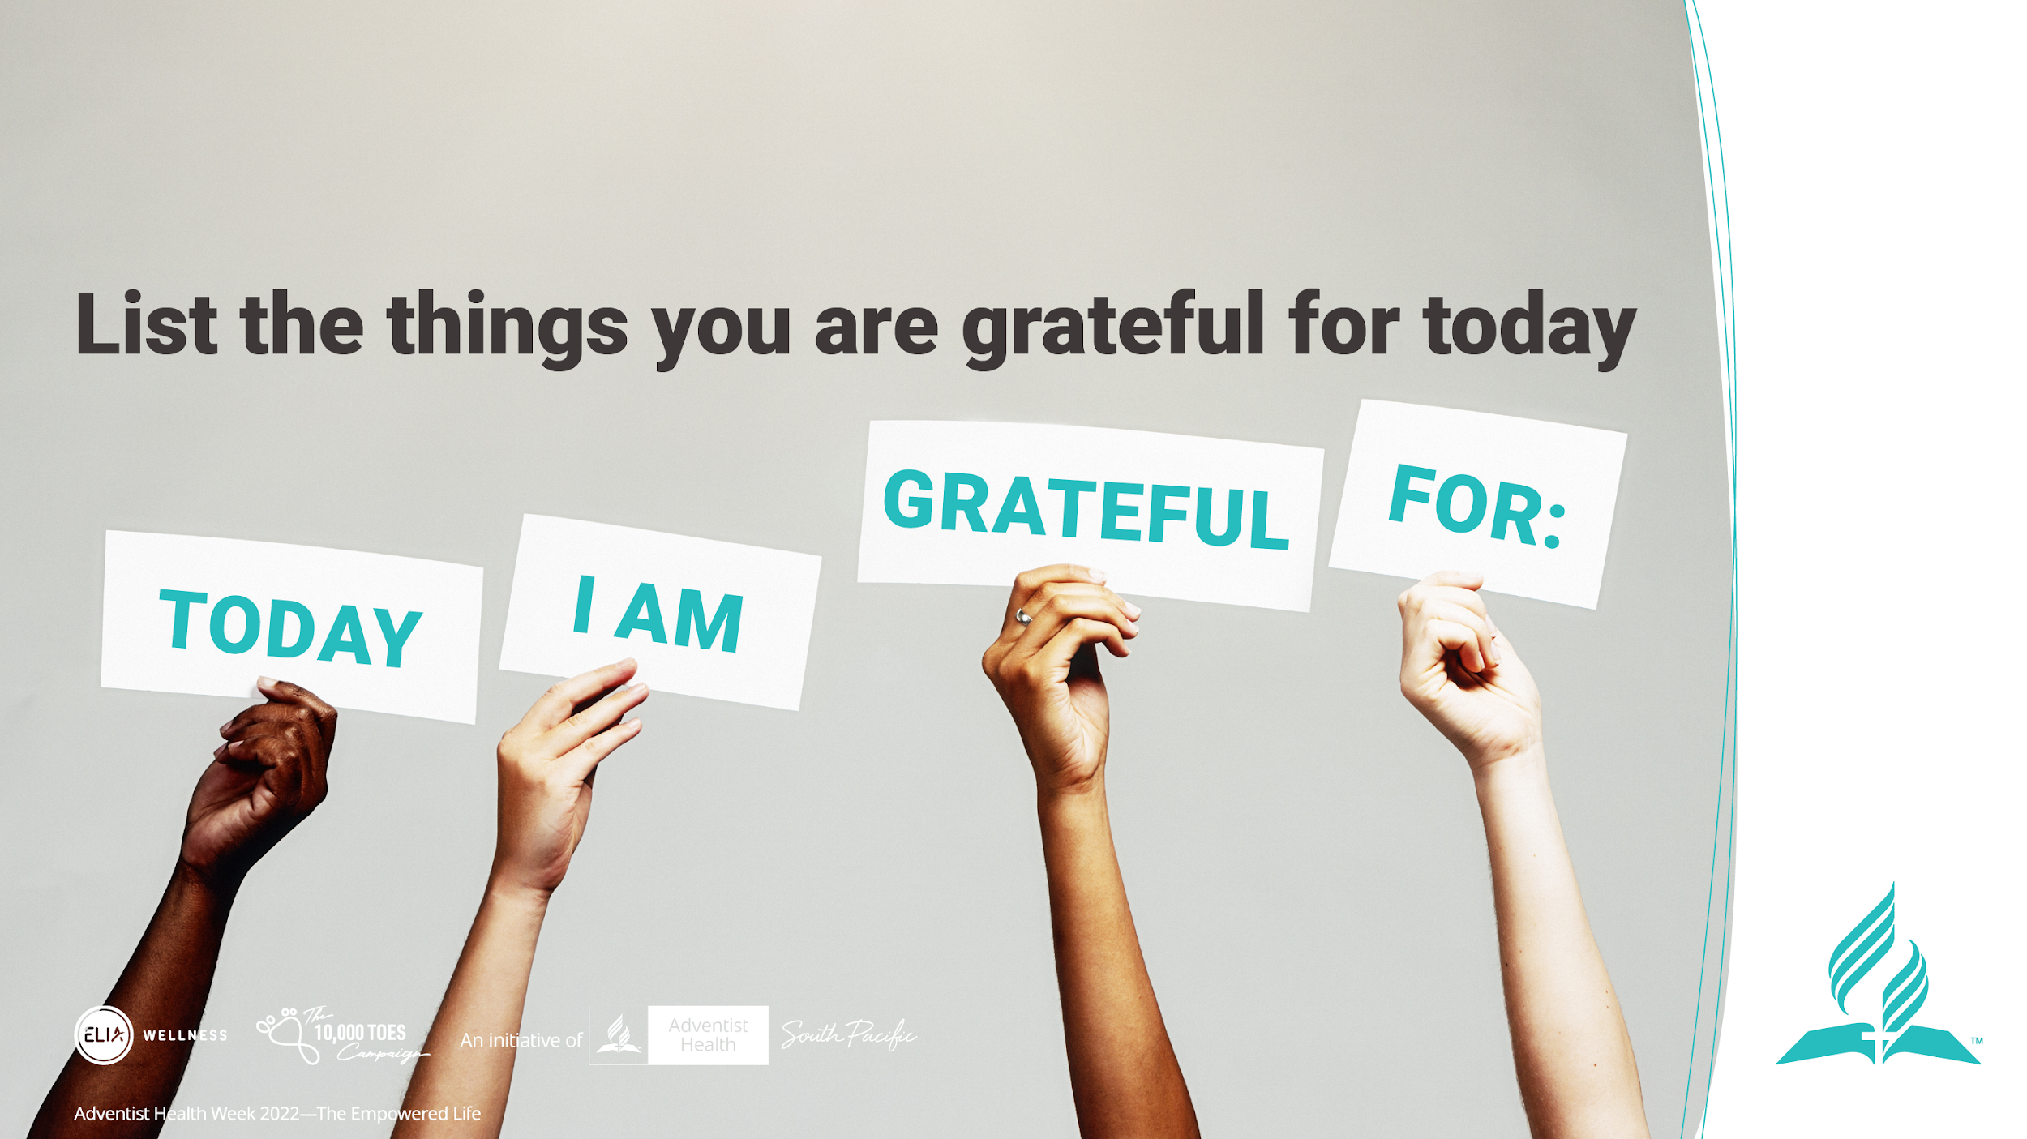
Notes:
As a speaker:
Invite the guests to list the things they are grateful for Today as a point of engagement

Slide 16
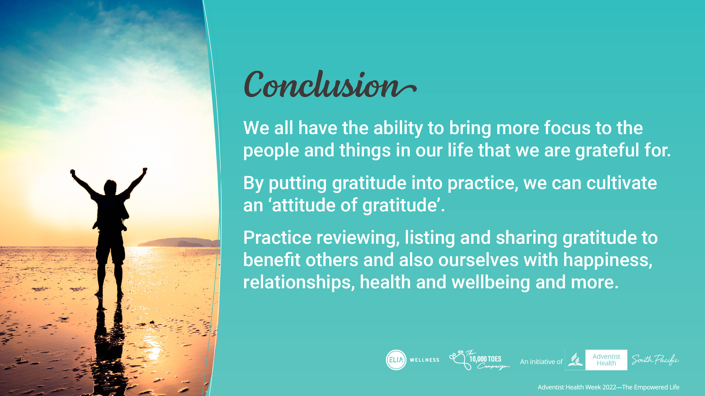
Notes:
In conclusion:
We all have the ability to bring more focus to the people and things in our life that we are grateful for
By putting gratitude into practice, we can cultivate an ‘attitude of gratitude’
Practice reviewing, listing and sharing gratitude to benefit others and also ourselves with happiness, relationships, health and wellbeing and more.

