Slide 2





COVID-19
VACCINATION ROLL OUT FOR PACIFIC COMMUNITIES
PRESENTATION
Updated 23rd August, 2021

Slide 3
WHAT IS COVID-19

Slide 4
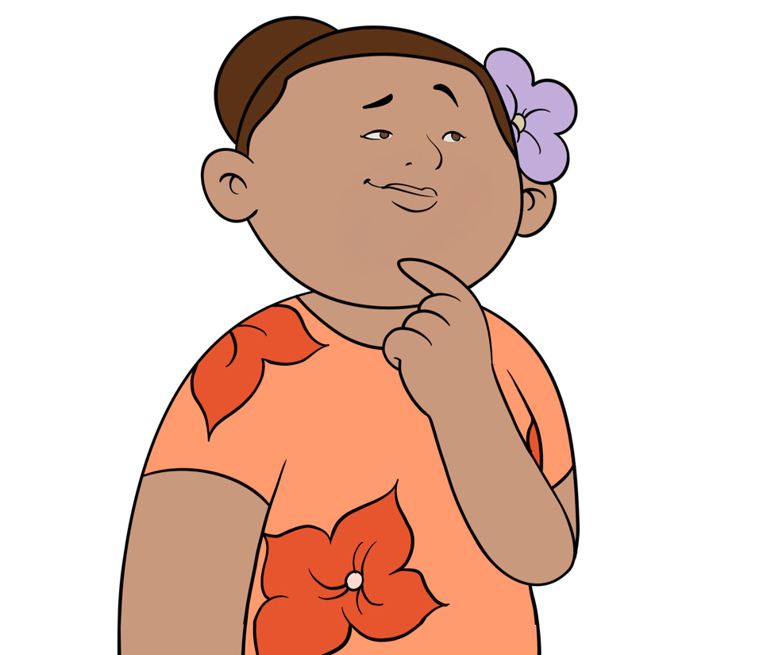

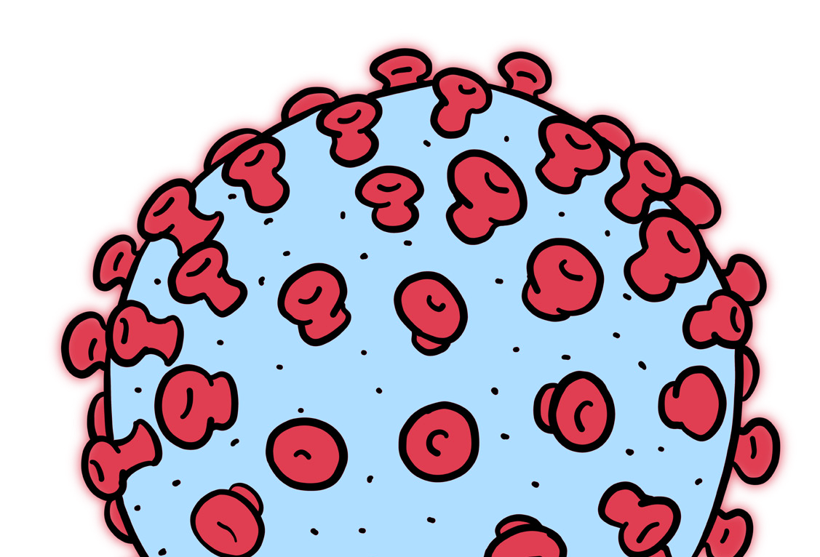
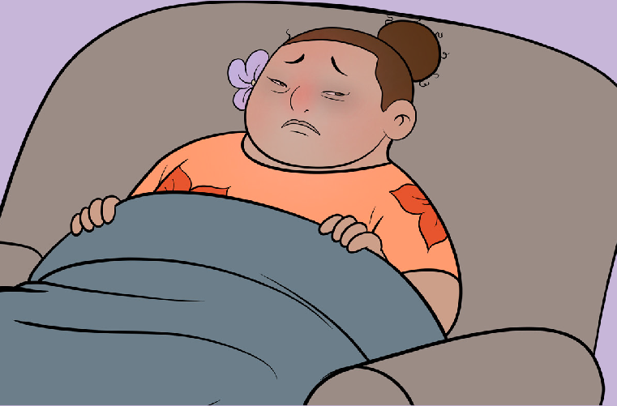





WHAT IS COVID-19?
FOR MORE INFORMATION CONTACT
Is a relatively new virus
Can cause severe illness
HEALTHLINE 0800 358 5453
www.preparepacific.nz

Slide 5


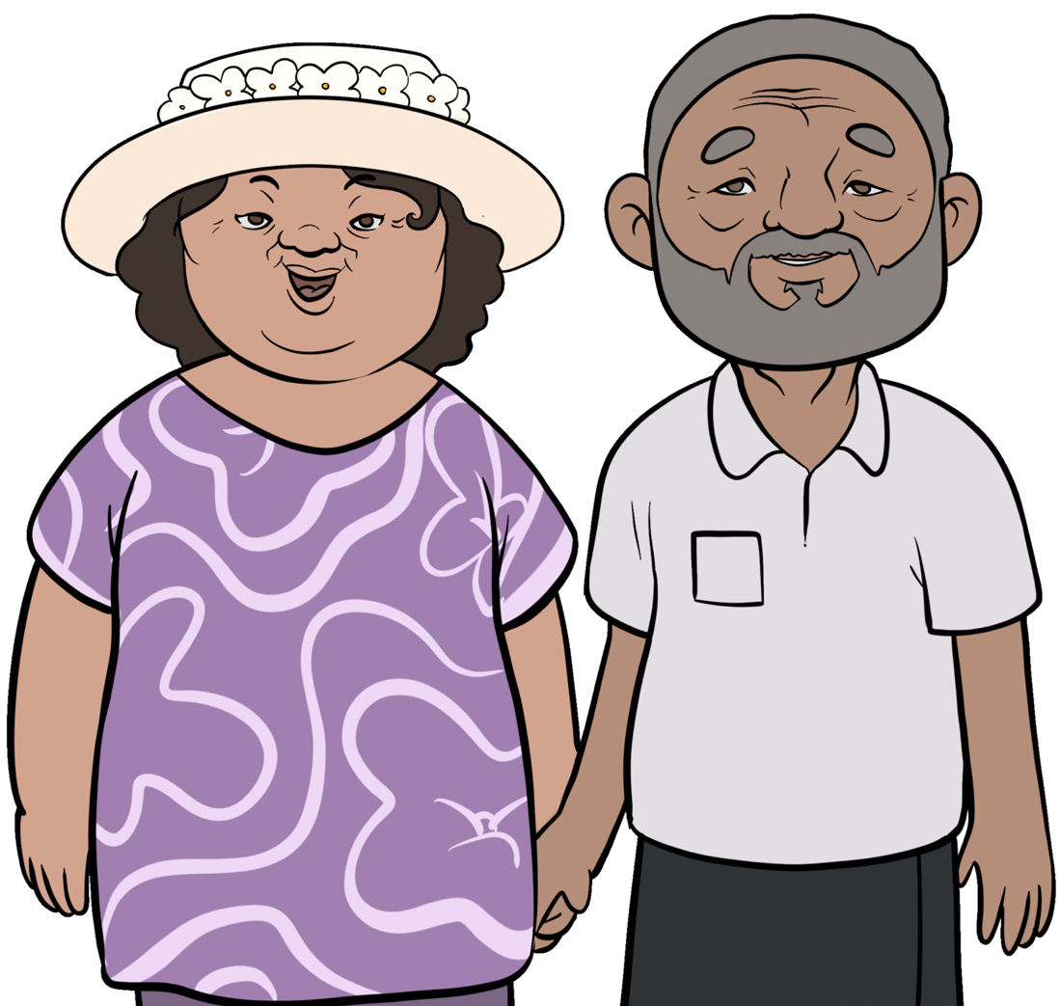
WHY COVID-19 IS SERIOUS
FOR MORE INFORMATION CONTACT
Over 176 million cases that have been reported worldwide
3 million+ deaths worldwide
Older people are at greater risk
HEALTHLINE 0800 358 5453
www.preparepacific.nz

Slide 6




WHY COVID-19 IS SERIOUS
Once COVID-19 is in the community it is hard to control because
it is contagious.
FOR MORE INFORMATION CONTACT
HEALTHLINE 0800 358 5453
www.preparepacific.nz

Slide 7

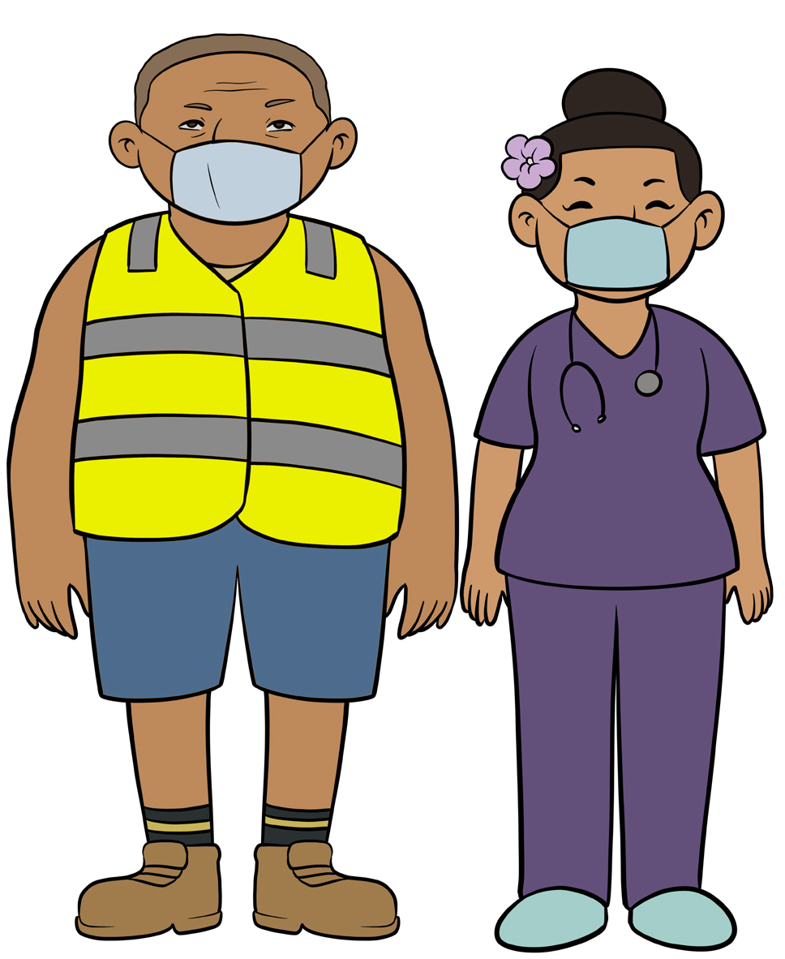
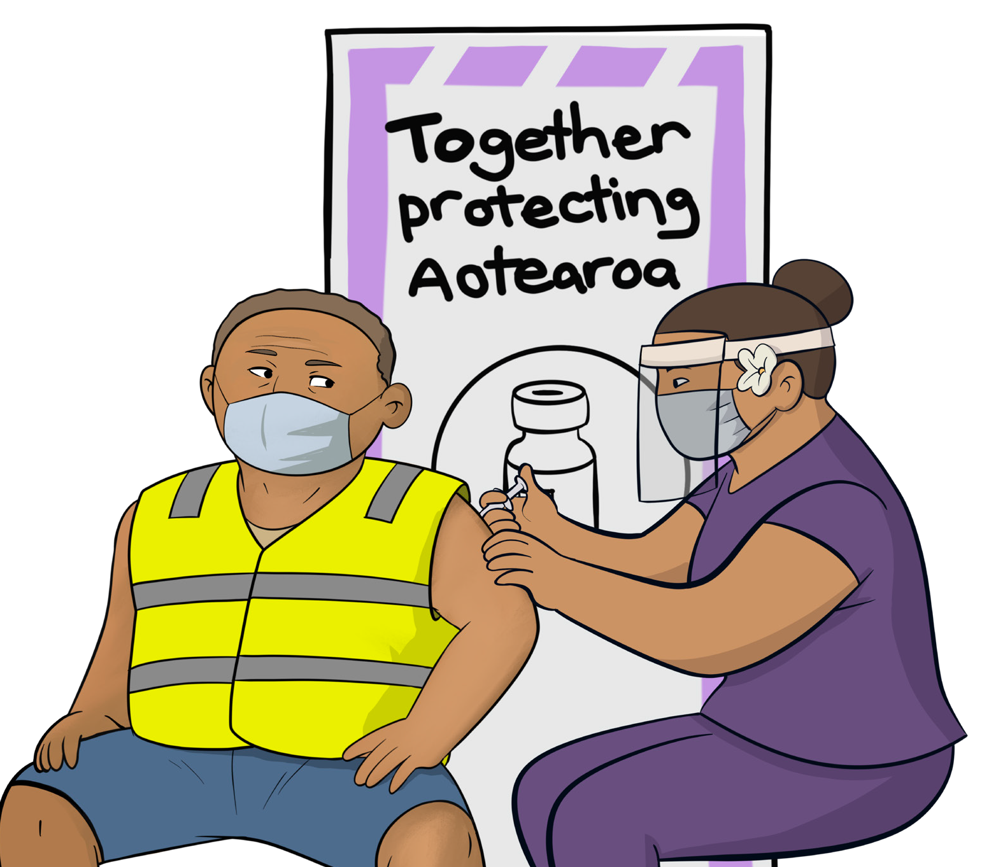
PACIFIC PEOPLES AT RISK
Encourage our Pacific communities to learn about the vaccine and to be vaccinated
FOR MORE INFORMATION CONTACT
HEALTHLINE 0800 358 5453
www.preparepacific.nz

Slide 8
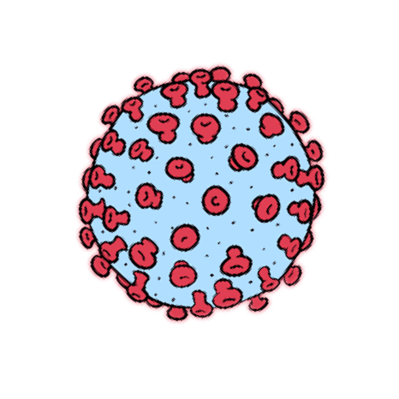

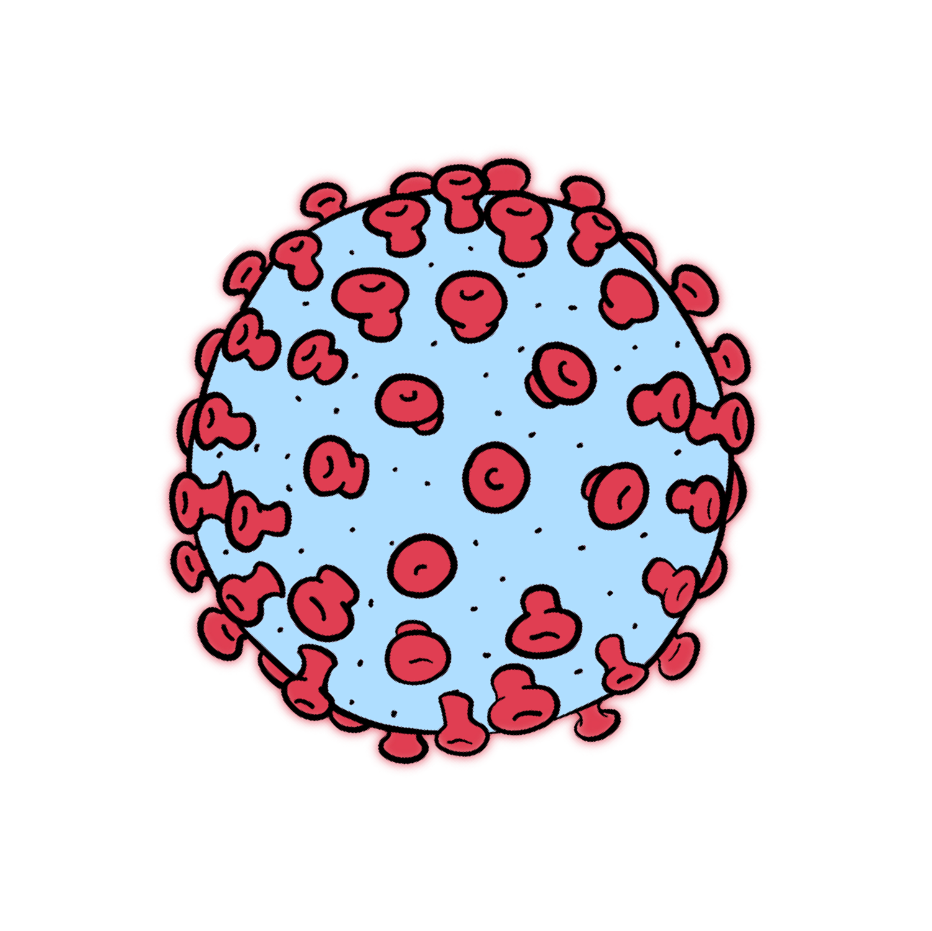
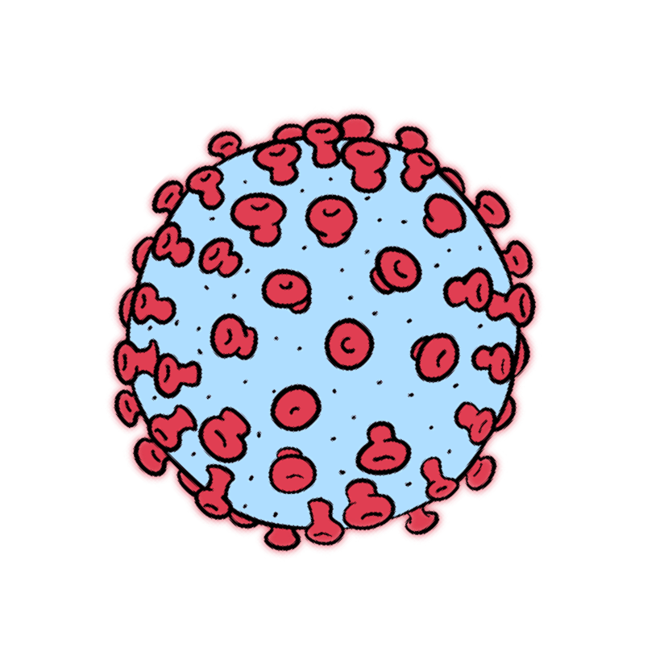
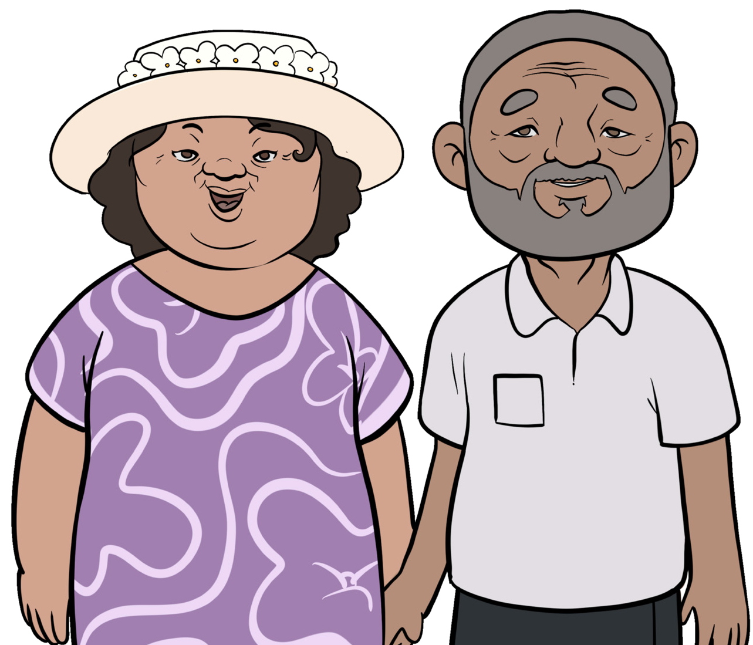
WHAT COVID-19 DOES TO THE BODY
The virus grabs onto healthy cells
The virus makes copies of itself
The virus can be more dangerous for people who have an underlying
health condition
FOR MORE INFORMATION CONTACT
HEALTHLINE 0800 358 5453
www.preparepacific.nz

Slide 9

HOW COVID-19 SPREADS
COVID-19 usually spreads when an infected person coughs, breathes or sneezes
FOR MORE INFORMATION CONTACT
HEALTHLINE 0800 358 5453
www.preparepacific.nz

Slide 10

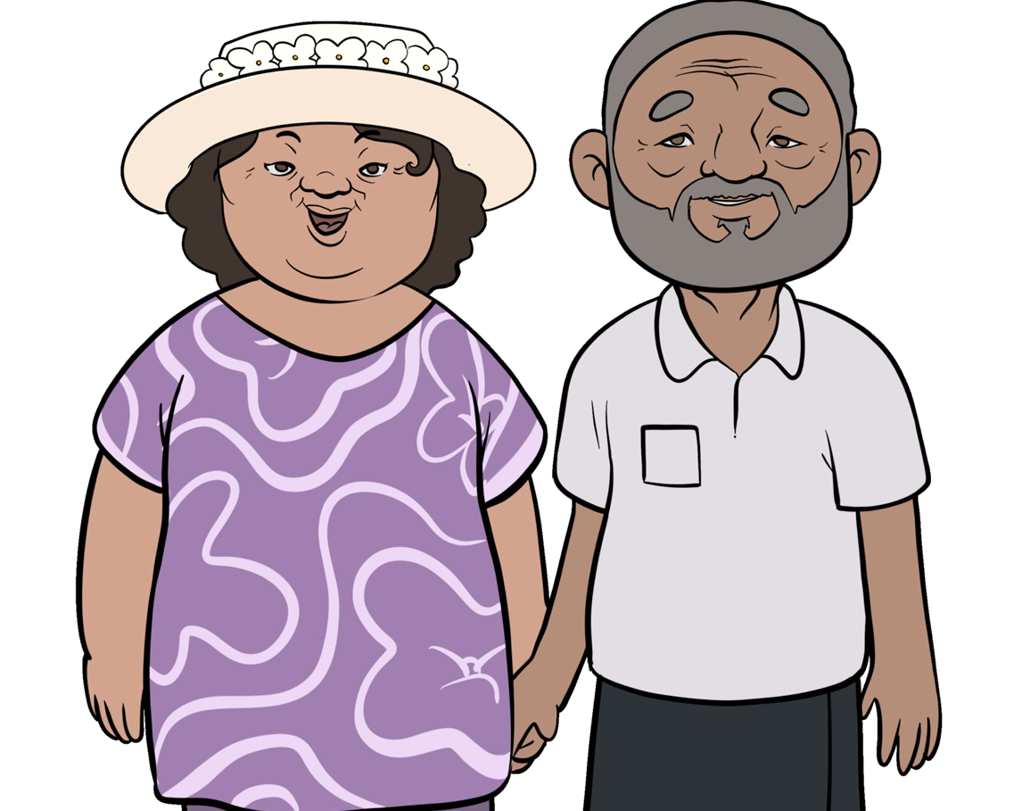
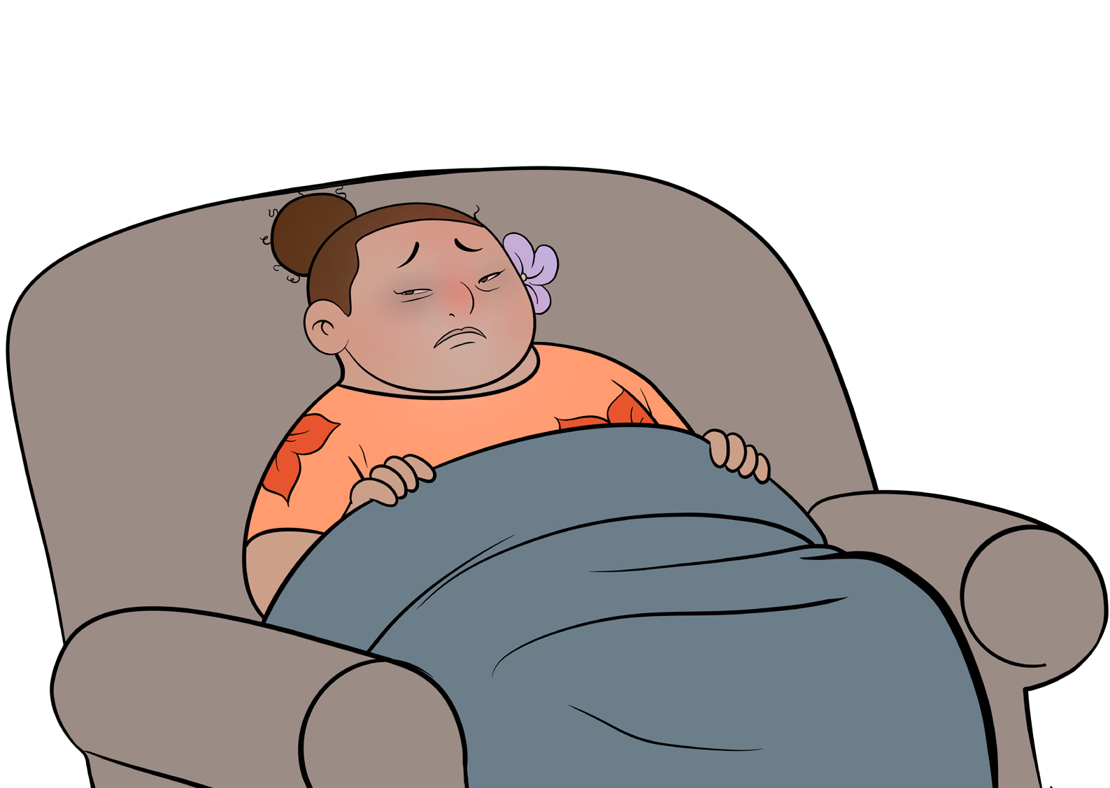
THE SYMPTOMS
Older people are most at risk
Coughing
Chills, sometimes with shaking, body aches
and headaches
FOR MORE INFORMATION CONTACT
HEALTHLINE 0800 358 5453
www.preparepacific.nz

Slide 11
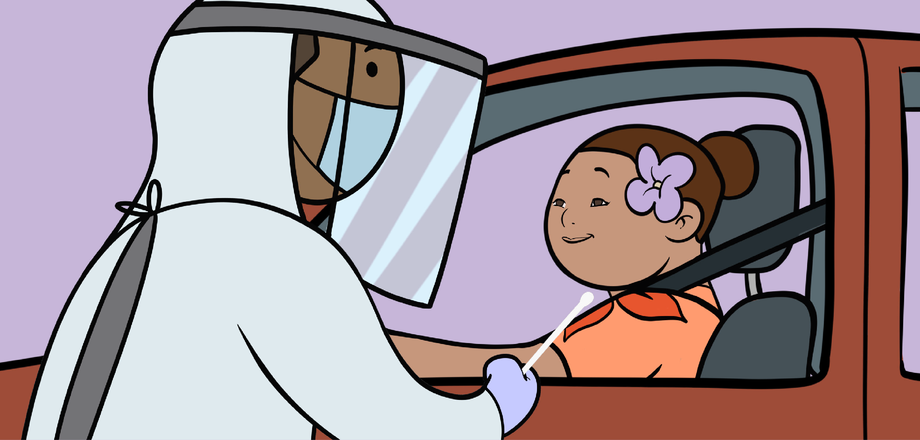
GETTING TESTED
There are COVID-19 testing centres that
you can drive through
FOR MORE INFORMATION CONTACT
HEALTHLINE 0800 358 5453
www.preparepacific.nz

Slide 12
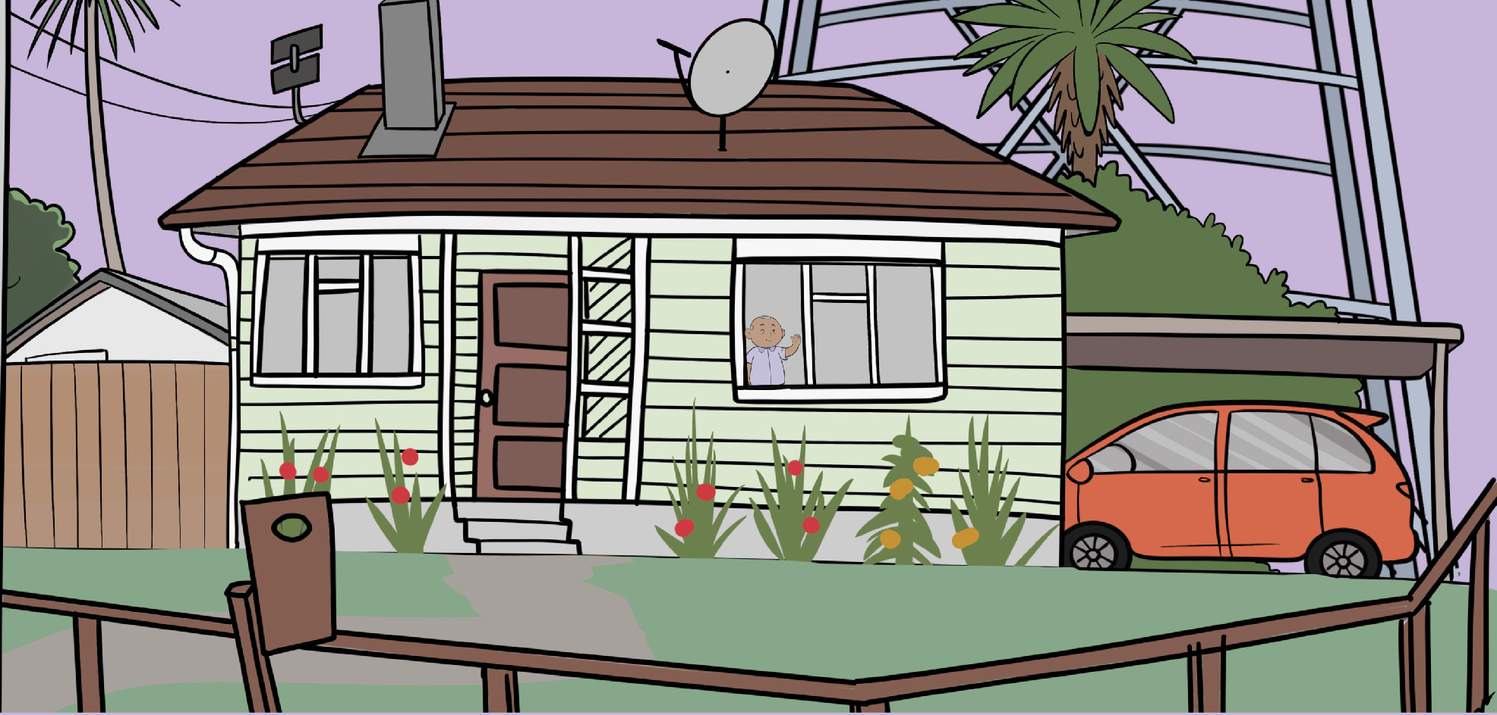
STAY AT HOME
Remember you should stay at home if you are sick
FOR MORE INFORMATION CONTACT
HEALTHLINE 0800 358 5453
www.preparepacific.nz

Slide 13
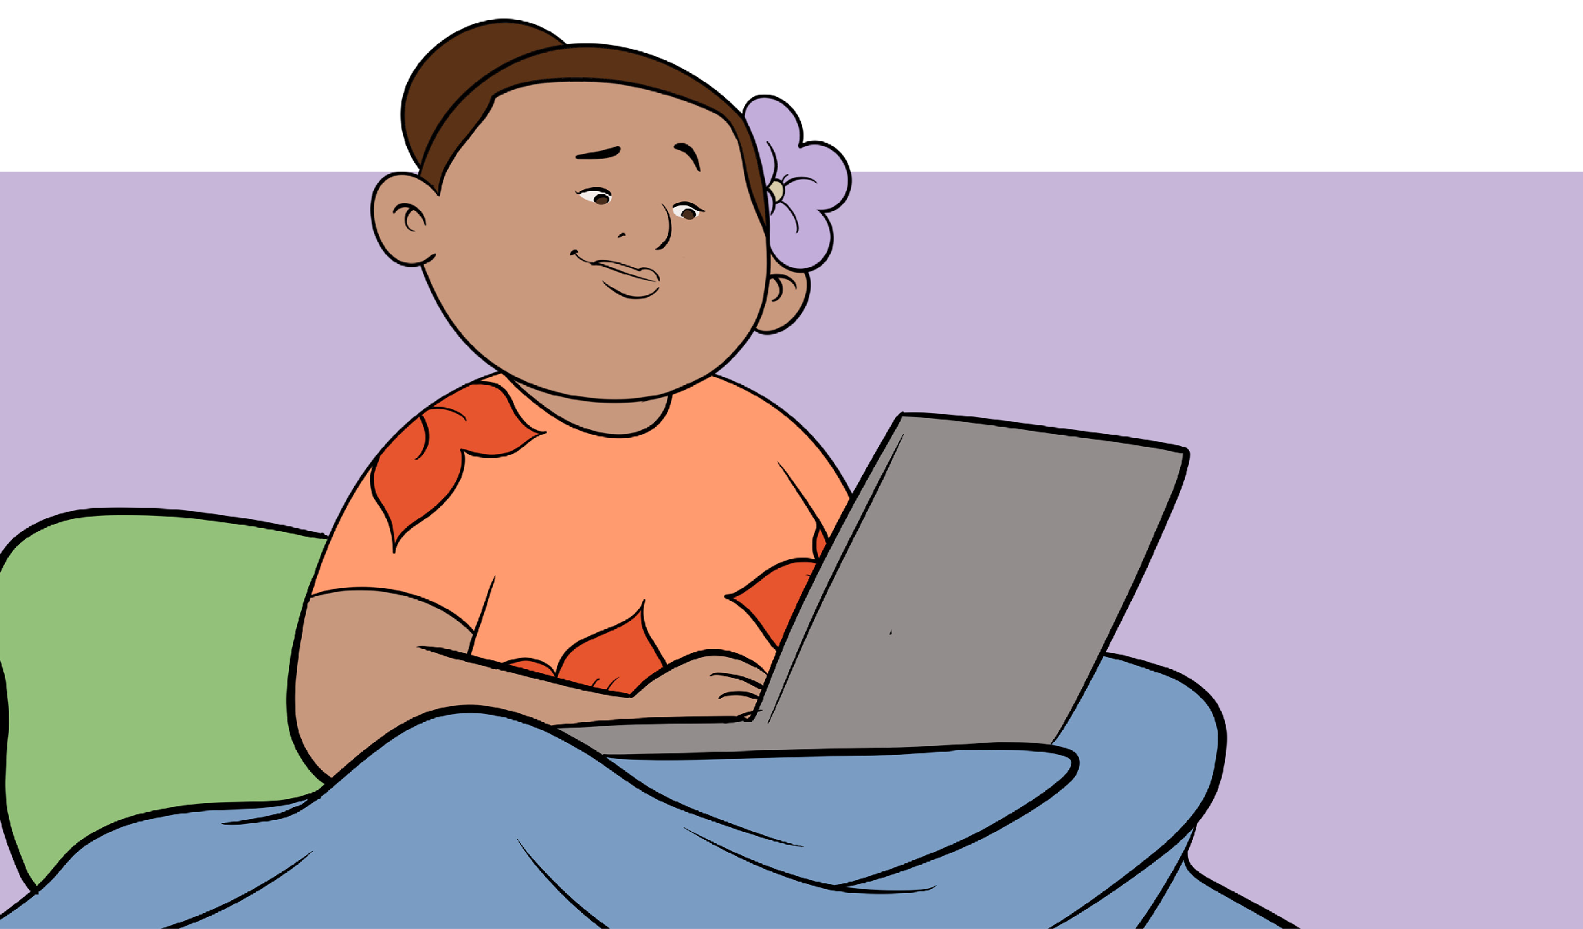
SICK LEAVE
See if it is possible for you to work from home, if you are required to
self-isolate
FOR MORE INFORMATION CONTACT
HEALTHLINE 0800 358 5453
www.preparepacific.nz

Slide 14

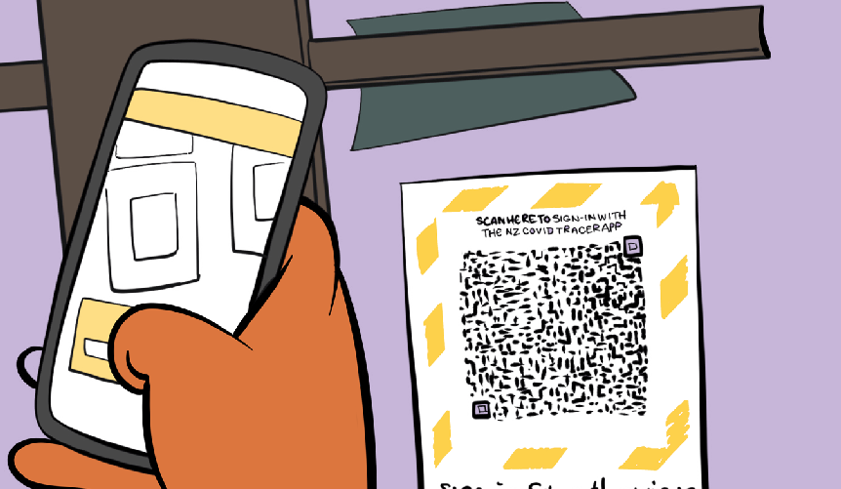

CONTACT TRACING
FOR MORE INFORMATION CONTACT
Keep a record of
where you’ve been
You can download the
COVID Tracer APP
HEALTHLINE 0800 358 5453
www.preparepacific.nz

Slide 15
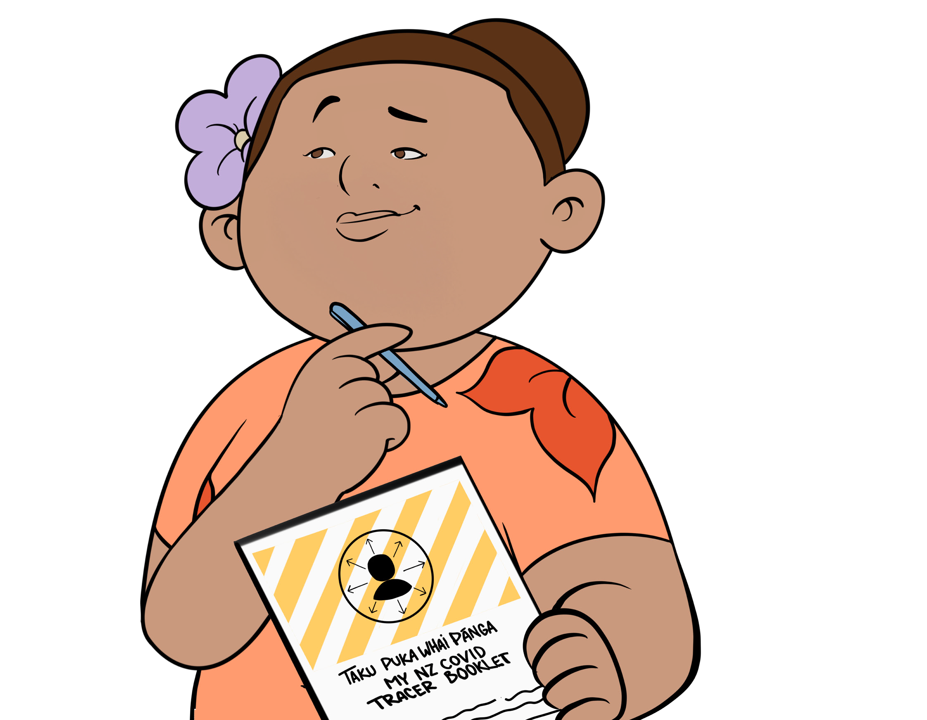
CONTACT TRACING
FOR MORE INFORMATION CONTACT
Its OK to use pen and paper to keep a record of where you’ve been and who you’ve seen
HEALTHLINE 0800 358 5453
www.preparepacific.nz

Slide 16
THE VACCINE

Slide 17


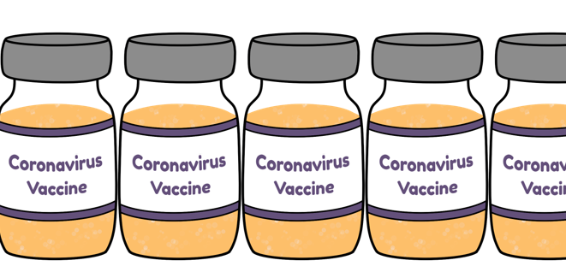
THE PFIZER VACCINE
FOR MORE INFORMATION CONTACT
Pfizer BioNTech
Vaccination is free
Receive two doses at least 3 weeks apart
HEALTHLINE 0800 358 5453
www.preparepacific.nz

Slide 18



WHAT IS IN THE VACCINE
FOR MORE INFORMATION CONTACT
Messenger RNA sends a message to our cells that will help protect our body
Messenger RNA has been
studied for many years
HEALTHLINE 0800 358 5453
www.preparepacific.nz

Slide 19

WHAT THE VACCINE DOES
FOR MORE INFORMATION CONTACT
Vaccines work with your body’s natural defence system, which is called the immune system
HEALTHLINE 0800 358 5453
www.preparepacific.nz

Slide 20



WHAT THE VACCINE DOES
FOR MORE INFORMATION CONTACT
Messenger RNA
Antibodies
Protein
HEALTHLINE 0800 358 5453
www.preparepacific.nz

Slide 21




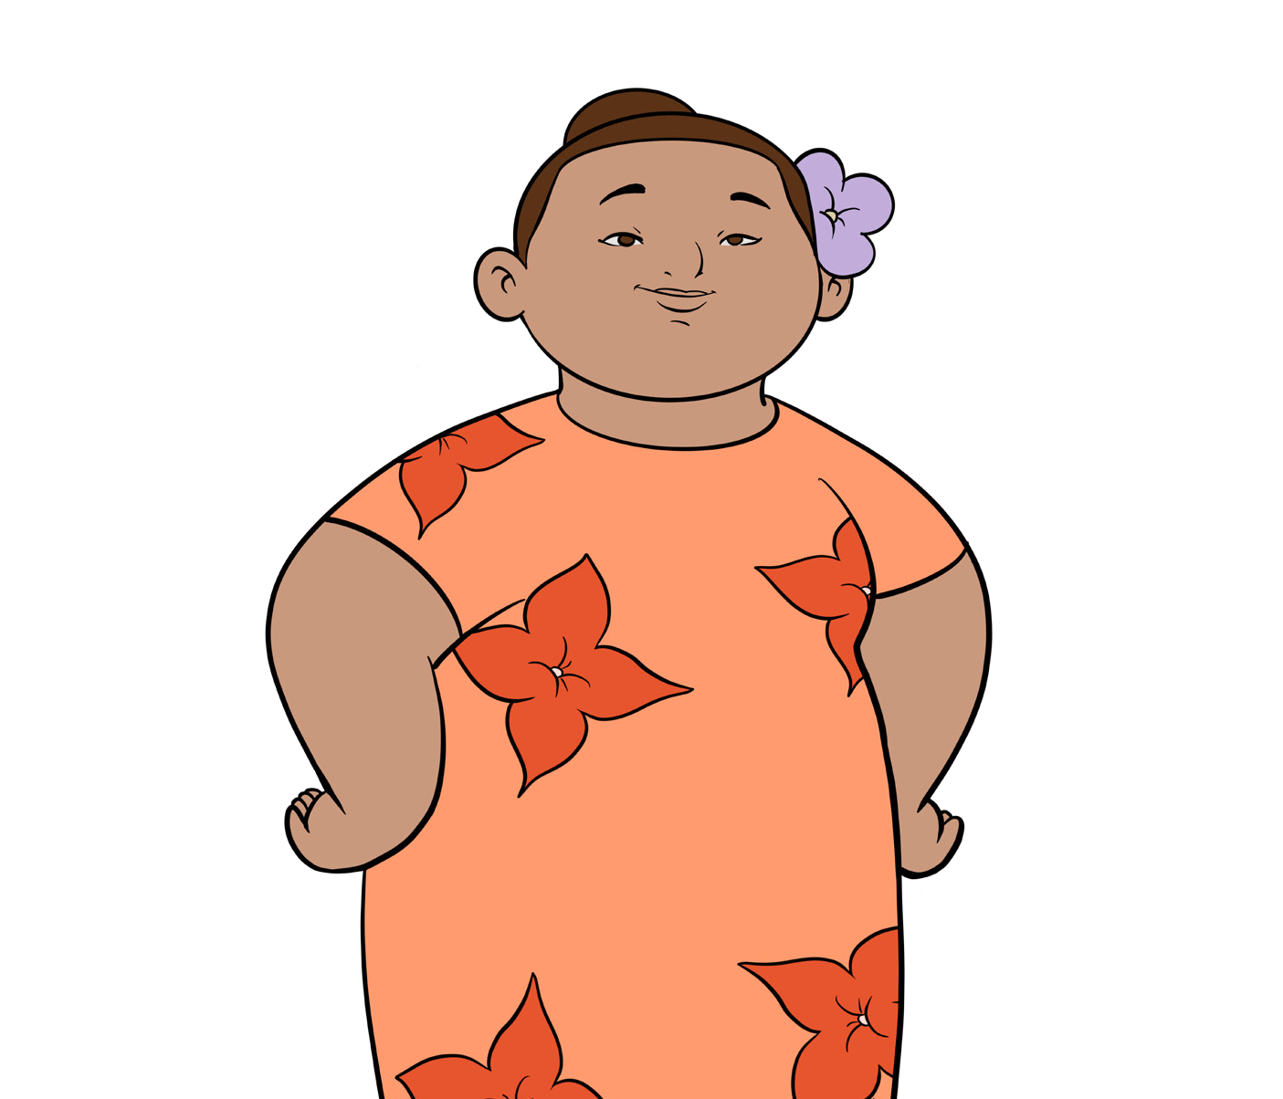
YOU CANNOT GET COVID-19 FROM THE VACCINE
FOR MORE INFORMATION CONTACT
It is not a live vaccine which means there is no virus
You cannot get COVID-19 from the vaccine
There are no human or animal products in this vaccine
HEALTHLINE 0800 358 5453
www.preparepacific.nz

Slide 22


THE VACCINE DOES NOT AFFECT OUR DNA
FOR MORE INFORMATION CONTACT
The vaccine does not affect your DNA in any way
The Messenger RNA
does not enter the
nucleus of the cell
HEALTHLINE 0800 358 5453
www.preparepacific.nz

Slide 23



TWO DOSES OF THE VACCINE
FOR MORE INFORMATION CONTACT
You will have two doses of the vaccine at least 3 weeks apart
After the first injection you will have some immunity
The second injection you receive increases your protection
HEALTHLINE 0800 358 5453
www.preparepacific.nz

Slide 24
VACCINE SAFETY

Slide 25

IF YOU FEEL WORRIED
FOR MORE INFORMATION CONTACT
In New Zealand, all new medicines, including vaccines, are assessed by an organisation called Medsafe
HEALTHLINE 0800 358 5453
www.preparepacific.nz

Slide 26






THE VACCINE IS SAFE
FOR MORE INFORMATION CONTACT
Vaccine is safe because it
went through months of
clinical testing
Many millions of people around the world have received the vaccine.
HEALTHLINE 0800 358 5453
www.preparepacific.nz

Slide 27
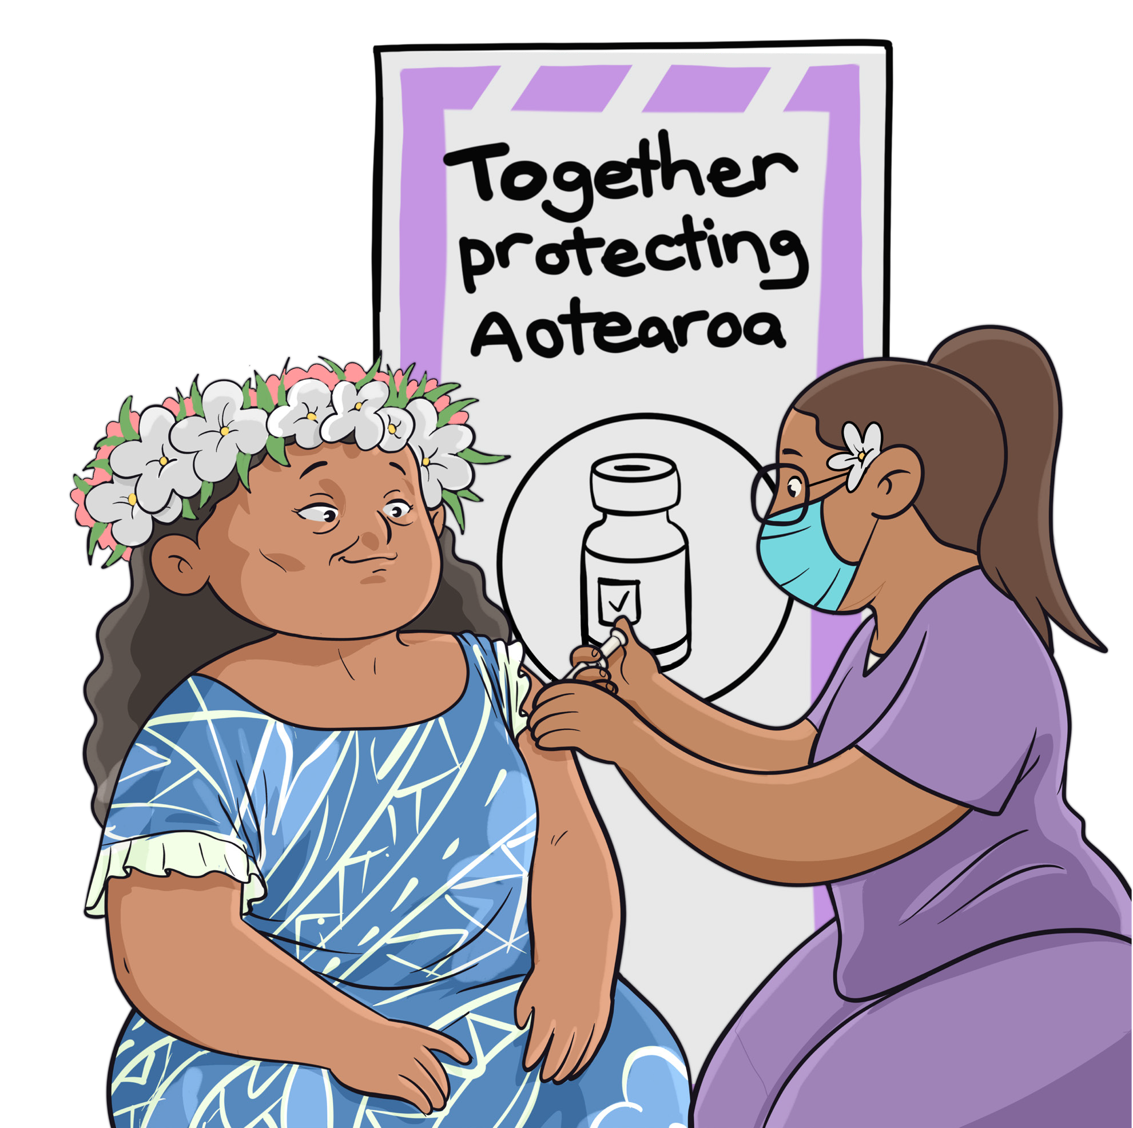
POSSIBLE SIDE-EFFECTS
The vaccine is injected into your upper arm
FOR MORE INFORMATION CONTACT
HEALTHLINE 0800 358 5453
www.preparepacific.nz

Slide 28
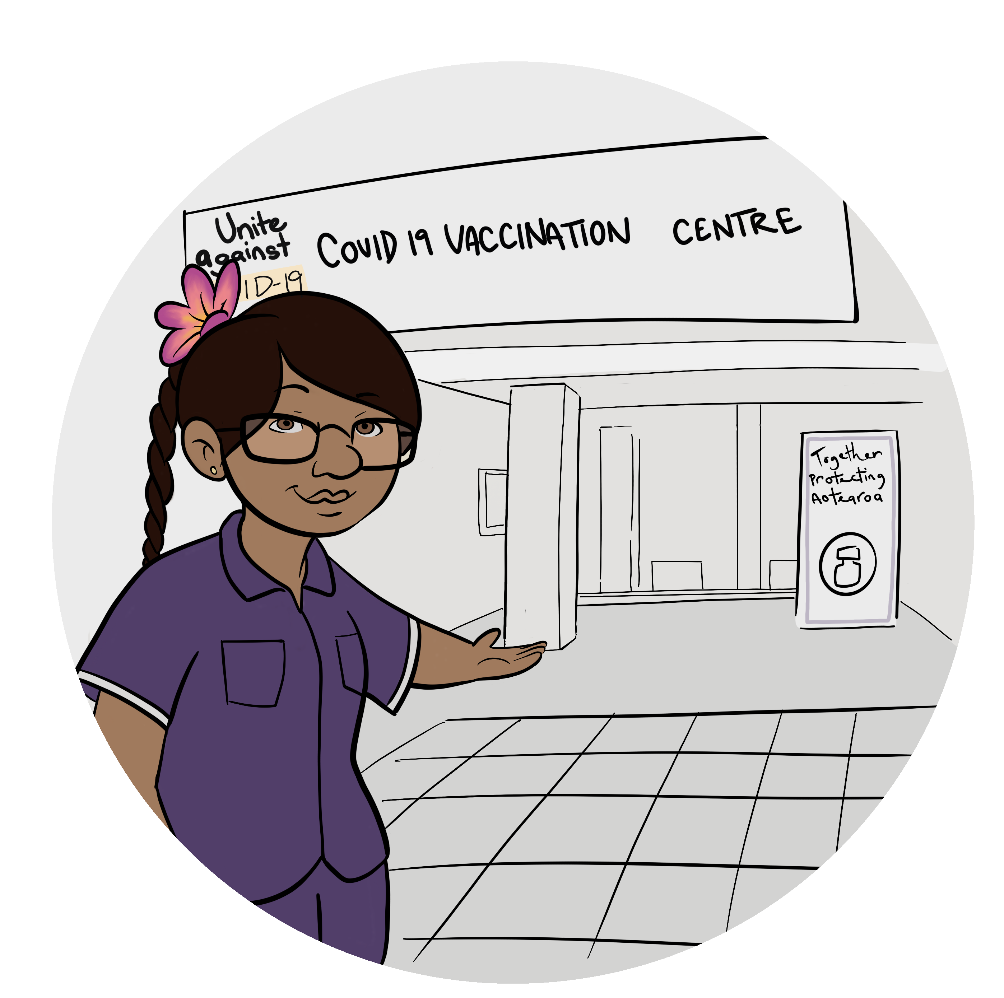
EXTRA SAFETY MEASURES IN PLACE
After you have been given the vaccine to be observed by a medical professional
FOR MORE INFORMATION CONTACT
HEALTHLINE 0800 358 5453
www.preparepacific.nz

Slide 29
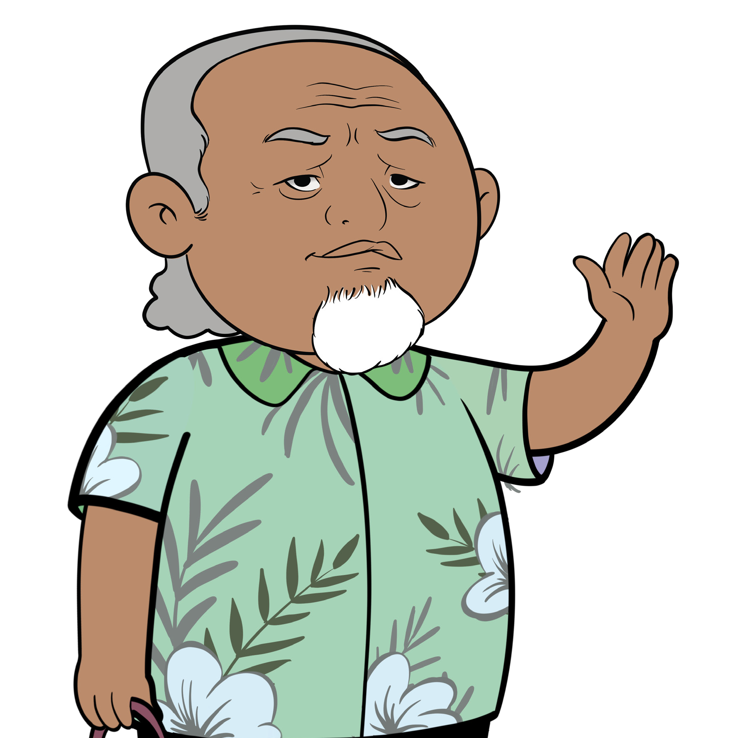
THE VACCINE IS SAFE FOR OLDER PEOPLE AND PEOPLE WITH A SERIOUS HEALTH CONDITION
It is very important that older people and those with serious health conditions get vaccinated
FOR MORE INFORMATION CONTACT
HEALTHLINE 0800 358 5453
www.preparepacific.nz

Slide 30

THE VACCINE IS SAFE FOR PREGNANT WOMEN
If you are pregnant and choose to have the vaccine, you can get early access
FOR MORE INFORMATION CONTACT
HEALTHLINE 0800 358 5453
www.preparepacific.nz

Slide 31

THE VACCINE IS SAFE FOR WOMEN WHO ARE BREASTFEEDING
There are no safety concerns about giving the vaccine to women who are breastfeeding
FOR MORE INFORMATION CONTACT
HEALTHLINE 0800 358 5453
www.preparepacific.nz

Slide 32
THE EFFECTIVENESS
OF THE VACCINE

Slide 33


IMMUNITY
FOR MORE INFORMATION CONTACT
HEALTHLINE 0800 358 5453
You will have some immunity as soon as you’ve received your first dose.
We expect you will have immunity two weeks after your second dose.
www.preparepacific.nz

Slide 34
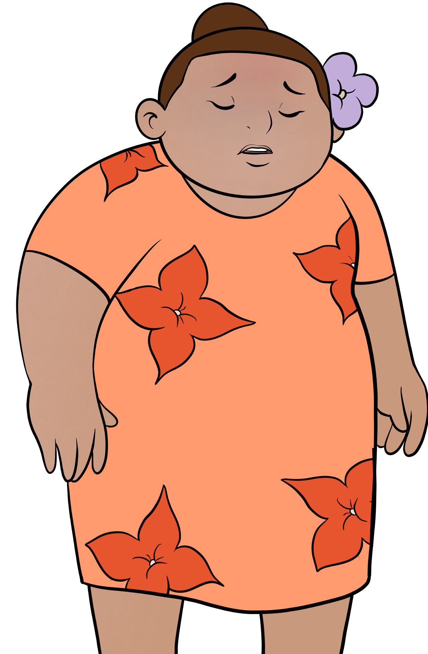
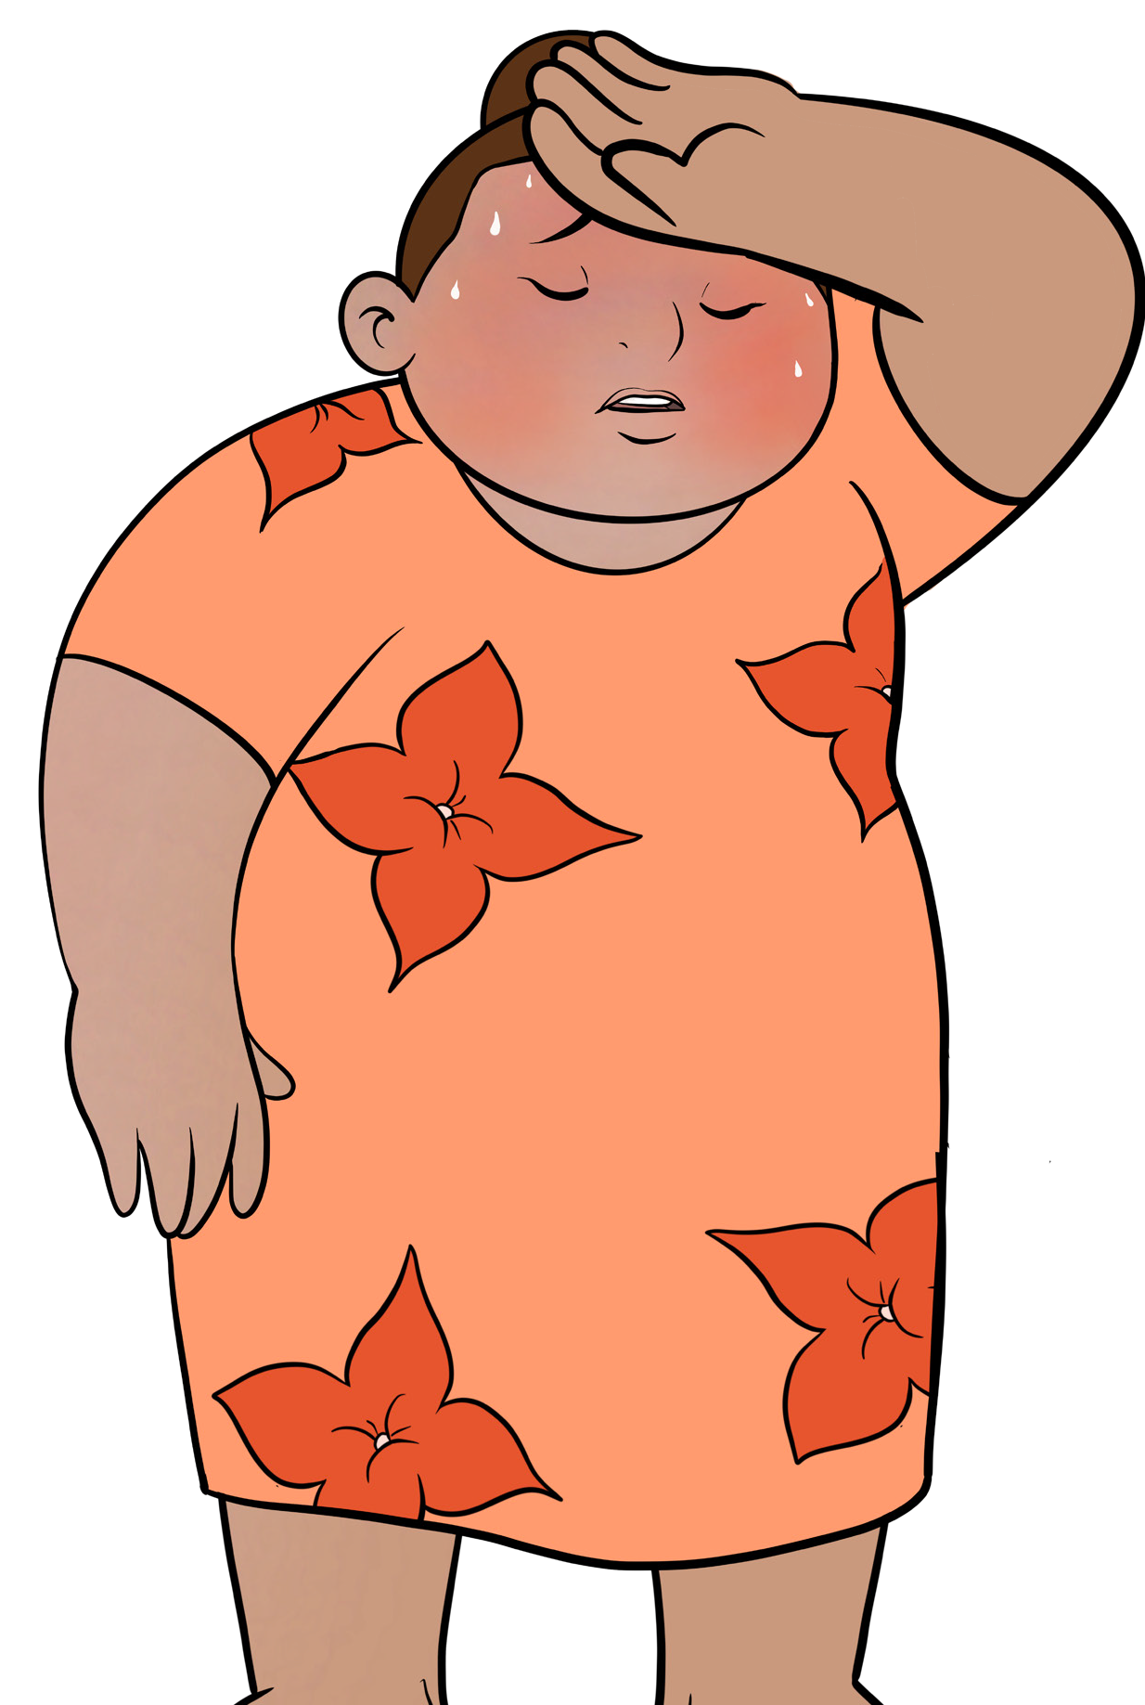
CAN I STILL GET COVID-19
FOR MORE INFORMATION CONTACT
HEALTHLINE 0800 358 5453
It is possible for people to get
COVID-19 even when they have been
vaccinated
www.preparepacific.nz

Slide 35

PFIZER VACCINE IS ONE
OF THE MOST EFFECTIVE IN THE WORLD
FOR MORE INFORMATION CONTACT
90 TO 95
PERCENT
EFFECTIVE
HEALTHLINE 0800 358 5453
www.preparepacific.nz

Slide 36
THE PACIFIC
VACCINATION CENTRES

Slide 37

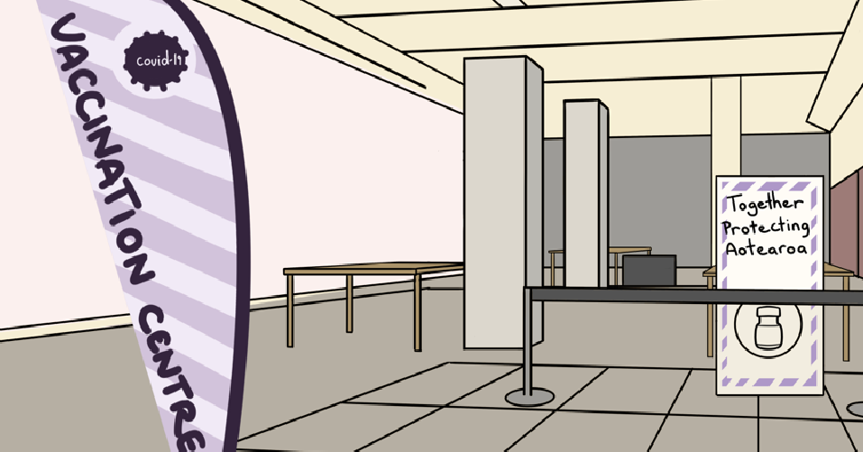
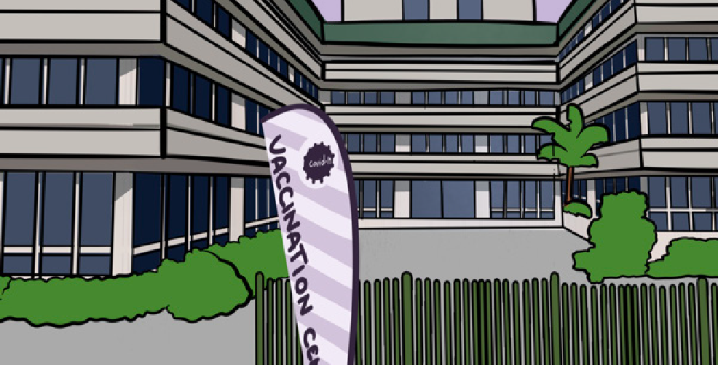
PACIFIC VACCINATION CENTRES
FOR MORE INFORMATION CONTACT
HEALTHLINE 0800 358 5453
There are a number of COVID-19 vaccination centres around Auckland and throughout the country
www.preparepacific.nz

Slide 38
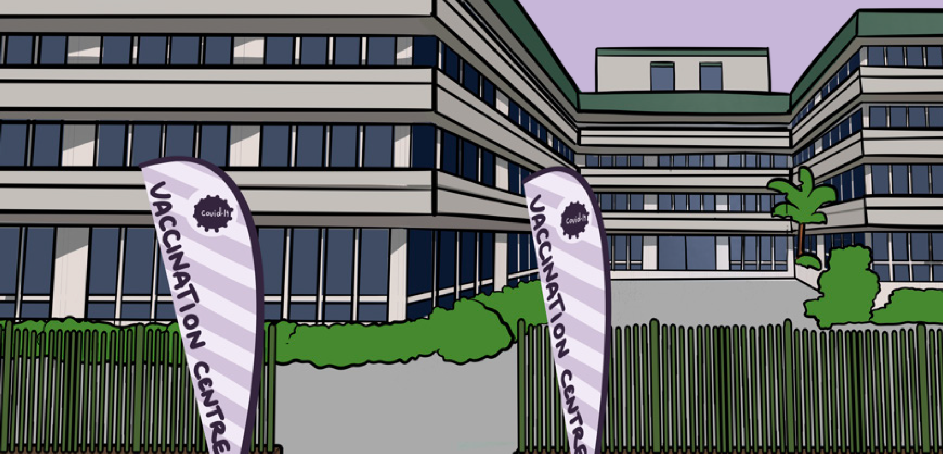
SOUTH AUCKLAND PACIFIC VACCINATION CENTRE
FOR MORE INFORMATION CONTACT
HEALTHLINE 0800 358 5453
A Pacific vaccination centre is up and running at the Ōtara MIT Building, 5 Ōtara Road
www.preparepacific.nz

Slide 39
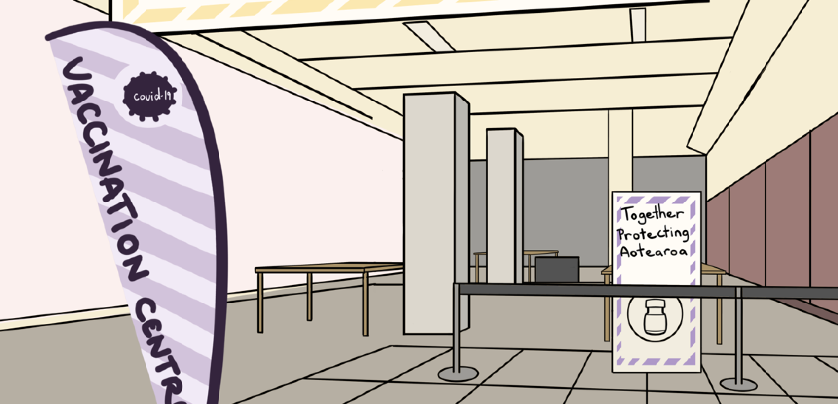
WEST AUCKLAND PACIFIC VACCINATION CENTRE
A Pacific vaccination centre in West
Auckland is up and running at 11 Westgate Drive
FOR MORE INFORMATION CONTACT
HEALTHLINE 0800 358 5453
www.preparepacific.nz

Slide 40
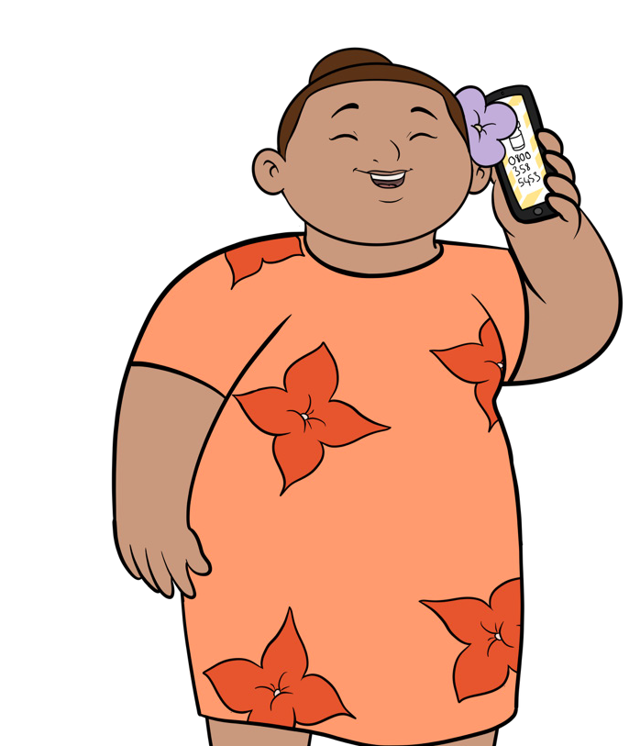
TO MAKE A BOOKING
It’s simple and free, just call
0800 21 12 21
8am-8pm, 7 days a week, to talk to a Pacific member of the Covid Vaccination Team to make a booking
FOR MORE INFORMATION CONTACT
HEALTHLINE 0800 358 5453
www.preparepacific.nz

Slide 41
FOR MORE INFORMATION CONTACT
Your family doctor or Healthline on 0800 358 5453
Prepare Pacific website www.preparepacific.nz
COVID 19 vaccines website:
www.covid19.govt.nz/health-and-wellbeing
/covid-19-vaccines
This Resource was developed based on the latest information available: Updated 23rd August, 2021

Slide 42

