Slide 1



Diabetes and the Seven Dimensions of wellness

Slide 2



Diabetes has been defined as a chronic and metabolic disease that is characterised by high blood glucose (sugar) levels.
There are two types of diabetes:
  Type 1 diabetes which used to be known as insulin-dependent diabetes where the pancreas produces little to no insulin. People with Type 1 diabetes need to take insulin for the rest of their lives.
  Type 2 diabetes, the most common type of diabetes and usually found among adults, occurs when the body develops a resistance to insulin or makes insufficient insulin
  (Diabetes Australia, 2021; World Health Organisation, 2021)

Slide 3



Globally there are about 422 million people who have diabetes.
A majority of these people live in low and middle income countries.
Every year 1.6 million people die from diabetic complications each year.
The prevalence of diabetes has been increasing in recent decades.
(World Health Organisation, 2021)

Slide 4



In PNG, the prevalence of diabetes in adults is 15.4% with total cases being 713,500
In Fiji, the prevalence of diabetes in adults is 15.1% with total cases being 87,000
In Tonga, the prevalence of diabetes in adults is 13.1% with total cases being 7,600
(International Diabetes Federation, 2021)

Slide 5

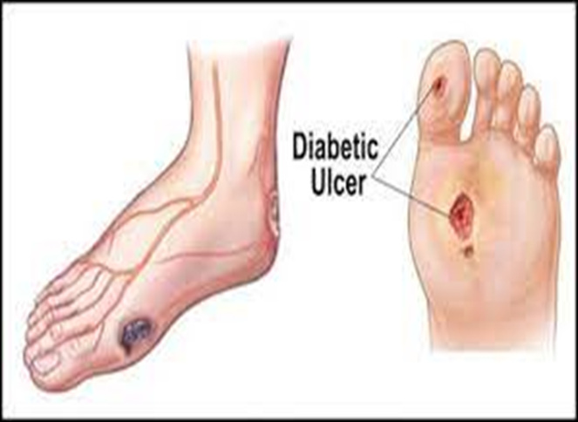
Develop over time, especially if blood sugar level is not well controlled and is frequently high.
Include:
  Cardiovascular disease (significant increase in risk)
  Damage to kidneys, eyes, feet and nerves,
  Infections on the skin
  Hearing impairment
  Alzheimer’s disease
  Depression
  (Mayo Clinic, 2021)

Slide 6



Slide 7

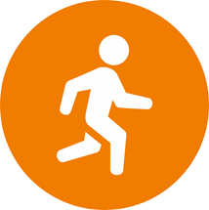




Diet:
  Eat plenty of whole foods that contain high fibre and are low in fat.
  Aim for a diet that has plenty of vegetables such as taro, cassava, sago, and greens, whole grains such as brown rice, and fruits such as papaya, mangoes and watermelon.
  These foods help to keep blood sugars low and promote a healthy functioning body.
  Avoid refined foods such as white rice, biscuits, sweets, and packet noodles as these cause high sugar levels in the blood and are harmful.
  Limit tin fish.

Slide 8

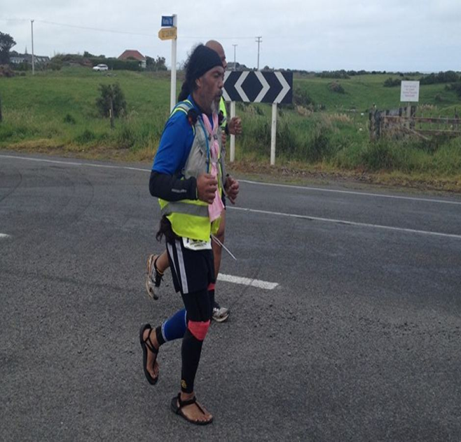
Exercise: Be more physically active. Exercise for about 30 minutes at least five days per week. Walking, or if you are feeling more energetic, jogging, or swimming, are great ways of exercising. Exercise helps to reduce insulin resistance in Type 2 diabetes and aids in managing sugar levels in Type 1 diabetics
Lose weight: If you are overweight, then losing weight can reduce the risk of developing diabetes. By eating a healthy diet and exercising, you can lose weight
Limit alcohol intake
(Based on the recommendations of Better Health Channel, 2020, and the Mayo Clinic, 2021)

Slide 9


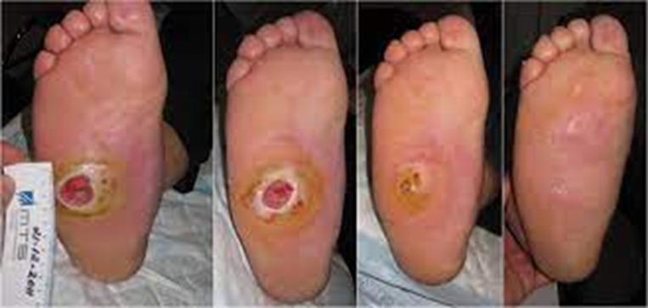

Sometimes initiating lifestyle change can be difficult.
Evaluate your feelings about diabetes.
Consider how you felt when hearing someone with diabetes share how having this condition has affected their life:
  The medication they need to take every day
  The frequency of testing sugar levels
  The complications they have developed such as kidney, foot, and nerve problems
  Loss of eye sight
  Heart attacks
  Foot ulcers
Use this reflection to motivate you to change your lifestyle so you reduce the risk of developing diabetes

Slide 10


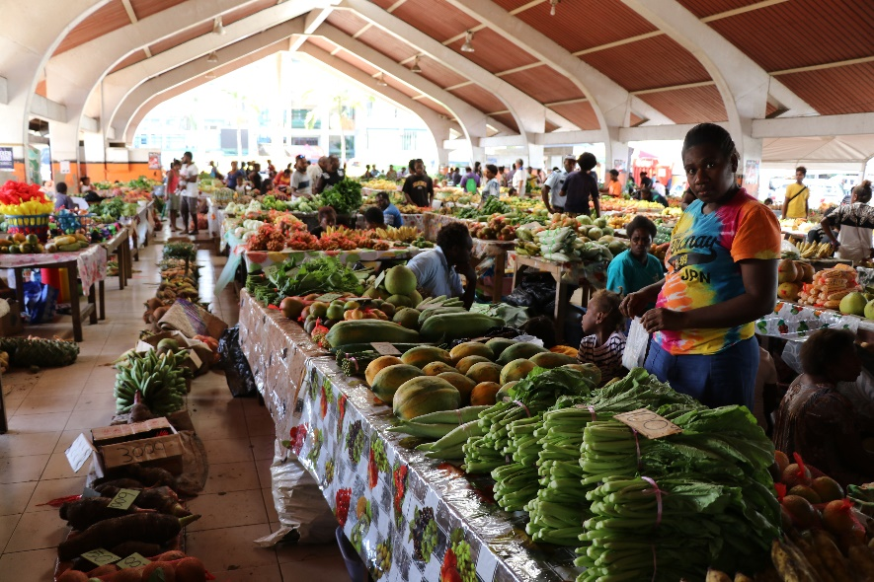
Eat healthy foods and exercise with family and friends.
  Eating well and exercising with others can be a strong motivator to keep up the lifestyle changes, especially as others also choose to eat healthy foods and exercise regularly as per recommendations above.
Goals can be set among family or friends to lose a certain amount of weight or eat certain foods at particular meals
Goals can also be set for exercise
Rewards for achieving goals
Grow the wonderful greens in your garden that grow so well in the Pacific that when eaten will do wonders to provide you with a good source of nutrition and form part of a diabetes prevention diet

Slide 11



Choose to move around during work. Sitting too long without moving will add to the risk of developing diabetes.
If you have a job that requires a lot of sitting, make sure you stand up and move around every hour or two.
  This will not only prevent diabetes but also help to prevent other issues such as musculoskeletal problems such as back pain and arthritis.

Slide 12



Think about your life journey and your relationship with God.
See the diabetes prevention and management strategies as a part of your duty as a Christian.
Remember the following Bible verse: “So, whether you eat or drink or whatever you do, do it all for the glory of God” (1 Corinthians 10:31).
Make a commitment to yourself that you will be careful with what you eat, drink, and other activities so you will glorify God through your healthy choices.
Ask God to help you to have the willpower and understanding to make good choices on what you eat, drink, and do.

Slide 13
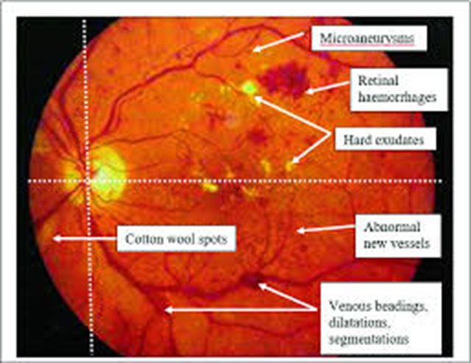


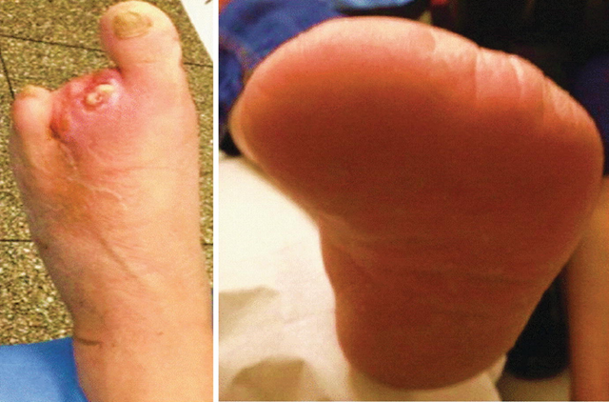
Think about the positive benefits of the diabetes prevention and management strategies and prevention of developing a debilitating condition that can be difficult to manage and easily progresses to long term complications if not properly managed.

Slide 14



Choose to exercise outside in the sunshine and fresh air. This can do wonders to your mood and make you feel better as you allow your skin to soak in the sun.
Go outside for exercise early in the morning or late in the afternoon to avoid the hotter parts of the day.
Walk among trees, flowers, and plants to help you feel happy and peaceful. Feeling good while exercising will help you to continue with your exercise program.

Slide 15
Strategy
Equip every Pacific village with the skills and tools to conduct community health assessments for the early detection of diabetes and other, related chronic diseases.
Train and resource lifestyle coaches to implement programs to prevent, arrest & reverse type 2 diabetes in every village.
Improve the capacity of Health Professionals working in health systems across the South Pacific to manage diabetes.

Slide 16

God bless you as you plan to make changes to your lifestyle to include these seven dimensions of wellness to prevent or manage diabetes.

