Slide 1
Giving Our Grandchildren a GRAND View of God
Presented by: (add presenter’s name here)
Written by:
Claudio Consuegra, DMin, is the Director of the Department of Family Ministries at the North American Division of Seventh-day Adventist in Columbia, Maryland, USA. Pamela Consuegra, PhD, is Associate Director of the Department of Family Ministries at the North American Division of Seventh-day Adventists in Columbia, Maryland, USA

Slide 2
Psalm 78:1-6
“Give ear, O my people, to my law; Incline your ears to the words of my mouth. I will open my mouth in a parable; I will utter dark sayings of old, which we have heard and known, and our fathers have told us.
We will not hide them from their children, telling to the generation to come the praises of the Lord, and His strength and His wonderful works that He has done.
For He established a testimony in Jacob, and appointed a law in Israel, Which He commanded our fathers, that they should make them known to their children; That the generation to come might know them, the children who would be born, that they may arise and declare them to their children.”

Slide 3

Grandparenting Today…
Think about the last conversation you had with a grandparent. Did they pull out photos of their grandchildren? Recall their words. What did they share?
Now, think about Facebook or other social media posts and photos of grandparents/grandchildren. What are they doing? How are they interacting with each other?

Slide 4
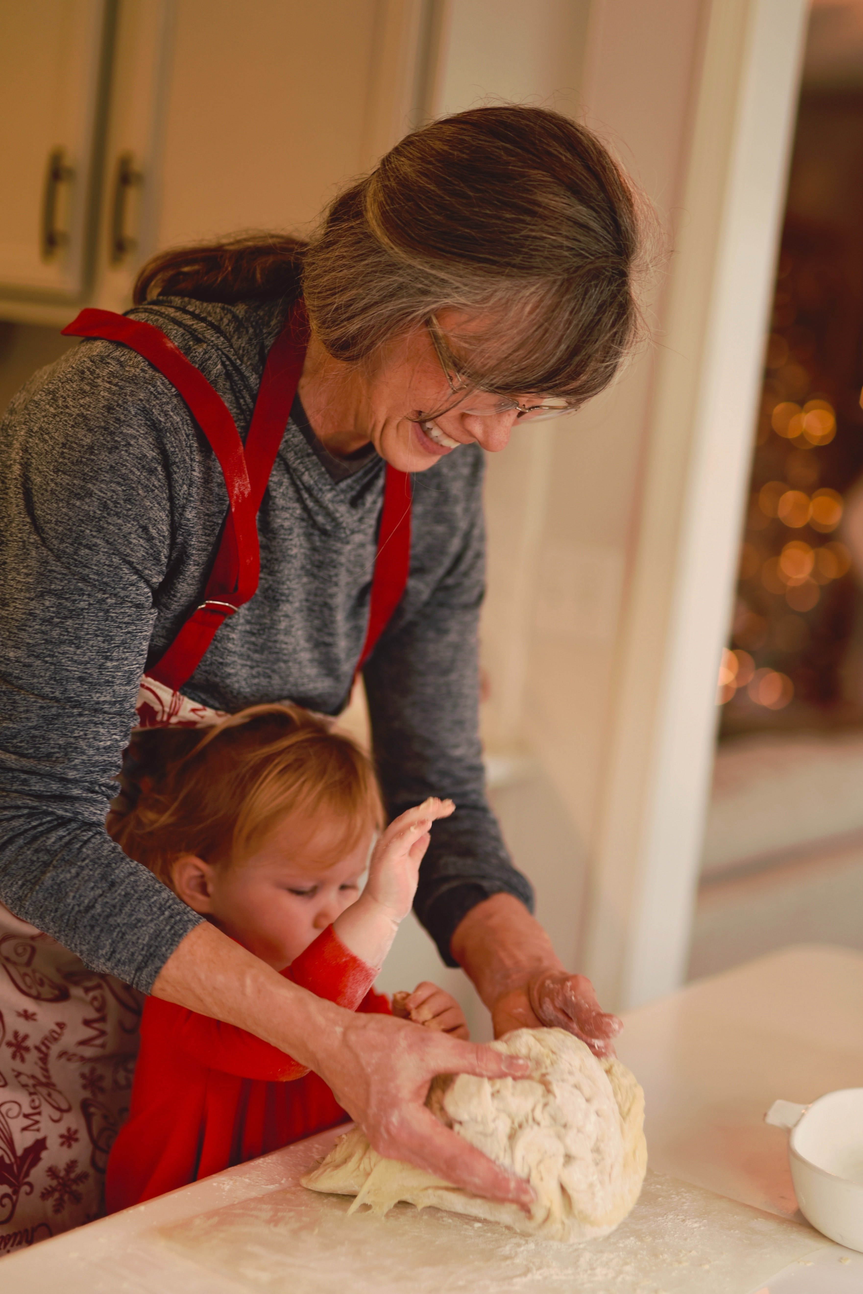
Grandparenting Today…
“…significantly longer life expectancies now project you will live over 30% of your life as a grandparent and up to 20% of your life as a great-grandparent” (Grands Matter, p. A10).

Slide 5

How Grandparents Describe Their Role…
My job is to spoil my grandchild.
I want to give them all the things I could not provide for my child.
I have time now to have fun with them.
I can play video or computer games with them.
I can babysit them.
I get to give them all the sweets they want and then send them back home.
I want to be the first to take them to Disneyland.

Slide 6
How Does Scripture Describe the Role of These Family Members?
Quote a Bible verse for each:
  Husband -
  Wife -
  Child -
  Grandparent –
The first 3 may come easy but we usually have to think harder about the role of grandparents!

Slide 7

Don’t skip the “AND”…
“Keep the commandments of the LORD your God…Teach them to your children AND your grandchildren.” (Deuteronomy 4: 2,9 NKJV).

Slide 8

More Biblical Direction…
“…that you may fear the Lord your God, to keep all His statutes and His commandments which I command you, you and your son and your grandson.”
Deuteronomy 6:2-9 (NKJV)

Slide 9
It’s More About SHOW Then Tell
“Grandparents teach young people social morality and give them a sense of right and wrong, a set of absolutes upon which they can build their lives. In this day of relative truth, grandchildren need models of truth and biblical morality, models that don’t change with the times. They need to see integrity consistently displayed. Creative, involved grandparents provide grandchildren a model of morality to emulate” (Schreur, J. & J., 2011).

Slide 10

Your Actions Speak Louder Than Your Words
Prayer
Personal Bible Study
Service Projects
Healthy Lifestyle
Technology Use
Marriage/Family

Slide 11
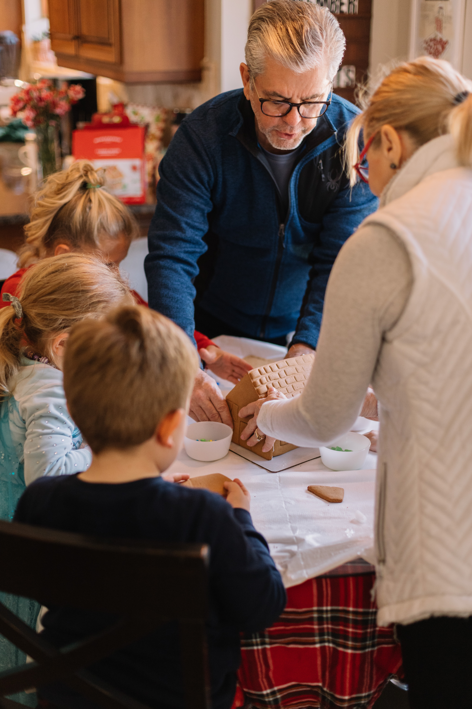
More Ways To Give Them a GRAND View
Include Them
Tell Them
Lead Them
Show Them

Slide 12

Invest Financial Resources in Ways that Matter
“Do not lay up for yourselves treasures on earth, where moth and rust destroy and where thieves break in and steal; but lay up for yourselves treasures in heaven, where neither moth nor rust destroys and where thieves do not break in and steal. For where your treasure is, there your heart will be also.” (Matthew 6:19-21, NKJV).

Slide 13
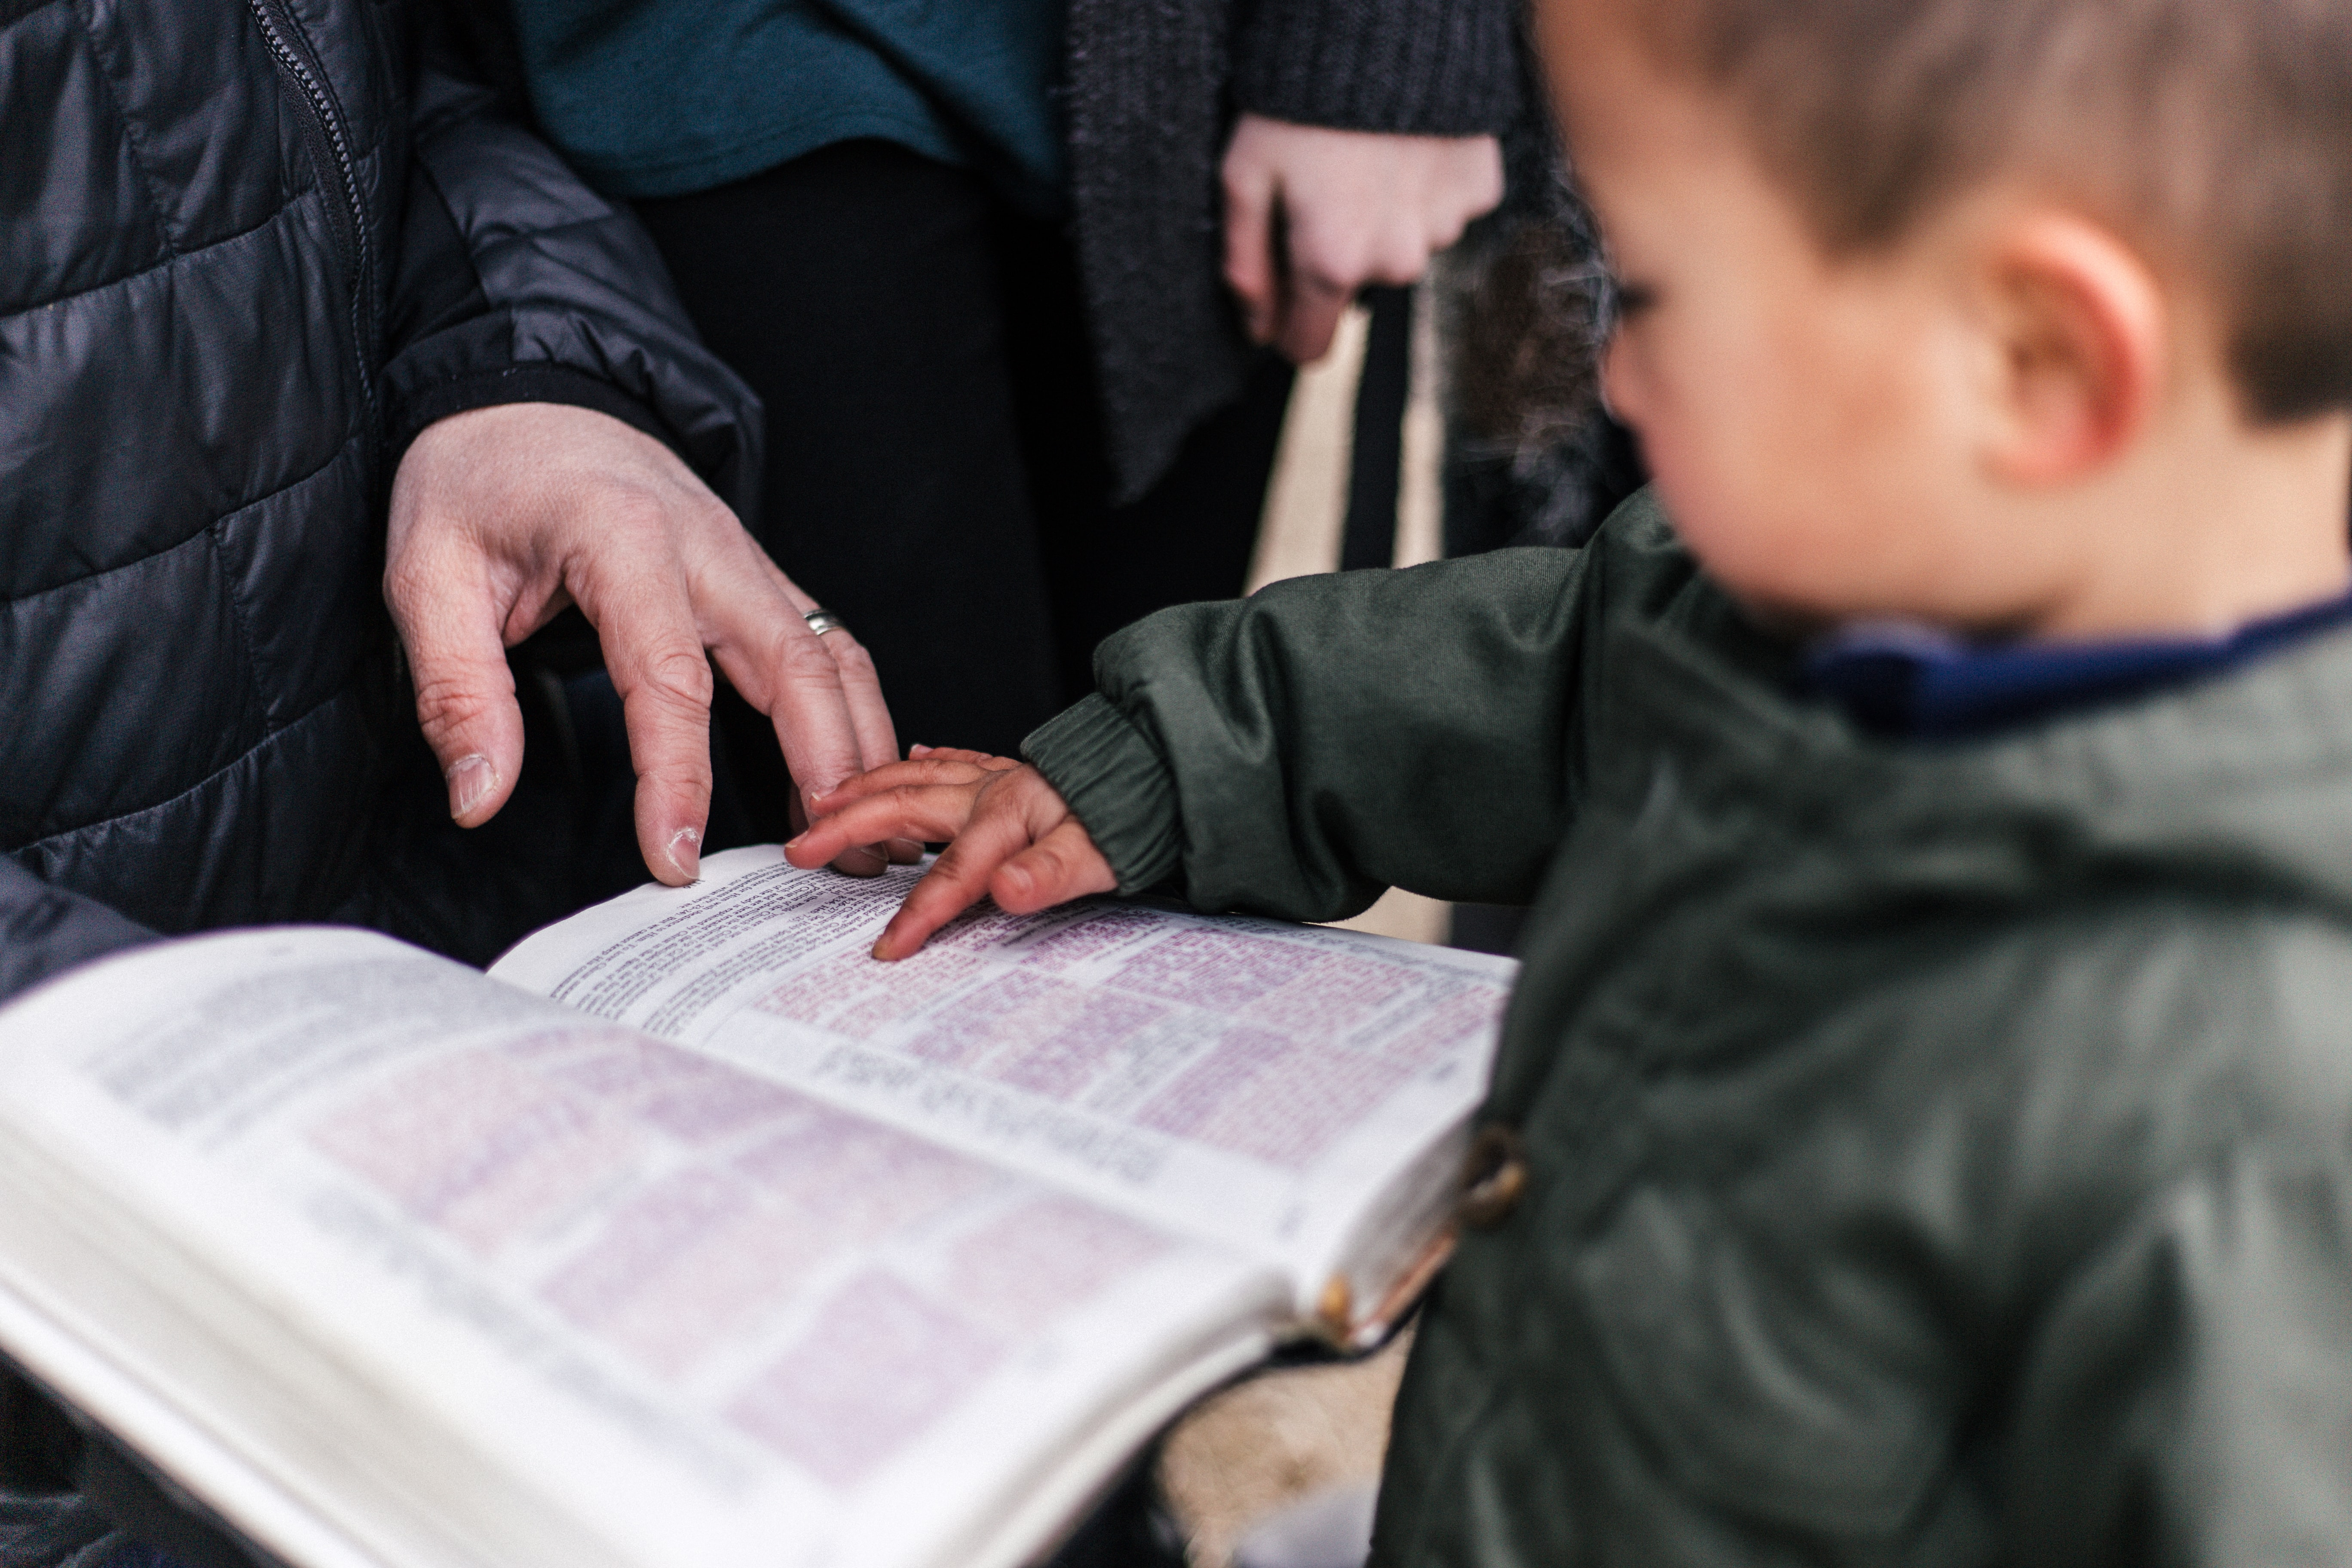
At the very heart of the role of Christian grandparenting is the gospel commission!
Don’t be so busy telling the gospel to “the whole world” that in the process, you skip over one of the most important treasures God has given you—your own grandchild. The gospel commission admonishes us to” Go and make disciples” (Matthew 28, 19).

Slide 14

Learn more…

Slide 15


