Slide 1

THE CHURCH
AS THE BODY OF CHRIST
Supporting Families in Crisis
Presented by: (add presenter’s name here)
Written by: Ann Hamel, PhD, DMin . Psychologist for the International Service Employee Support Team of the General Conference of Seventh-day Adventists . Board Certified Expert in Traumatic Stress. Fellow, American Academy of Experts in Traumatic Stress. Resides in Berrien Springs, Michigan, USA.

Slide 2

Supporting Families in Crisis
“Now you are the body of Christ
and individually members of it.”
1 Corinthians 12:27
To Ponder and Consider
What are the privileges and responsibilities that one has as a member of the church and the Body of Christ?
  THE CHURCH AS THE BODY OF CHRIST, Supporting Families in Crisis

Slide 3

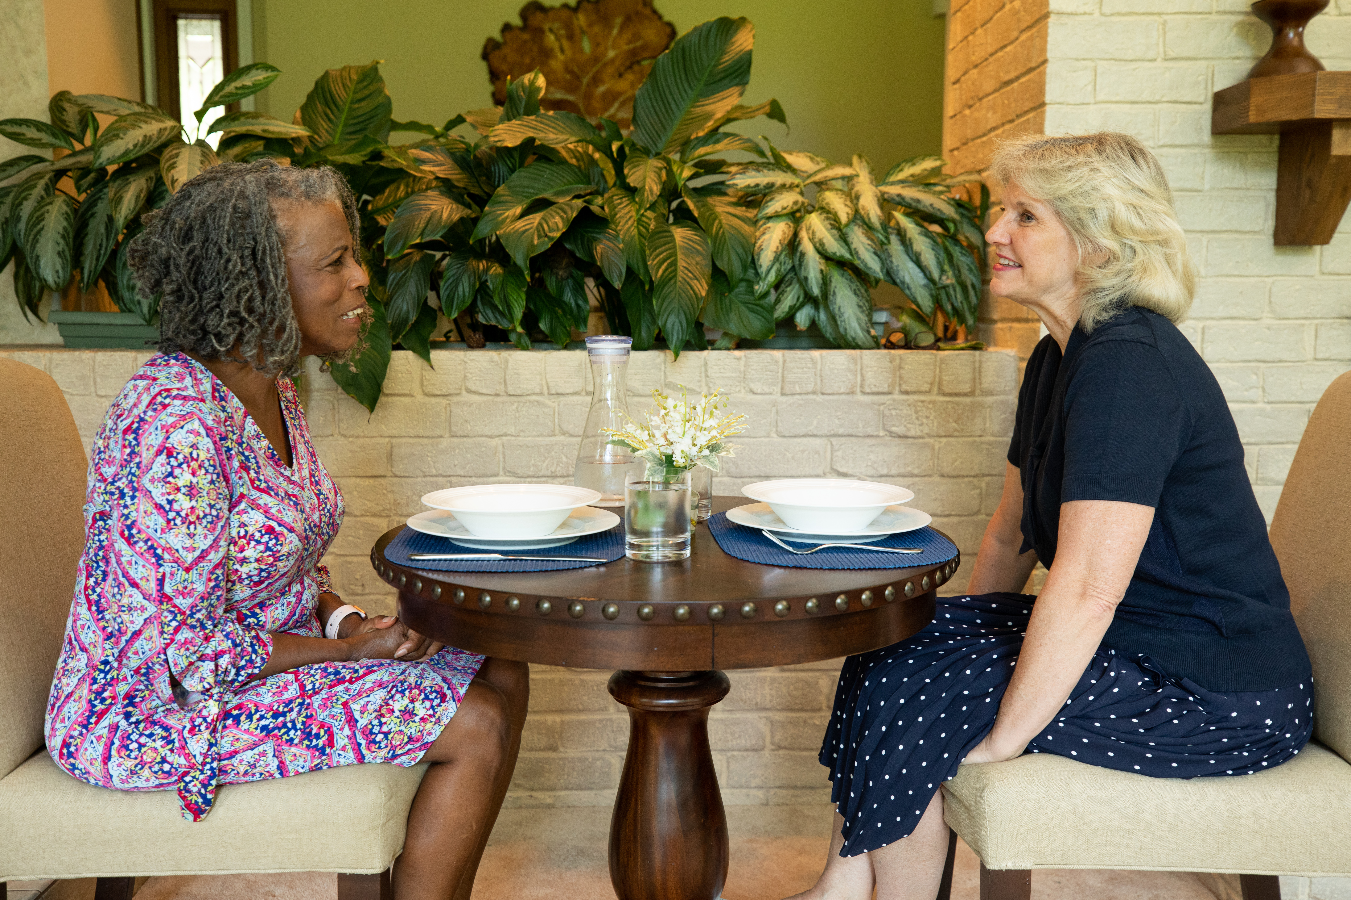
  THE CHURCH AS THE BODY OF CHRIST, Supporting Families in Crisis
THE CHURCH AS THE BODY OF CHRIST, Supporting Families in Crisis​
Notes:
Most Mondays I have lunch with a dear friend and colleague– that is, most Mondays that we’re both in town. Beverly is a psychiatric nurse practitioner, and I am a psychologist, and we work together in a primary care medical office as therapists. We both consider the work we do to be a ministry. While we use the skills of our professions in our effort to help people, our goal is to bring hurting individuals into the presence of Jesus, the ultimate source of all healing.
Neither Beverly nor I work full-time at the medical center. Beverly and her husband David, do seminars all over the country where they bring groups of people into the healing presence of Jesus. I work eighty percent time for the General Conference providing mental health care and crisis intervention for the missionaries.
I first began working at the medical center after completing a master’s in Community Mental Health Counseling in 1994. Four years prior to that, I had returned to the United States from mission service in Africa. My husband and I had received a call to serve as missionaries during my senior year in college. The weekend I graduated, we were packing for Africa. We left the states on our second wedding anniversary and spent the next three years in Bujumbura, the capital of Burundi’s small central African country. Our first son was born during our time there. We were then asked to move to the neighboring country of Rwanda to help with the building and development of the Adventist University of Central Africa. Over the next eight years we were able to open the doors of the university to its first students, see them graduate, and take roles within the church across Africa. During this same period of time, we were blessed to have two more sons.
My interest in the field of psychology is the result of my own personal experience as a missionary. In 1990, my husband, our three sons and I were returning to our home in Rwanda when we had a head-on-collision with a truck. Four days later, I awakened in a hospital bed in Belgium, not knowing where I was or how I’d gotten there. I learned that my husband been killed instantly and had already been buried in Rwanda. I also learned that my six- and eight-year-old sons were the only two family members at their father’s funeral. My three-year-old son, Andrew, was four floors above me in the pediatrics unit. His skull was fractured, his leg was crushed, and two toes were missing. He was still unconscious. After spending two weeks in the hospital in Belgium, Andrew and I were transferred to a hospital in the United States, where we remained in the hospital for two more weeks.
Returning to the United States was not easy. I had a college degree, but I had never held a full-time job. I had no idea where I would live or how I would manage life in the United States as a widow and single mother of three growing and active boys. The challenges ahead of me seemed overwhelming.
Psychologists who specialize in the treatment of trauma understand how vital an individual’s support system is in making a successful recovery from the impact of trauma. Missionaries are particularly vulnerable to the impact of trauma because they leave their social support systems behind and it takes time and effort to build a new support system. Many individuals today lack strong social support systems even in their homelands. That was certainly my case.

Slide 4
Supporting Families in Crisis
Discussion:
Has there been a time in your life when you needed support? What kind of support did you need? Who provided what you needed? What did you find helpful?
If you have not found yourself in a position where you needed support, do you know anyone who has faced a crisis and has needed support to face that crisis?
  THE CHURCH AS THE BODY OF CHRIST, Supporting Families in Crisis

Slide 5
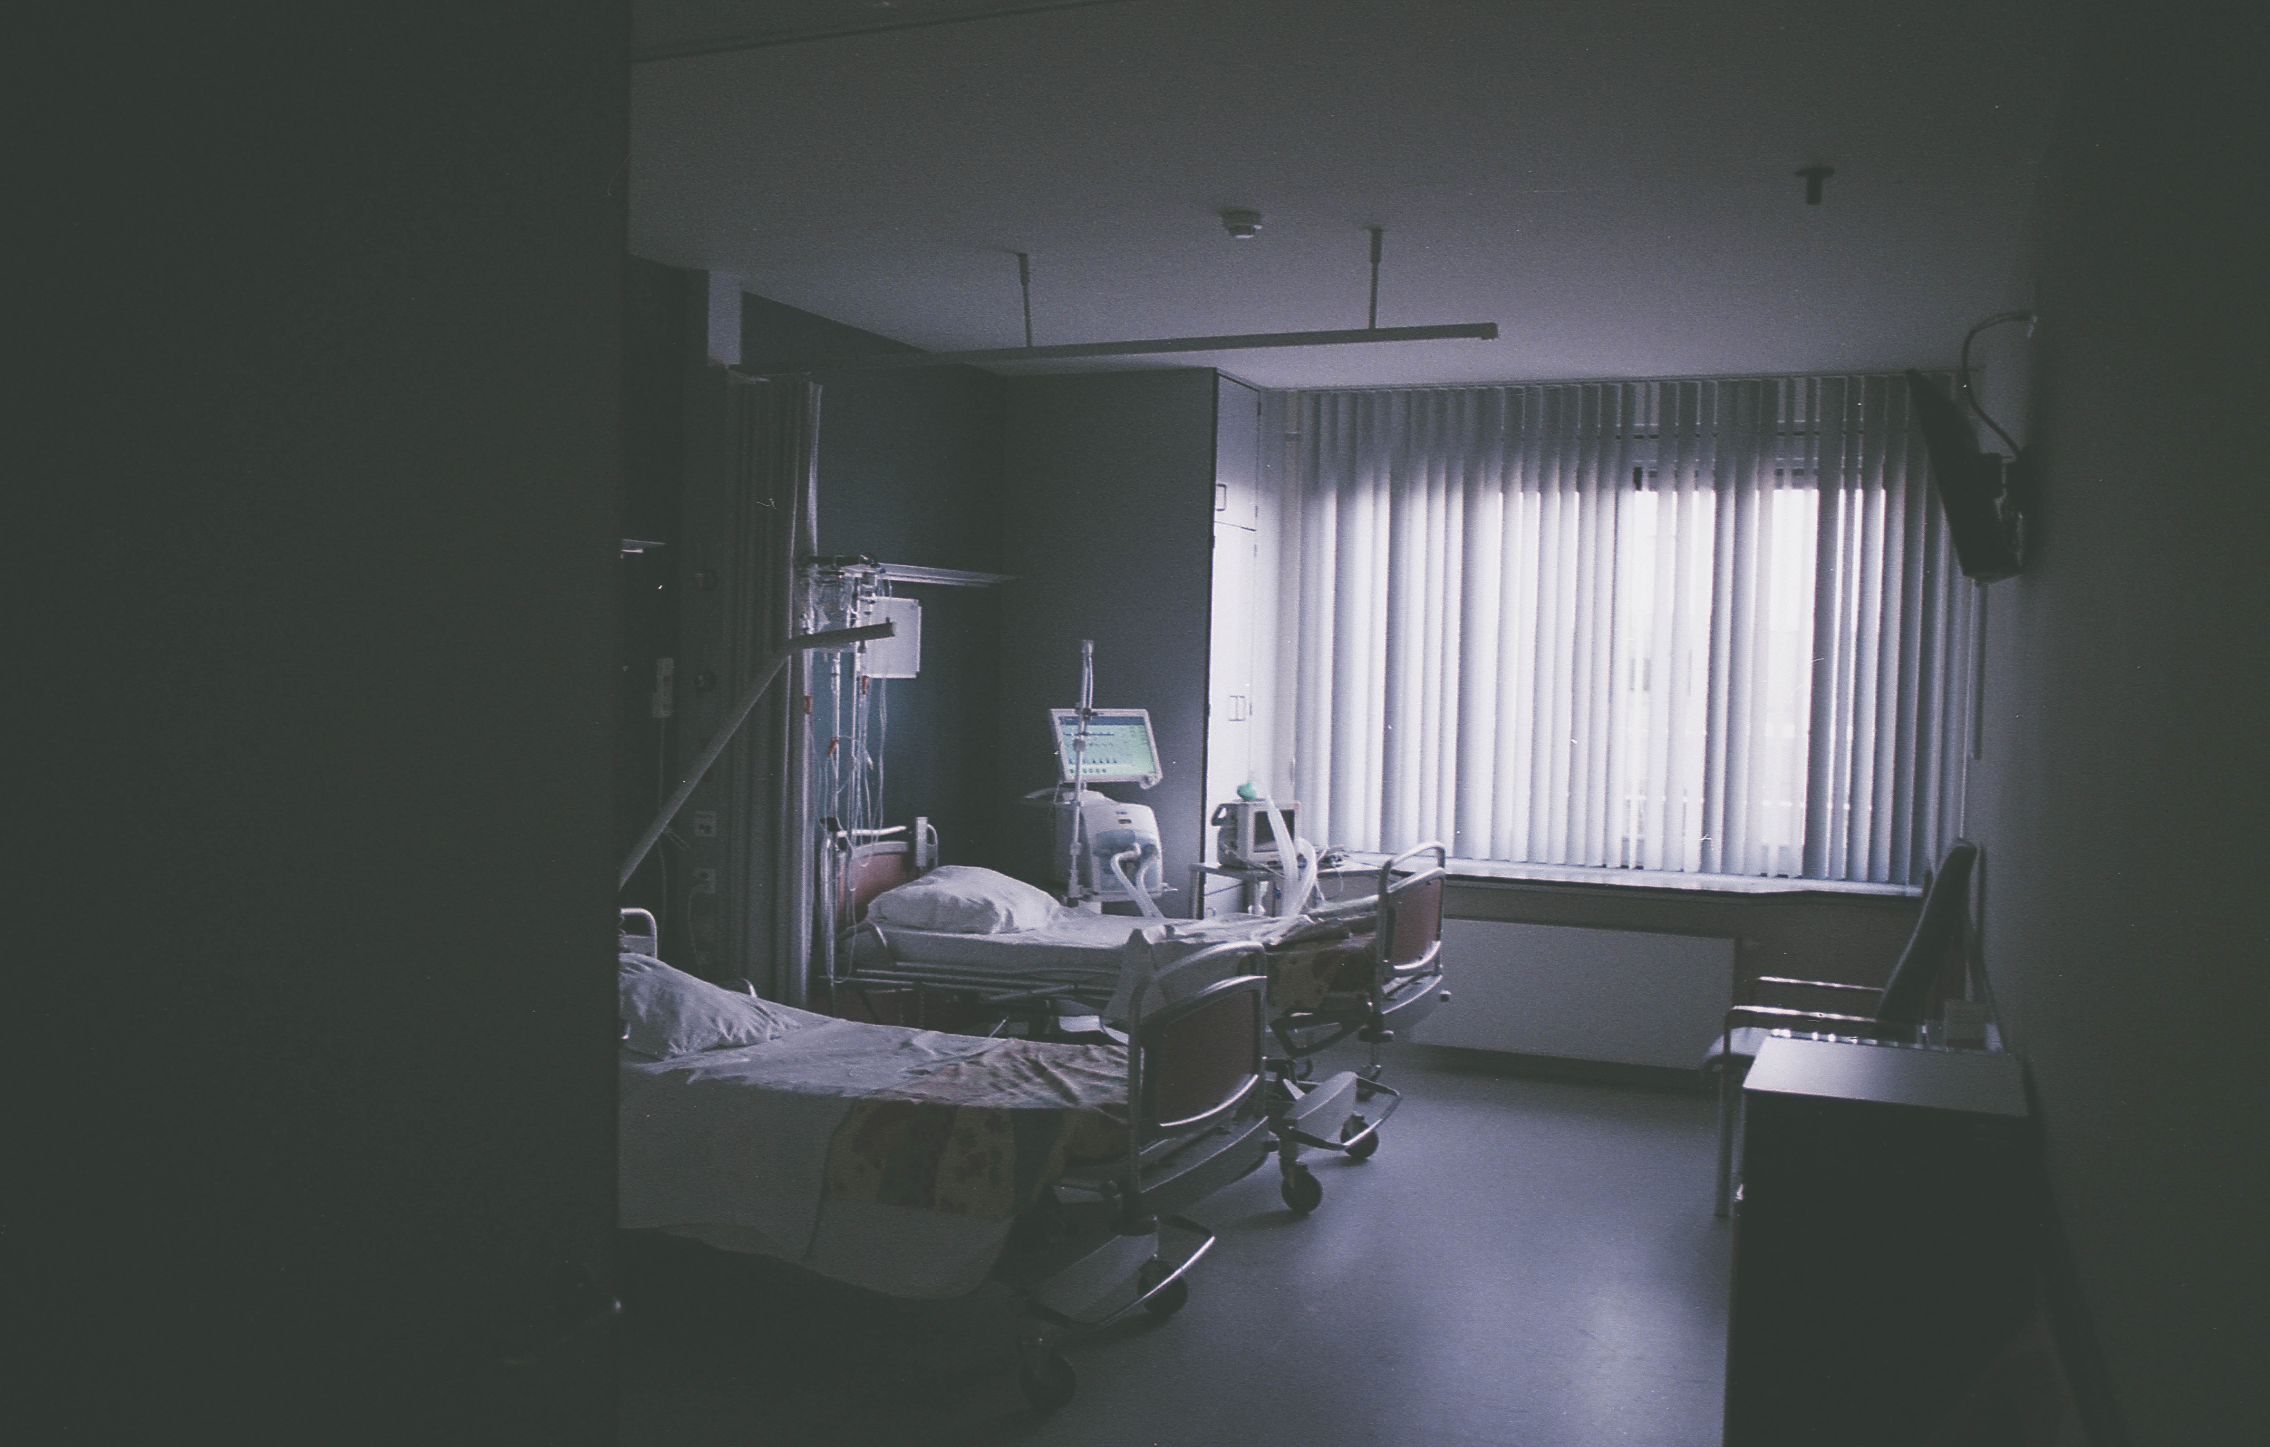
Supporting Families in Crisis
THE CHURCH AS THE BODY OF CHRIST, Supporting Families in Crisis​​
Notes:
The concern that most occupied my thoughts and prayers during the month that I spent in the hospital was related to where I would live once I got out. There was no obvious answer to that question. At the time of our return to the United States, my mother was in the beginning stages of Alzheimer’s, and my father had developed a serious drinking problem. My in-laws were serving as missionaries themselves and would return to their mission assignment shortly after our release from the hospital. Once I was out of the hospital, I knew it would still be weeks before I could physically care for myself and my sons. Just like God provided oil for the widow of Zarephath, a place of safety for Martin Luther, and an upper room for Jesus and his disciples to share the Passover meal, he provided a place for my sons and me to live and someone to care for us until I was able to do so. While still in the hospital, a friend called and offered to have us come and live with her and her family.
Spending our first two months in my friend’s home after being released from the hospital was ideal. My friend taught in a one-room church school. My sons were able to ride to school with her every morning and come back with her every afternoon. We ate our meals together every day. My husband’s brother and his wife lived nearby so they would pick us up on the weekends. God provided a safe place for us to begin to heal. After I had recovered enough so that I was able to take care of myself and my sons, I began to pray about where I should set up a home for my boys and myself.

Slide 6
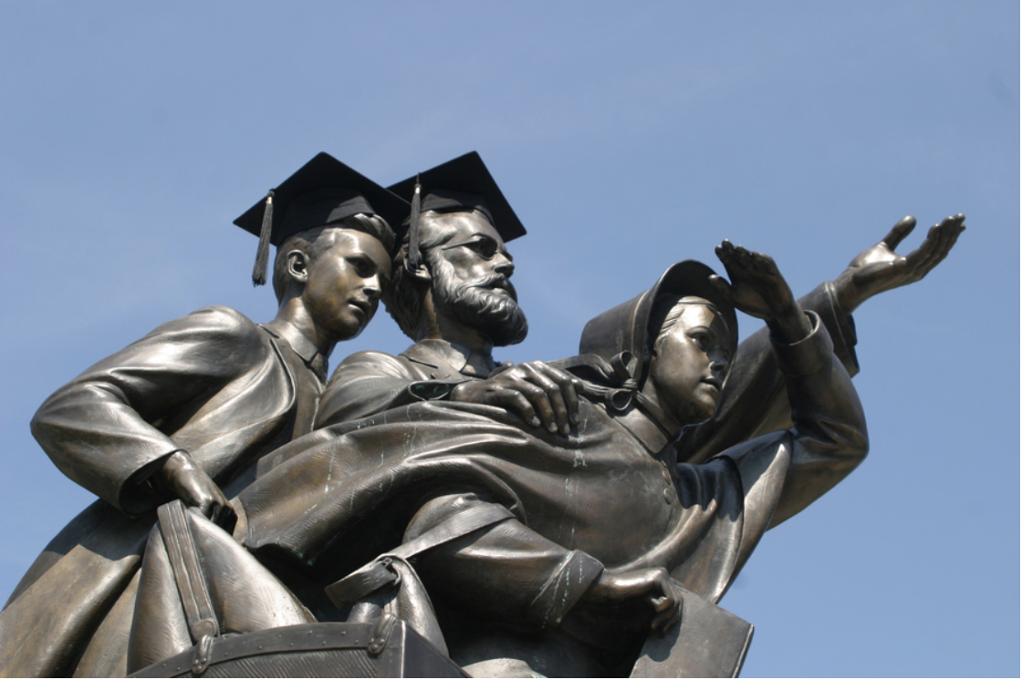
Supporting Families in Crisis
**Picture of JN Andrews statue here
THE CHURCH AS THE BODY OF CHRIST, Supporting Families in Crisis​​
Notes:
Andrews University is named after the first Seventh-day Adventist missionary. The Seventh-day Adventist Institute of World Mission was located on the campus of Andrews University for many years. This is where my husband and I attended mission institute (our pre-mission field training seminar). The members of Pioneer Memorial Church on the campus of Andrews University prayed for our family when they heard the news of what had happened. After weeks of asking God for a sign and seeking His guidance, I called the principle of the elementary school there and talked to her about my concern for my son’s adjustment in light of what they had experienced. My heart was touched when this woman, whom I had never met, told me that she had been praying for my boys and me since she first heard about our accident.

Slide 7
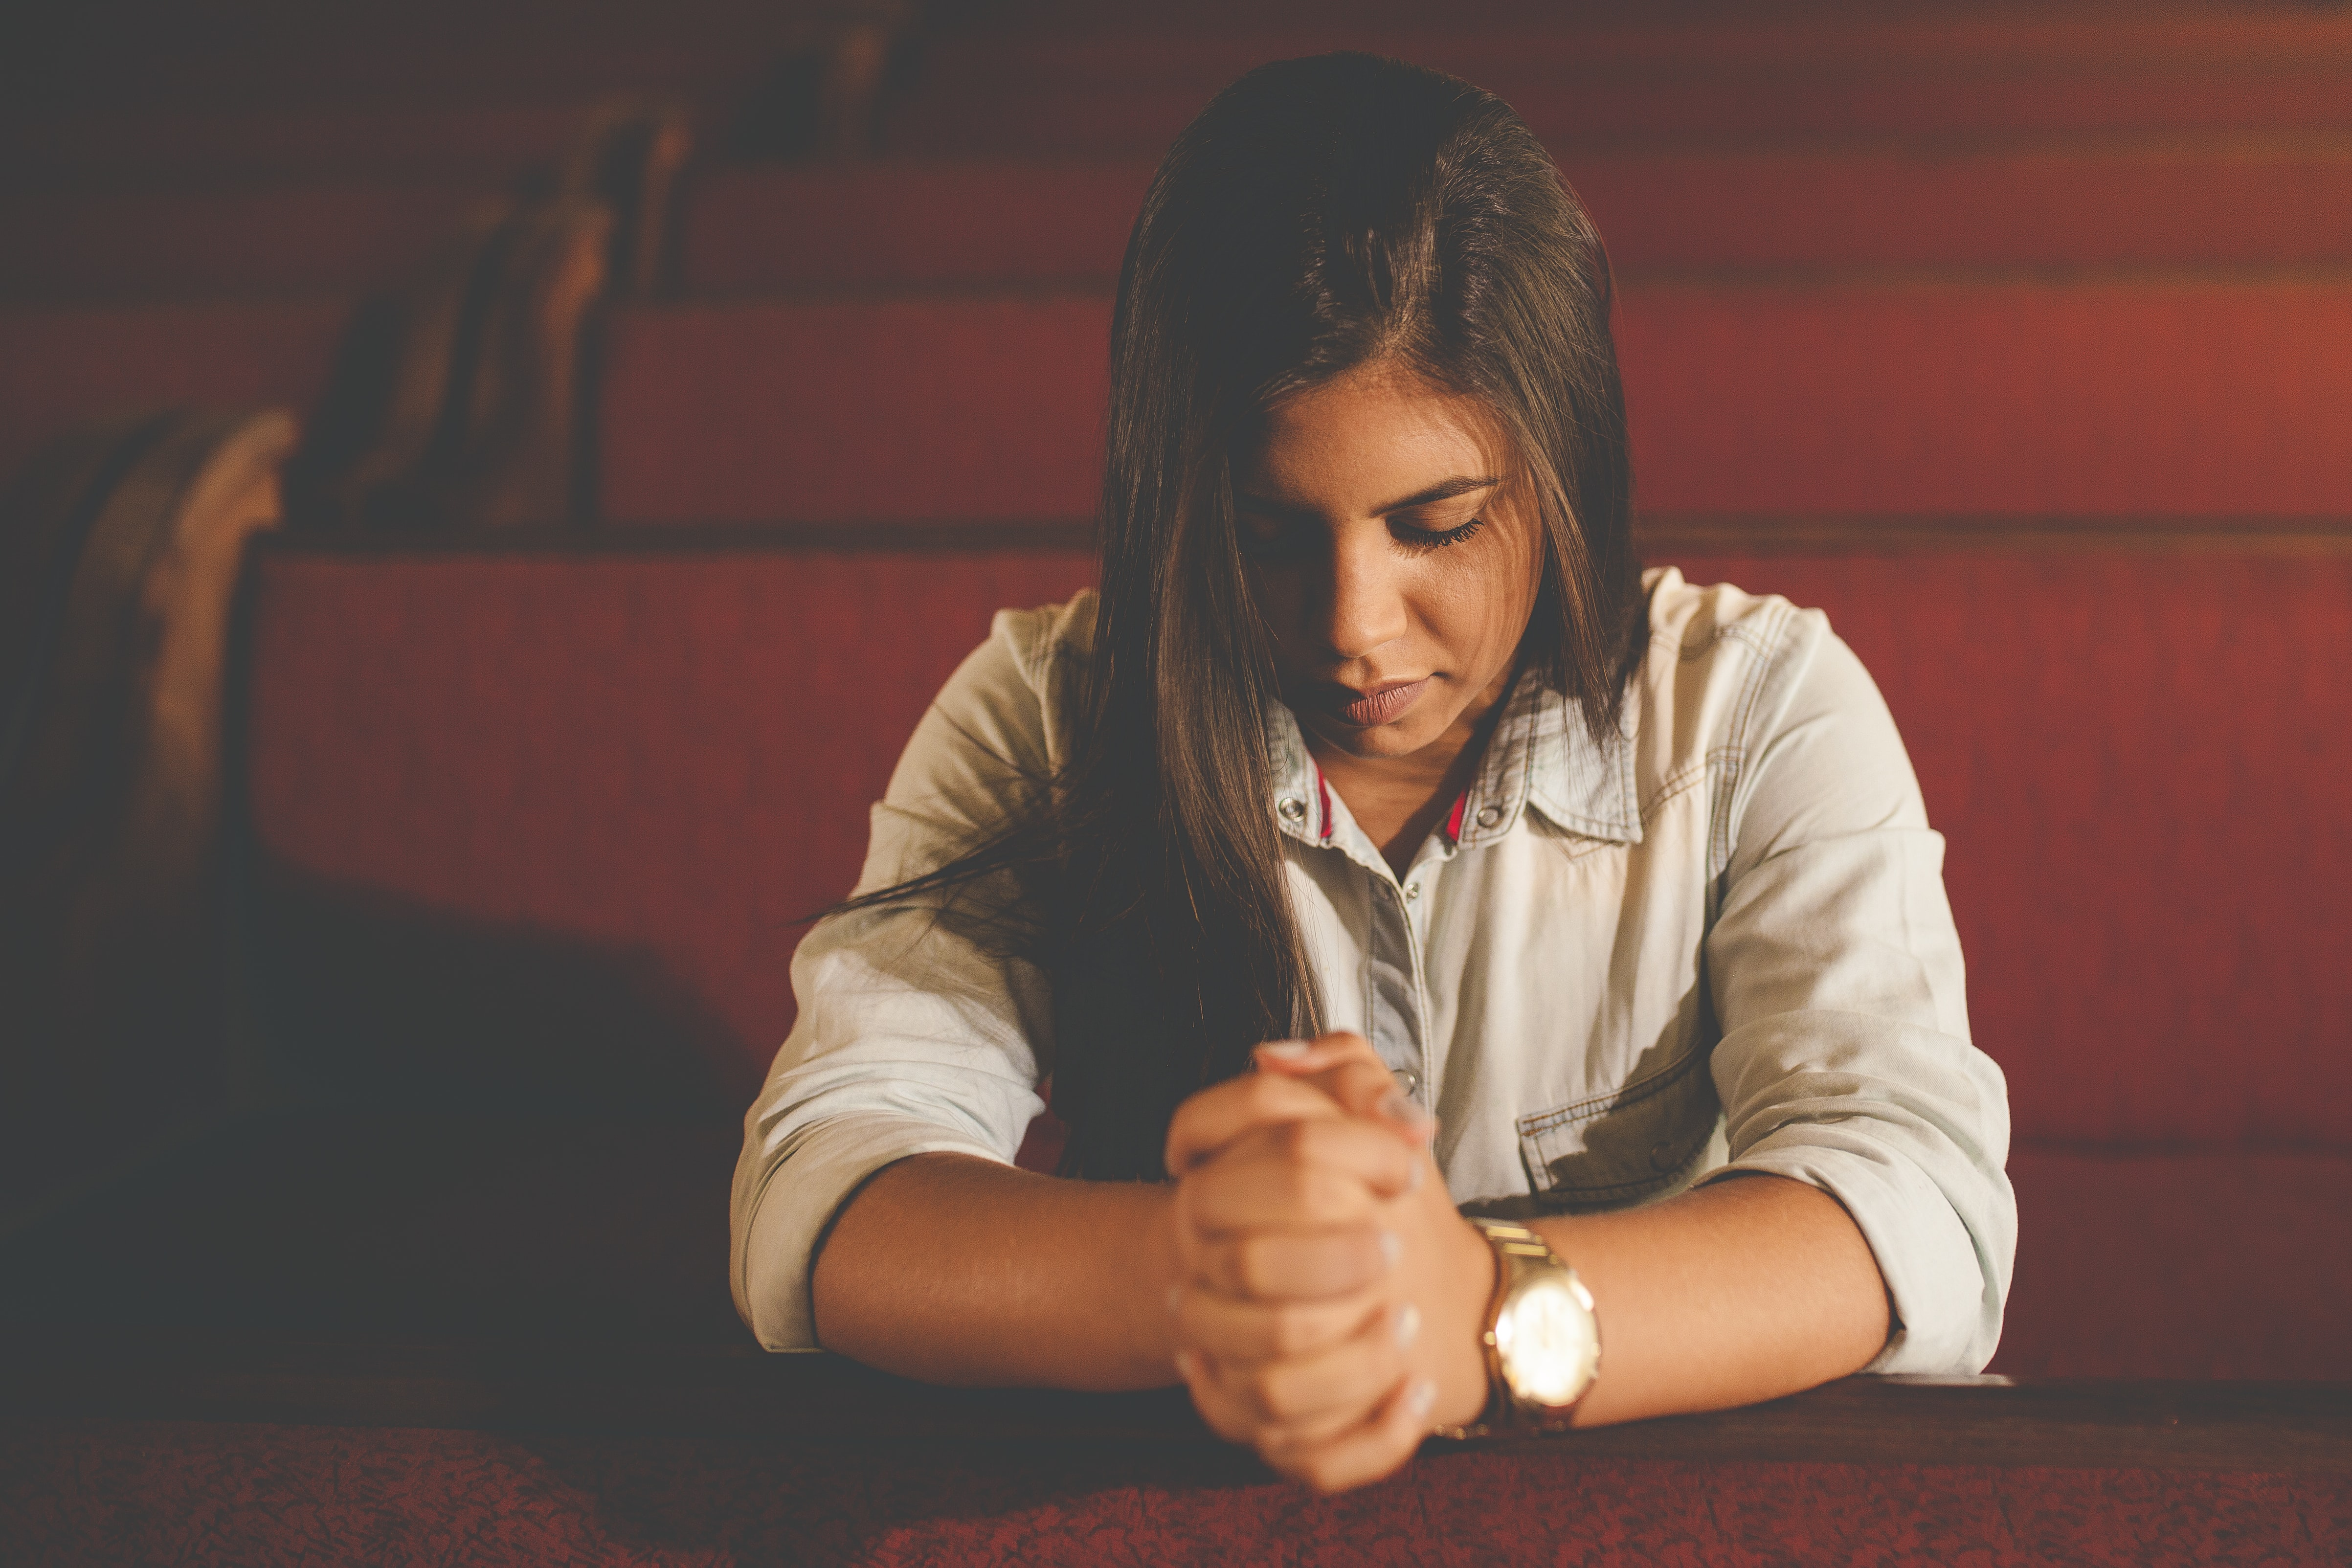
Supporting Families in Crisis
**Picture of someone praying or praying hands here
THE CHURCH AS THE BODY OF CHRIST, Supporting Families in Crisis​​
Notes:
This woman’s prayers were a big factor in my decision to move to Andrews University. I was deeply touched that a stranger hundreds of miles away was praying for us. I made the long trip to Berrien Springs because I believed that I would find a loving Christian community where my sons and I could become a part. When we arrived in Berrien Springs, my heart was overwhelmed when I walked into the apartment and found each of our beds made, dishes and food in the cupboards, even Bible Story books on the bookshelves, as well as fresh food in the refrigerator. We came from Africa with suitcases that someone else had packed for us. I moved to Berrien Springs with nothing to set up a home with. Members of the Pioneer Memorial Church and the School of Education at Andrews University furnished our apartment. God had, through these loving and generous people, provided everything that we needed. There were even stuffed animals on my sons’ beds and winter coats in the closet.

Slide 8
Supporting Families in Crisis
Discussion:
How is your church providing for the needs of the various members of your church?
As you consider the time in your life that you needed support, what role did the church play in providing that support?
  THE CHURCH AS THE BODY OF CHRIST, Supporting Families in Crisis

Slide 9
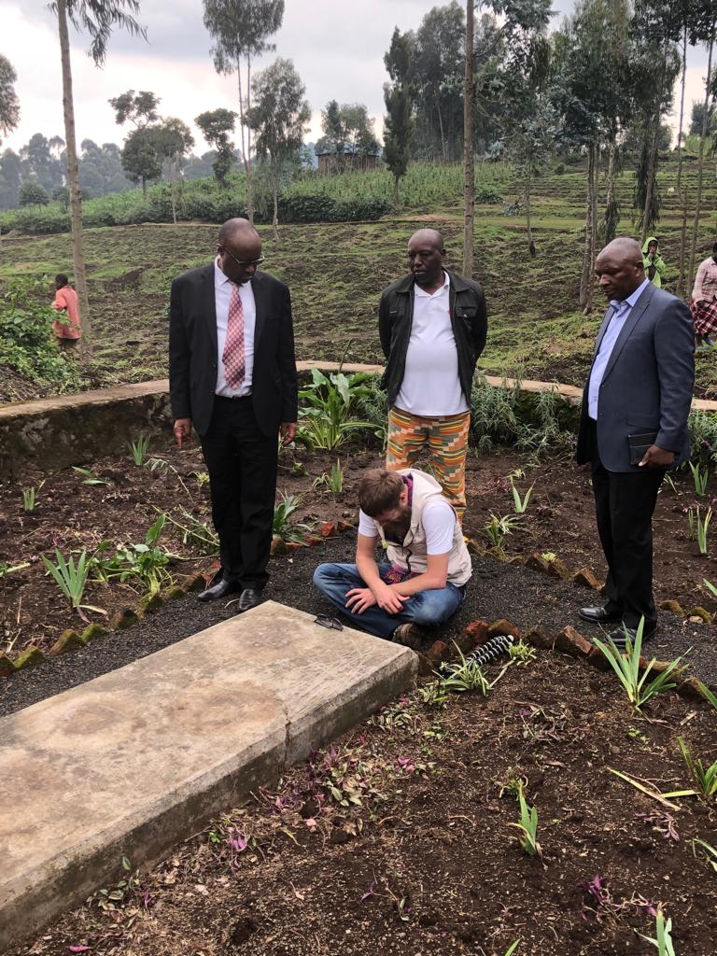
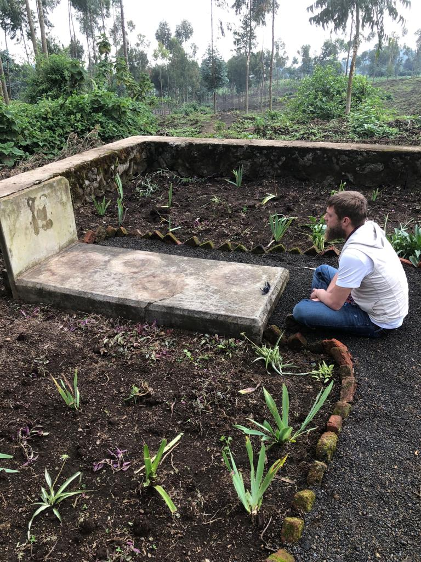
Supporting
Families in Crisis
THE CHURCH AS THE BODY OF CHRIST, Supporting Families in Crisis​​
Notes:
As Beverly and I were having lunch I shared with her that my oldest son would be leaving that week to go back to Rwanda to visit his father’s grave. The East Central Africa Division was building a medical school in Rwanda and planned to name the main academic building after my late husband. Paul felt that he still had unresolved grief that he needed to process before he could freely share in the celebration of naming a building after his father. I shared with Beverly that I had posted on Facebook that he would be going and had asked for prayers on his behalf. Paul was eight-years old when his father was killed in Rwanda. He was not in the car with us at the time of the accident but was in a friend’s car just ahead of us. Paul has vivid memories of coming back to the accident site and finding his father dead behind the wheel of the car. He remembers searching in and around the car for his little brother’s toes. He remembers the small African hospital that we had been transported to. He remembers the screams and blood and twisted metal of our family car.

Slide 10
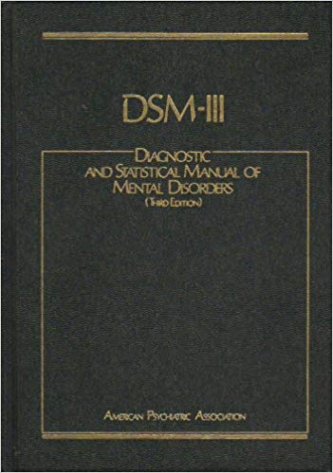
Supporting Families in Crisis
“…an event outside the range of usual human experience.”
  THE CHURCH AS THE BODY OF CHRIST, Supporting Families in Crisis
Notes:
In the 3rd edition of the diagnostic and statistical manual of mental disorders, the manual used by mental health professionals to diagnose mental health problems, trauma was defined as an event outside the range of usual human experience. A tragic motor vehicle accident fits that definition. Fortunately, most of us will never be in a serious motor vehicle accident so in that sense it is outside the range of usual human experience. Yet according to the World Health Organization, motor vehicle accidents cause close to 1.3 million deaths worldwide each year. That means someone is killed somewhere in the world every 25 seconds due to a motor vehicle accident.

Slide 11
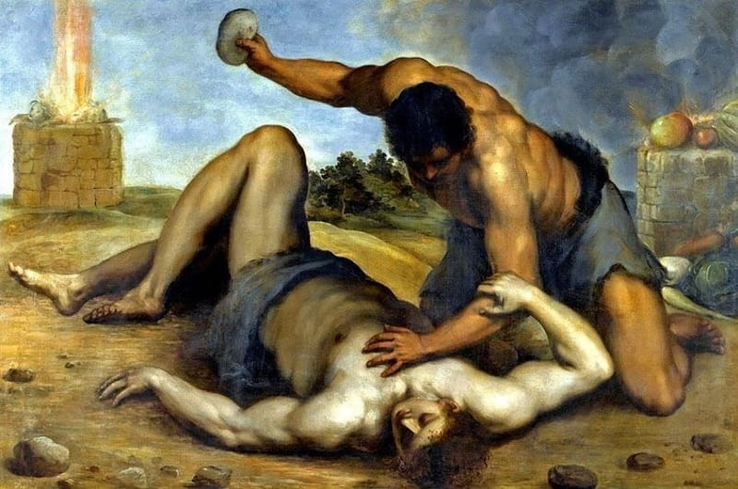
Supporting Families in Crisis
Supporting Families in Crisis
  THE CHURCH AS THE BODY OF CHRIST, Supporting Families in Crisis
Notes:
Unfortunately, trauma is pervasive in the world we live in, and has been throughout history. The risk of exposure to trauma has been a part of the human condition since Cain murdered Abel.

Slide 12
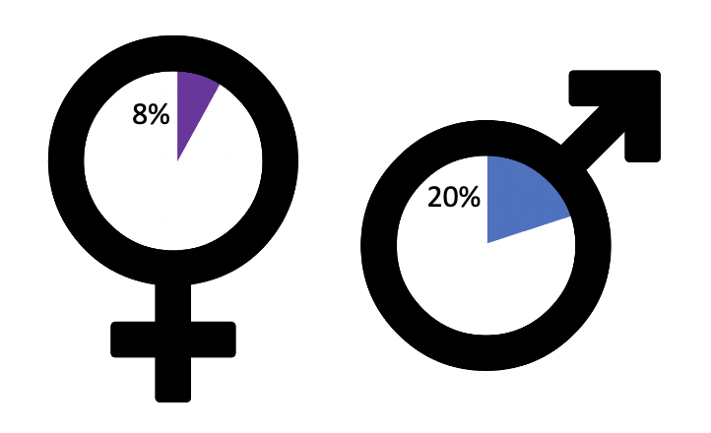
Supporting Families in Crisis
Prevalence of PTSD in those with trauma
  THE CHURCH AS THE BODY OF CHRIST, Supporting Families in Crisis
Notes:
Research has shown that of those who have experienced a traumatic event, 20% of women and 8% of men will develop PTSD, with 30% of those going on to develop life-long symptoms. That is only 6% of women and 2.4% of men who go on to develop life-long problems.
While human beings are amazingly resilient, and the vast majority of people are able to recover emotionally and psychologically when they experience traumatic events, not everyone does. Children are the most vulnerable when it comes to the impact of trauma.
Research has documented the impact of childhood trauma on later life functioning. Strong, frequent or prolonged activation of a child’s stress response system, particularly in the absence of a supportive adult, can interfere with healthy brain development and increase the risks of developing physical and mental health problems later in life. It also increases the risks of academic and behavioral problems in school aged children as well as occupational, legal, financial, relational, and substance abuse problems in adults.

Slide 13

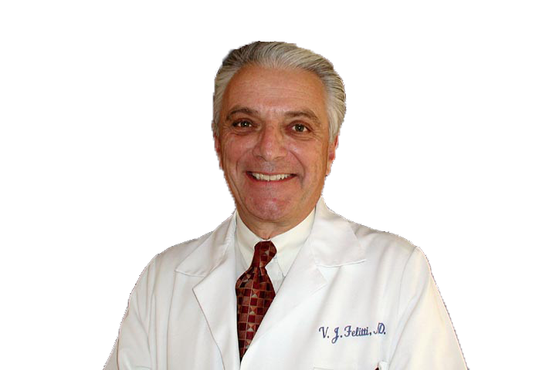
Supporting Families in Crisis
A dverse
C hildhood
E xperiences
Vincent Felitti, MD
  THE CHURCH AS THE BODY OF CHRIST, Supporting Families in Crisis
Notes:
Until the work of Dr. Vincent Felitti, the mental health field had no idea of the extent of childhood trauma; it’s pervasive in our society or its impact on brain development.
Between 1995 and 1997, the largest investigation of childhood abuse and neglect and later-life health and well-being ever done was conducted in the United States. More than 17,000 people completed surveys regarding their childhood experiences and their current health status and life-style behaviors.

Slide 14
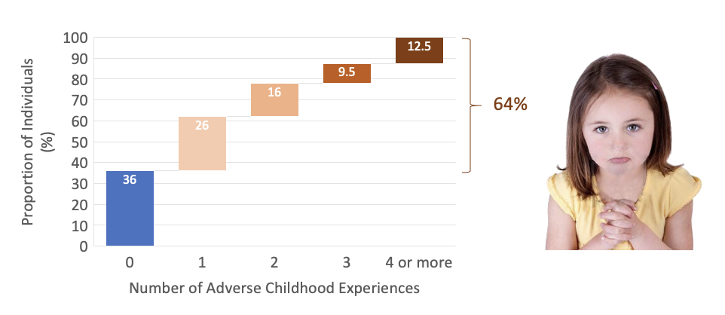
Supporting Families in Crisis
Prevalence of Adverse Childhood Experiences
  THE CHURCH AS THE BODY OF CHRIST, Supporting Families in Crisis

Slide 15
Supporting Families in Crisis
World
H ealth
O rganization
In addition to the impact of trauma on early brain development, the World Health Organization has identified social disruption as the greatest risk factor to mental health in people of all ages.
  THE CHURCH AS THE BODY OF CHRIST, Supporting Families in Crisis
Notes:
In addition to the impact of trauma on early brain development, the World Health Organization has identified social disruption as the greatest risk factor to mental health in people of all ages. We had lived in a close-knit missionary community on the campus of the Adventist University of Central Africa in the mountains of northwestern Rwanda. My sons had known the love and friendship of the Rwandan people as well as the love and support of other missionaries serving there with us. This gave them a very strong sense of identity and belonging. Not only did they lose their father and experience the physical and emotional trauma of a tragic motor vehicle accident, they lost their home and the community they loved and belonged to.
The journey has not been easy for any of my sons. Most returning missionaries struggle to find their place when they return to their homelands. Missionary children develop what is known as a third culture identity, not belonging fully to either their parent’s home culture or the culture of the host country. Those who are not able to find a peer group who can understand their life experiences are often left with feelings of social alienation. In a similar manner, individuals who have experienced childhood abuse frequently feel that no one can understand them and also experience feelings of social and emotional alienation. When trauma is added to a cross-cultural transition, the challenges are intensified.

Slide 16
  Supporting Families in Crisis
THE CHURCH AS THE BODY OF CHRIST, Supporting Families in Crisis
Notes:
I often share with others how these wonderful people in the little town of Berrien Springs were used by our heavenly Father to show my sons and me His love. As Beverly and I were having lunch I told her that one of the women who had helped furnish our apartment identified herself to me for the very first time after she read my Facebook post requesting prayers on behalf of Paul. She had been one of the women who had brought things and helped set up our apartment. She committed to praying for Paul. Beverly seemed puzzled and questioned me. I shared that I never known any of the people who had helped my aunt furnish our apartment. “None of them?” Beverly asked. “No, none of them.” Beverly was more than puzzled. We had arrived in Berrien Springs in late October, a week or so after Paul’s 9th birthday. I shared that at Christmas, someone had bought new sweaters for each of my sons with specific instructions to my aunt to keep their identity anonymous. I was grateful for the sweaters. They were beautiful. It was nice to have something warm and new for my sons. That first Christmas was the very worst in our lives. It felt so incredibly lonely. Beverly just looked at me. Tears began to flow down my cheeks. I had never considered any response to this story except gratitude.
Research shows that the single most important factor in recovering from a traumatic experience is social support. Beverly pointed out that what I received was material support, not social support. The tears continued to flow. I shared that I had always been grateful to be in Berrien Springs. I had felt like I was surrounded by loving and caring people. But I did acknowledge that my sons and I spent most Sabbaths alone. We never missed church or Sabbath School. Never. But each Sabbath, we came back to our little apartment and ate alone and spent most afternoons alone. Sabbath was the hardest day of the week. My depression seemed to deepen on Sabbaths. I would often have a nap because I could not bear the loneliness. My little boys were angels. They didn’t sleep, but they let me sleep. They tried to be caring and loving toward me. My tears continued to flow as Beverly and I talked. It’s still difficult to think about three active little boys in a tiny apartment in the depths of a Michigan winter with a seriously depressed mother who only minimally engaged them. How were they feeling? What emotions were they experiencing? They were good boys. They would color or draw or play with Lego. But they were also grieving. They had lost their father, their home, their friends and their way of life in Rwanda. In some sense, they had also lost their mother. But they all tried to be strong. Paul in particular. He was the oldest and he wasn’t in the car at the time of the accident. In his own childish and limited way, he tried to carry the emotional burden of our family – to be strong for all of us.

Slide 17
  Supporting Families in Crisis
Childhood Exposure | Subcategory
Abuse | Physical Verbal Sexual
THE CHURCH AS THE BODY OF CHRIST, Supporting Families in Crisis
Notes:
The ACE questionnaire asks about various types of adverse childhood experiences. The first three ask about physical, emotional and sexual abuse.

Slide 18
  Supporting Families in Crisis
Childhood Exposure | Subcategory
Abuse | Physical Verbal Sexual
Neglect | Physical Emotional
THE CHURCH AS THE BODY OF CHRIST, Supporting Families in Crisis
Notes:
Followed by physical and emotional neglect.

Slide 19
  Supporting Families in Crisis
Childhood Exposure | Subcategory
Abuse | Physical Verbal Sexual
Neglect | Physical Emotional
Household dysfunctions | Domestic violence Household substance abuse Family member in jail Household mental illness Parental separation or divorce
THE CHURCH AS THE BODY OF CHRIST, Supporting Families in Crisis
Notes:
The last five ask about various types of family dysfunction.
This scale includes stressors found commonly among the mostly college-educated, mostly white, middle-classed Americans, who were all employed and had good health insurance that the survey studied.
The scale doesn’t include the death of a parent, discrimination, bullying, poverty, community violence, war, famine, or dislocation. Nor does it include traumatic experiences caused by natural or manmade disasters or various types of accidents. Motor vehicle accidents are one of the leading causes of death in people around the world. All of these things impact the developing brain of a child.
Administer the ACE to people in the congregation
Research has shown that facing difficulties in life with the help and support of a caring adult actually builds resilience. With support, one is able to grow rather than be damaged by challenging or even traumatic experiences. One of the challenges of growing up in a single parent home is that many single parents struggle to find the time and energy they need to provide the support and nurture their children need. Many single parents lack a strong family support system or supportive community to help them raise their children. In Africa there is a saying that it takes a village to raise a child. Cultures that are group and family oriented are more likely to provide the support and care a child needs when a parent dies or is absent from the home. Rarely are children able to get the support and care they need from one adult alone.

Slide 20
Supporting Families in Crisis
Discussion:
As you consider the challenging experiences of your childhood, was there someone in your life that you could depend on to help you cope with what was happening? Share who that was and how their support helped you.
  THE CHURCH AS THE BODY OF CHRIST, Supporting Families in Crisis

Slide 21
  Supporting Families in Crisis
THE CHURCH AS THE BODY OF CHRIST, Supporting Families in Crisis
Notes:
In answer to my prayers, I believed God provided a place for us to live on the campus of Andrews University. Our neighbors were mostly international students, so my sons felt at home among them and were able to make friends quickly. Nonetheless, becoming a part of the community took a long time. I struggled as a single parent. I was deeply depressed, incapable of reaching out to others and making friends. Although I clung to God, I didn’t understand what He was doing or what His plans were for my life. Six months after our accident, I enrolled in my first class toward a doctoral degree in counseling psychology. Taking one class at a time, I began focusing on school and parenting. I also saw a Christian psychologist weekly for almost two years.
The five years that I spent as a single parent were very challenging for my sons and me. We were all grieving the death of my husband and their father and the loss of the community that we had belonged to at the same time that we were also trying to adapt to a new life in the United States. My sons did this without adult support other than what I was able to provide as a severely depressed and grieving mother. Becoming a part of a large university church had both benefits and risks. I deeply appreciated the student pastor in the seminary who took a personal interest in my oldest son and his group of friends. He was willing to spend time with them and mentor them in their walk with Christ. But as is true of any student population, this young seminary student graduated and moved away.
Three years after our accident, God brought a Christ-centered man into my life, a single father of four children. Recognizing the challenges of blending seven children into one family, I choose marital satisfaction within a remarried family as the topic of my doctoral dissertation. Two years later, after completing all the classes toward my doctorate, we married and blended our seven children into a family of nine. In spite of the challenges, my husband and I both believed that we could parent our children better together than either of us could alone. We were both committed to being the best parents we could be to all seven of our children. Nonetheless, probably none of them felt they got all the attention they wanted or needed.

Slide 22
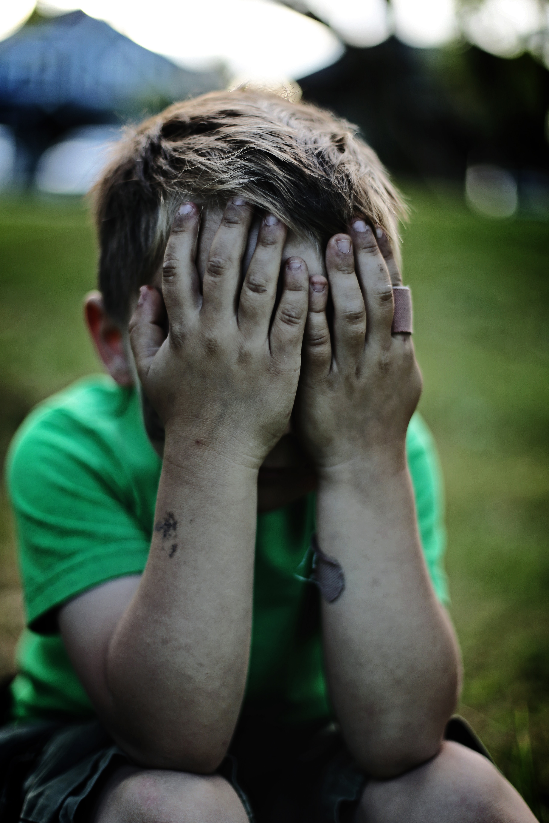
  Supporting Families in Crisis
  Children are adaptable and resilient
THE CHURCH AS THE BODY OF CHRIST, Supporting Families in Crisis
Notes:
Generally speaking, children are adaptable and resilient. They are born with an inherent capacity to deal with the inevitable challenges of life. Their stress response system develops and matures as attentive adults provide support and care for them as they face these challenges. As a mother soothes her distressed infant, the child’s developing brain learns the process of self-regulation. As children face the increasing challenges of maturation with the support of a caring adult, their capacity to deal with challenges increases and they become increasingly resilient. When psychological trauma overwhelms the child’s underdeveloped stress response system, it damages the developing brain, limiting the child’s ability to deal with stress.

Slide 23

  Supporting Families in Crisis
Academic and learning problems
THE CHURCH AS THE BODY OF CHRIST, Supporting Families in Crisis
Notes:
The effects of childhood trauma first become evident in school. More than half of those with ACE scores of four or higher reported having learning or behavioral problems, compared with 3% of those with a score of 0.
Some families are not healthy or functional enough to provide appropriate support to their children. The ACE research has shown that many children are being raised in dysfunctional households that are abusive, neglectful, or both. Many children are growing up in single-parent homes, and many of these homes lack support from other caring adults.
The teenage years are particularly difficult. They are a time of transition and change, even for healthy and well-adjusted teens. Many experience a wide range of strong and often confusing emotions. If there is unprocessed or repressed pain from the past, it often surfaces during the teenage years. Each of my sons experienced this, and one after the other, they began to act out their pain. Even though I was a practicing psychologist, I failed to recognize the imprint of their childhood trauma in their behavior. After all, I would say to myself; God has restored our lives. He has given us a new family and home and a new sense of belonging. My husband had embraced my sons as his own and loved them with as only a father could. In my own life I believed it was wrong to use the pain of the past as an excuse for poor choices or behaviors in the present. It was not until the results of the Adverse Childhood Experiences study were published in 1998 that professionals began to understand the impact of early childhood trauma on brain development. It was many years later before this information became commonly understood and professionals understood the link between adverse childhood experiences and the later life functioning. Due to the teenager’s natural desire to experiment, this is a period of time when many engage in various high-risk behaviors, including, for many, mood-altering substances. Those who have experienced trauma and adversity in childhood begin to use these substances to help regulate their emotions and are therefore at a far higher risk of becoming addicted.

Slide 24

Supporting Families in Crisis
High risk behaviors and addiction
  THE CHURCH AS THE BODY OF CHRIST, Supporting Families in Crisis
Notes:
The greater the mobility within any culture the greater the likelihood that children will grow up without adult support other than their parents. Mobility and social disruption go hand in hand, a risk factor that has been identified by the World Health Organization. Social support is essential to the health and well-being of every human being. Reliable and available adult support serve as a protective factor as children face the inevitable challenges of growing up. It takes time and intentional effort for families who are new to a community to build a support system that they can access in times of need. Many children do not have regular enough contact with grandparents, aunts, uncles, or other caring adults to develop a trusting and supportive relationship with them. Cultures that have the greatest mobility are also the cultures that have the greatest number of people living alone. Living alone was uncommon a century ago but has become increasingly common in many wealthy countries around the world today. The number has more than doubled in the US in the last 50 years. This reality presents new challenges to the church to truly function as the family of God and the body of Christ and to provide support for its members. That need is the most evident during times of crisis.

Slide 25
Supporting Families in Crisis
Discussion:
What support does your church offer to single people in your congregation, families with children, as well as couples who are in transition or in crisis? Does your church have programs available to mentor and support teenagers and young people in your church? Do you personally take an interest in the well-being of the children in your congregation?
Church members often call each other brother and sister. How can we take that role more seriously? Are we willing to take the role of aunt and uncle, grandma and grandpa to the children and teenagers among us?
  THE CHURCH AS THE BODY OF CHRIST, Supporting Families in Crisis

Slide 26
Supporting Families in Crisis
References
Mueller, E., & De Souza, E. B. (2015).
Marriage: Biblical and Theological Aspects (E. Mueller & E. B. De Souza Eds.
Vol. 1). Silver Spring, MD: Review and Herald.
Oliver, W., & Oliver, E. (2018). Hope for Today’s Families. Silver Spring, MD: Review and Herald.
Stanley, S. M., Trathen, D., McCain, S., & Bryan, B. M. (2013). A Lasting Promise: Christian Guide to Fighting for Your Marriage: John Wiley & Sons.
White, E.G. (2003). Adventist Home. Hagerstown, MD: Review and Herald Publishing Association.
https://ourworldindata.org/living-alone
https://acestoohigh.com/2012/10/03/the-adverse-childhood-experiences-study-the-largest-most-important-public-health-study-you-never-heard-of-began-in-an-obesity-clinic/
American Journal of Preventive Medicine, Volume 14, Issue 4, Pages 245-258 (May 1998)
  THE CHURCH AS THE BODY OF CHRIST, Supporting Families in Crisis

Slide 27


