Slide 1

WHAT EVERY PERSON NEEDS TO KNOW BEFORE GETTING MARRIED
Presented by: (add presenter’s name here)
Written by: Willie Oliver, PhD, CFLE and Elaine Oliver, PhD(c), LCPC, CFLE are Directors of the Department of Family Ministries at the General Conference of Seventh-day Adventists World Headquarters in Silver Spring, Maryland, USA.

Slide 2

STATEMENT OF PURPOSE
To explore what Christian marriage is and how it differs from societal norms and myths.
To give an overview of factors that contribute to marital success or distress.
WHAT EVERY PERSON NEEDS TO KNOW BEFORE GETTING MARRIED

Slide 3

LOOKING FOR LOVE
Genesis 2:18
Genesis 1:27, 28a
Genesis 2:24
Matthew 19:6
1 Corinthians 13:4-8b
2 Corinthians 6:14
Galatians 5:22, 23
WHAT EVERY PERSON NEEDS TO KNOW BEFORE GETTING MARRIED

Slide 4



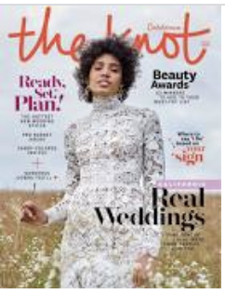

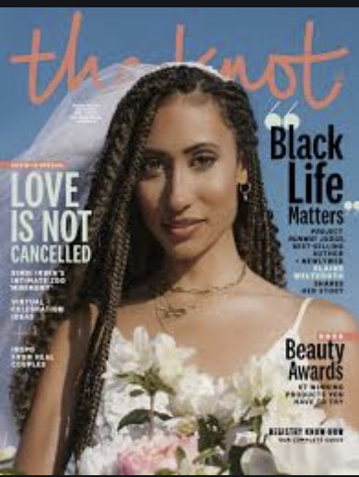


Will I have my dream wedding?
Will he or she meet all my needs?
Do they have the right hair or eye color?
Do they have the finances to meet my needs?
Will I find my true soulmate to complete me?
WHAT EVERY PERSON NEEDS TO KNOW BEFORE GETTING MARRIED

Slide 5
His Needs
Marriage
Her Needs
WHAT EVERY PERSON NEEDS TO KNOW BEFORE GETTING MARRIED

Slide 6

WHAT EVERY PERSON NEEDS TO KNOW BEFORE GETTING MARRIED
GOD CREATED MARRIAGE

Slide 7
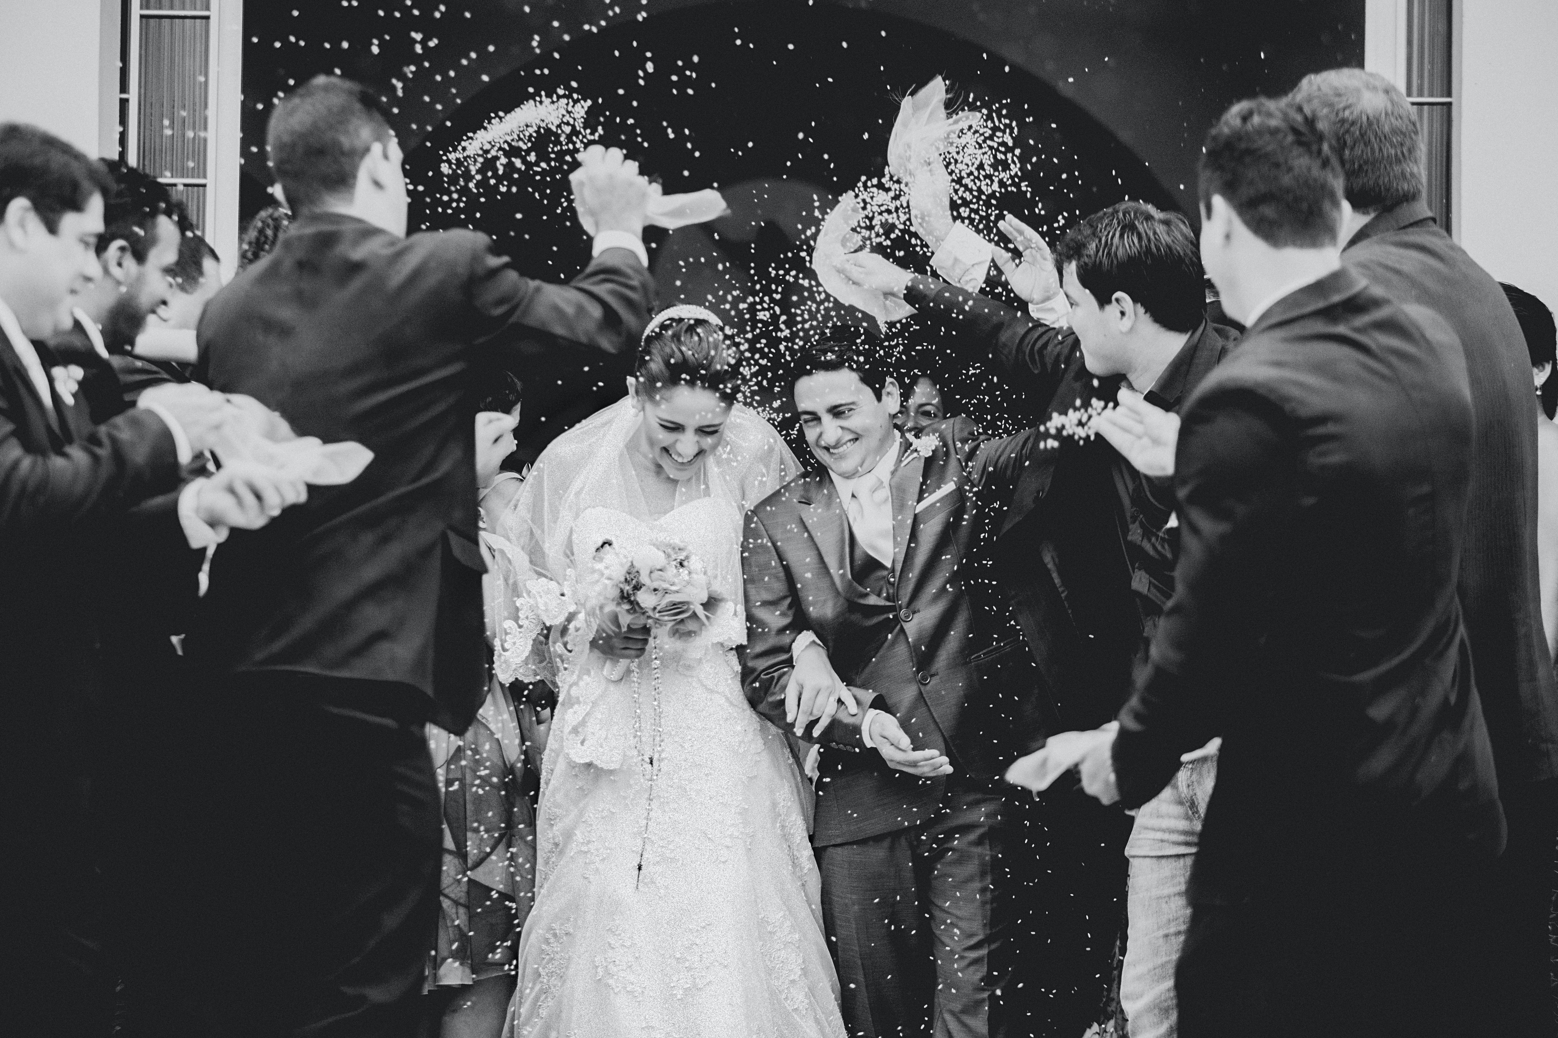
GOD CREATED MARRIAGE
Two become one - Genesis 2:18.
“It is not good for the man to be alone, I will make a helper comparable to him.”
God created marriage before all other social conventions and presents marriage as the foundational structure of community for human beings (Hasel, 2015).
WHAT EVERY PERSON NEEDS TO KNOW BEFORE GETTING MARRIED

Slide 8
GOD CREATED MARRIAGE
Marriage is designed by God not humans—it is God’s gift to humankind.
As the covenant is made, priorities shift from one’s
parents to one’s spouse.
The marriage ceremony is a public statement before witnesses that testifies to the significance, permanence and sacred nature of marriage.
WHAT EVERY PERSON NEEDS TO KNOW BEFORE GETTING MARRIED

Slide 9
GROUP DISCUSSION (4 to 6 Participants)
Read and reflect on the scripture texts below
  Genesis 2:18
  Genesis 1:27-28a
  Genesis 2:24
  Matthew 19:6
WHAT EVERY PERSON NEEDS TO KNOW BEFORE GETTING MARRIED
Notes:
“And the Lord God said, it is not good that man should be alone; I will make a helper comparable to him.” Genesis 2:18,NKJV
“So God created man in His own image; in the image of God He created Him; male and female He created them. Then God blessed them.” Genesis 1:27-28a, NKJV
“Therefore a man shall leave his father and mother and be joined to his wife and they shall become one flesh.” Genesis 2:24,NKJV
“So they are no longer two, but one flesh. Therefore what God has joined together, let not man separate.” Matthew 19:6, NKJV

Slide 10
GROUP DISCUSSION cont.
How do these passages of scripture shape or redefine your understanding of God’s intent for marriage?
  How does God’s intent differ from society’s notions or values about marriage?
  God designed marriage to reflect His image. How does this idea conflict with the prevailing idea that marriage is a matter of self-fulfillment or to “complete me?”
WHAT EVERY PERSON NEEDS TO KNOW BEFORE GETTING MARRIED

Slide 11
WHAT EVERY PERSON NEEDS TO KNOW BEFORE GETTING MARRIED
THE ILLUSION OF LOVE

Slide 12

THE ILLUSION OF LOVE
A well-orchestrated wedding does not guarantee a lasting and
happy marriage.
Nearly 40-50% of all
first-time marriages will end in divorce.
WHAT EVERY PERSON NEEDS TO KNOW BEFORE GETTING MARRIED

Slide 13
TRUE LOVE
True love is a decision you make every day.
Build your marriage on realistic dreams.
Participate in a comprehensive premarital education program which includes relationship assessments that will help prepare for future challenges in marriage.
WHAT EVERY PERSON NEEDS TO KNOW BEFORE GETTING MARRIED

Slide 14
GROUP DISCUSSION (4 to 6 Participants)
Read 1 Corinthians 13:4-8b:
  ”⁴ Love is patient and kind; love does not envy or boast; it is not arrogant ⁵ or rude. It does not insist on its own way; it is not irritable or resentful; ⁶ it does not rejoice at wrongdoing but rejoices with the truth. ⁷ Love bears all things, believes all things, hopes all things, endures all things. ⁸ Love never ends.”
WHAT EVERY PERSON NEEDS TO KNOW BEFORE GETTING MARRIED

Slide 15
GROUP DISCUSSION cont.
Compare and contrast the biblical understanding of love with contemporary views of “love.”
Consider how the terms “falling in love” and “not in love” relate to the Biblical definition of love? Based on this passage, is it possible to fall out of love? If so, was that really love, or just a natural chemical reaction where dopamine and serotonin were being dumped into the limbic system of the brain, giving one a euphoric experience described as “love”? How does this passage of scripture help us better understand true love and commitment in marriage?
WHAT EVERY PERSON NEEDS TO KNOW BEFORE GETTING MARRIED

Slide 16
Marriage is Sacred
Christian marriage is designed by God not humans.
Christian marriage is designed to teach us how to love as God loves.
Husbands and wives come together as one to reflect God’s image.
True love is a commitment.
Christian marriage is designed to make you more like God.
WHAT EVERY PERSON NEEDS TO KNOW BEFORE GETTING MARRIED

Slide 17
WHAT EVERY PERSON NEEDS TO KNOW BEFORE GETTING MARRIED
PREDICTING MARRIAGE FAILURE OR SUCCESS

Slide 18
Predicting Marriage Failure or Success
There are four broad premarital factors that contribute to marriage quality and satisfaction and marital distress:
Family background
Individual characteristics
Social contexts
Couple interactional processes
lman, 2001; Olson, Larson, & Olson-Sigg, 2009; S. M. Stanley, Trathen, McCain, & Bryan, 2013
WHAT EVERY PERSON NEEDS TO KNOW BEFORE GETTING MARRIED

Slide 19

Predicting Marriage Failure or Success
Family History
  We develop relational skills in
  our family of origin.
  Our birth order, interactions with parents, siblings, and other family members, genetics, and neurological structure all contribute to how we relate to others.
  Atmosphere of the home contributes to who we become as adults.
WHAT EVERY PERSON NEEDS TO KNOW BEFORE GETTING MARRIED

Slide 20
Predicting Marriage Failure or Success
Individual characteristics
  Refers to personality features, temperament, attitudes, beliefs, and values.
  It is often said that opposites attract but, the reality is the more things you have in common, the easier it will be to get along and resolve conflict.
  Mate selection is one of the most critical aspects of getting married and should be a thoughtful and purposeful process.
WHAT EVERY PERSON NEEDS TO KNOW BEFORE GETTING MARRIED

Slide 21
INDIVIDUAL ACTIVITY
Spend 5-7 minutes thinking about the characteristics you would want in a mate. Now think about this mate wanting the same things in you.
Do you have the same or similar traits that you are seeking in a mate?
Are you ready to meet these same needs in the other person?
In what ways do you see yourself dependent on the other person?
Are you expecting your future spouse to build or enhance your self-esteem?
Are you prepared to build or enhance theirs?
WHAT EVERY PERSON NEEDS TO KNOW BEFORE GETTING MARRIED

Slide 22
Predicting Marriage Failure or Success
Socio-cultural factors that impact marital success or distress:
  Previous marriage
  Parents’ divorce
  Cohabitation
  Religious dissimilarity – 2 Corinthians 6:14
  Holman, 2001; Larson, Blick, Jackson, & Holman, 2010; S. M. Stanley et al., 2013
WHAT EVERY PERSON NEEDS TO KNOW BEFORE GETTING MARRIED

Slide 23

Predicting Marriage Failure or Success
Couple Interactional Processes
  How a couple communicates, relates to another, and resolves conflict is the most critical factor that predict marital success or distress.
WHAT EVERY PERSON NEEDS TO KNOW BEFORE GETTING MARRIED

Slide 24
Predicting Marriage Failure or Success
Healthy Couples learn to:
  Share ideas without criticism or being judgmental
  Learn to disagree without destroying the relationship
  Listen for understanding
  Repair and forgive hurts quickly
  Have a positive attitude towards spouse & marriage
WHAT EVERY PERSON NEEDS TO KNOW BEFORE GETTING MARRIED

Slide 25

Galatians 5:22, 23
“But the fruit of the spirit is love, joy, peace, patience, kindness, goodness, faithfulness, gentleness, and self-control. Against such things there is no law.”
WHAT EVERY PERSON NEEDS TO KNOW BEFORE GETTING MARRIED

Slide 26
WHAT EVERY PERSON NEEDS TO KNOW BEFORE GETTING MARRIED
MARRIAGE:
GOD’S IDEA

Slide 27
MARRIAGE: GOD’S IDEA
Alternatives to marriage
are on the rise as our society
becomes more secular.
However, those who are interested
in a Christian view of marriage
need to consider that
God is the Creator of marriage.
WHAT EVERY PERSON NEEDS TO KNOW BEFORE GETTING MARRIED

Slide 28
MARRIAGE: GOD’S IDEA
“The Bible opens and closes with marriage. Genesis presents marriage as the first institution established by God at creation while the last chapters of Revelation use marriage as a metaphor to portray the relationship between Christ and His people” (Oliver & Oliver, 2015).
WHAT EVERY PERSON NEEDS TO KNOW BEFORE GETTING MARRIED

Slide 29
GROUP DISCUSSION (4 to 6 Participants)
Read this passage from the Adventist Home. Based on what has been presented in this seminar, how is this passage still relevant in contemporary society?
“Examine carefully to see if your married life would be happy or inharmonious and wretched. Let the questions be raised, will this union help me heavenward? Will it increase my love for God? And will it enlarge my sphere of usefulness in this life? If these reflections present no drawback, then in the fear of God move forward.”
Adventist Home 45.2
For additional reading—The Adventist Home, chapter 6
WHAT EVERY PERSON NEEDS TO KNOW BEFORE GETTING MARRIED

Slide 30
References
Gottman, J. M., & Silver, N. (2015). Seven Principles for Making Marriage Work. New York, NY: Harmony Books.
Hasel, F. M. (2015). The Biblical Concept of Marriage in the Bible. In E. Mueller & E. B. De Souza (Eds.), Marriage: Biblical and Theological Aspects (Vol. 1). Silver Spring, MD: Review and Herald Publishing Association.
Holman, T. B. (2001). Premarital Prediction of Marital Quality or Breakup: Research, Theory, and Practice. New York, NY: Kluwer Academic/Plenum Publishers.
Larson, J. H., Blick, R. W., Jackson, J. B., & Holman, T. B. (2010). Partner Traits That Predict Relationship Satisfaction for Neurotic Individuals in Premarital Relationships. Journal of Sex & Marital Therapy, 36(5), 430-444. doi:10.1080/0092623X.2010.510778
Oliver, W., & Oliver, E. (2015). An Introduction: The Beauty of Marriage. In E. Mueller & E. B. De Souza (Eds.), Marriage: Biblical and Theological Aspects (Vol. 1). Silver Spring, MD: Review and Herald Publishing Association.
Oliver, W. H. (2008). The relationship of religious homogamy and practices and marital satisfaction and stability: A case study of the Seventh-day Adventist (PhD Dissertation). American University, Washington DC. Available from ProQuest UMI Dissertation Abstracts database.
Olson, D., Larson, P., & Olson-Sigg, A. (2009). Couple Checkup: Tuning Up Relationships. Journal of Couple & Relationship Therapy, 8(2), 129-142. doi:10.1080/15332690902813810
Stanley, S., & Rhoades, G. (2018). Cohabitation is pervasive. Retrieved from https://ifstudies.org/blog/cohabitation-is-pervasive
Stanley, S. M., Trathen, D., McCain, S., & Bryan, B. M. (2013). A Lasting Promise: The Christian Guide to Fighting for Your Marriage: John Wiley & Sons.
Wright, H. H. (1992). The Premarital Counseling Handbook. Chicago, IL: Moody Press.
WHAT EVERY PERSON NEEDS TO KNOW BEFORE GETTING MARRIED

Slide 31


