Slide 1
Leadership
Bringing about change

Slide 2
Leadership is the discipline of deliberately exerting special influence within a group to move it toward goals of beneficial permanence that fulfil the group's real needs.
John Haggai

Slide 3
The Authoritarian Leader
Determines the goals and policies and wants the group to choose the goal he/she has chosen
More interested in the subject matter (content) than with the people (process)
Aggressive
Makes decisions regardless of other viewpoints
Talks too much
Focuses attention on him/herself
Group members are almost puppets
Hostility, resistance and resentment emerge
Discontent and aggressive attitudes grow among members
Aloof from active group participation except when demonstrating
A group will say when a task is finished and the goal achieved, "We did this ourselves".

Slide 4
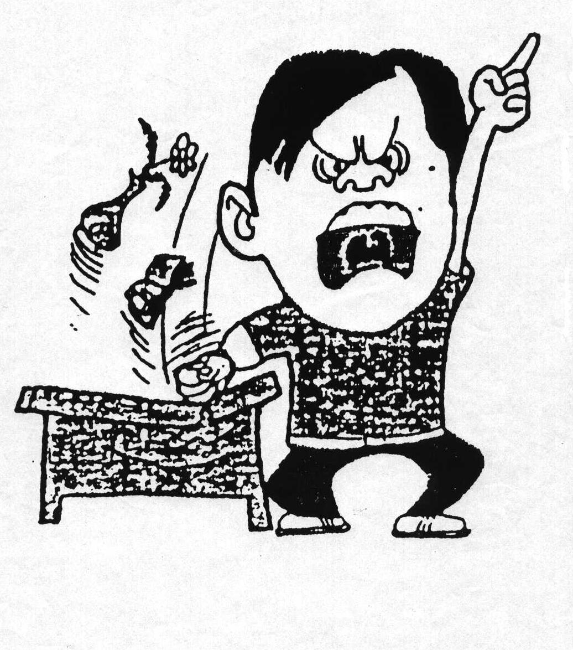

Slide 5
The Laissez-Faire Leader
Doesn't prepare and lets things drift
Doesn't seem to care
Causes the group to accomplish little
Encourages fragmentation through bad discipline and unreliability
Makes no attempt to appraise or regulate the course of events
Lacks courage in making decisive plans
Gives little guidance
Allows individual initiative and fosters personality growth
Lets people go, their own way
A group will say when a task is finished and the goal achieved, "We did this ourselves".

Slide 6


Slide 7
The Democratic Leader
Accepts the fact that leadership is the function of the whole group and not just of one individual
Shares leadership responsibility
Believes in other people
Creates a sense of security and belonging in the group
Ensures that other members have an opportunity of leadership
The leaders withdrawal will not mean the group will fall apart
All policies are a matter of group discussion and only assisted by the leader
Sensitive to the needs of others
Allows individuals initiative and fosters personal growth
A group will say of this type of leadership, if the goal is achieved , "we did this Together' ,

Slide 8
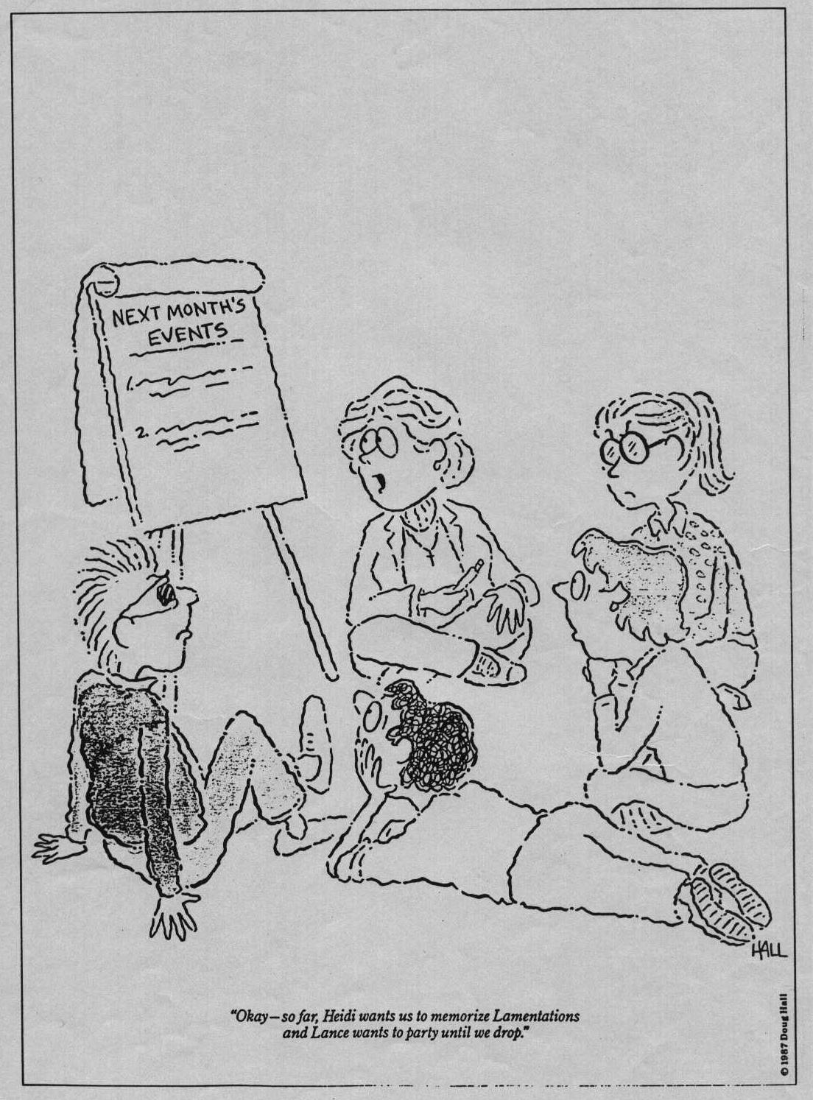

Slide 9
Empowering Potential Leaders
Help them discover their values
Let them develop their dreams.
Help them discover their gifts.
Give them freedom to fail.
Help them succeed.
Train them in leadership.

Slide 10
The mentoring curve

Slide 11
The Four Phases of Leadership Development
Phase I – I do it – you watch
Phase II - I Do it and you do it – We do it together
Phase III - You do it and I’ll support and supervise
Phase IV - You do it and I’ll spend more time with the next group in training

Slide 13
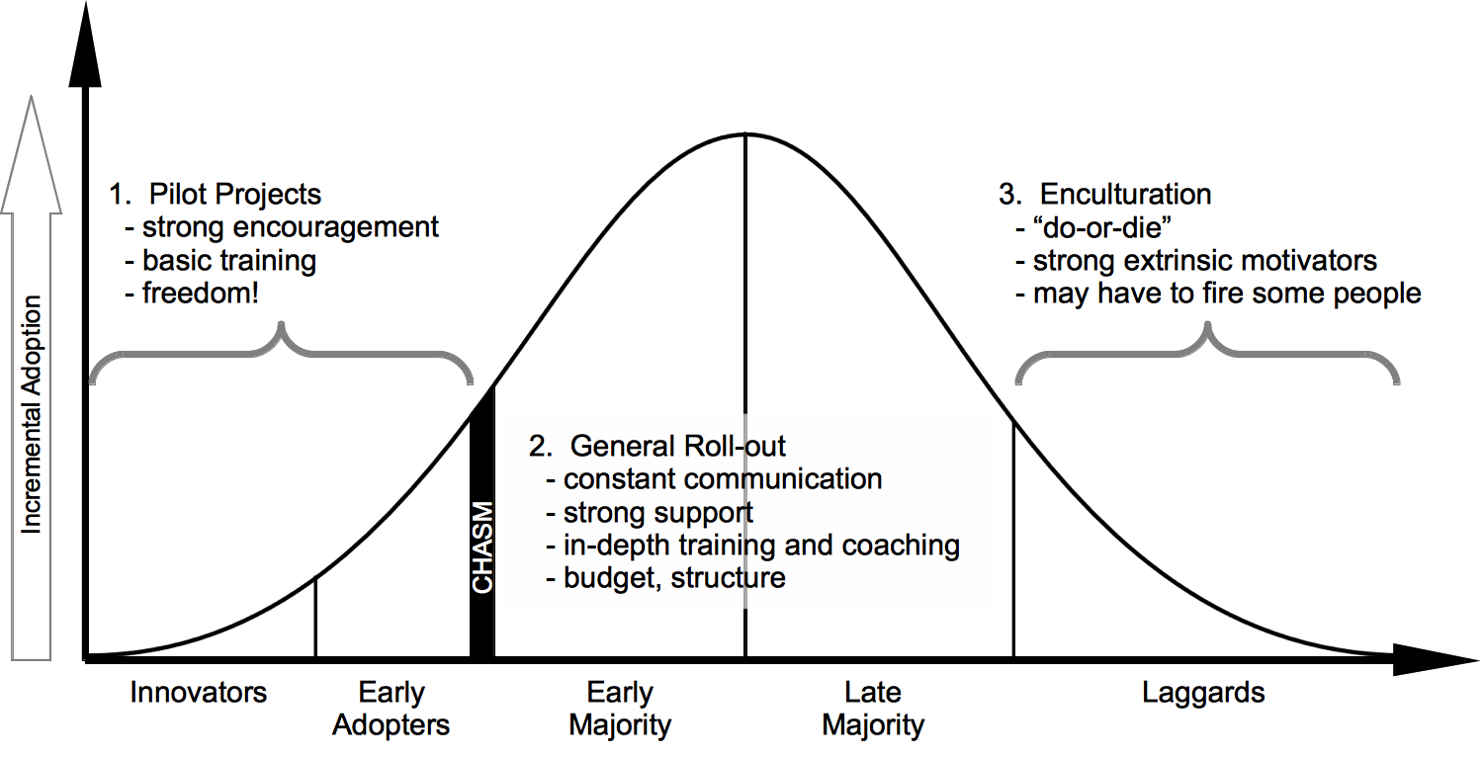

Slide 14
The Law of Reproduction
How do leaders become leaders?
  Survey - 10% Natural Giftedness.
  5% Result of a Crisis.
  85% Influence of another leader
Majority - established leaders mentored them.
We teach what we know - we reproduce what we are
It takes a giant killer to produce giant killers - leaders to raise other leaders

Slide 15
Leaders Develop Followers
Leaders Develop Leaders
Need to be Needed
Focus on Weaknesses
Develop the Bottom 20%
Treat their people the same for “fairness”
Hoard Power
Spend time with others
Grow by addition
Impact only people they touch personally
Want to be Succeeded
Focus on Strengths
Develop the top 20%
Treat their Leaders as individuals for impact
Give power away
Invest time in others
Grow by multiplication
Impact people far beyond their own reach

Slide 16
Leadership
Bringing about change

Slide 17

Redefining pastor’s role

Slide 18
Think it through…
What are ministry roles, tasks are you excepted to effectively fulfil to be successful in your ministry?
  Preacher
  Chaplain (Visitations)
  Etc
  Etc
  Etc

Slide 19
In groups 5 min
Develop a simple schedule of roles, activities you will engage in as you begin ministering in a new church

Slide 20
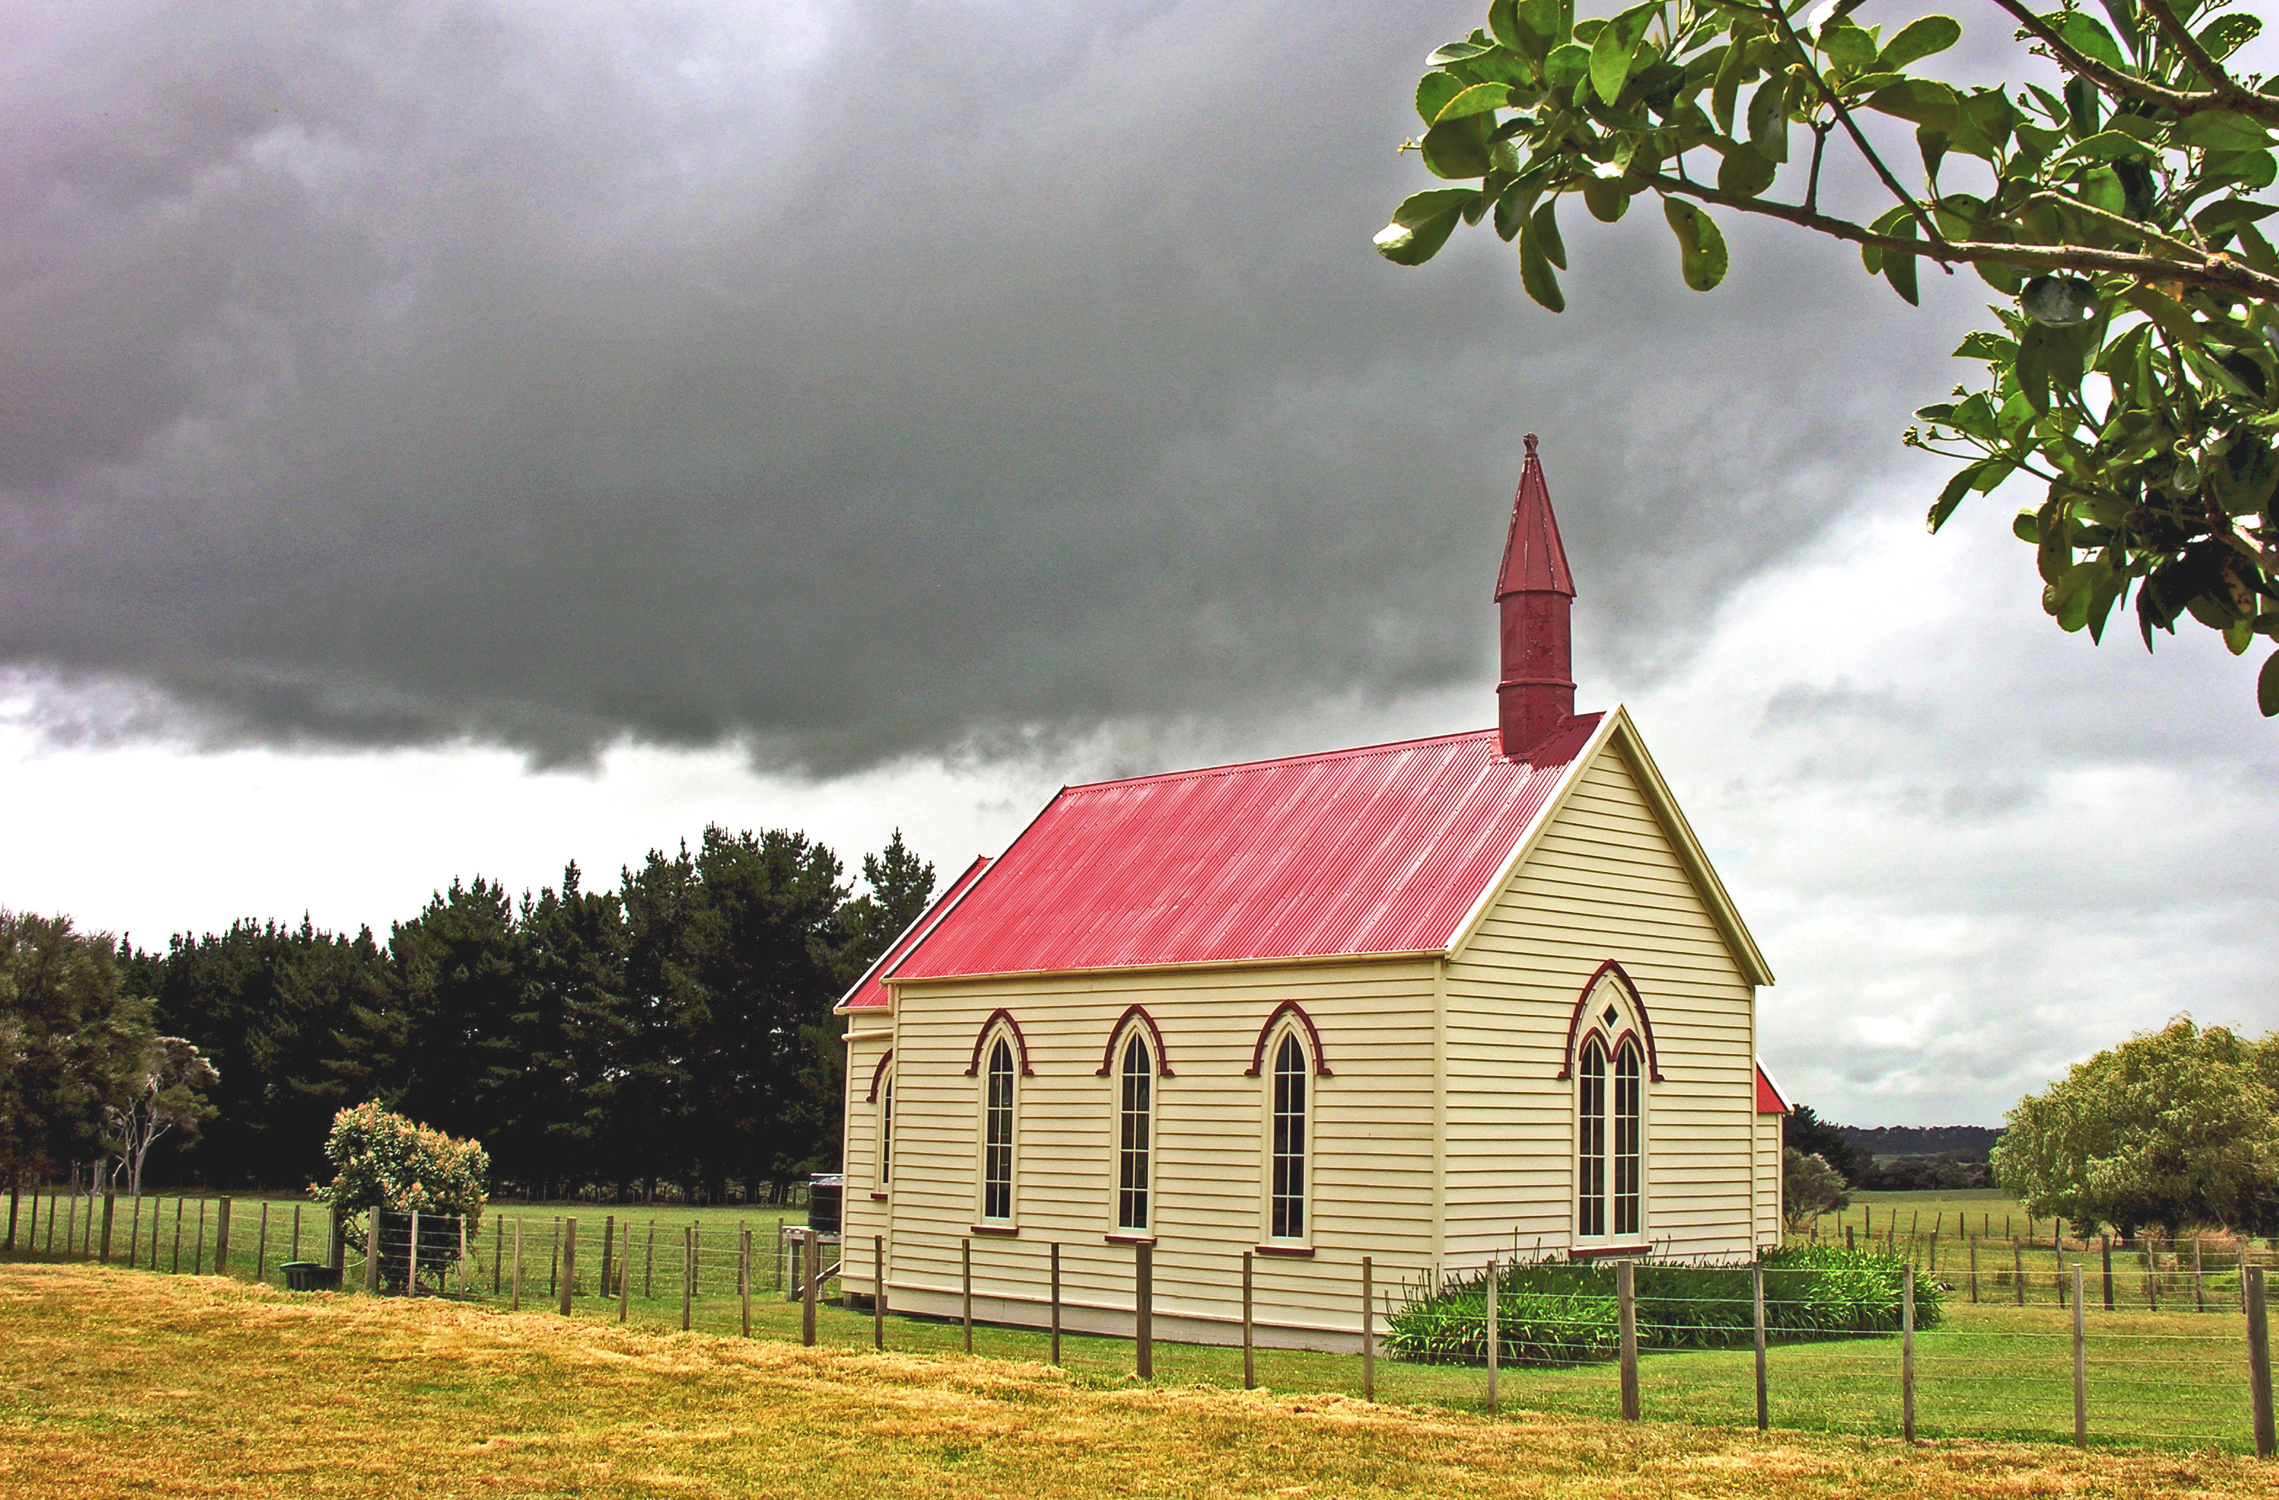
Old view of roles
Preacher
Minister (Pastor)

Slide 21
Old view of tasks
Preach
Teach (Bible Studies)
Visit
Board Meetings

Slide 22

new view of roles
Leader
Equipper
Trainer

Slide 23
Have you been taught the difference?

Slide 24
The future is not a result of choices among alternative paths offered by the present, but a place that is created, first in mind, next in will, then in activity. The future is not some place we are going to, but a place we are creating. The paths are not to be discovered, but made: and the activity of making the future changes both the maker and the destination.

Slide 25
Any enterprise is built by wise planning, becomes strong through common sense, and profits wonderfully by keeping abreast of the facts.
Proverbs 24:3,4. (Living Bible)

Slide 26
Get Serious
"It is a sin to be heedless, purposeless, and
indifferent in any work in which we may engage,
but especially in the work of God. Every enterprise
connected with His cause should be carried
forward with order, forethought, and earnest
prayer."
"The work you are engaged in cannot be done
except by forces which are the result of well-
understood plans."...
Evangelism,
(1946, Review & Herald Pub. Assoc.),
page 94

Slide 27
Get Focused
"There must be far more...thinking and planning, far
more mental power brought into the labor put forth
for the Master. This would enlarge the capacity of the
mind, and give keener perceptions as to what to do
and HOW..."
Testimonies to Ministers and Gospel Workers,
(1962,
Pacific Press), page 498

Slide 28
Successful planning
Values Mission Vision

Slide 29
What are your Values?
Write them down
Notes:
This morning, I can’t cover HOW you can discover those but I would like to point you in the right direction…

Slide 30
What is your Purpose?
What does your church exist for?

Slide 31
What is your Vision?
What do you want to be IN 3 or 5 years from now?

Slide 32
Successful planning
Values Mission Vision
Assess needs
Notes:
Church and community

Slide 33
SWOT Exercise
Strengths
Weaknesses
Opportunities
Threats
Strengths | Weaknesses
Opportunities | Threats

Slide 34
Successful planning
Values Mission Vision
Assess needs
Choose objectives & goals

Slide 35
Smart Planning
SPECIFIC they should be specific steps rather than vague desires.
MEASURABLE if you can't measure them, you can't monitor them.
ATTAINABLE set them high but still within reach.
REALISTIC set them within your available resources in the church
TANGIBLE some intangible goals can be achieved through smaller tangible steps.

Slide 36
Successful planning
Values Mission Vision
Assess needs
Choose objectives & goals
Strategic steps

Slide 37
Successful planning
Values Mission Vision
Coherent plan
Consistent direction
Review Regularly
Assess needs
Choose objectives & goals
Strategic steps

Slide 38
Evaluating in a Nutshell
What is going well? Why? (strengths)
What is not going well? (weaknesses)
What are the opportunities?
What are our greatest threats?

Slide 39
Evaluating in a Nutshell
Something you are not doing enough
Something you are not doing at all but should
Something you have tried before, perhaps briefly, then stopped
Things you have never done before, or any other new ideas

Slide 40
Evaluating in a Nutshell
When appropriate, ask:
What are the trends, if any?
What changes ought to be anticipated?

Slide 41
The Pastor
The Elders
Church Leaders (involved members)
Outside Observers (surveys & secret shoppers)
Who is Involved With Evaluation

Slide 42
Are people’s needs being met?
Are people developing into disciples & leaders?
Are people prepared to move on?
Are we being effective?
What Are the Major Concerns for Evaluation

Slide 43
Successful planning
Values Mission Vision
Coherent plan
Consistent direction
Review Regularly
Assess needs
Choose objectives & goals
Strategic steps

Slide 44
Leadership That People Follow
Honest – Have integrity
Forward Looking – Have a Vision
Competent – Know how to get the job done
Inspiring – enthusiastic, energetic, positive
Kouzes and Posner

