Slide 1


Slide 2

Every person while becoming more like* Jesus, makes* disciples.
VISION
*Galatians 5:22-23; 1 John 4:20; John 13:35
** John 15:8

Slide 3
Many churches struggle to articulate their Discipleship Pathway. We can guide them as they discover their unique Pathway so they fulfil God’s purpose.

Slide 4
Construct
Cruise
Clarify

Slide 5
Clarify
Construct
Church has aligned itself with the new path, adopted new approaches and let go of the old.
Cruise
Church sustains consistent direction congruent with the new path and finds ways to improve.
Church is united in understanding God’s unique calling and can articulate it clearly.

Slide 6
Clarify
pray
discover
Construct
align
install
Cruise
let go
choose
sustain
review
measure

Slide 7

CLARIFY: Pray, Discover, Choose
Has your church discovered and been united around where God is working in your church and community?
What has God called your church to do in your community?
What is your church’s pathway (strategy) to fulfil God’s purpose?

Slide 8
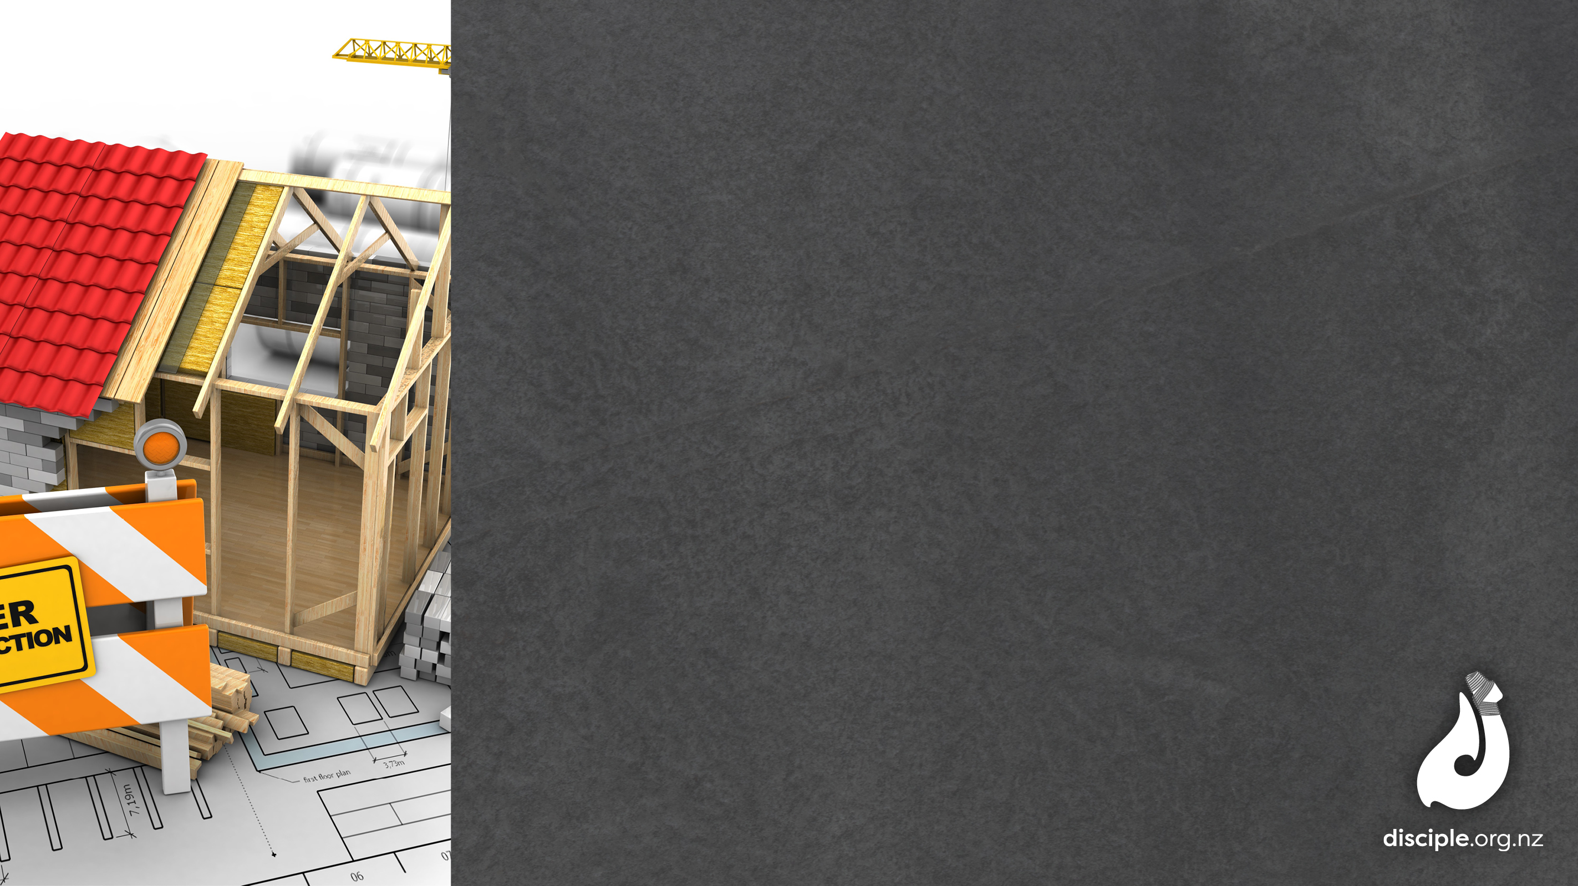
CONSTRUCT: Align, Install, Let Go
What needs to change in the running of your church to align with your new pathway (strategy)?
What operational changes have you already implemented?
What have you had to let go to be more focused on the new pathway (strategy)?

Slide 9

CRUISE: Sustain, Measure, Review
What support systems have you developed to ensure sustainable progress?
What measures do you use to track the progress of your pathway (strategy)?
How could you make your review/evaluation of your overall strategy more effective and thorough?

