Slide 1
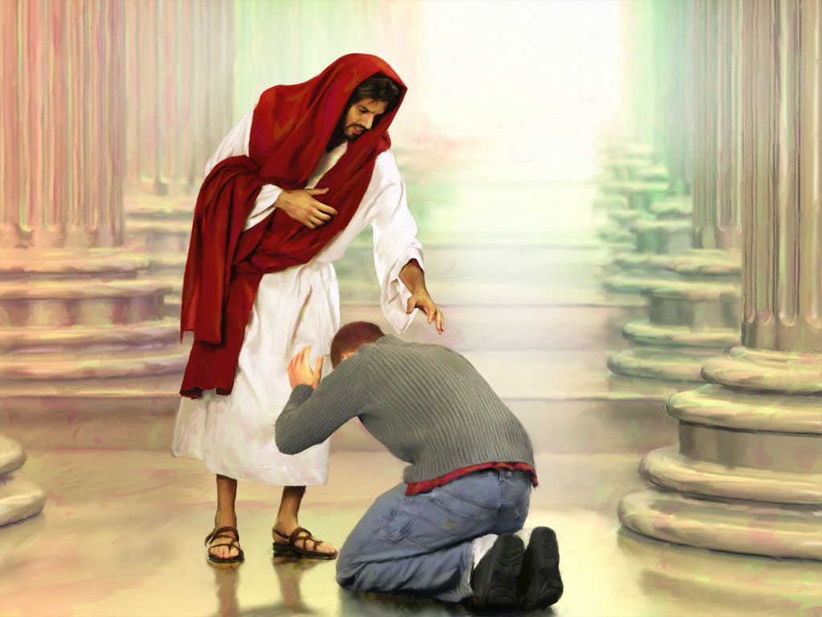

Slide 2

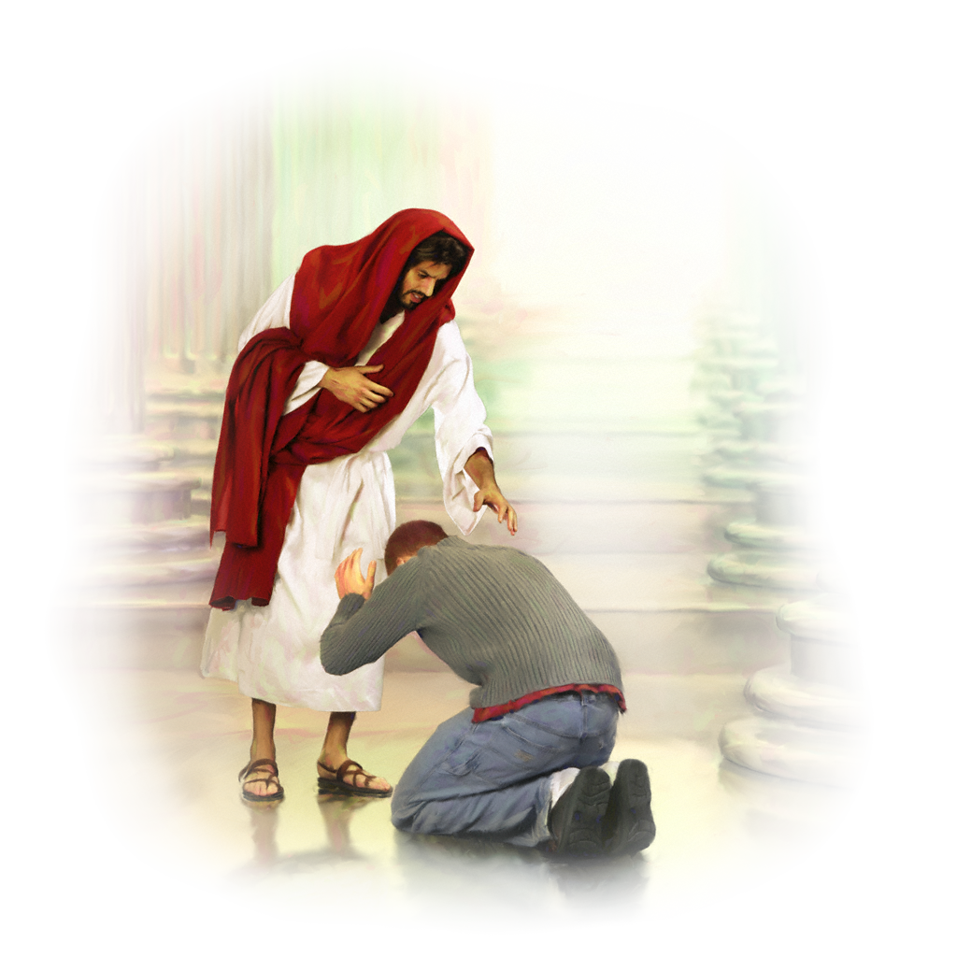
The relationship with God explained!

Slide 3

Romans 5:7-8
“…most people would not be willing to die for an upright person, though someone might perhaps be willing to die for a person who is especially good. But God showed his great love for us by sending Christ to die for us while we were still sinners.”

Slide 4
It’s not man who is looking for God, it is God who is looking for man!

Slide 5

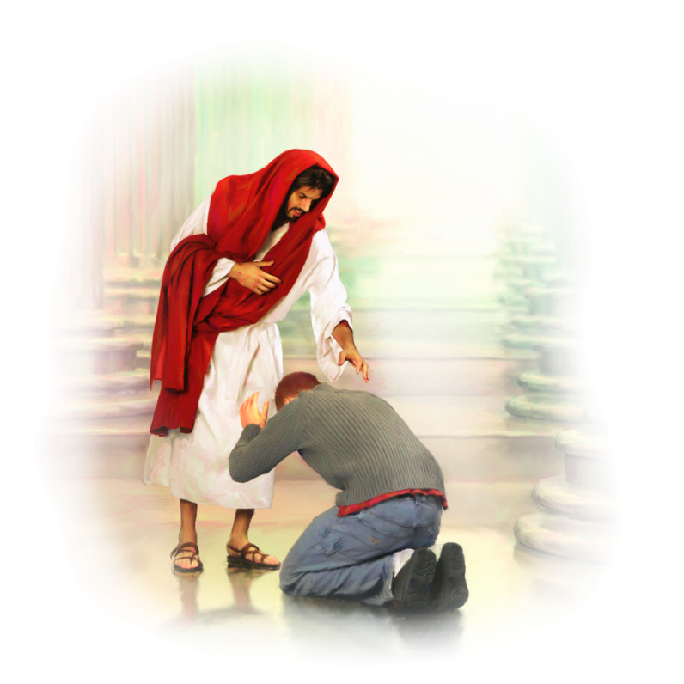
God came to look for people who hated Him! God didn’t come to show love to those who loved Him. He came to love those ones who hated Him and eventually killed Him.

Slide 6
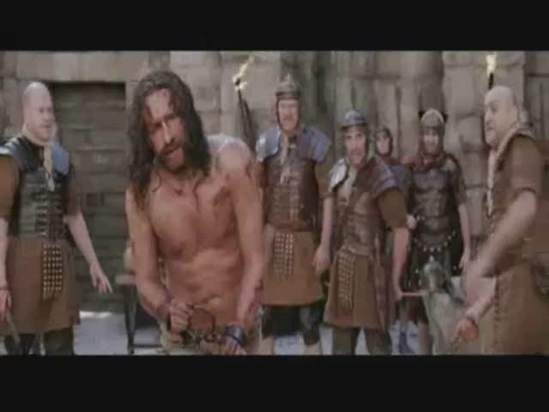
“Father, forgive them, for they do not know what they do.” Luke 23:34.

Slide 7
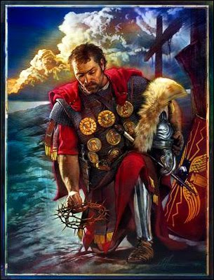
“So when the centurion saw what had happened, he glorified God, saying, “Certainly this was a righteous Man.” Luke 23:47.

Slide 8
“We love Him because He first loved us.” 1 John 4:19.

Slide 9
To acknowledge God’s love revealed in His Son Jesus Christ and allow Him to lead you in restoration of His image in you.

Slide 10
“As you therefore have received Christ Jesus the Lord, so walk in Him…” Colossians 2:6.

Slide 11
It is about continuity or consistency in responding to the leading and promptings of God. The fact that you have accepted Him as your Lord and Saviour doesn’t mean you have arrived, it is just the beginning.

Slide 12
“And I will pray the Father, and He will give you another Helper, that He may abide with you forever.” John 14:16.

Slide 13
“He will give you another Helper (παρακλητον), that He may abide with you forever.”
‘παρα-κλητον’ – the one who is called to dwell alongside to help!

Slide 14
“Since we live by the Spirit, let us keep in step with the Spirit.” Galatians 5:25. NIV

Slide 15
The success of our spiritual growth doesn’t depend on our knowledge of the truth, although it is part of it, but on the consistent and constant following and responding to the leading of the Holy Spirit.

Slide 16
Here is the ‘formula’:
1. As we learn the truth, our faith grows,
“Faith comes from hearing the message, and the message is heard through the word about Christ…” Romans 10:17

Slide 17
Here is the ‘formula’:
2. This truth we discover sets us free,
“You will know the truth, and the truth will set you free.” John 8:32.

Slide 18
Here is the ‘formula’:
3. In order to set us free, the truth, the Word of God, will penetrate into the darkest corners of our heart,
“For the word of God is alive and powerful. It is sharper than the sharpest two-edged sword, cutting between soul and spirit, between joint and marrow. It exposes our innermost thoughts and desires.” Hebrews 4:12.

Slide 19
Here is the ‘formula’:
4. The Holy Spirit will make it plain and convict us of what is right and what is wrong,
“When the Spirit of truth comes, he will guide you into all truth.” John 16:13.

Slide 20
Here is the ‘formula’:
5. It is a lifetime experience,
“Since we live by the Spirit, let us keep in step with the Spirit.” Galatians 5:25. NIV

Slide 21
Here is the ‘formula’:
6. The goal of the Holy Spirit is to restore God’s image in us, not to pump us with truthful knowledge,
“…put on the new man who is renewed in knowledge according to the image of Him who created him…” Colossians 3:10.

Slide 22
“…love, joy, peace, longsuffering, kindness, goodness, faithfulness, gentleness, self-control.” Galatians 5:22-23.

Slide 23
“The Lord God has opened my ear; And I was not rebellious, Nor did I turn away.” Isaiah 50:5.

Slide 24
“You almost persuade me to become a Christian.” Acts 26:28.

Slide 25
“…love, joy, peace, longsuffering, kindness, goodness, faithfulness, gentleness, self-control.” Galatians 5:22-23.

Slide 26
We can read the bible, go to church, pray and serve others and still not have a relationship with God, but if we have a relationship with God we will read the bible, go to church, pray and serve others.

Slide 27
Going to church, reading the Bible, praying and serving others is not a relationship with God. These are very vital spiritual disciplines which can facilitate the development of a relationship but they cannot guarantee it will happen. What truly guarantees a transforming relationship with God is our constant and continuous response to His work of restoration of His image in us.

Slide 28
Going to church, reading the Bible, praying and serving others is not a relationship with God. These are very vital spiritual disciplines which can facilitate the development of a relationship but they cannot guarantee it will happen. What truly guarantees a transforming relationship with God is our constant and continuous response to His work of restoration of His image in us.

Slide 29
“Knowledge puffs up…” 1 Corinthians 8:1.

Slide 30
When people accept God’s truth without the context of a relationship with Him they become judgemental, formalist, critical of others, proud and self-righteous!

Slide 31
The relationship with God is a consistent and constant following and responding to the leading of the Holy Spirit, as He is working on restoration of His image in us until completion, which leads to the abundant life He promised to all of His Children.

Slide 32
“Since we live by the Spirit, let us keep in step with the Spirit.” Galatians 5:25. NIV

Slide 33

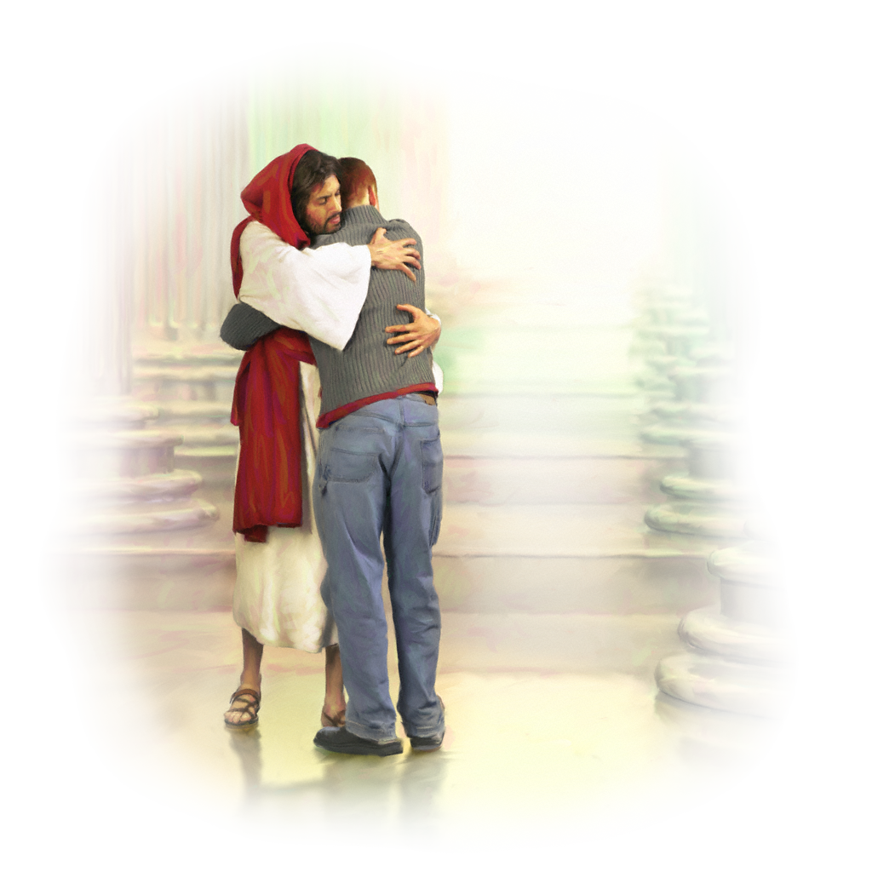
Am I walking in step with the Spirit?

Slide 34
