Slide 1

things that matter

Slide 2
Revelation 2:1-7

Slide 3
I know your works, your hard labour for God’s sake, your patience and endurance, your intolerance towards evil and sin, your perseverance and that you haven’t become weary in all these.
Revelation 2:1-7

Slide 4
“Nevertheless” NKJ, or
“Yet” NIV, or
“But” NLT

Slide 5
Revelation 2:4
“Nevertheless I have this against you, that you have left your first love.”

Slide 6
three questions
What is this first love Jesus referred to, and
why was the first love so essential that Jesus called them to repentance thus making all their ‘good works’ not good enough, and
what is a message for us in this passage today?

Slide 7
What is this first love Jesus referred to?

Slide 8
“The enthusiasm was gone and the members were starting to lose touch with God and love for one another. Religion in the church of Ephesus became…loveless. …they were backsliding from true, ardent love for Christ and their fellow believer that characterised them in their early days. They had forgotten that only the gospel can balance religious duty with loving affection for fellow Christians.”
Revelation of Jesus Christ, Commentary on the book of Revelation, by Ranko Stefanovic.

Slide 9
“As these false doctrines were urged, differences sprang up, and the eyes of many were turned from beholding Jesus as the Author and Finisher of their faith. The discussion of unimportant points of doctrine, and the contemplation of pleasing fables of man’s invention, occupied time that should have been spent in proclaiming the gospel. The masses that might have been convicted and converted by a faithful presentation of the truth were left unwarned.”
– {AA 580.2}

Slide 10
First love is the affection for Christ and passion for and enthusiasm in spreading the Gospel Message!
It is a compulsory ingredient of God’s church! ANY church, no matter how faithful and diligent the members are, isn’t fulfilling its purpose without passionate love for Jesus, His people, enthusiastic and contagious witnessing and disciples making.

Slide 11
…repent and do the first works, or else I will come to you quickly and remove your lampstand from its place—unless you repent.
Revelation 2:5

Slide 12
that’s where we see that the first love is an absolute ingredient of one’s spiritual life without which he/she won’t be able to represent Christ in the true light

Slide 13
The focus of the church in Ephesus shifted from being witnesses of God’s saving power and saving the lost to being keepers of God’s truth!

Slide 14
“The Lord does not now work to bring many souls into the truth, because of the church members who have never been converted and those who were once converted but who have backslidden. What influence would these unconsecrated members have on new converts? Would they not make of !!!no effect!!! the God-given message which His people are to bear?”
Testimonies, vol. 6, p.371

Slide 15
Perils of losing the focus
Their object was to do things right, when it must have been on doing right things
  They confused the method with the purpose
    What’s the purpose of a boat?
    What’s the purpose of a rugby game?

Slide 16


Slide 17
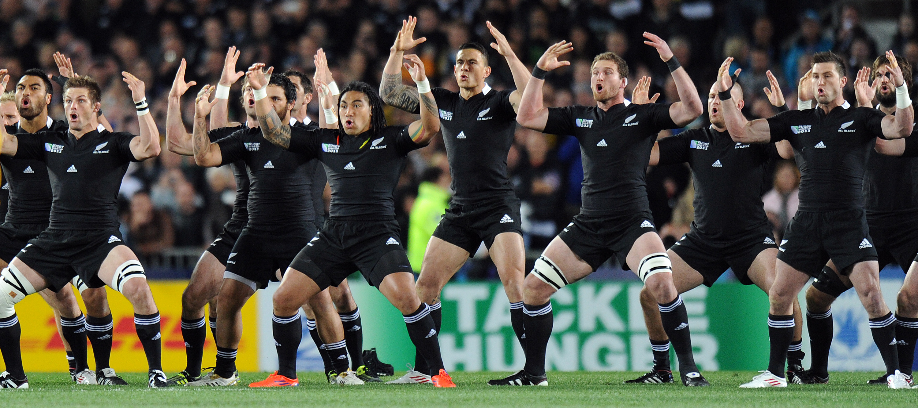

Slide 18
Perils of losing the focus
Instead of arguing about how they would be saving the lost they were arguing about:
  Dress code
  Music
  Form of worship
  Colour of carpet, roof, pews or chairs

Slide 19
Worship
Mission
Small G
Ministries
Programmes
What’s the purpose of Church

Slide 20
Programmes
Mission
Small G
Ministries
Mission
What’s the purpose of Church

Slide 21
Mission
Worship
Small G
Ministries
Programmes
What’s the purpose of Church

Slide 22
Remember therefore from where you have fallen; repent and do the first works…
Revelation 2:5

Slide 23
…life of a powerful and faithful witness of God's indescribable love is NOT so much in knowledge or instruction but in motivation!!

Slide 24
Are we deeply touched by the grace of God and have we truly experienced the power of Jesus in our hearts and are we excited and enthusiastic about the message of the Gospel we are going to share with the people in Cook Islands?

Slide 25
What is one principle I learnt and I’m going to apply in my Christian walk?

Slide 26
