Slide 1
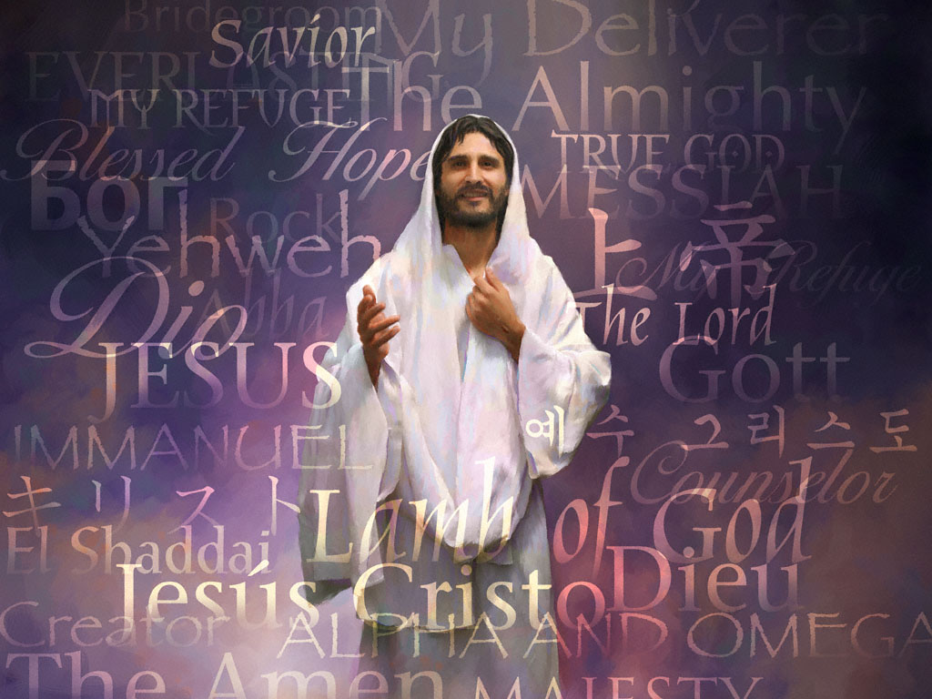
In Christ Alone

Slide 2

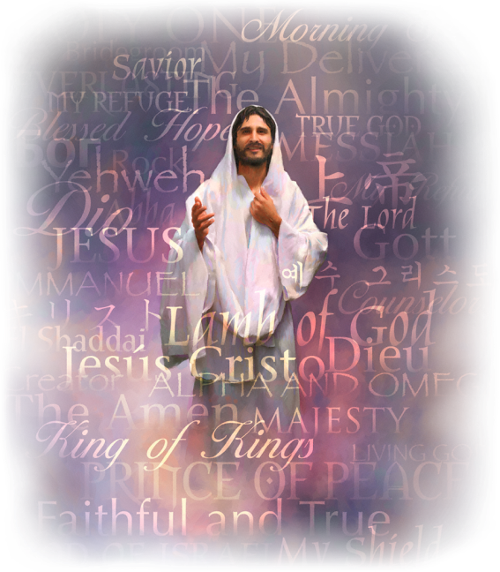
‘We can’t be saved and grow spiritually because we make all the effort to obey the Divine Moral Law, and yet, we can’t be saved if we live in disobedience to this Law and do not grow spiritually.’
In Christ Alone

Slide 3
Hebrews 12:2
“Let us fix our eyes on Jesus, the author and perfecter of our faith…”
In Christ Alone

Slide 4

It is God’s initiative to save us –
He changes our attitude towards Him –
He reveals Himself to us –
He draws us to Himself –
He encourages repentance in us –
He forgives our sins –
He encourages us to pray –
He produces the desire for righteousness in us –
He produces divine love in us –
He leads us to, and guides us in, all the truth –
He enables us to live righteous lives –
He wraps these gifts nicely and brings them to our door.
In Christ Alone

Slide 5
What God cannot do and will not do for us, or on our behalf:
The first one is –
  He cannot make choices on our behalf!
The second one is –
  He cannot carry out obedience to the Divine Moral Law on our behalf!
In Christ Alone

Slide 6
Philippians 2:12
“...continue to work out your salvation with fear and trembling,..”
In Christ Alone

Slide 7
Philippians 2:13
“…for it is God who works in you to will and to act according to his good purpose.”
In Christ Alone

Slide 8

How can our obedience be the result of God’s work in us, and not our own works?
In Christ Alone

Slide 9
Matthew 7:21-23
“Not everyone who says to me, ‘Lord, Lord,’ will enter the kingdom of heaven, but only he who does the will of my Father who is in heaven. Many will say to me on that day, ‘Lord, Lord, did we not prophesy in your name, and in your name drive out demons and perform many miracles?’ Then I will tell them plainly, ‘I never knew you. Away from me, you evildoers!’’
In Christ Alone

Slide 10
‘To bring us into a relationship with God by setting us free from sin, and by growing us into the likeness of Jesus’ Character.’
In Christ Alone

Slide 11
By setting us free from sin,
  “…if the Son sets you free, you will be free indeed.” John 8:36
He produces the fruit of righteousness in us,
  “…the fruit of the Spirit [not our effort] is love, joy, peace, patience, kindness, goodness, faithfulness, gentleness and self-control. Against such things there is no law.” Galatians 5:22-23
In Christ Alone

Slide 12
So we can grow spiritually into the likeness of His Character,
  “…until we all reach unity in the faith and in the knowledge of the Son of God and become mature, attaining to the whole measure of the fullness of Christ.” Ephesians 4:13,
Which brings us to the ultimate goal of salvation – to know God, [not about God]
  “Now this is eternal life: that they may know you, the only true God, and Jesus Christ, whom you have sent.” John 17:3
In Christ Alone

Slide 13
By setting us free from sin,
He produces the fruit of righteousness in us,
So we can grow spiritually into the likeness of His Character,
Which brings us to the ultimate goal of salvation – to know God!
In Christ Alone

Slide 14
All the Spiritual Disciplines we practice in our spiritual life are not the goal of our salvation they are the means of placing ourselves before God so He can transform us.
In Christ Alone

Slide 15
‘You CAN practice the Spiritual Disciplines without God, but you CAN’T be with God without practicing the Spiritual Disciplines.’
In Christ Alone

Slide 16
Matthew 5:20
“…unless your righteousness surpasses that of the Pharisees and the teachers of the law, you will certainly not enter the kingdom of heaven.”
In Christ Alone

Slide 17
The presence and the continual growth of the Fruit of the Holy Spirit in one’s life is the ultimate evidence of Spiritual Growth and a relationship with God.
In Christ Alone

Slide 18
Since our goal is not to practice the Spiritual Disciplines but to know God on a personal and intimate level our focus should be on being with Jesus, not on doing the Spiritual Disciplines. If our being with Jesus by the means of the Spiritual Disciplines doesn’t produce the Fruit of the Spirit [the ultimate evidence of a relationship with God] we need to look at the attitude [condition of our heart] with which we approach them.
In Christ Alone

Slide 19
Hebrews 8:10
“I will put my laws in their minds and write them on their hearts. I will be their God, and they will be my people.”
In Christ Alone

Slide 20
“Those who become new creatures in Christ Jesus will bring forth the fruits of the Spirit, "love, joy, peace, long-suffering, gentleness, goodness, faith, meekness, temperance." Galatians 5:22, 23. The things they once hated they now love, and the things they once loved they hate. The proud and self-assertive become meek and lowly in heart. The vain and supercilious become serious and unobtrusive. The drunken become sober, and the profligate pure. The vain customs and fashions of the world are laid aside.” Steps to Christ
In Christ Alone

Slide 21
‘Satan will constantly present allurements to induce us to break these ties – to choose to separate ourselves from Christ. Here is where we need to watch, to strive, to pray, that nothing may entice us to choose another master; for we are always free to do this. But let us keep our eyes fixed upon Christ, and He will preserve us. Looking unto Jesus, we are safe. Nothing can pluck us out of His hand.’ Steps to Christ
In Christ Alone

Slide 22
Galatians 2:20
“I have been crucified with Christ and I no longer live, but Christ lives in me. The life I live in the body, I live by faith in the Son of God, who loved me and gave himself for me.”
In Christ Alone

Slide 23
