Slide 1

Have you accepted The Gift yet?

Slide 2

James 4:17
“Anyone, then, who knows the good he ought to do and doesn’t do it, sins.”

Slide 3
Romans 14:23
“…everything that does not come from faith is sin.”

Slide 4
Steps to Christ
“Many have an idea that they must do some part of the work alone. They have trusted in Christ for the forgiveness of sins, but now they seek by their own efforts to live aright. But every such effort must fail.”

Slide 5
Steps to Christ
“No more can you, by anxiety or effort of yourself, secure spiritual growth.”

Slide 6
Steps to Christ
“He who is trying to become holy by his own works in keeping the law, is attempting an impossibility. It is the grace of Christ alone, through faith, that can make us holy.”

Slide 7
“You can’t be saved and grow spiritually because you make all the effort to obey the law, and yet, you can’t be saved if you live in disobedience to the Divine Moral Law and do not grow spiritually.”

Slide 8
“Our spiritual life and growth is initiated and maintained by the work of God in our hearts!”

Slide 9
Steps to Christ
“He who is trying to become holy by his own works in keeping the law, is attempting an impossibility. It is the grace of Christ alone, through faith, that can make us holy.”

Slide 10


“Let us fix our eyes on Jesus, the author and perfecter of our faith…” Hebrews 12:2

Slide 11

It is God’s initiative to save us – “Once you were alienated from God and were enemies in your minds because of your evil behavior.” Colossians 1:21 and “…While we were still sinners, Christ died for us.” Romans 5:8
He changes our attitude towards Him – “…when we were God’s enemies, we were reconciled to him through the death of his Son.” Romans 5:10
He reveals Himself to us – “...since what may be known about God is plain to them, because God has made it plain to them.” Romans 1:19

Slide 12
He draws us to Himself – “…when I am lifted up from the earth, will draw all men to myself.” John 12:32
“No one can come to me unless the Father who sent me draws him…” John 6:44
He encourages repentance in us – “God’s kindness leads you toward repentance” Romans 2:4
He forgives our sins – “I, even I, am he who blots out your transgressions, for my own sake, and remembers your sins no more.” Isaiah 43:25

Slide 13
He encourages us to pray – “We do not know what we ought to pray for, but the Spirit himself intercedes for us with groans that words cannot express.” Romans 8:26
He produces the desire for righteousness in us – “…for it is God who works in you to will and to act according to his good purpose.” Philippians 2:13
He produces divine love in us – “We love because he first loved us.” 1 John 4:19

Slide 14
He leads us to, and guides us in all the truth – “But when he, the Spirit of truth, comes, he will guide you into all truth.” John 16:13
He enables us to live righteous lives – “I will put my laws in their minds and write them on their hearts. I will be their God, and they will be my people.” Hebrews 8:10
He wraps these gifts nicely and brings them to your door. – “Here I am! I stand at the door and knock. If anyone hears my voice and opens the door, I will come in…” Revelation 3:20

Slide 15
Hosea 11:4
“I led them with cords of human kindness, with ties of love; I lifted the yoke from their neck and bent down to feed them.”

Slide 16
Deuteronomy 30:19
“I have set before you life and death, blessings and curses. Now choose life, so that you and your children may live…”

Slide 17
God cannot…
…make choices on our behalf!

Slide 18
Romans 8:7
“…the sinful mind is hostile to God. It does not submit to God’s law, nor can it do so.”

Slide 19
Philippians 2:13
“…for it is God who works in you to will and to act according to his good purpose.”

Slide 20
“Let us fix our eyes on Jesus, the author and perfecter of our faith…” Hebrews 12:2

Slide 21
Steps to Christ
“Our growth in grace, our joy, our usefulness – all depend upon our union with Christ. It is by communion with Him, daily, hourly – by abiding in Him that we are to grow in grace.”

Slide 22
Our effort should not be focused on producing spiritual fruit of obedience to God, instead it should be focused on being with Christ!

Slide 23
Galatians 3:1-3NLT
“Oh, foolish Galatians! Who has cast an evil spell on you? For the meaning of Jesus Christ’s death was made as clear to you as if you had seen a picture of his death on the cross. ² Let me ask you this one question: Did you receive the Holy Spirit by obeying the law of Moses?”

Slide 24
Galatians 3:1-3NLT
“Of course not! You received the Spirit because you believed the message you heard about Christ. ³ How foolish can you be? After starting your Christian lives in the Spirit, why are you now trying to become perfect by your own human effort?”

Slide 25
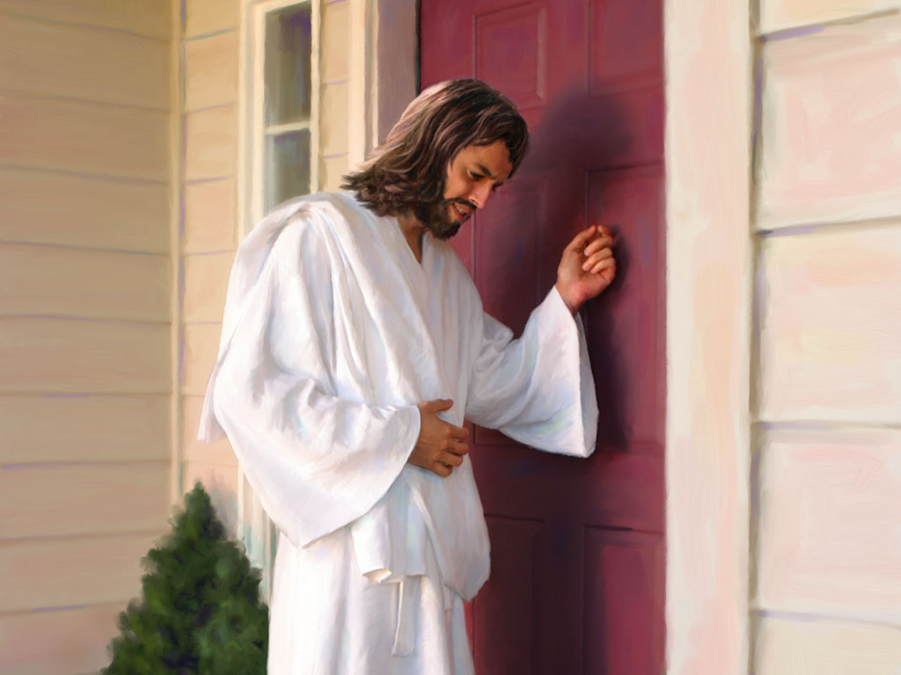

Slide 26
“Let us fix our eyes on Jesus…” Hebrews 12:2

Slide 27
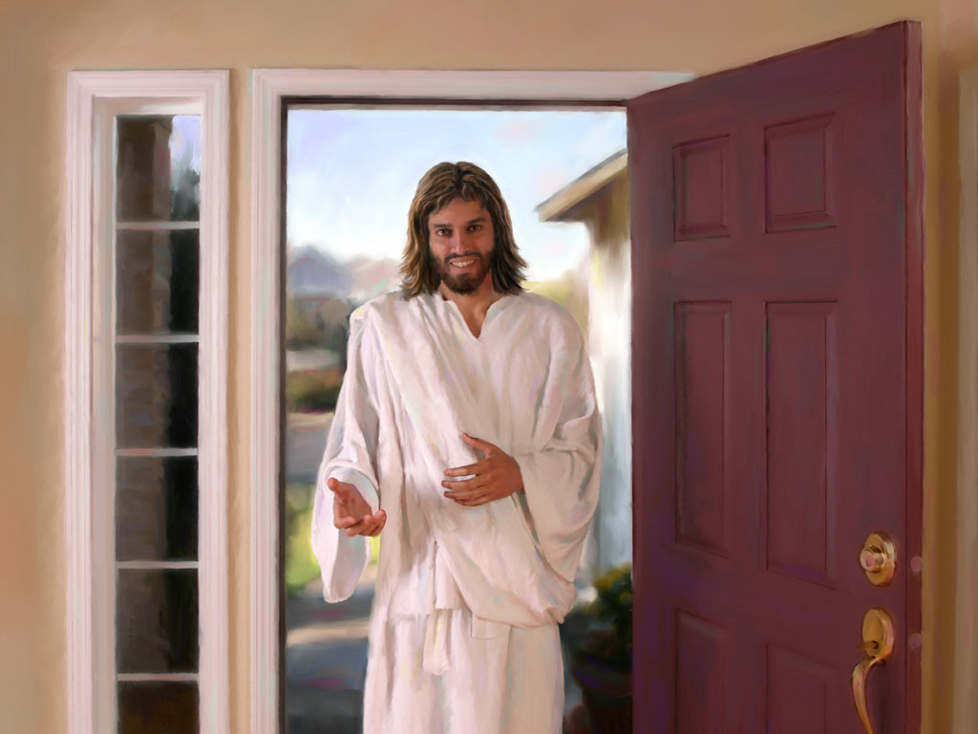

Slide 28


Slide 29


Have you accepted
The Gift yet?

