Slide 1
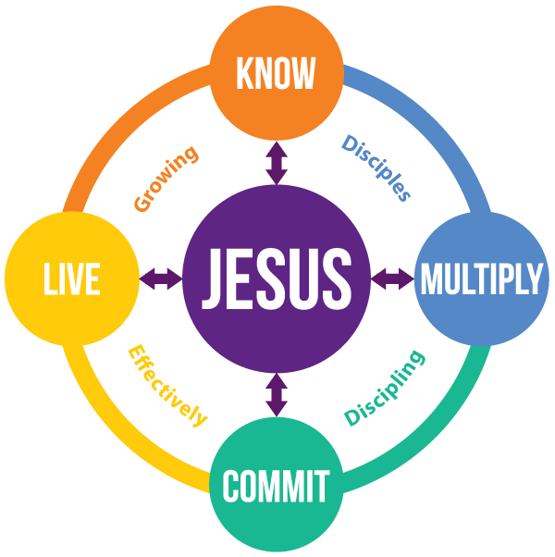
Discipleship Journey in Rarotonga

Slide 2
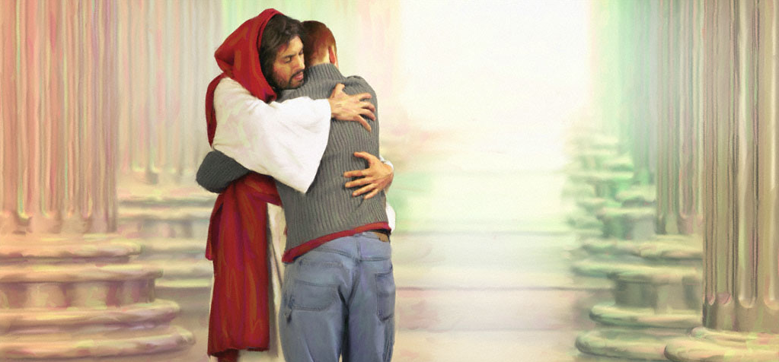
Do you really know Him?

Slide 3
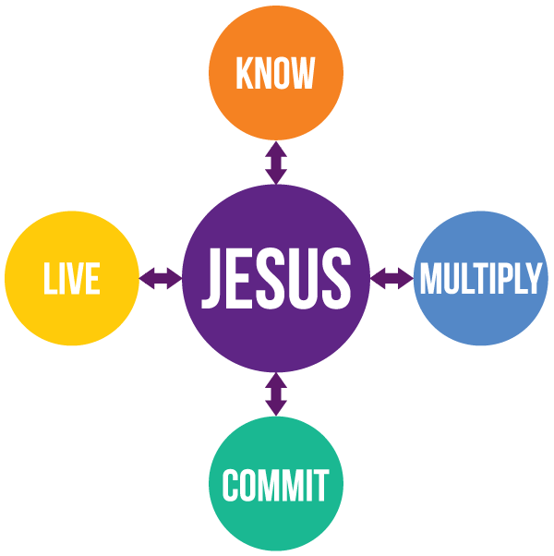
“You are truly my disciples if you remain faithful to my teachings.” John 8:31 NLT
And John 17:3
behold
“Your love for one another will prove to the world that you are my disciples.”
John 13:35 NLT
“This is to my Father's glory, that you bear much fruit, showing yourselves to be my disciples.” John 15:8 NIV
belong
bear
“And if you do not carry your own cross and follow me, you cannot be my disciple.” Luke 14:27 NLT
believe

Slide 6
What is your spiritual life about?
What – Why – How
Why do we do all the spiritual disciplines?
Discussion
Notes:
Why are we doing what we are doing in our life? What’s the purpose?
If you were to express in a few words, How would you describe it?

Slide 7
Now this is eternal life: that they know you, the only true God, and Jesus Christ, whom you have sent.
John 17:3NIV

Slide 8
And this is the way to have eternal life – to KNOW you, the only true God, and Jesus Christ, the one you sent to earth.
John 17:3NLT

Slide 9
Adam knew Eve his wife, and she conceived and bore Cain…
Genesis 4:1 ESV

Slide 10
What does knowing Jesus look like?
What – Why – How
What do you do to know Jesus
Discussion

Slide 11
?
prayer
bible study
worship
giving
service
?

Slide 12
I stand at the door and knock. If anyone hears my voice and opens the door, I will come in to him and eat with him, and he with me.
Revelation 3:20 ESV

Slide 13
You say, 'I am rich; I have acquired wealth and do not need a thing.'
Revelation 3:17

Slide 14
But you do not realize that you are wretched, pitiful, poor, blind and naked.
Revelation 3:17

Slide 15
I counsel you to buy … salve to put on your eyes, so you can see.
Revelation 3:18

Slide 16
It is not and will not guarantee a relationship with Jesus.
?
prayer
bible study
worship
giving
service
?
Notes:
Bad marital advice – to have a great intimate relationship with your spouse you need to:
Live in the same house
Love the same food
Shop in the same store
And yes, have kids … and yes, have mortgage…

Slide 17
I stand at the door and knock. If anyone hears my voice and opens the door, I will come in to him and eat with him, and he with me.
Revelation 3:20 ESV
Why on earth, does Jesus offer to have a dinner with His followers?

Slide 18
This is what you can do for your spiritual growth! And this is THE ONLY discipline that ultimately makes the difference!

Slide 19
If you open the door, I will come in, and we will share a meal together as friends.
Revelation 3:20 NLT

Slide 20
Jesus’ currency is INTIMACY.
This He values above all the good deeds. INTIMACY with Jesus is truly KNOWING HIM.

Slide 21
time
?
?

Slide 22
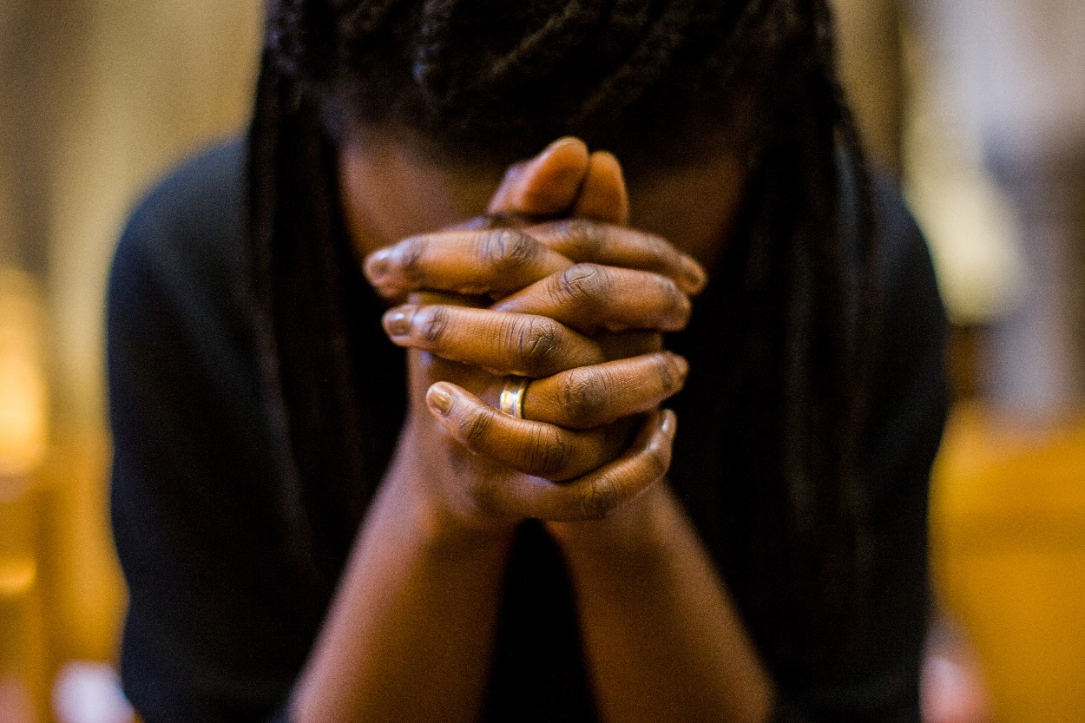
unrushed
unstructured
undivided
time with God

Slide 23
Why are we struggling with finding time with Jesus?
Discussion

Slide 24
The wind blows wherever it pleases. You hear its sound, but you cannot tell where it comes from or where it is going. So it is with everyone born of the Spirit.
John 3:8 NIV

Slide 25
time
transparency
?

Slide 26
Search me, God, and know my heart; test me and know my anxious thoughts.
See if there is any offensive way in me, and lead me in the way everlasting.
Psalm 139:23-24 NIV

Slide 27
The Sovereign LORD has spoken to me, and I have listened. I have not rebelled or turned away.
Isaiah 50:5 NLT

Slide 28
time
transparency
submission

Slide 29
…put on the new self, which is being renewed in knowledge in the image of its Creator.
Colossians 3:10.

Slide 30
By knowing Jesus intimately, we inevitably change into His image and ultimately, experience eternal life.

Slide 31
