Slide 1
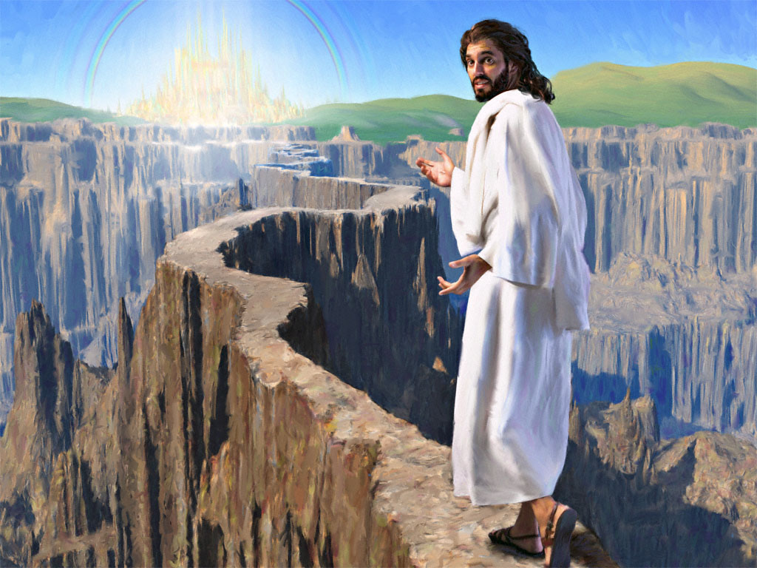
The essence of discipleship

Slide 2
What is the ultimate purpose of our Christian walk?
Question to ponder

Slide 3
Matthew 28:19-20
"Go therefore and make disciples of all the nations, baptizing them in the name of the Father and of the Son and of the Holy Spirit, teaching them to observe all things that I have commanded you; and lo, I am with you always, even to the end of the age."

Slide 4
The Great Commission
“Going,
Make disciples of all nations,
Baptizing them…
Teaching them to obey everything I have commanded you.”

Slide 5
The Great Commission
…discipleship is teaching for the purpose of training.

Slide 6
The Great Commission
…discipleship is the vehicle God uses to expand His kingdom on earth.

Slide 7
The Great Commission
The church and all what’s happening in it is a vehicle for disciples making.

Slide 8
“‘Come, follow me,’ Jesus said, ‘and I will send you out to fish for people.’”
Matthew 4:19 TNIV

Slide 9
The Great Commission
The first thing the original disciples heard about the nature of their calling was also the last thing they heard about their commission.

Slide 10
“Now these are the gifts Christ gave to the church: the apostles, the prophets, the evangelists, and the pastors and teachers. 12 Their responsibility is to equip God’s people to do his work and build up the church, the body of Christ. 13 This will continue until we all come to such unity in our faith and knowledge of God’s Son that we will be mature in the Lord, measuring up to the full and complete standard of Christ.”
Ephesians 4:11-13 NLT

Slide 11
“Their responsibility is to equip God’s people to do his work and build up the church, the body of Christ.”
Ephesians 4:11-13 NLT

Slide 12
‘Every church should be a training school for Christian workers. Its members should be taught … how to work for the unconverted.’
EGW, MH p. 149

Slide 13
‘Christ intends that His ministers shall be educators of the church in gospel work.’
EGW, DA p. 825

Slide 14
‘Ministers should not do the work which belongs to the church, thus wearying themselves, and preventing others from performing their duty. They should teach the members how to labour in the church and in the community’.
EGW, RH Oct. 12, 1886

Slide 15
What are the signs of true discipleship?
Question to ponder

Slide 16
“You are truly my disciples if you remain faithful to my teachings.” John 8:31 NLT
A DISCIPLE IS ONE WHO ABIDES IN JESUS’ WORDs

Slide 17
“Your love for one another will prove to the world that you are my disciples.” John 13:35
A DISCIPLE IS ALSO ONE WHO LOVES THE BRETHREN

Slide 18
“And anyone who does not carry his cross and follow me cannot be my disciple.” Luke 14:27. “…take up his cross daily and follow me.” Luke 9:23
A DISCIPLE IS ONE WHO IS COMMITTED

Slide 19
“This is to my Father's glory, that you bear much fruit, showing yourselves to be my disciples.” John 15:8
A DISCIPLE IS ONE WHO BEARS MUCH FRUIT

Slide 20
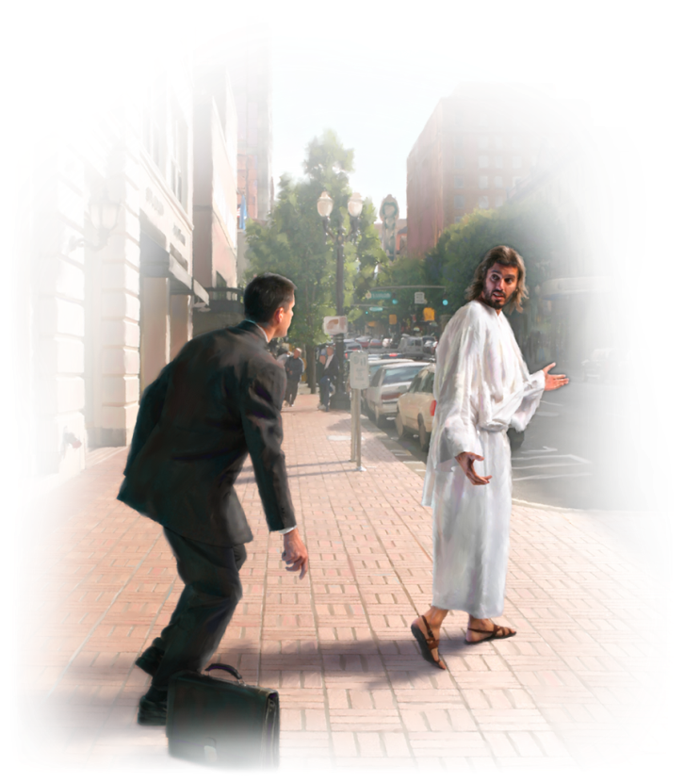
Here is the self test on true discipleship
Do you have a strong desire to follow Jesus and become like Him?
Do you love your brethren just as He loved you?
Do you share your faith with others which results in making new disciples?

Slide 21
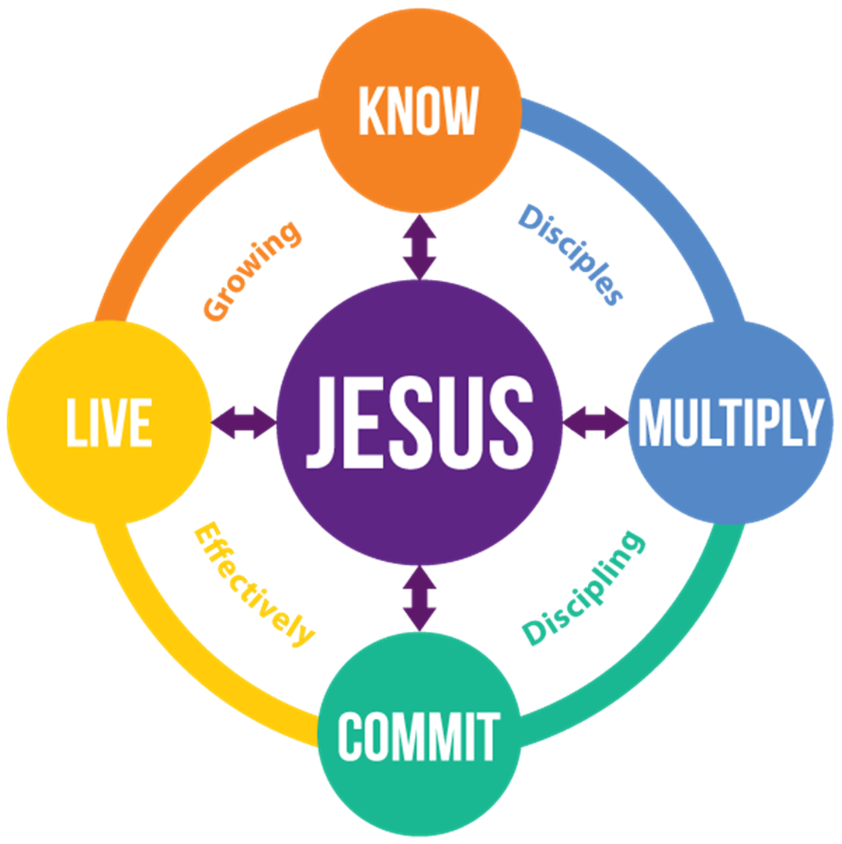

Slide 22
