Slide 1
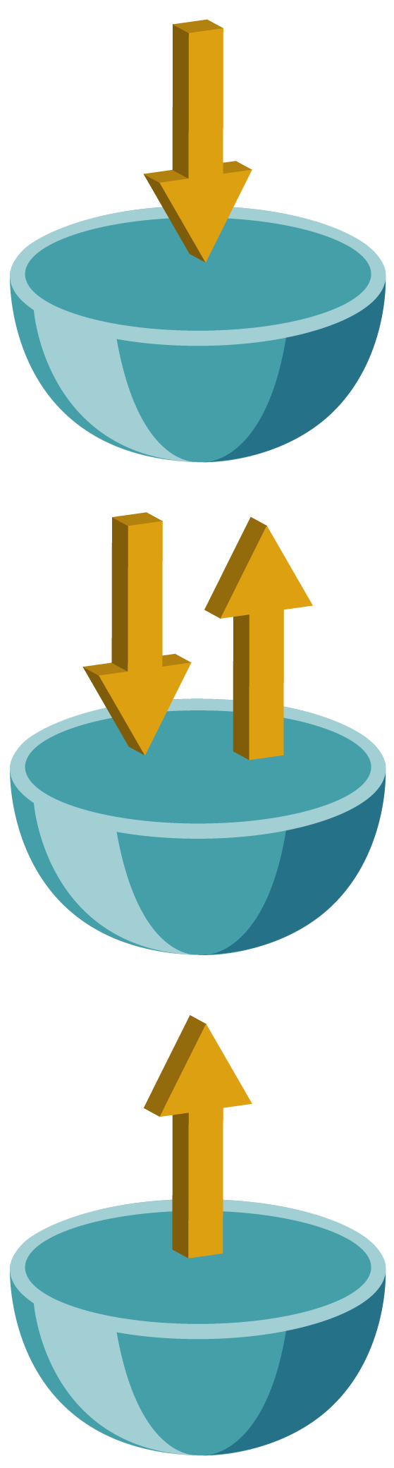
Takers, Traders, and Investors

Slide 2
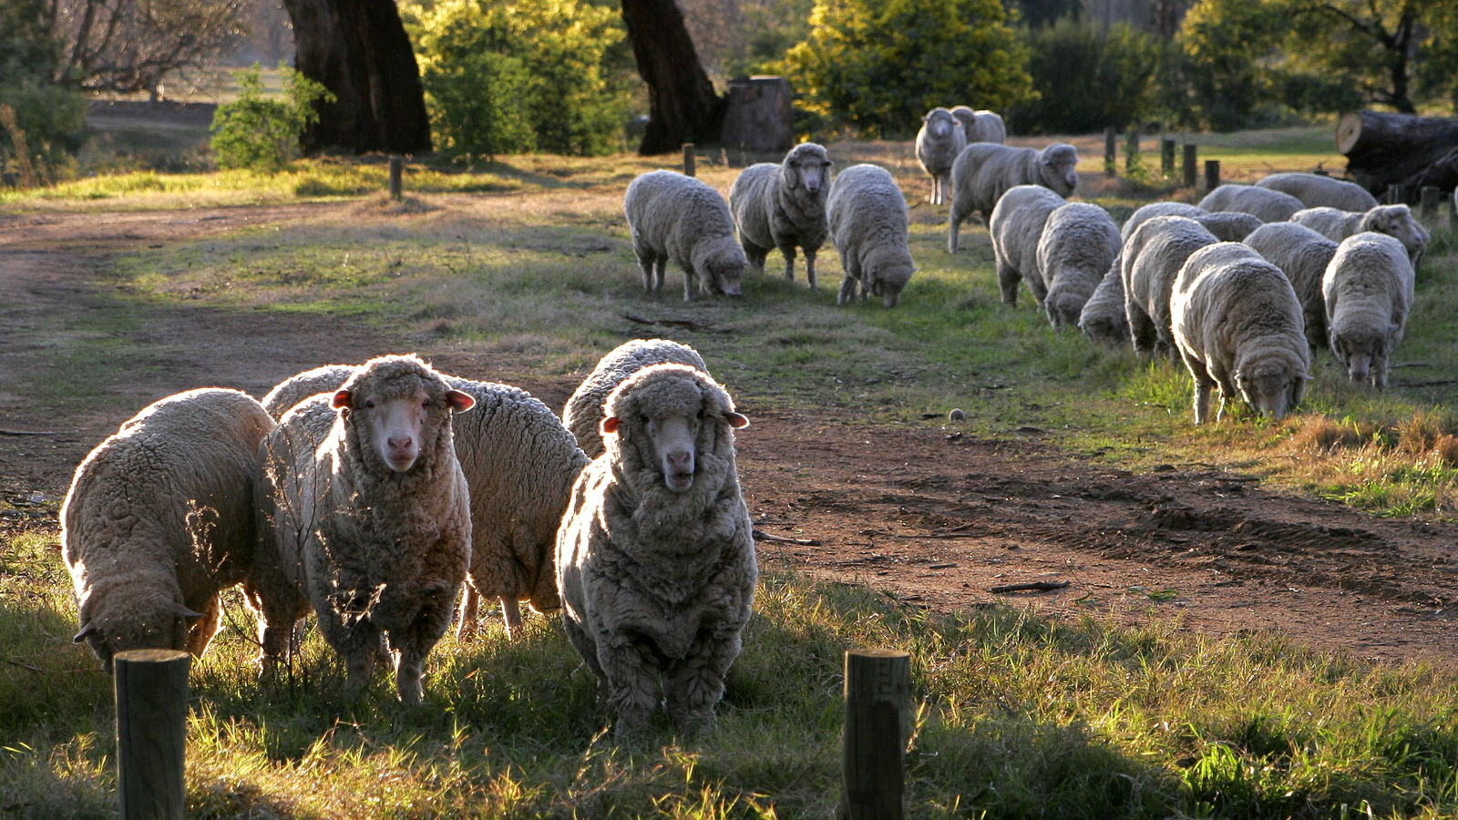
Attribution:Fir0002
Notes:
This photo was found by searching Wikimedia commons.
https://commons.wikimedia.org/wiki/File:Sheep_looking.jpg
Taken by Fir0002 (https://en.wikipedia.org/wiki/User:Fir0002)
This file is licensed under the Creative Commons Attribution-Share Alike 3.0 Unported license. You are free: to share – to copy, distribute and transmit the work
to remix – to adapt the work
Under the following conditions: attribution – You must give appropriate credit, provide a link to the license, and indicate if changes were made. You may do so in any reasonable manner, but not in any way that suggests the licensor endorses you or your use.
share alike – If you alter, transform, or build upon this work, you may distribute the resulting work only under the same or similar license to this one.

Slide 3
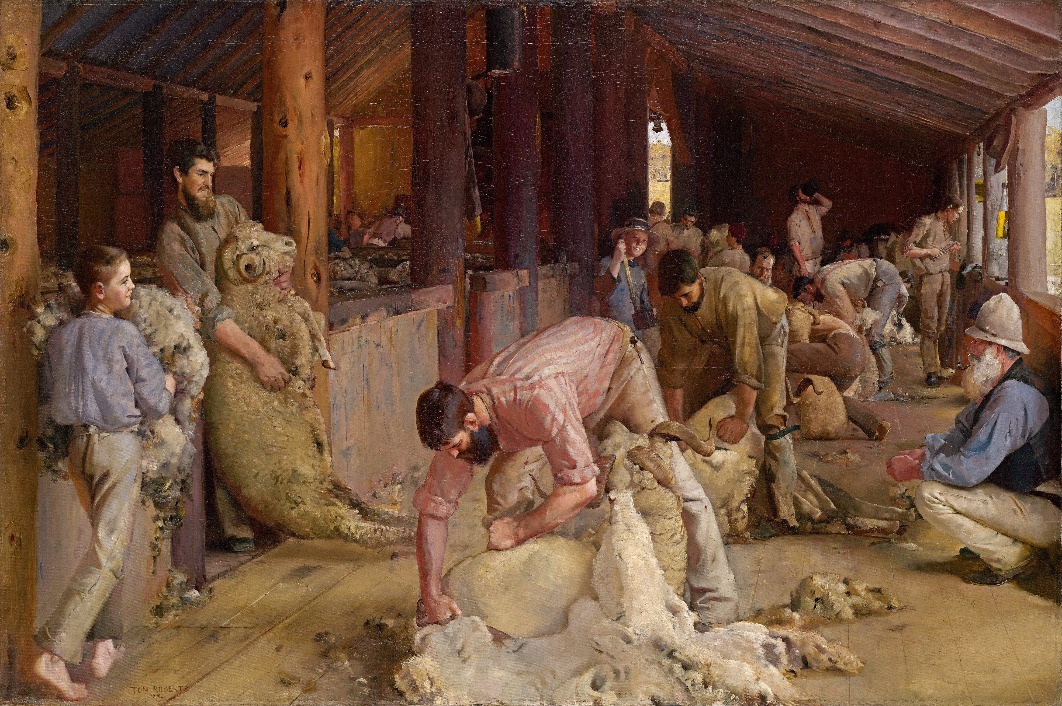
Notes:
This reproduction of this artwork was found by searching Wikimedia commons.
https://commons.wikimedia.org/wiki/File:Tom_Roberts_-_Shearing_the_rams_-_Google_Art_Project.jpg
The original painting was titled: Shearing the rams. It was painted in 1890. It was painted by Tom Roberts (1856-1931)
This work is in the public domain in the United States because it was published (or registered with the U.S. Copyright Office) before January 1, 1924.
The author died in 1931, so this work is in the public domain in its country of origin and other countries and areas where the copyright term is the author's life plus 80 years or less.

Slide 4

Nehemiah 8:10-12 KJV
Then he said to them, “Go your way, eat the fat, drink the sweet, and send portions to those for whom nothing is prepared.” . . . And all the people went their way to eat and drink, to send portions and rejoice greatly.

Slide 5
1 Samuel 25:5-8 KJV
David sent ten young men; and David said to the young men, “Go up to Carmel, go to Nabal, and greet him in my name. And thus you shall say to him who lives in prosperity: ‘Peace be to you, peace to your house, and peace to all that you have!’

Slide 6
1 Samuel 25:5-8 KJV
Now I have heard that you have shearers. Your shepherds were with us, and we did not hurt them, nor was there anything missing from them all the while they were in Carmel. Ask your young men, and they will tell you.

Slide 7
1 Samuel 25:5-8 KJV
Therefore, let my young men find favor in your eyes, for we come on a feast day. Please give whatever comes to your hand to your servants and to your son David.”

Slide 8
Deuteronomy 16:14 KJV
You shall rejoice in your feast, you and your son and your daughter, your male servant and your female servant and the Levite, the stranger and the fatherless and the widow, who are within your gates.

Slide 9
Luke 14:13,14 KJV
When you give a feast, invite the poor, the maimed, the lame, the blind. And you will be blessed, because they cannot repay you; for you shall be repaid at the resurrection of the just.

Slide 10
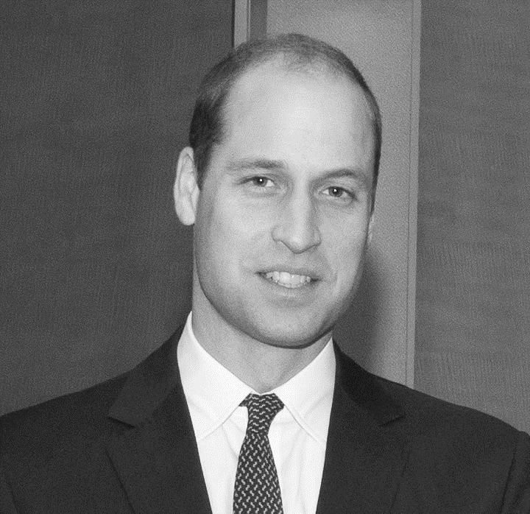
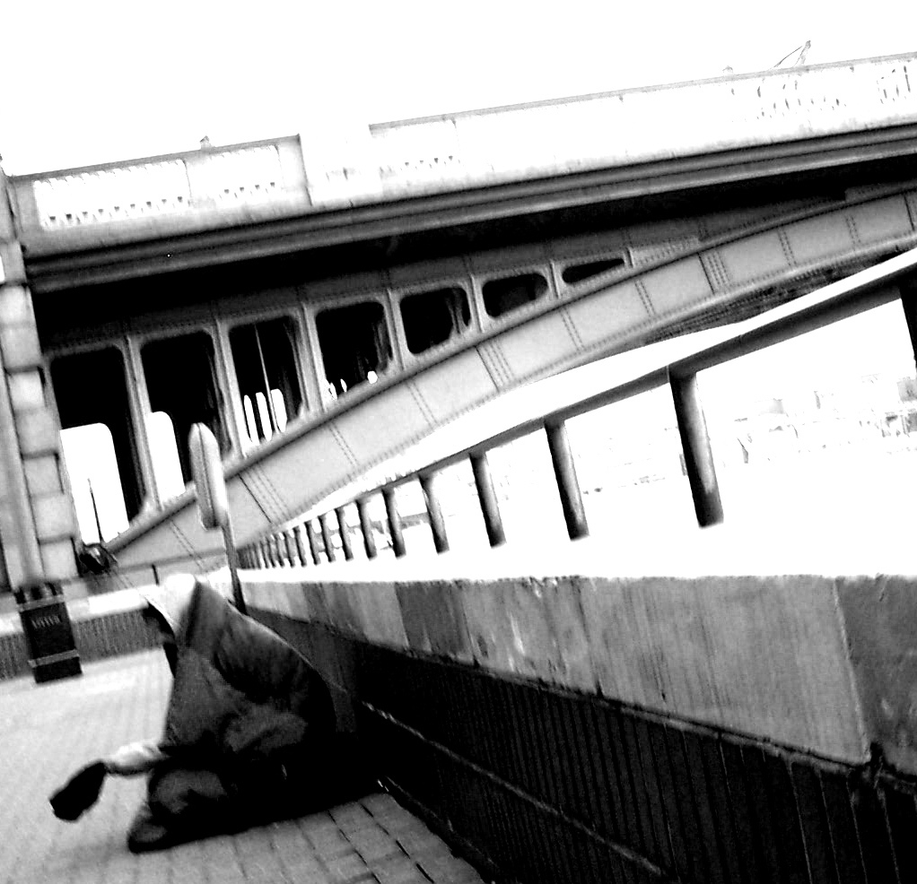
Attribution: http://www.cgpgrey.com
Notes:
Photos were found using Wikimedia commons.
The picture of Prince William, Duke of Cambridge is in the Public Domain in the United States because it is a work prepared by an officer or employee of the United States Government as part of that person’s official duties under the terms of Title 17, Chapter 1, Section 105 of the US Code.
https://commons.wikimedia.org/wiki/File:Prince_William,_Duke_of_Cambridge.jpg
The picture of the bridge is licensed under the Creative Commons Attribution 2.0 Generic license.
https://commons.wikimedia.org/wiki/File:2005-01-07_-_United_Kingdom_-_England_-_London_-_Homeless_at_the_Southwark_Bridge_-_Miscellenaeous_4887146105.jpg

Slide 11
Ezekiel 16:49 NIV
Now this was the sin of your sister Sodom: She and her daughters were arrogant, overfed and unconcerned; they did not help the poor and needy.

Slide 12
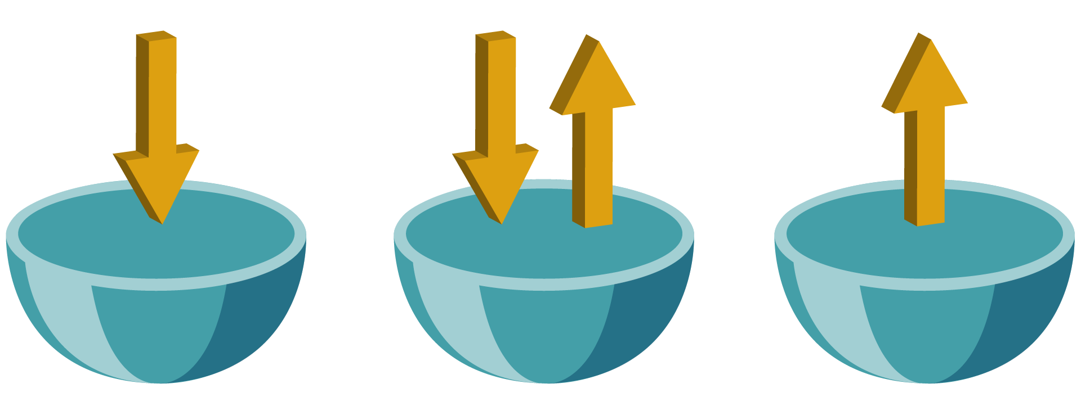
Takers
Traders
Investors

Slide 13
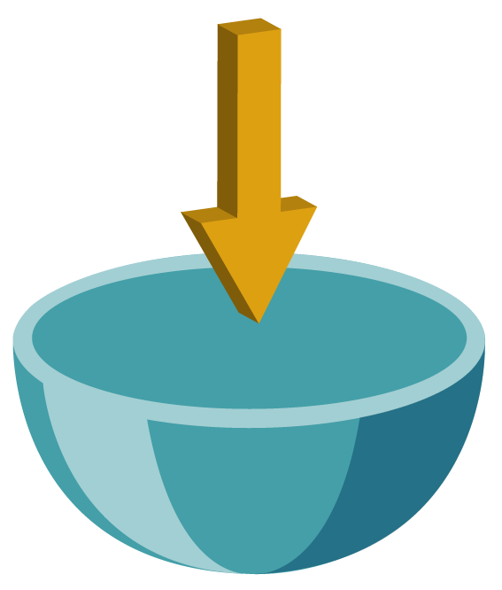
Takers
They take more than they give
They wait for others to give so that they can enjoy the benefits
They love to make “withdrawals” while they expect others to make “deposits”

Slide 14

traders
They give in order to receive
They are busy looking for their own set of friends
They may be generous with their friends, but they also keep a close eye on what they receive in return

Slide 15

investors
Investors actively look for ways to help
They look for strangers in church so that they can be friendly to them
They go out of their way to help those who are in need

Slide 16
investors
Their eyes are quick to notice what needs to be done and they do it
They give freely to support the church’s ministries
They give without a thought of receiving anything in return

Slide 17
2 Corinthians 8:1-5 KJV
Moreover, brethren, we make known to you the grace of God bestowed on the churches of Macedonia: that in a great trial of affliction the abundance of their joy and their deep poverty abounded in the riches of their liberality.

Slide 18
2 Corinthians 8:1-5 KJV
For I bear witness that according to their ability, yes, and beyond their ability, they were freely willing, imploring us with much urgency that we would receive the gift and the fellowship of the ministering to the saints.

Slide 19
2 Corinthians 8:1-5 KJV
And not only as we had hoped, but they first gave themselves to the Lord, and then to us by the will of God.

Slide 20
Personal Story
Notes:
This would be a good place to insert a personal story, or put the provided stories into third person.

Slide 21





Are you a Taker, Trader, or Investor?
How would you classify yourself?

Slide 22
Matthew 25:34-40 KJV
Then the King will say to those on His right hand, ‘Come, you blessed of My Father, inherit the kingdom prepared for you from the foundation of the world:

Slide 23
Matthew 25:34-40 KJV
for I was hungry and you gave Me food; I was thirsty and you gave Me drink; I was a stranger and you took Me in; I was naked and you clothed Me; I was sick and you visited Me; I was in prison and you came to Me.

Slide 24
Matthew 25:34-40 KJV
. . . And the King will answer and say to them, “Assuredly, I say to you, inasmuch as you did it to one of the least of these My brethren, you did it to Me,”

Slide 25
Personal Story
Notes:
This would be a good place to insert a personal story, or put these stories into third person.

