Slide 1

discipleship network
nzpuc

Slide 2
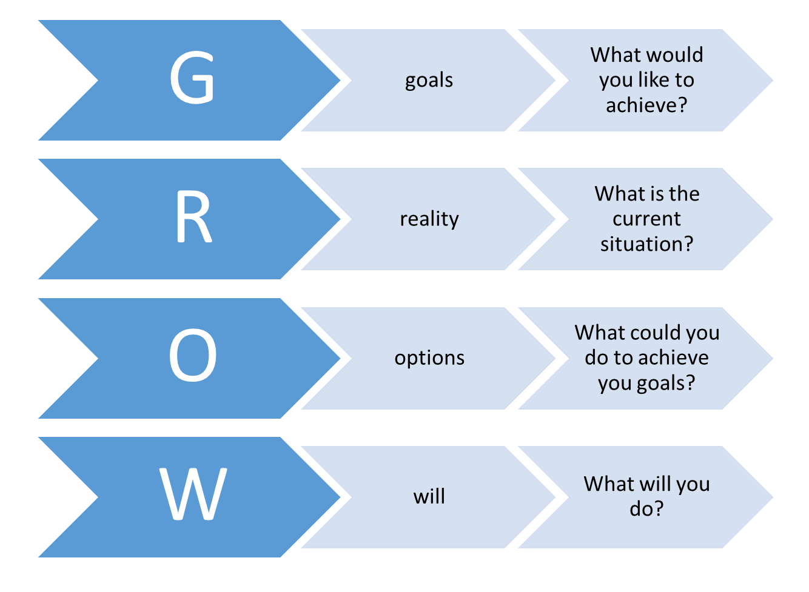
Coaching Sessions Design
coaching format
coaching model
10 min
  Prayer
  Relationships
    what’s new
  Celebrate
  Accountability
40 min
  GROW – coaching model
10 min
  Anything else?
  Prayer

Slide 3
R
reality
What is the current situation?
O
options
What could you do to achieve you goals?
W
will
What will you do?
G
goals
What would you like to achieve?

Slide 4
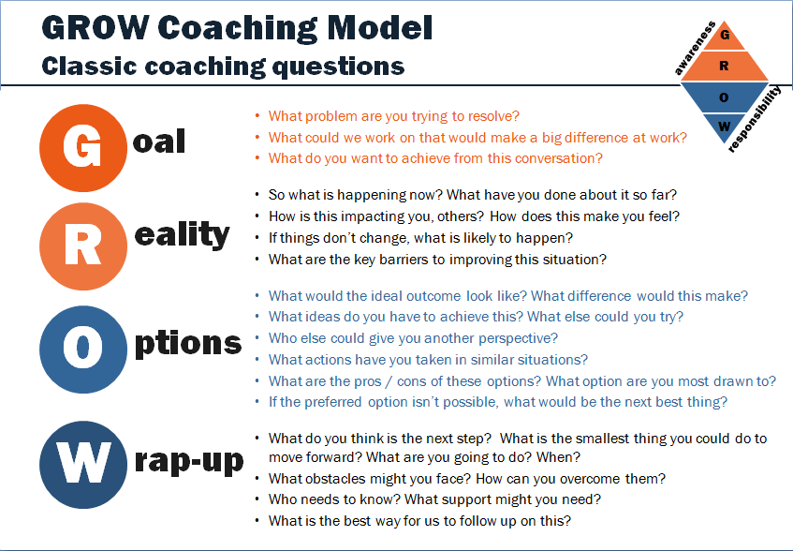

Slide 5
