Slide 1

Discipleshift in NZPUC

Slide 2

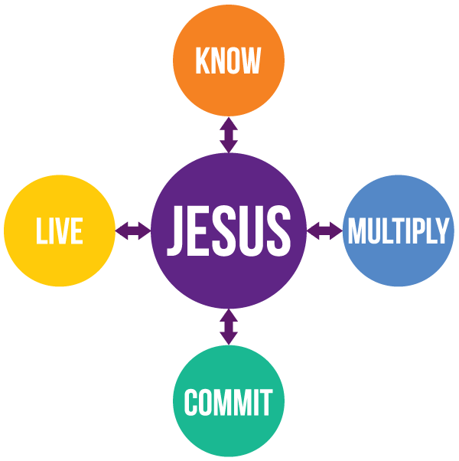
“You are truly my disciples if you remain faithful to my teachings.” John 8:31 NLT
And John 17:3
behold
“Your love for one another will prove to the world that you are my disciples.”
John 13:35 NLT
“This is to my Father's glory, that you bear much fruit, showing yourselves to be my disciples.” John 15:8 NIV
belong
bear
“And if you do not carry your own cross and follow me, you cannot be my disciple.” Luke 14:27 NLT
believe

Slide 3
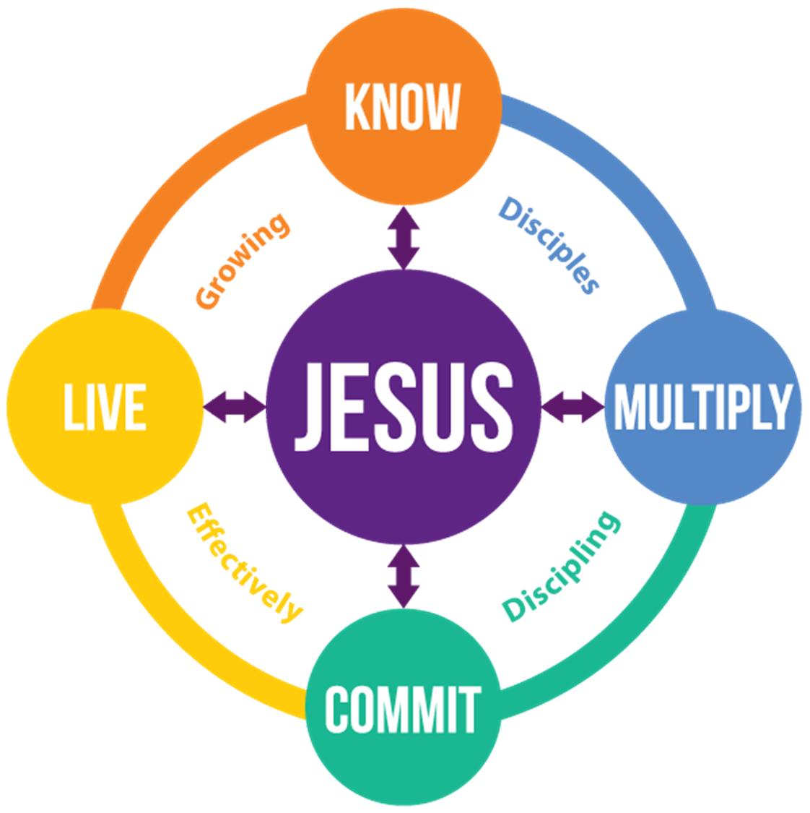

Slide 4

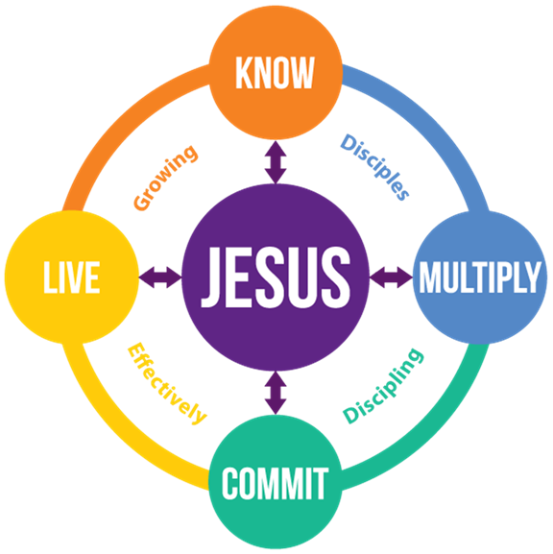
A disciple, while becoming more like Jesus, makes disciples.
Discipleship is a journey of a deepening KNOWledge of Jesus, growing in COMMITMENT to Him and His body, LIVING and serving in loving community and MAKING disciples.

Slide 5
inputs
process
outputs
Encounter with Jesus
Passion for living in the presence of God
Personal Experience of Grace
Gospel view of God
Appreciation of other believers
Concern for others (seek and save)
outcomes
impact
Disciples, while becoming more like* Jesus, make** disciples.
*Galatians 5:22-23
1 John 4:20
John 13:35
** John 15:8
Believers are growing spiritually, connected with each other as they grow in influence in their local community.

Slide 6
Words
Modelling
Experience

Slide 7
‘Word’
Gospel
Live
Groups
Mission
Sermons
Sabbath School/Life Groups
Blogs/Bulletins
Additional Reading
Leaders Meetings
Community
Inclusive
Vulnerable
Trust
Love etc…
Witnessing 411 (Steve Addison)
Other Community Projects

Slide 8
inputs
Following Jesus
Self review
Desire of Ages
Sermons
Leadership Material
Training Material
process
Gospel Preaching
Journey with Jesus
Life Groups
Active witnessing
Community Services
outputs
Encounter with Jesus
Passion for living in the presence of God
Personal Experience of Grace
Gospel view of God
Appreciation of other believers
Concern for others (seek and save)
outcomes
impact
Disciples, while becoming more like* Jesus, make** disciples.
*Galatians 5:22-23
1 John 4:20
John 13:35
** John 15:8
Believers are growing spiritually, connected with each other as they grow in influence in their local community.

Slide 9
inputs
Sermons*
Journey with Jesus*
Following Jesus Book
Self review bookmark
Leaders Training Material*
process
Pastor to identify key leaders
Monthly leaders meetings
Journey with Jesus Campaign
Gospel Sermons
Blogs
Additional Reading
Start of 1 Life Group
Following Jesus Method
outputs
The leadership team and members have clarity around D Values and Processes; are excited about their new journey.
outcomes
impact
3 months journey
Leader in my local church have started to mobilise to live out Discipleship Values.
* These resources are provided by the NZPUC Discipleship Ministries at no cost to you.

Slide 10
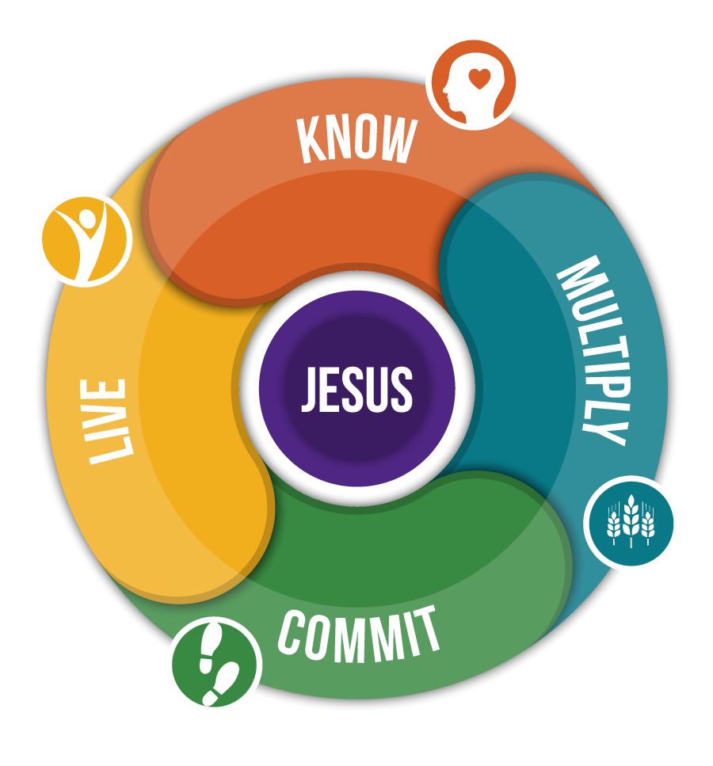

Slide 11


To KNOW is to personally discover, and be transformed by, the presence of Jesus.

Slide 12


To LIVE is to choose a Jesus inspired lifestyle that transforms our relationships.

Slide 13


To COMMIT is to unconditionally embrace Jesus’ will for my life and His Church in everything that I am, I do and I have.

Slide 14


To MULTIPLY is to actively engage with the unchurched so they personally discover, and are transformed by, the presence of Jesus.

