Slide 1
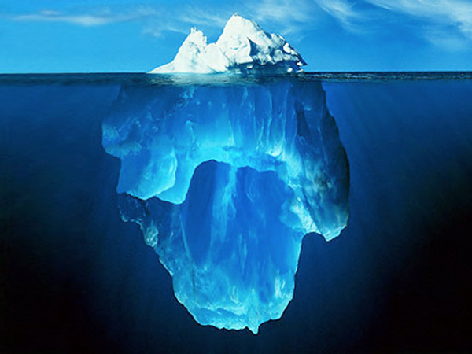
  What people see…
  Behavior
  Values
  Beliefs
  Worldview
  What is hidden…

Slide 2


what is intentional Christian living?
Intentional Christian living is centered on discipleship
What are we seeking?
  Baptisms?
  Church-members?
  Real disciples?
The existence of true disciples is the greatest evidence of God’s work and the advancement of His Kingdom
Notes:
From ancient times, we humans have been myth weavers, storytellers, poets, novelists, and bloggers.

Slide 3

discipleship:
the path to transformation

Slide 4
the importance of discipleship
Greatest problem: Christianity/Adventism without discipleship
Main difficulties related with discipleship:
  Nature
  Scope
  Development
Notes:
From ancient times, we humans have been myth weavers, storytellers, poets, novelists, and bloggers.

Slide 5
the meaning of discipleship
Discipleship today is a concept much broader than what it was in the past.
Result of the integration of three movements:
  Classical discipleship
  Biblical spirituality
  Relational discipleship
Notes:
From ancient times, we humans have been myth weavers, storytellers, poets, novelists, and bloggers.

Slide 6
following the Master
Christ taught us that having faith means to follow.
This is the first test of faith.
This is the basic presupposition of discipleship.
  “If anyone desires to come after Me, let him deny himself, and take up his cross daily, and follow Me.” (Luke 9:23)
Notes:
From ancient times, we humans have been myth weavers, storytellers, poets, novelists, and bloggers.

Slide 7
the nature of discipleship
In simple terms, discipleship means to follow and learn from a master
One of the greatest problems is the lack of comprehension of discipleship as a process
Discipleship is vital to the healthy development of any local church
Discipleship is the “soul” of intentional living
Notes:
From ancient times, we humans have been myth weavers, storytellers, poets, novelists, and bloggers.

Slide 8
the nature of discipleship
Discipleship cannot be seen as a program.
Discipleship cannot be seen as a department or a ministry of the church.
Discipleship needs to permeate the “whole” of any local church.
Notes:
From ancient times, we humans have been myth weavers, storytellers, poets, novelists, and bloggers.

Slide 9
main barriers… lack of:
Submission
Vulnerability
Change
Confession
Effort
Commitment
Discipline
Obedience
Notes:
From ancient times, we humans have been myth weavers, storytellers, poets, novelists, and bloggers.

Slide 10
Steps to Christ, p. 60
“Obedience—the service and allegiance of love—is the true sign of discipleship.”

Slide 11
discipleship: our mission
The Great Commission
  It is found in different versions in the Gospels (Mark 16:15-16; Luke 24:44-49; John 20:19-23)
  It is also found in the book of Acts (1:1-2a, 6-8).
  The most known: Matthew 28:18-20
    One imperative (order)
    Three participles (actions, movements)
Notes:
From ancient times, we humans have been myth weavers, storytellers, poets, novelists, and bloggers.

Slide 12
discipleship: our mission
The Great Commission is TO MAKE DISCIPLES
  How a disciple is formed?
    At the “new” birth?
    Through training?
    Both?
  How a disciple is maintained?
    Alone?
    In community?
Notes:
From ancient times, we humans have been myth weavers, storytellers, poets, novelists, and bloggers.

Slide 13
discipleship: our mission
The Great Commission is TO MAKE DISCIPLES
  Christ has never asked us to go in to world to “make church members.”
  With the Great Commission, transformation became the mission
Notes:
From ancient times, we humans have been myth weavers, storytellers, poets, novelists, and bloggers.

Slide 14
Testimonies, Vol 3, p. 381
“The mission of the church of Christ is to save perishing sinners. It is to make known the love of God to men and to win them to Christ by the efficacy of that love.”

Slide 15
discipleship = transformation
What is transformation?
How can it be achieved?
  Conversion (event)
  Happens over time
  Use of one’s will
  Individual journey
  Transformation

Slide 16
discipleship = transformation
This understanding about transformation has some basic presuppositions:
  Transformation happens in the moment of conversion (“surrender”)
  It continues (“grows”) as time goes by
  It is achieved mainly by an act of the will
  The best way is alone

Slide 17
discipleship = transformation
Transformation at conversion (event)?
  There is a deep, miraculous change of habits, attitude, and so on.
  This is the Saul/Paul model. The experience of the Damascus Road.
  Change is always the immediate result of conversion

Slide 18
discipleship = transformation
Continuous transformation as time goes by?
  Faith “automatically” grows with time.
  The greater is the “church experience” the more spiritually mature one becomes.
  In this model, the main effort in making disciples is only filling up the church with people.
  It is what really happens with time?

Slide 19
discipleship = transformation
Transformation is achieved only by an effort of the will?
  What does not happen with time, will happens when we make our best.
  The fruit of the Spirit always comes when we dedicate the required effort.
  In this model, the only barrier to become a disciple is the effort used.

Slide 20
discipleship = transformation
Transformation is better achieved alone?
  Independency, spiritual individualism
  A “personal relationship” with Jesus became synonymous of “particular relationship” with Jesus.
  The vast majority of books, seminars, sermons is centered on this idea: all is a matter of individual application.

Slide 21
discipleship = transformation
If these presuppositions were valid, the results would be a exponential growth, not only in numbers, but especially in the spiritual life of every church member
Why we do not see the transformation we dream of?
Wouldn’t be necessary an adjustment in these views on discipleship?

Slide 22
discipleship = transformation
Transformation begins at conversion (salvation)
  This is the view that we accept
  This is the beginning of the sanctification process
  This is a journey towards complete transformation.
  Paul himself experienced this reality.

Slide 23
discipleship = transformation
Transformation takes more than just time
  Being exposed to “information” is not enough.
  Have church members really understood and committed themselves to this process?
  Unfortunately, church pews are full of individuals who have been there for years but never went through real transformation.

Slide 24
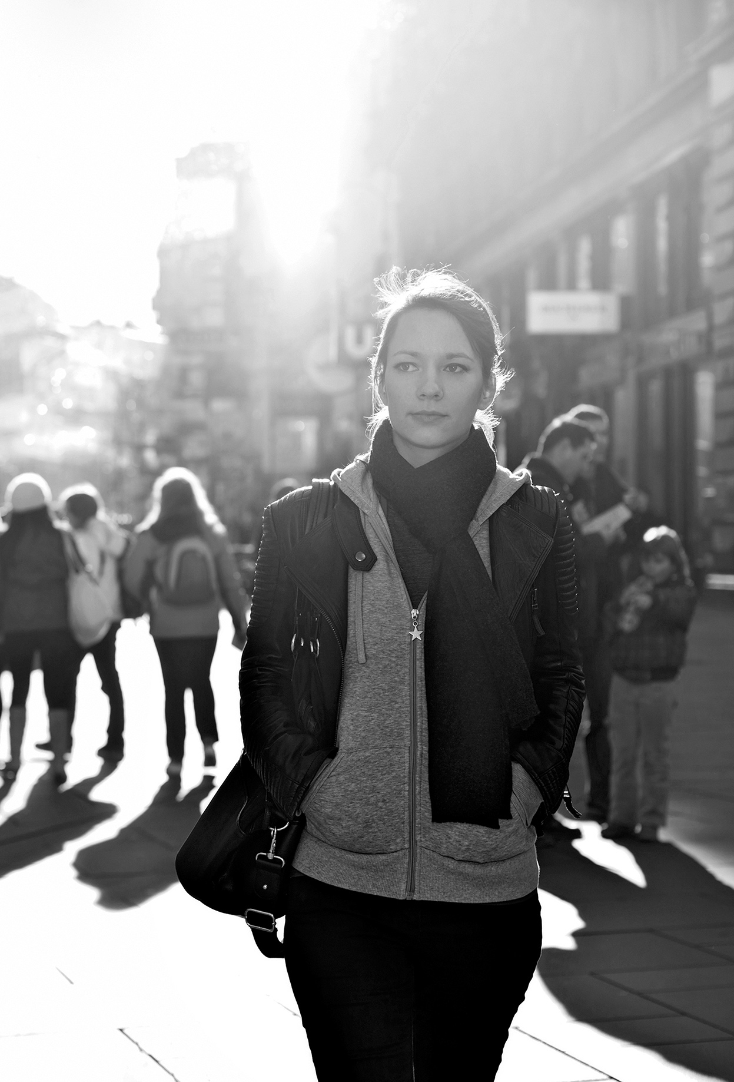
Hebrews 5:12-13
“In fact, though by this time you ought to be teachers, you need someone to teach you the elementary truths of God’s word all over again. You need milk, not solid food! Anyone who lives on milk, being still an infant, is not acquainted with the teaching about righteousness.”

Slide 25
Hebrews 5:12-13
“In fact, though by this time you ought to be teachers, you need someone to teach you the elementary truths of God’s word all over again. You need milk, not solid food! Anyone who lives on milk, being still an infant, is not acquainted with the teaching about righteousness.”

Slide 26
discipleship = transformation
Transformation takes learning and not only personal desire (use of the will).
  “Trying” to experience life transformation never brings the results were need.
  “Train yourself to be godly.” (1 Timothy 4:7, NIV)
  Be a disciple does not happen simply by “trying.” It takes dedication and training.
  Discipleship involves teaching/learning.

Slide 27
discipleship = transformation
Transformation takes learning and not only personal desire (use of the will).
  “The student is not above the teacher, but everyone who is fully trained will be like their teacher.” (Luke 6:40, NIV)
  How much training is necessary?
  Disciple vs. “Discipler”
  Training for trainers (T4T)

Slide 28
discipleship = transformation
Transformation is also a process that happens within a community
  Example: AA
  What is their secret? System of relationships and personal support
  “As iron sharpens iron, so one person sharpens another.”(Proverbs 27:17, NIV)
  The value of community (Hebrews 10:24-25)

Slide 29
discipleship = transformation
Transformation is also a process that happens within a community
  Synergy created by the group
  The power of “small groups”
  In community we find the best environment to a healthy development of the discipleship process.
  It goes beyond growth. It is growing “together”
  Discipleship cannot be a lonely experience.

Slide 30
discipleship = transformation
What is transformation?
Some changes are essential:
  Conversion (event)
  Happens over time
  Use of one’s will
  Individual journey
  Transformation

Slide 31
discipleship = transformation
What is transformation?
Some changes are essential:
  Conversion (process)
  Happens over time
  Use of one’s will
  Individual journey
  Transformation

Slide 32
discipleship = transformation
What is transformation?
Some changes are essential:
  Conversion (process)
  Intentionality
  Use of one’s will
  Individual journey
  Transformation

Slide 33
discipleship = transformation
What is transformation?
Some changes are essential:
  Conversion (process)
  Intentionality
  Capacitation
  Individual journey
  Transformation

Slide 34
discipleship = transformation
What is transformation?
Some changes are essential:
  Conversion (process)
  Intentionality
  Capacitation
  Community
  Transformation

Slide 35
implications
Fundamental steps in a meaningful discipleship process:
  Need of continuous capacitation/training
    Spiritual disciplines
    Christian service
  Creation of opportunities for meaningful relationships
    Intentionality
    Group life

Slide 36
sharing Christ
with unbelievers

Slide 37
how to share my faith?
Keep a humble, prayerful attitude, speaking the truth in love
  We cannot change their worldview
  We can only present Christ to them
  We have been called to share the reasons of our faith (1 Peter 3:15)
  How? Speak the truth in love (Ephesians 4:15)
Notes:
From ancient times, we humans have been myth weavers, storytellers, poets, novelists, and bloggers.

Slide 38
how to share my faith?
Pay attention to the reasons of their unbelief
  Many of them decide to reject religion because of bad past experiences (church, family, friends)
  Never underestimate the need to understand what they think and value and how they feel in responding to their questioning
Notes:
From ancient times, we humans have been myth weavers, storytellers, poets, novelists, and bloggers.

Slide 39
how to share my faith?
Use Christian apologetics with wisdom and tact
  The art of persuasion (knowledge, reason) is an important role Christian apologetics
  Apology – “give a defense”
  How? “But do this with gentleness and respect.” (1 Peter 3:15b)
  What is the point in winning an argumentation and losing a “possible friend”?
Notes:
From ancient times, we humans have been myth weavers, storytellers, poets, novelists, and bloggers.

Slide 40
how to share my faith?
If possible, invite them to your home first, then to your church.
  Sceptics are normal people with normal feelings and struggles
  Problem? Treat them as trophies to be conquered rather than people to be appreciated and loved
  Trust-building is crucial
  Share your personal life-story
Notes:
From ancient times, we humans have been myth weavers, storytellers, poets, novelists, and bloggers.

Slide 41

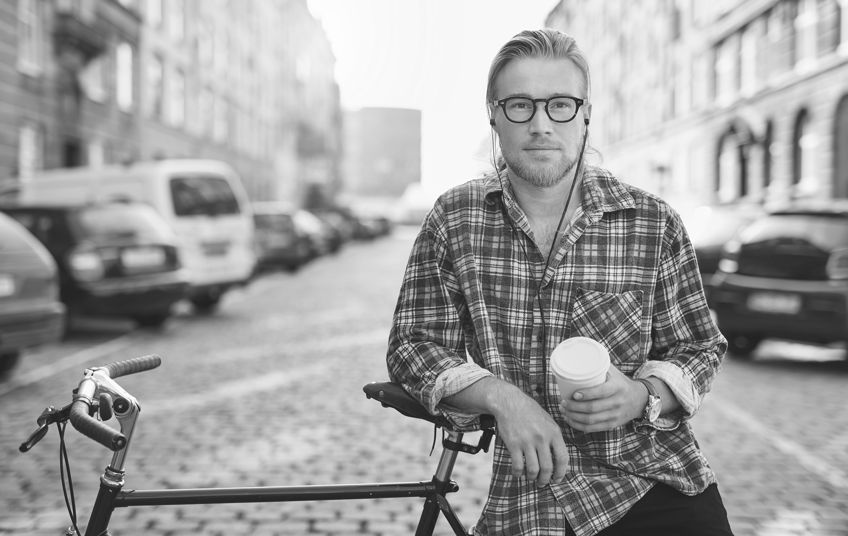


THANK YOU!

Slide 42
questions?

