Slide 1

Intentional Christian Living:
How to (Really!) Share Christ in Post-Christian and Pluralistic Contexts
re-Ignite the Advent Movement
New Zealand Pacific Union Conference
Ministerial Summit
Auckland, April 23-26, 2018
By Kleber D. Gonçalves

Slide 2


introduction

Slide 4


Slide 5


Slide 6


Slide 7


Slide 8


Slide 9


Slide 12

a new reality
We live in an increasingly post-Christian world
A moment of conflict, tension, challenges, crisis
  A real threat?
  A real opportunity?
Notes:
From ancient times, we humans have been myth weavers, storytellers, poets, novelists, and bloggers.

Slide 13
a new reality
Spiritual development
  Disassociated from religious institutions
  Many people in the Western world still say they believe in “something”
Notes:
From ancient times, we humans have been myth weavers, storytellers, poets, novelists, and bloggers.

Slide 14
    THE CHALLENGE
    Largest “religious” groups in the world:
1st – Christians (2.2 billion)
2nd – Muslims (1.6 billion)
3rd – Non-religious/unaffiliated (1.1 billion)

Slide 15
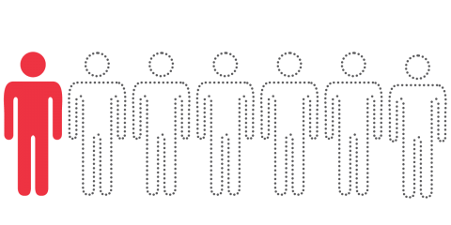
    THE CHALLENGE
    1 in 7

Slide 16
    WHO
    ARE
    THEY?

Slide 17

Notes:
They are in many aspects similar to us…

Slide 18
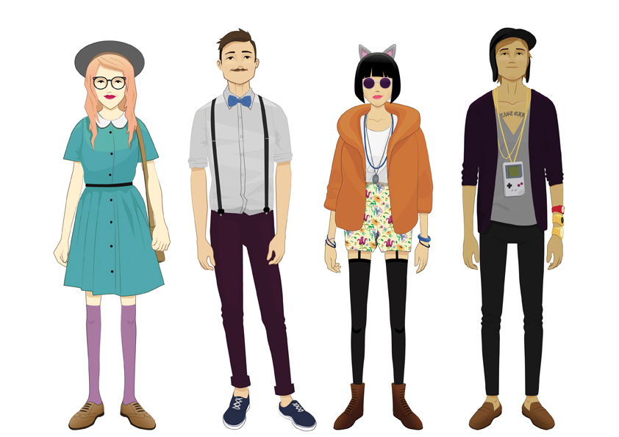
Notes:
But at the same time they are quite different from us…
To the church standards many of them are NOT normal people…

Slide 19
    WHERE
    ARE
    THEY?

Slide 20
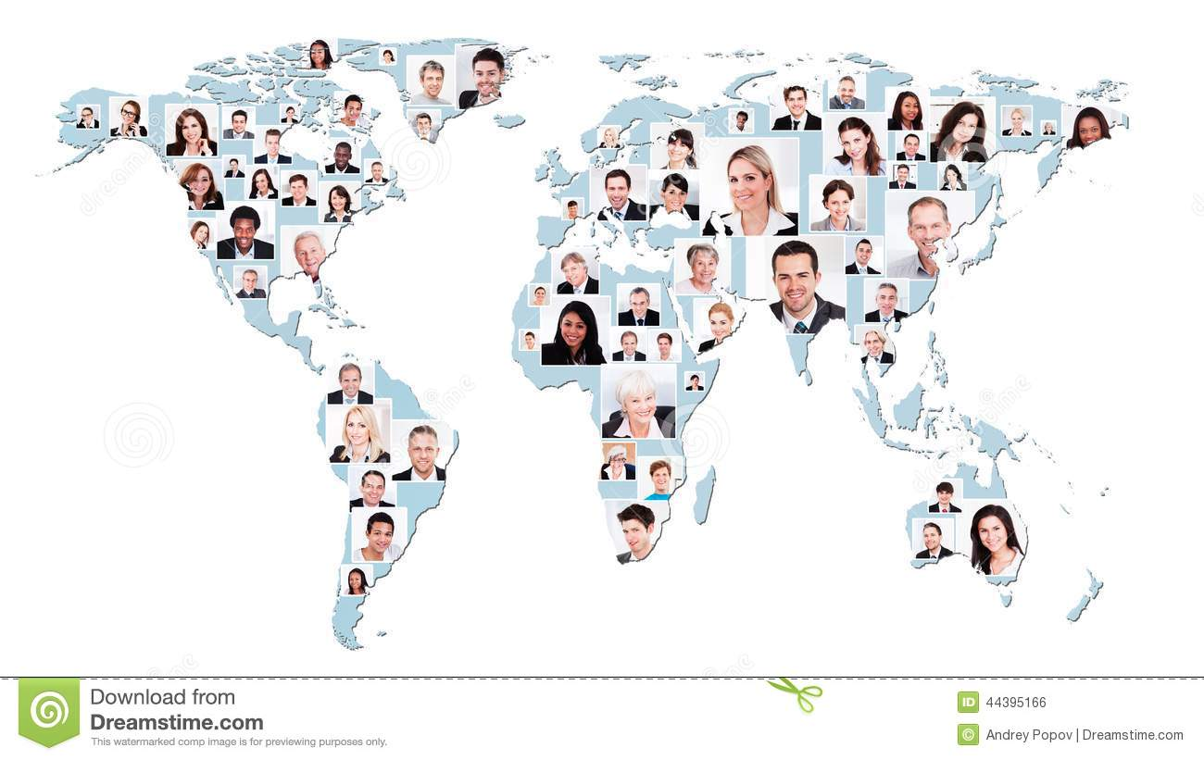
Notes:
They are everywhere.
In every continent.
In every city.
In most religious traditions.

Slide 21


Slide 22
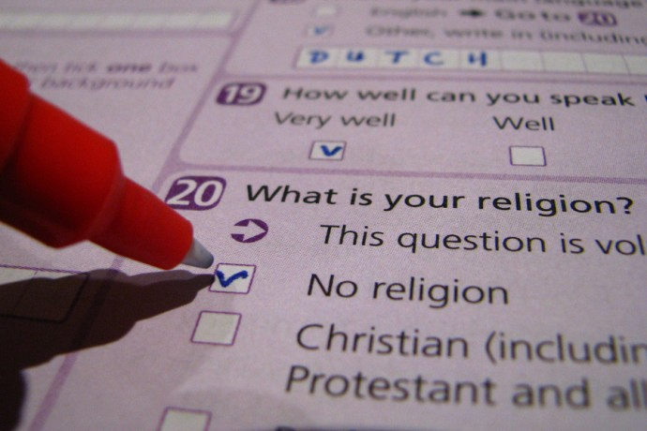
    THE CHALLENGE

Slide 23
GREAT BRITAIN

Slide 24
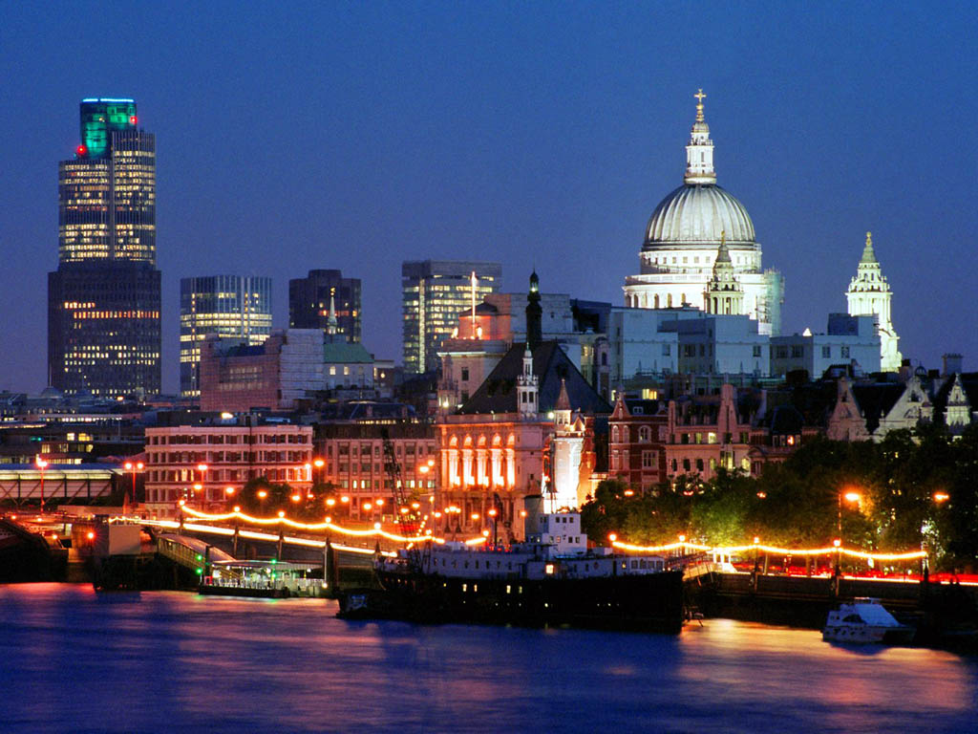

Slide 25
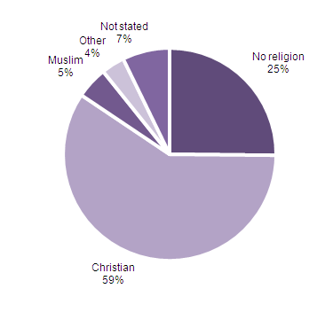
    Great Britain’s Religion

Slide 26
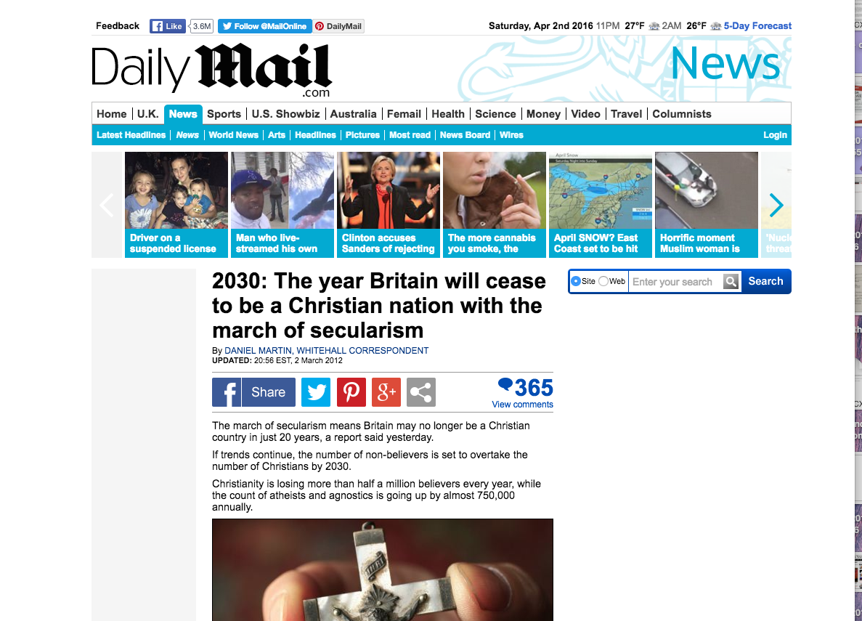

Slide 27
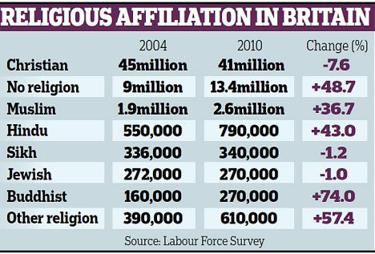

Slide 28
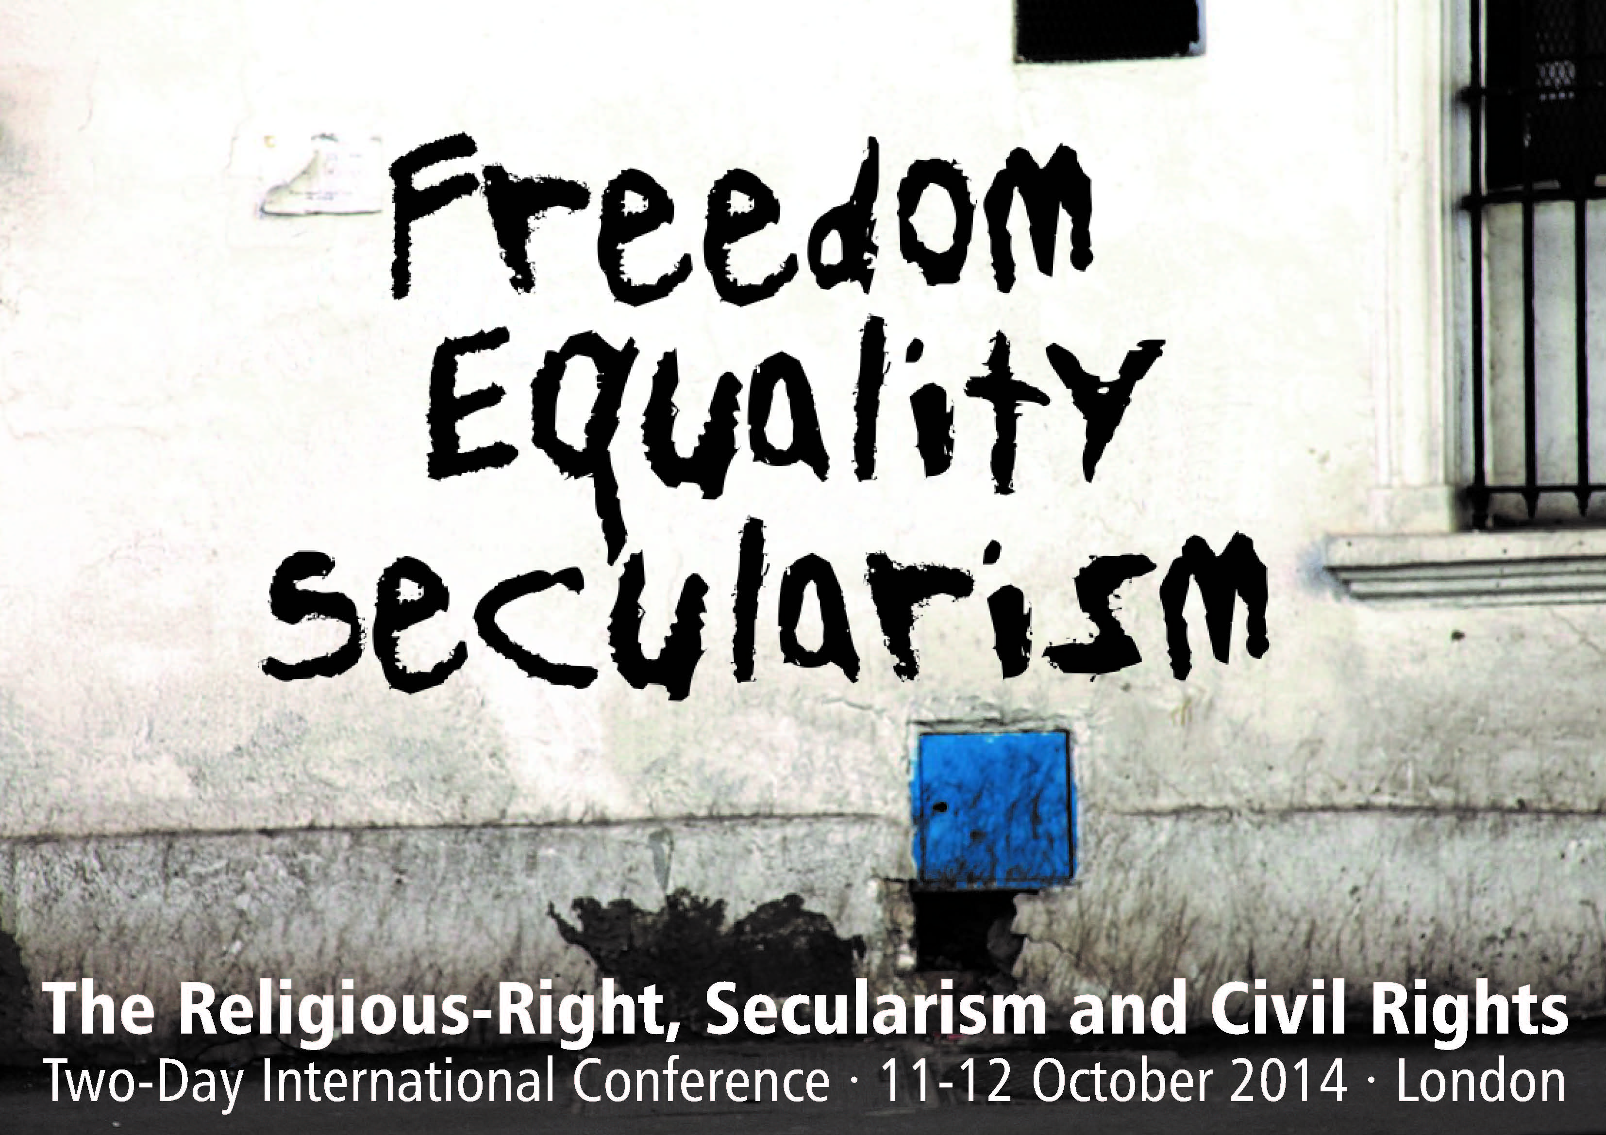

Slide 29
United States

Slide 34
AUSTRALIA

Slide 36
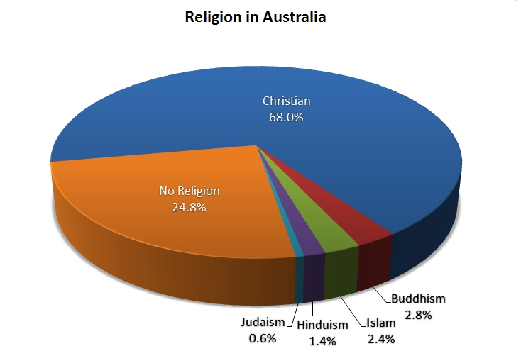
    Religious Affiliation in Australia

Slide 39
NEW ZEALAND

Slide 41
    Religious Affiliation in New Zealand

Slide 42
    Religious Affiliation in New Zealand

Slide 46
a new reality
Spiritual development
  Disassociated from religious institutions
  Many people in the Western world still say they believe in “something”
  Blend of anything acceptable to one’s perspective
  People are engaging in spiritual experiences of their own choice
Notes:
From ancient times, we humans have been myth weavers, storytellers, poets, novelists, and bloggers.

Slide 47
a new reality
Social structures
  Searching for happiness
  Economic and physical security
  Subjective well-being, self-expression, quality of life
  People are developing social arrangements of their own choice
Notes:
From ancient times, we humans have been myth weavers, storytellers, poets, novelists, and bloggers.

Slide 48
a new reality
Multicultural society
  Heavily influenced by globalization
  Economic hardships
  Immigration of migrant workers
  It requires
    A new attitude of tolerance toward others
    A new worldview
Notes:
From ancient times, we humans have been myth weavers, storytellers, poets, novelists, and bloggers.

Slide 49
sharing Christ in post-Christian and pluralistic contexts

Slide 50
Ephesians 5:1-2, NVI
“Be imitators of God, therefore, as dearly loved children and live a life of love, just as Christ loved us and gave Himself up for us as a fragrant offering and sacrifice to God.”

Slide 51
Ephesians 5:1-2, NVI
“Be imitators of God, therefore, as dearly loved children and live a life of love, just as Christ loved us and gave Himself up for us as a fragrant offering and sacrifice to God.”

Slide 52
Ephesians 5:1-2, NVI
“Be imitators of God, therefore, as dearly loved children and live a life of love, just as Christ loved us and gave Himself up for us as a fragrant offering and sacrifice to God.”

Slide 53
Ephesians 5:8-10, NVI
“For you were once darkness, but now you are light in the Lord. Live as children of light (for the fruit of the light consists in all goodness, righteousness and truth) and find out what pleases the Lord.”

Slide 54
Ephesians 5:8-10, NVI
“For you were once darkness, but now you are light in the Lord. Live as children of light (for the fruit of the light consists in all goodness, righteousness and truth) and find out what pleases the Lord.”

Slide 55
Ephesians 5:8-10, NVI
“For you were once darkness, but now you are light in the Lord. Live as children of light (for the fruit of the light consists in all goodness, righteousness and truth) and find out what pleases the Lord.”

Slide 56
Ephesians 5:15-16, NVI
“Be very careful, then, how you live—not as unwise but as wise, making the most of every opportunity, because the days are evil.”

Slide 57
Ephesians 5:15-16, NVI
“Be very careful, then, how you live—not as unwise but as wise, making the most of every opportunity, because the days are evil.”

Slide 58
Ephesians 5:15-16, NVI
“Be very careful, then, how you live—not as unwise but as wise, making the most of every opportunity, because the days are evil.”

Slide 59
what is intentional Christian living?
Being imitators (followers) of Jesus
Living a life of love
Living as children of light
Finding out what pleases Jesus
Being careful how you live
Making the most of every opportunity
Notes:
From ancient times, we humans have been myth weavers, storytellers, poets, novelists, and bloggers.

Slide 60
what is intentional Christian living?
Intentional living flows out a life of a real disciple of Christ
It is a renewed way of following Christ
  Doing
  Feeling
  Thinking
Notes:
From ancient times, we humans have been myth weavers, storytellers, poets, novelists, and bloggers.

