Slide 1

Sharing Our Faith with
Post-Christian Generations:
The Power of Storytelling
re-Ignite the Advent Movement
New Zealand Pacific Union Conference
Ministerial Summit
Auckland, April 23-26, 2018
By Kleber D. Gonçalves

Slide 2


Suggestive principles
Experience
Community
Storytelling
Notes:
From ancient times, we humans have been myth weavers, storytellers, poets, novelists, and bloggers.

Slide 3

storytelling in history

Slide 4
Storytelling in history
The use of narrative, stories as a way in organizing life.
Self-expressions
Communication process
Notes:
From ancient times, we humans have been myth weavers, storytellers, poets, novelists, and bloggers.

Slide 5
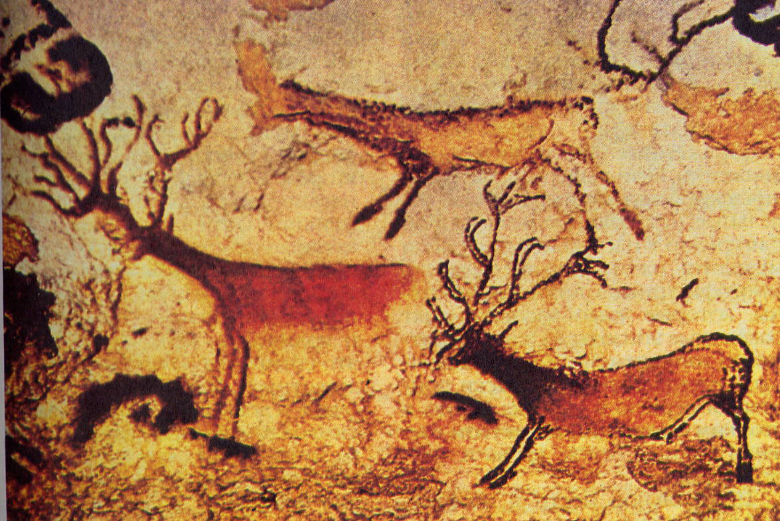

Slide 6
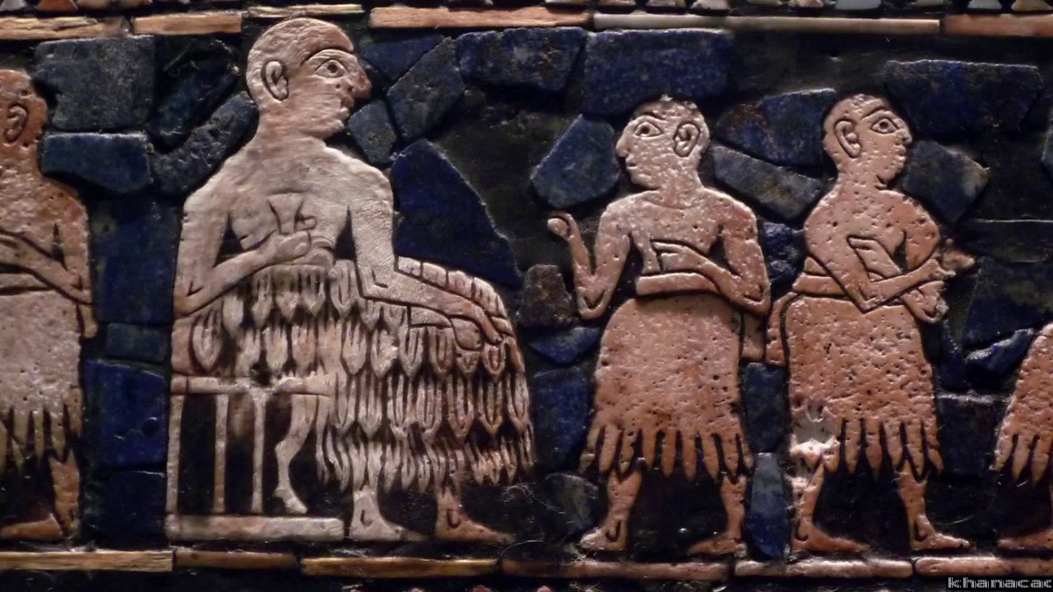

Slide 7
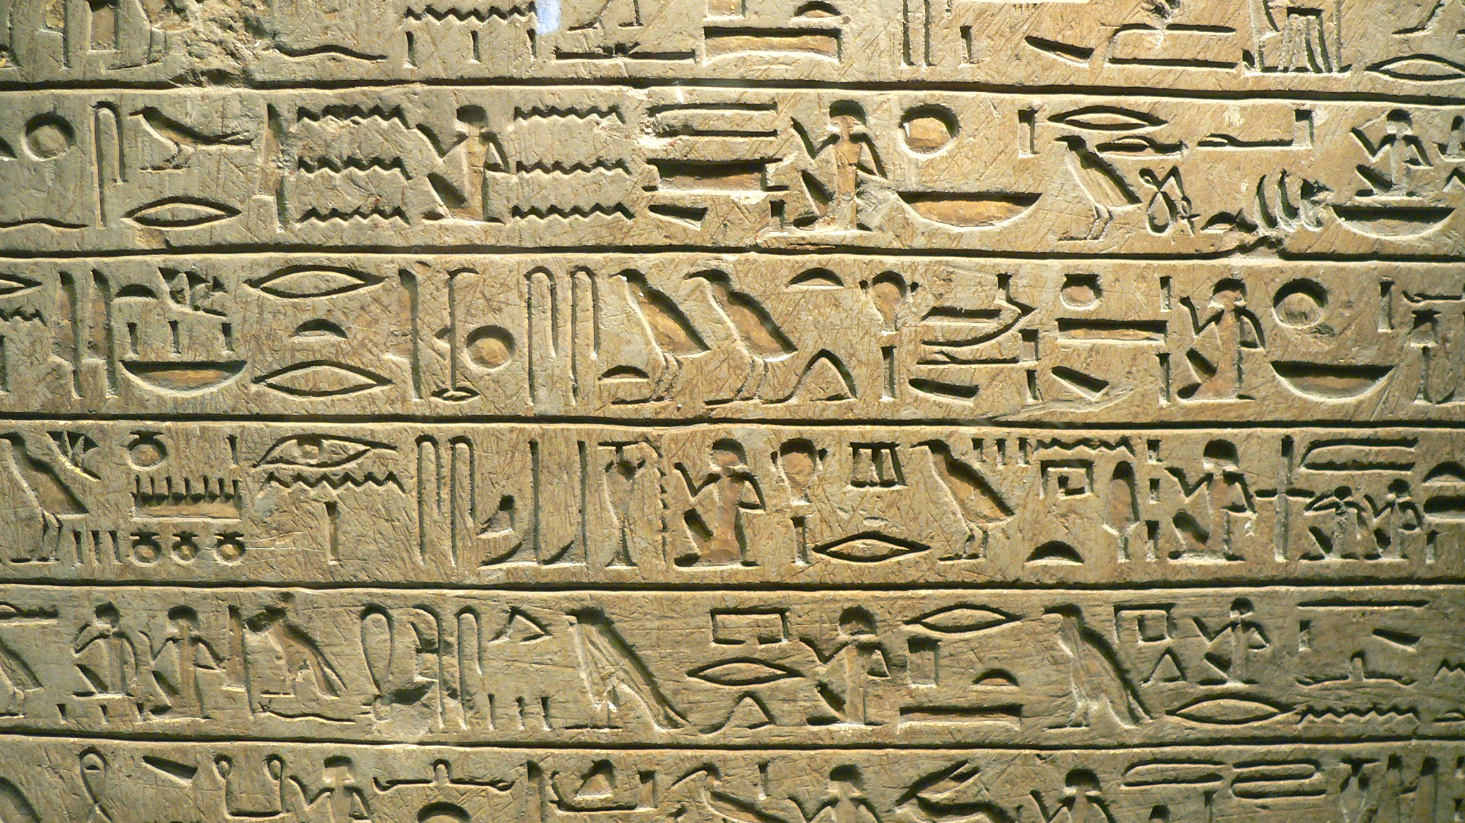

Slide 8
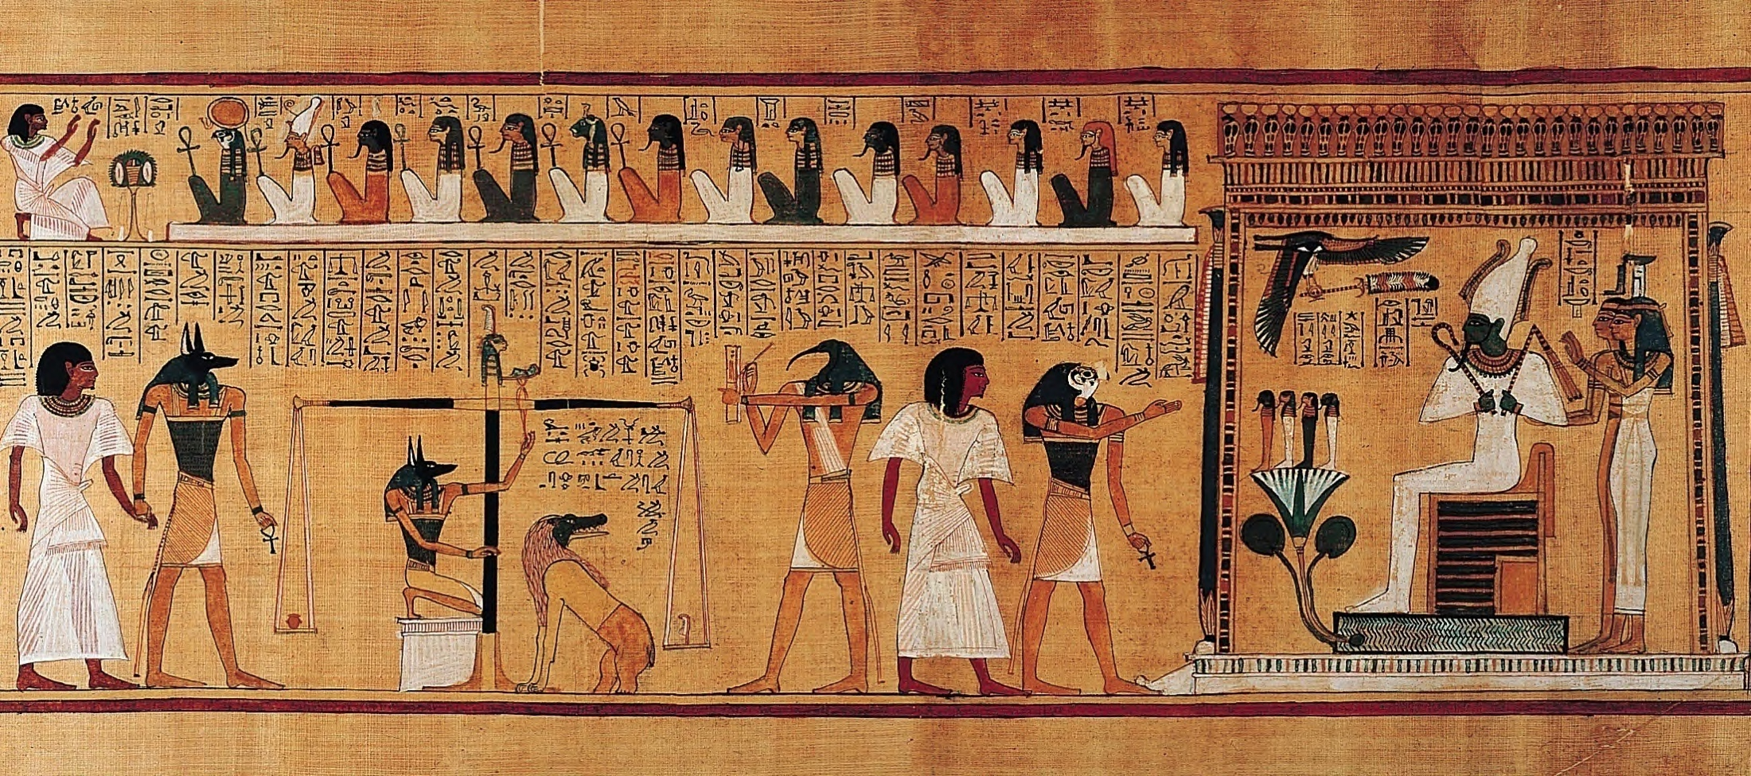

Slide 9
Storytelling in history
The use of narrative, stories as a way in organizing life.
Self-expressions
Communication process
Sharing of lessons learned, experiences
Mythical stories (i.e.: “The Epic of Gilgamesh”)

Slide 10
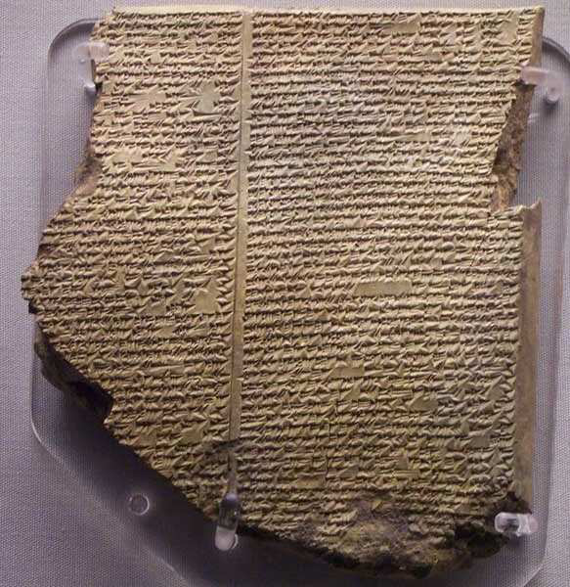
Notes:
THE FLOOD TABLET: “The Epic of Gilgamesh” is an epic poem from ancient Mesopotamia and among the earliest known literary writings in the world. It originated as a series of Sumerian legends and poems in cuneiform script dating back to the early 3rd or late 2nd millennium BCE, which were later gathered into a longer Akkadian poem (the most complete version existing today, preserved on 12 clay tablets, dates from the 12th to 10th Century BCE)

Slide 11
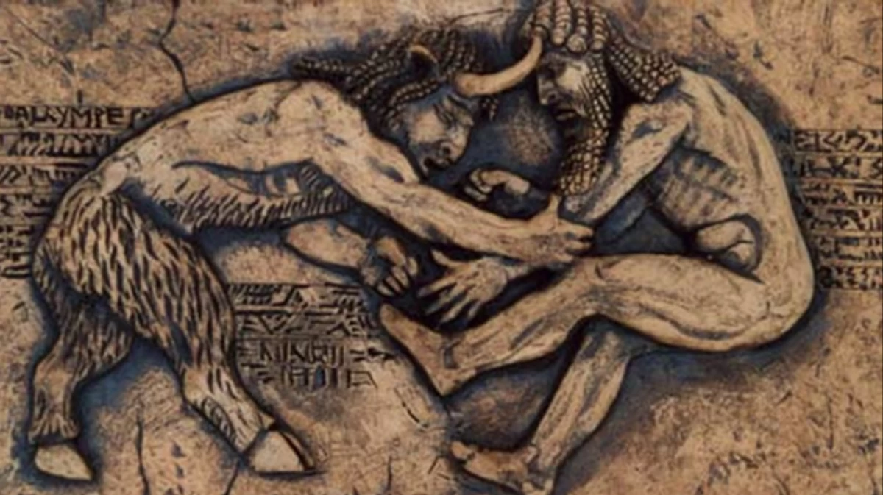
Notes:
Gilgamesh, the mythological hero-king of Uruk, and his half-wild friend, Enkidu, as they undertake a series of dangerous quests and adventures, and then Gilgamesh’s search for the secret of immortality after the death of his friend. It also includes the story of a great flood very similar to the story of Noah
Clear example that ancient civilizations used narratives to record the accounts of their origins and the affairs with their gods.

Slide 12
Rediscover of storytelling
Pre-Enlightenment worldview
Secularization of historical narratives
Rejection of metanarratives
The post-Christian world is one that has lost its story
  Confusion
  Fragmentation
  Contradiction
  Too many options, several competing stories
Notes:
Secularization of historical narratives: Who needs story or myth to make sense of the world when we have the hard sciences? Story and myth became nearly pejorative terms to describe tales that may have been helpful to premodern, technological unsophisticated audiences, but not to modern people.

Slide 13
Rediscover of storytelling
Today we can easily see an intentional emphasis on the importance of storytelling
  Oral cultures
  Written cultures
  Digital cultures
Storytelling on a multicultural context

Slide 14
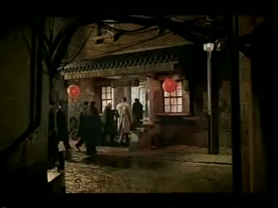

Slide 15
The search for identity
We have been created with curiosity, complexity, profound need for meaning
The longing for understanding the bigger questions of life brings new opportunities in reaching millennial generations
Life itself is a drama, a narrative
Need of stories that can define personal identity and give purpose to life

Slide 16
the art of storytelling

Slide 17
The power of storytelling
It is what connects us in our humanity
  It links us to our past
  It provides a glimpse into our future
It creates empathy

Slide 18
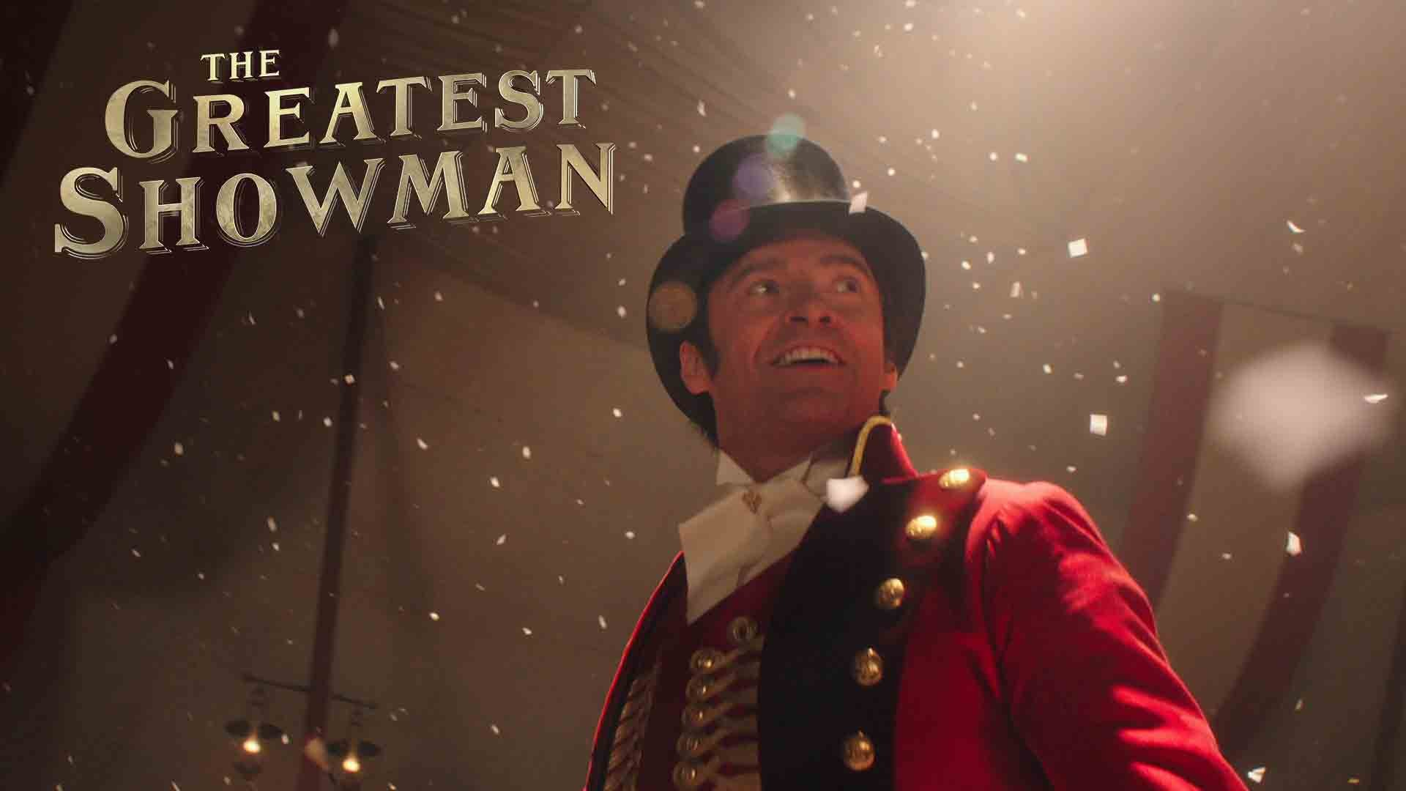
Notes:
Story of P.T. Barnum (creator of the show business)

Slide 19
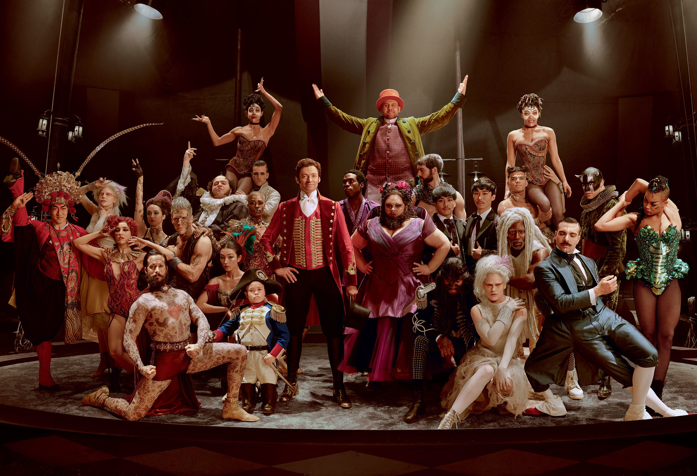
Notes:
Pride and defiance about overcoming prejudice and ignorance

Slide 20
The power of storytelling
It is what connects us in our humanity
  It links us to our past
  It provides a glimpse into our future
It creates empathy
Things happen to us (elements of a story)
We enjoy to hear stories with a beginning, a middle, and an end…
Why?

Slide 21
Our brains love good stories
Stories change our attitudes, beliefs, and behaviors
Good stories stick to our brains

Slide 22
Jennifer Aaker, Stanford University
Notes:
Stanford students had a minute to present a persuasive argument. Average - 2.5 statistics in their presentations.1 in 10 told a story
After 10 minutes … 5% remembered any statistic; 60% remembered the stories.

Slide 23
Jennifer Aaker, Stanford University
“Stories are remembered up to 22 times more than facts alone.”
Notes:
Stanford students had a minute to present a persuasive argument. Average - 2.5 statistics in their presentations.1 in 10 told a story
After 10 minutes … 5% remembered any statistic; 60% remembered the stories.

Slide 24
Our brain loves good stories
Stories change our attitudes, beliefs, and behaviors
Good stories stick to our brains
Oxytocin: neurochemical/hormone
  Regulates social interaction
  Guides sexual reproduction
  Empathy
  Generosity
  Creates the feeling of falling in love
Notes:
Article published in the Harvard Business Review by Dr. Paul Zak: “Why Your Brain Loves Good Storytelling”
Movie theater: heart rate increases, palms sweat – measuring the brain activity of some viewers

Slide 25
What stories can do for us?
Gain trust
Win hearts
Transform minds
Get decisions
Motivate people
Get us out of speeding tickets!

Slide 26
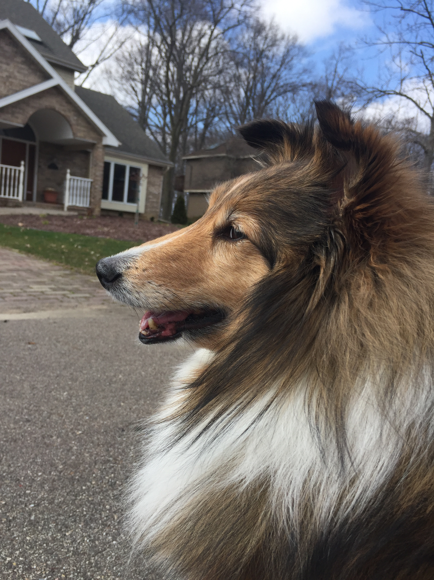

Slide 27
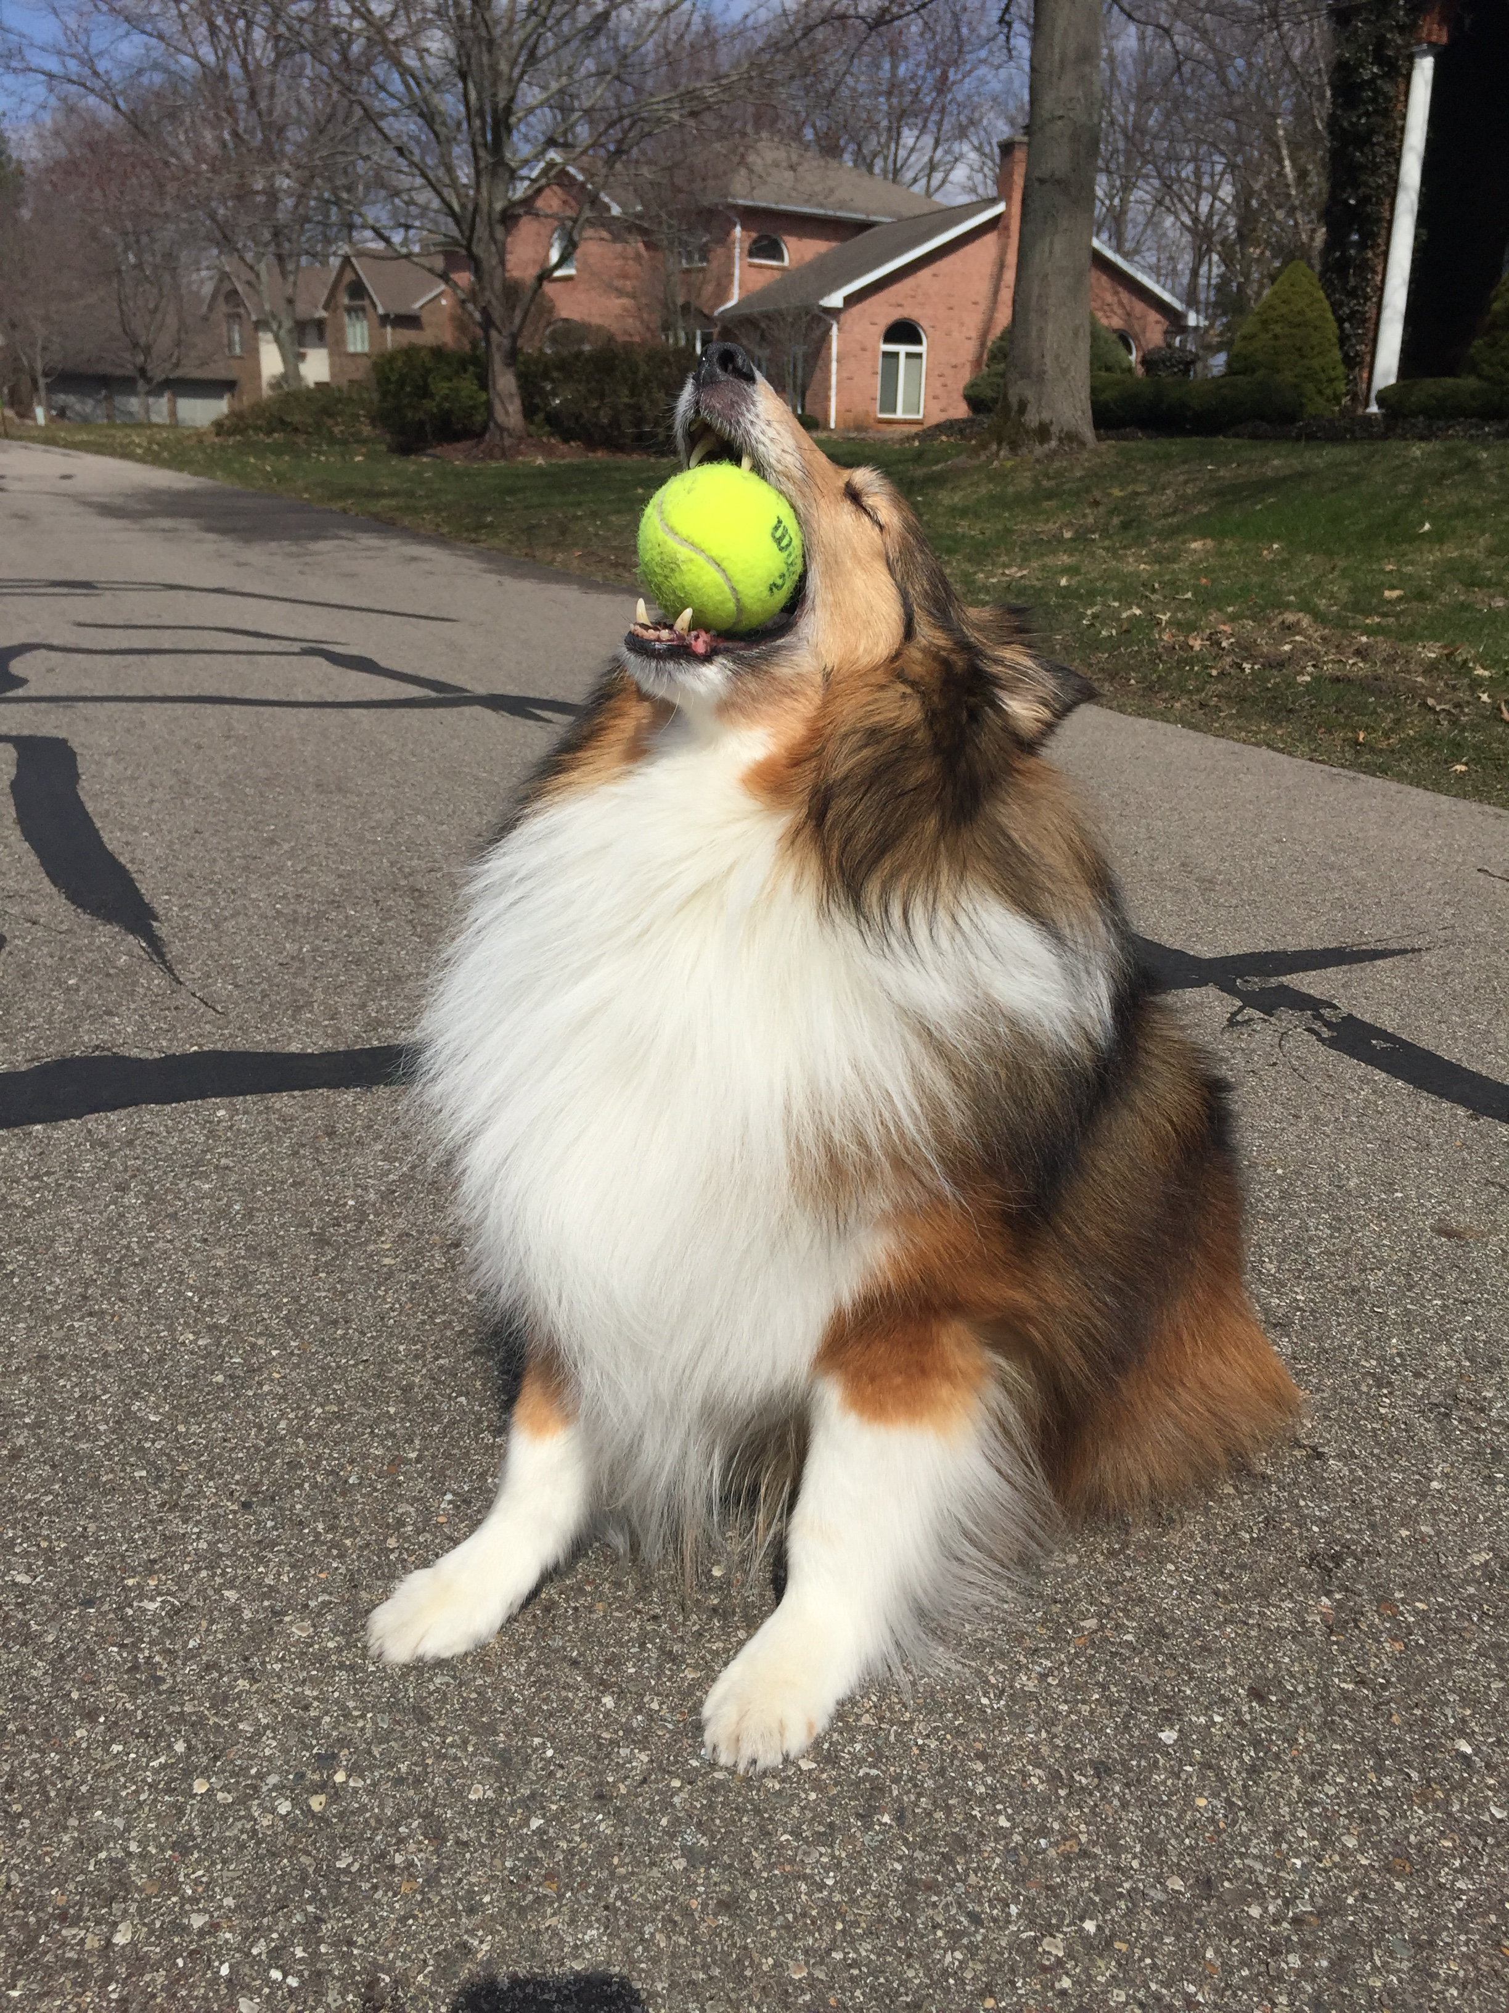

Slide 28
Keys to powerful stories
They touch our emotions

Slide 29
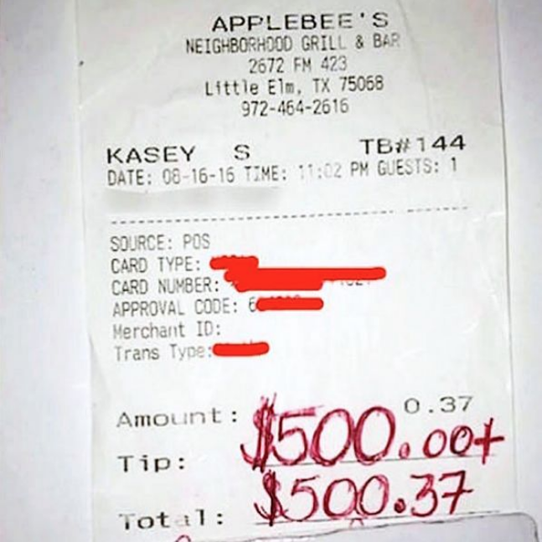
the emotion factor…
Notes:
Kasey Simmons, a waiter at an Applebee’s in Little Elm, Texas, was waiting in the checkout line at Kroger supermarket when he noticed the woman ahead of him had been crying. He decided to pay for the stranger’s $17 worth of groceries and gave her his contact info, along with an offer to come by his workplace for a coffee or dessert on the house to talk.
The next day, Simmons received a $500 tip on a 37-cent bill for a flavored water. A note on a napkin read,
“On behalf of the Sullivan family, I want to thank you for being the person you are. On one of the most depressing days of the year (the death of my father, 3 year anniversary) you made my mother’s day wonderful. She has been smiling since you did what you did.”

Slide 30
Keys elements to powerful stories
They touch our emotions
They put a face on an issue
They connect us
They show we are humans
They present “values”
They show, not simply tell

Slide 31
Simple structure for storytelling
Context
Character
Goal
Challenge/Conflict/Obstacles
Resolution

Slide 32
How to create/tell a story
Identify and understand your audience
  Who are they?
  What do they want?
  What do you have in common?
  What are their doubts, fears, misperceptions?
  What do they know?
  What is their mood, mindset, and culture?

Slide 33
How to create a story
Identify and understand your audience
Find and use the right character
Determine your goal
Present the challenge(s)
Bring it to resolution

Slide 34
storytelling path
Climax
Falling Action
(results)
Rising Action
(conflict)
Resolution
Exposition

Slide 35
the power of the biblical narrative

Slide 36


Slide 37
Becoming storytellers
We must develop the ability to think creatively and adapt wisely
New approaches in communicating the Eternal Gospel becomes imperative
Storytelling is one of the most powerful ways to reach younger generations

Slide 38
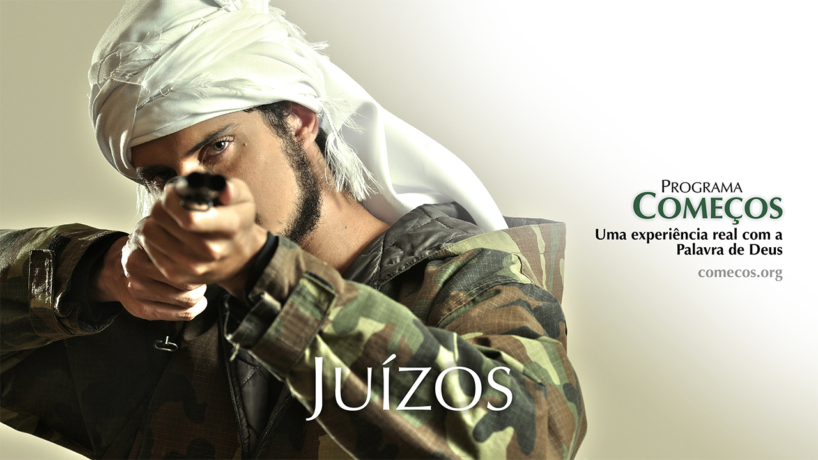

Slide 39
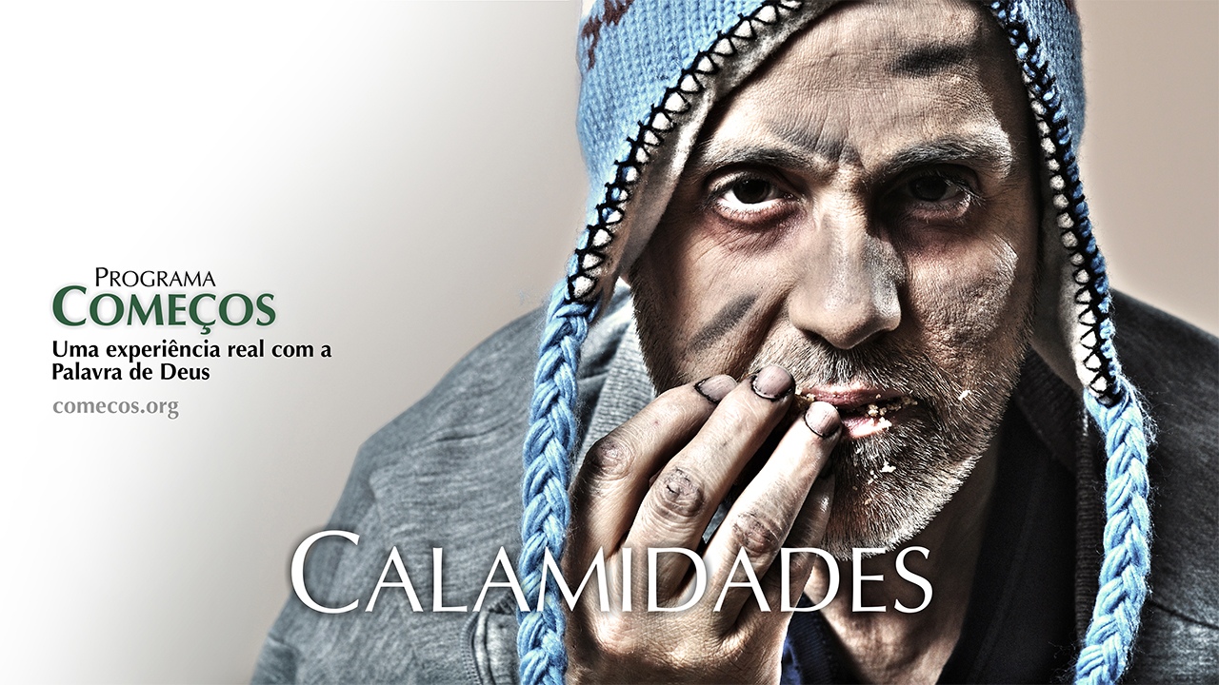

Slide 40
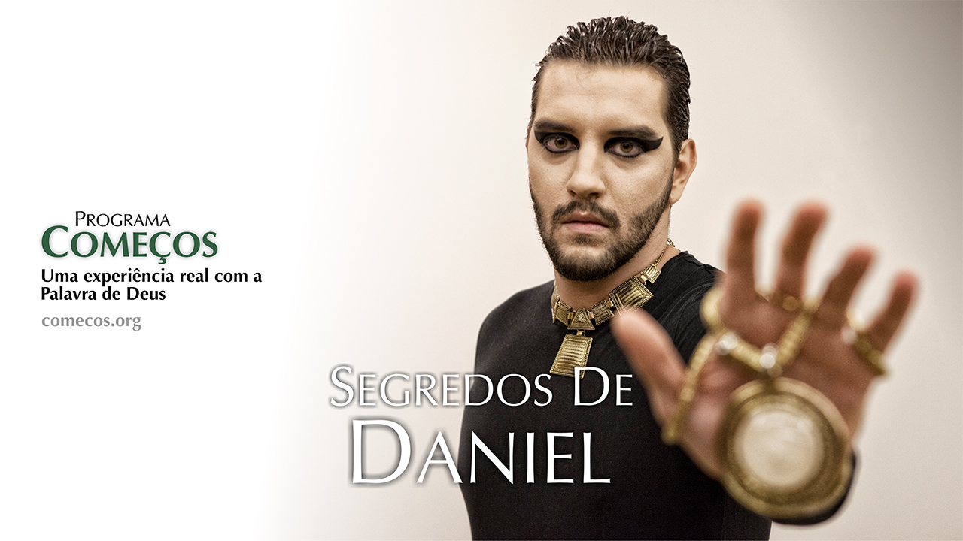

Slide 41
Becoming storytellers
We must develop the ability to think creatively and adapt wisely
New approaches in communicating the Eternal Gospel becomes imperative
Storytelling is one of the most powerful ways to reach younger generations
Nothing can substitute the relevance and applicability of biblical narrative in this process

Slide 42




THANK YOU!

Slide 43
group discussion

Slide 44
questions for group discussion
How do you relate to the fact that God was the first storyteller? How does it tell you the importance of storytelling to us, His creatures?
How can you intentionally incorporate storytelling in your ministry?
Read Luke 15:11-32 with a partner in two different Bible versions. Tell the story without looking to the text. What principles did you learn?

