Slide 1

Live a Real Experience with God:
Personal Reflections on My Own
Urban Mission Journey
re-Ignite the Advent Movement
New Zealand Pacific Union Conference
Ministerial Summit
Auckland, April 23-26, 2018
By Kleber D. Gonçalves

Slide 2


first steps

Slide 3
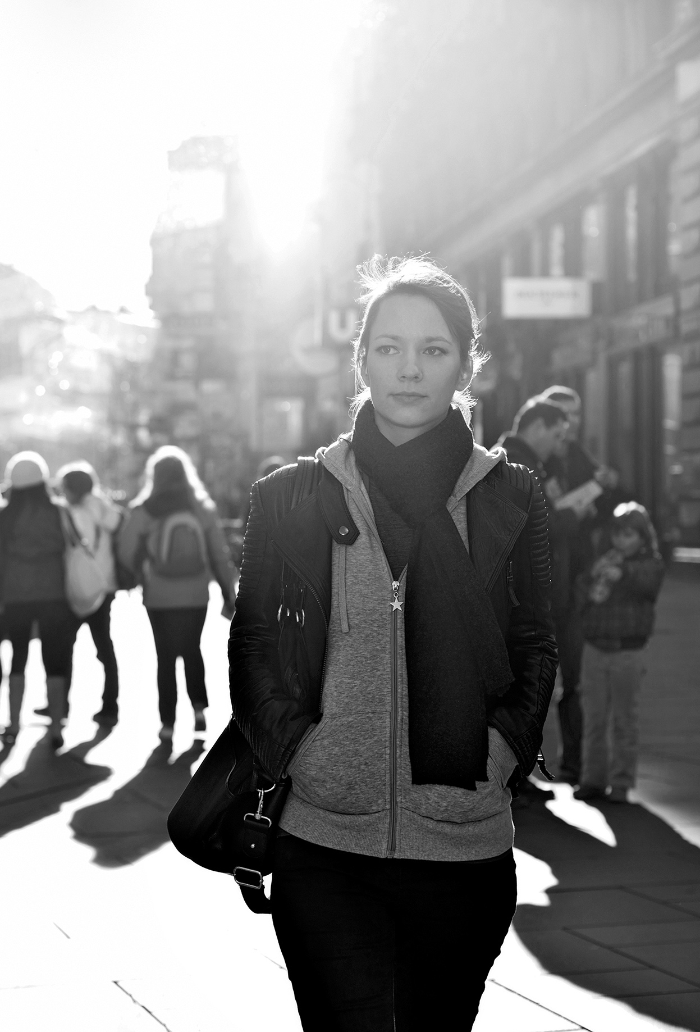
a real experience with God
Missional vision
Growth
Mission and discipleship as priorities
Ministerial structure
Opportunities for service
Community involvement

Slide 4
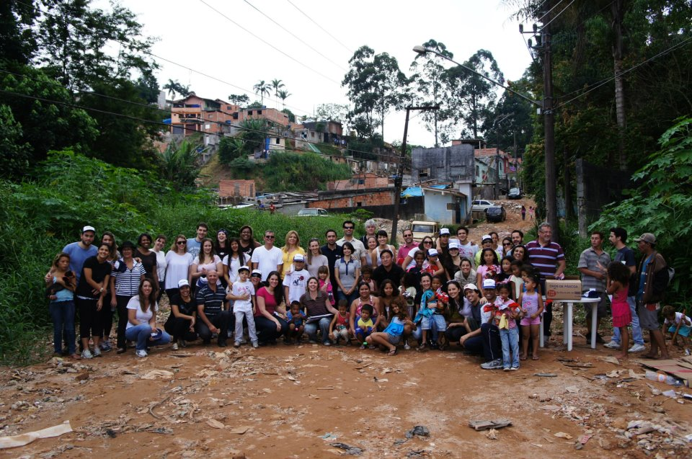

Slide 5
lessons learned

Slide 6

lessons learned
Church planting in an urban mission context
Importance of children’s ministries

Slide 9


Slide 10
lessons learned
Church planting in an urban mission context
Importance of children’s ministries
Dealing with “non-committed” Seventh-day Adventists
Importance of the full support from the local field
The power of community

Slide 11
case study: link

Slide 12
the power of community
Mobilization of younger generations
Intentional community development
Not only growth, but growing together
Mission AND discipleship

Slide 13


Slide 14
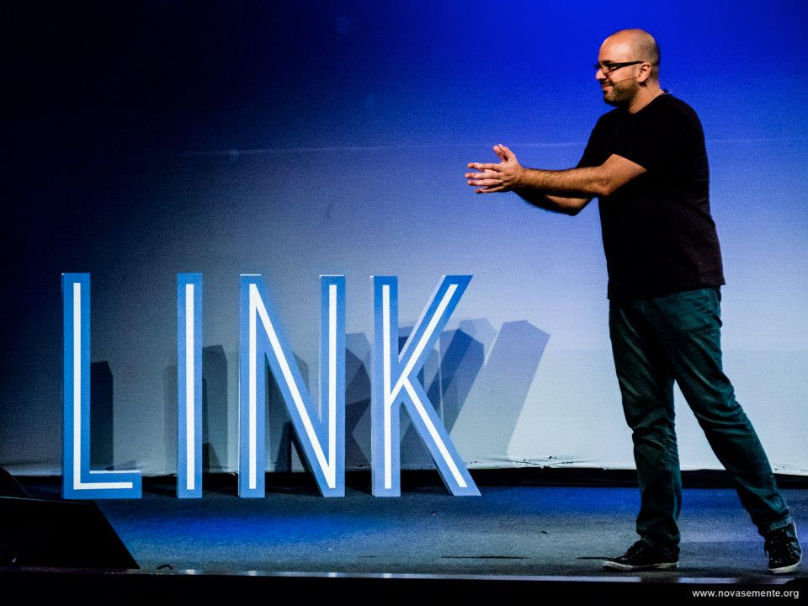

Slide 15

Intimity with God
(Jo 10:27)
8
Link
(100)
Discipleship
Intimity w/ the mission
(Jo 15:8)
Intimity with others
(Jo 13:35)
Link
(50)

Slide 16
lessons learned
Church planting in an urban mission context
Importance of children’s ministries
Dealing with “non-committed” Seventh-day Adventists
Importance of the full support from the local field
The power of community
Discipleship as a transformational process

Slide 17
discipleship = transformation
What is transformation?
How can it be achieved?
  Conversion (event)
  Happens over time
  Use of one’s will
  Individual journey
  Transformation

Slide 18
discipleship = transformation
This understanding about transformation has some basic presuppositions:
  Transformation happens in the moment of conversion (“surrender”)
  It continues (“grows”) as time goes by
  It is achieved mainly by an act of the will
  The best way is alone

Slide 19
discipleship = transformation
Transformation at conversion (event)?
  There is a deep, miraculous change of habits, attitude, and so on.
  This is the Saul/Paul model. The experience of the Damascus Road.
  Change is always the immediate result of conversion

Slide 20
discipleship = transformation
Continuous transformation as time goes by?
  Faith “automatically” grows with time.
  The greater is the “church experience” the more spiritually mature one becomes.
  In this model, the main effort in making disciples is only filling up the church with people.
  It is what really happens with time?

Slide 21
discipleship = transformation
Transformation is achieved only by an effort of the will?
  What does not happen with time, will happens when we make our best.
  The fruit of the Spirit always comes when we dedicate the required effort.
  In this model, the only barrier to become a disciple is the effort used.

Slide 22
discipleship = transformation
Transformation is better achieved alone?
  Independency, spiritual individualism
  A “personal relationship” with Jesus became synonymous of “particular relationship” with Jesus.
  The vast majority of books, seminars, sermons is centered on this idea: all is a matter of individual application.

Slide 23
discipleship = transformation
If these presuppositions were valid, the results would be a exponential growth, not only in numbers, but especially in the spiritual life of every church member
Why we do not see the transformation we dream of?
Wouldn’t be necessary an adjustment in these views on discipleship?

Slide 24
discipleship = transformation
Transformation begins at conversion (salvation)
  This is the view that we accept
  This is the beginning of the sanctification process
  This is a journey towards complete transformation.
  Paul himself experienced this reality.

Slide 25
discipleship = transformation
Transformation takes more than just time
  Being exposed to “information” is not enough.
  Have church members really understood and committed themselves to this process?
  Unfortunately, church pews are full of individuals who have been there for years but never went through real transformation.

Slide 26
Hebrews 5:12-13
“In fact, though by this time you ought to be teachers, you need someone to teach you the elementary truths of God’s word all over again. You need milk, not solid food! Anyone who lives on milk, being still an infant, is not acquainted with the teaching about righteousness.”

Slide 27
Hebrews 5:12-13
“In fact, though by this time you ought to be teachers, you need someone to teach you the elementary truths of God’s word all over again. You need milk, not solid food! Anyone who lives on milk, being still an infant, is not acquainted with the teaching about righteousness.”

Slide 28
discipleship = transformation
Transformation takes learning and not only personal desire (use of the will).
  “Trying” to experience life transformation never brings the results were need.
  “Train yourself to be godly.” (1 Timothy 4:7, NIV)
  Be a disciple does not happen simply by “trying.” It takes dedication and training.
  Discipleship involves teaching/learning.

Slide 29
discipleship = transformation
Transformation takes learning and not only personal desire (use of the will).
  “The student is not above the teacher, but everyone who is fully trained will be like their teacher.” (Luke 6:40, NIV)
  How much training is necessary?
  Disciple vs. “Discipler”
  Training for trainers (T4T)

Slide 30
discipleship = transformation
Transformation is also a process that happens within a community
  Example: AA
  What is their secret? System of relationships and personal support
  “As iron sharpens iron, so one person sharpens another.”(Proverbs 27:17, NIV)
  The value of community (Hebrews 10:24-25)

Slide 31
discipleship = transformation
Transformation is also a process that happens within a community
  Synergy created by the group
  The power of “small groups”
  In community we find the best environment to a healthy development of the discipleship process.
  It goes beyond growth. It is growing “together”
  Discipleship cannot be a lonely experience.

Slide 32
discipleship = transformation
What is transformation?
Some changes are essential:
  Conversion (event)
  Happens over time
  Use of one’s will
  Individual journey
  Transformation

Slide 33
discipleship = transformation
What is transformation?
Some changes are essential:
  Conversion (process)
  Happens over time
  Use of one’s will
  Individual journey
  Transformation

Slide 34
discipleship = transformation
What is transformation?
Some changes are essential:
  Conversion (process)
  Intentionality
  Use of one’s will
  Individual journey
  Transformation

Slide 35
discipleship = transformation
What is transformation?
Some changes are essential:
  Conversion (process)
  Intentionality
  Capacitation
  Individual journey
  Transformation

Slide 36
discipleship = transformation
What is transformation?
Some changes are essential:
  Conversion (process)
  Intentionality
  Capacitation
  Community
  Transformation

Slide 37
implications
Fundamental steps in a meaningful discipleship process:
  Need of continuous capacitation/training
    Spiritual disciplines
    Christian service
  Creation of opportunities for meaningful relationships
    Intentionality
    Group life

Slide 38
lessons learned:
Different formats, strategies, and methods can be used.
There is not such a thing as a “miraculous prescription” for discipleship.
Much prayer is needed.
The guidance of the Holy Spirit is essential.
It depends of the intentionality.
It depends of the efforts employed.

Slide 39
FollowMe “culture”

Slide 40
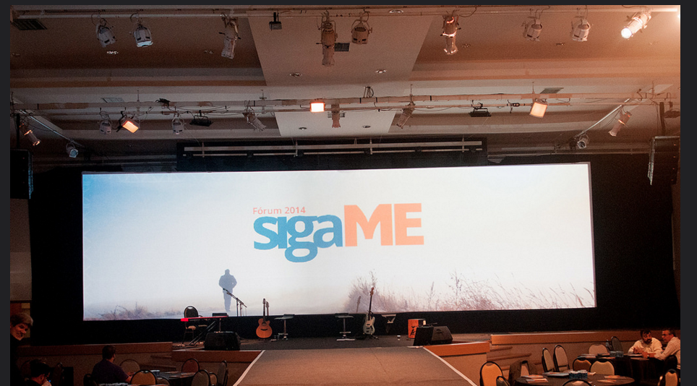

Slide 41

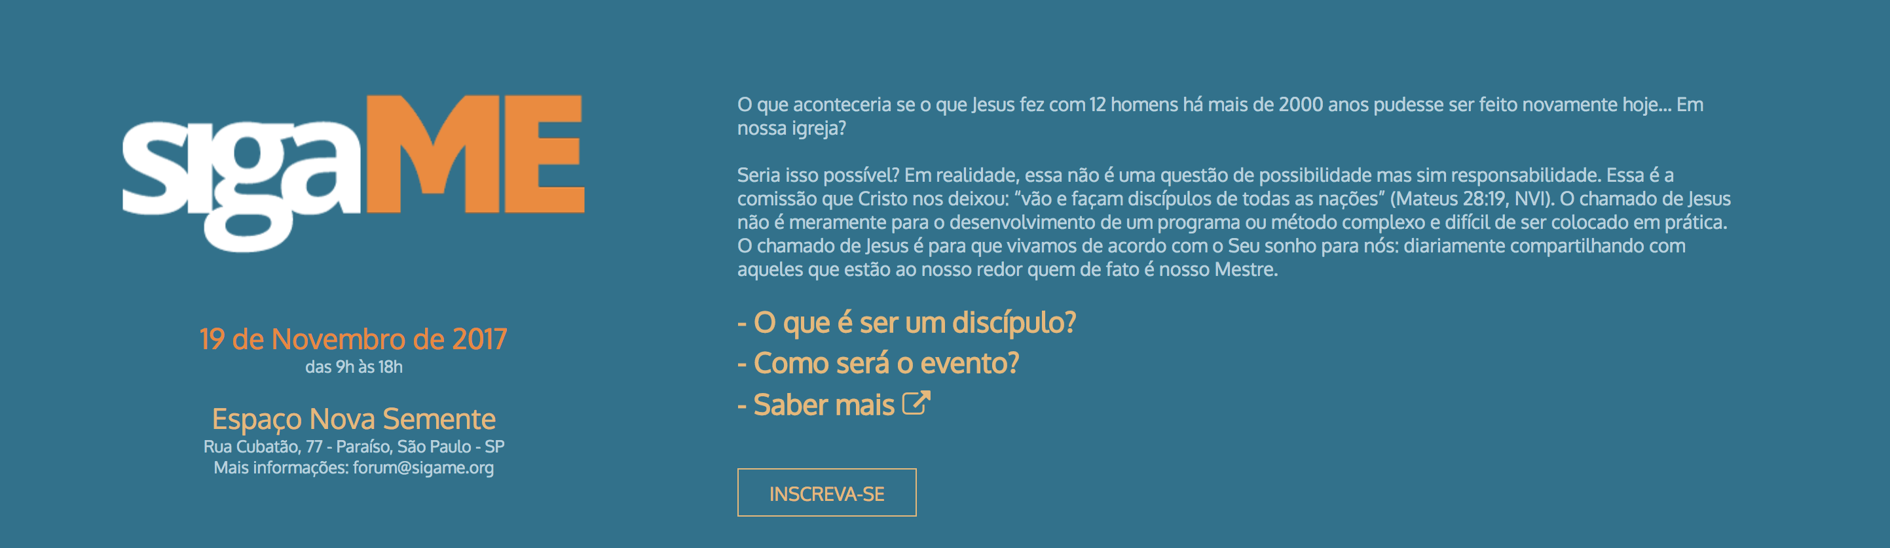

Slide 42
lessons learned
Church planting in an urban mission context
Importance of children’s ministries
Dealing with “non-committed” Seventh-day Adventists
Importance of the full support from the local field
The power of community
Discipleship as a transformational process
God works in mysterious ways

Slide 44
lessons learned
Church planting in an urban mission context
Importance of children’s ministries
Dealing with “non-committed” Seventh-day Adventists
Importance of the full support from the local field
The power of community
Discipleship as a transformational process
God works in mysterious ways

Slide 46
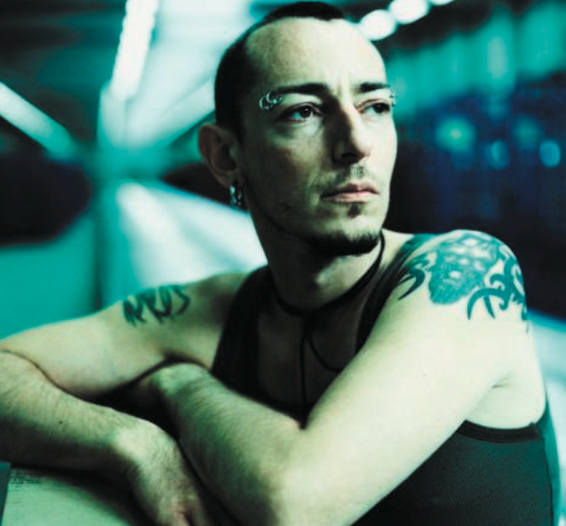
    THE 100th
    SHEEP
“I tell you that in the same way there will be more rejoicing in heaven over one sinner who repents than over ninety-nine righteous persons who do not need to repent.”
Luke 10:2

Slide 47


Slide 48

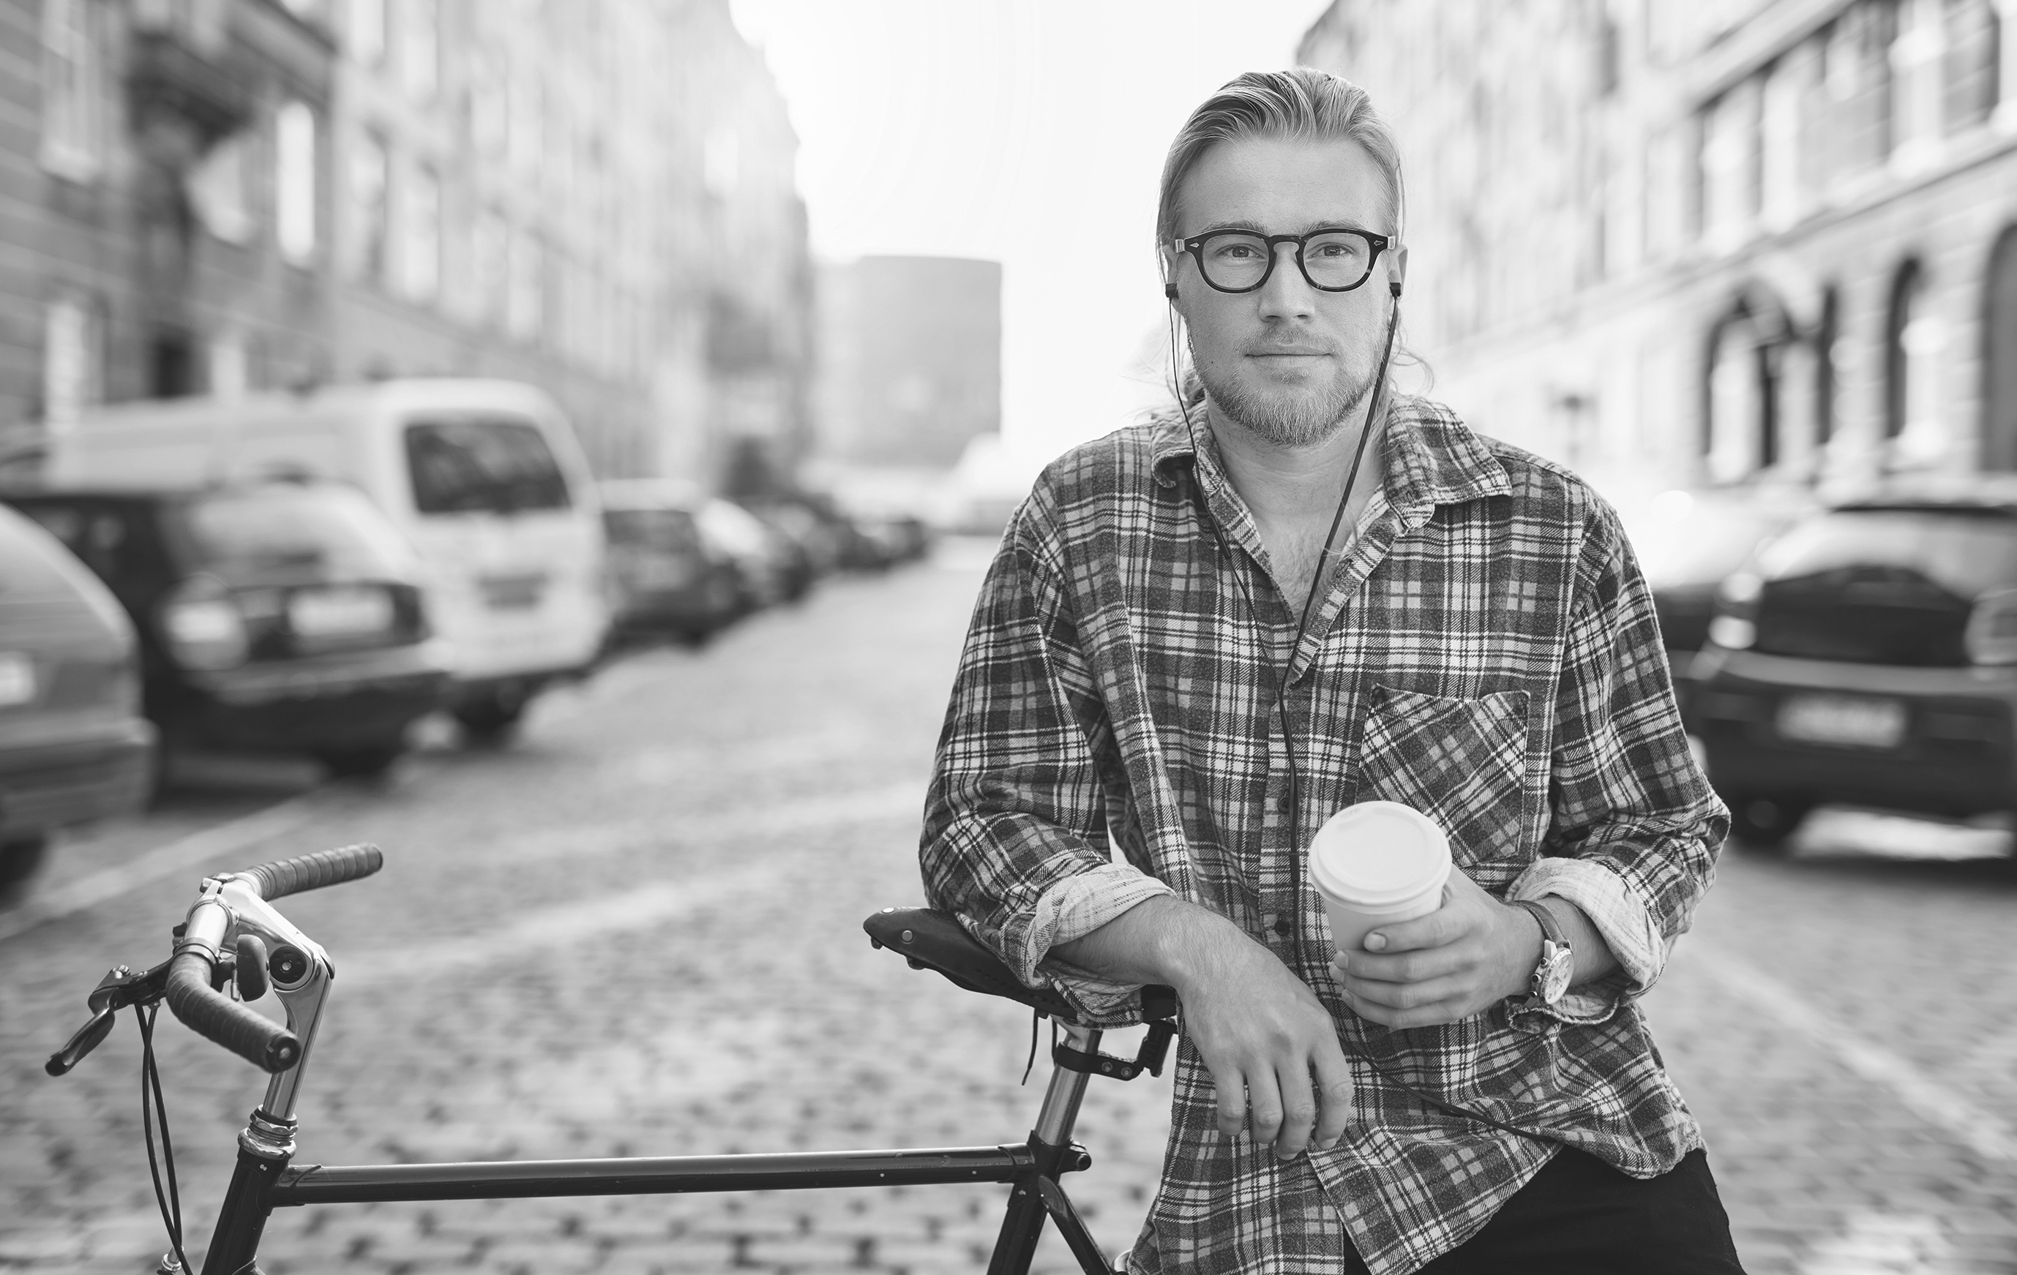


THANK YOU!

Slide 49
group discussion

Slide 50
questions for group discussion
What are some of the lessons you have learned in winning secular, non-Christian friends for Christ?
What practical steps can we take to implement a relevant and lasting discipleship process in our churches?
How can we create communities where people can indeed have a real experience with God?

