Slide 1

Transforming Discipleship:
New Opportunities in Following the Master
in a Post-Christian World
re-Ignite the Advent Movement
New Zealand Pacific Union Conference
Ministerial Summit
Auckland, April 23-26, 2018
By Kleber D. Gonçalves

Slide 2


a choice

Slide 3
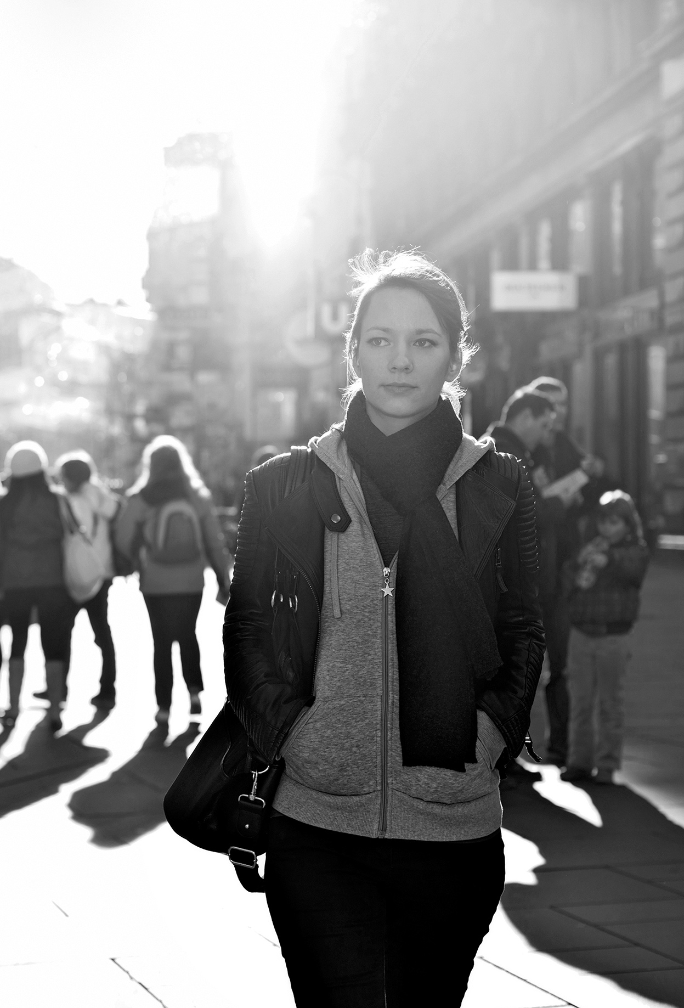
discipleship: the original purpose
“Come follow me . . . and I will make you fishers of men” (Matt 4:19 NIV).
Life transforming journey
Very intentional and purposeful process
Pattern for “discipleship”
“Follow me . . .”

Slide 4
today’s reality
Brief orientation/training
  Doctrinal teachings
  Denomination beliefs
Baptism
Automatic assimilation in the body?
Devoted disciples?

Slide 5
results…
Names on church books
Regular “customers” looking for a “religious product”
Very few committed, passionate followers of Christ
Focus remains on personal choices
Religious routine

Slide 6
what are we missing?
Membership vs Discipleship
Where should be our primary goal?
How can we be meaningful and relevant?
How can we impact post-Christian generations with the transforming power of the Eternal Gospel?

Slide 7
the historical discipleship journey

Slide 8

the historical discipleship path
Throughout history experiences and lessons learned have been transmitted to the next generations
Bible examples:
  Moses – Joshua
  Elijah – Elisha
  Paul – Timothy

Slide 9
2 Tim 1:13-14; 2:2
“What you heard from me, keep as the pattern of sound teaching, with faith and love in Christ Jesus. Guard the good deposit that was entrusted to you—guard it with the help of the Holy Spirit who lives in us. […] And the things which you have heard from me in the presence of many witnesses, entrust these to faithful men who will be able to teach others also.”

Slide 10
2 Tim 1:13-14; 2:2
“What you heard from me, keep as the pattern of sound teaching, with faith and love in Christ Jesus. Guard the good deposit that was entrusted to you—guard it with the help of the Holy Spirit who lives in us. […] And the things which you have heard from me in the presence of many witnesses, entrust these to faithful men who will be able to teach others also.”

Slide 11
2 Tim 1:13-14; 2:2
“What you heard from me, keep as the pattern of sound teaching, with faith and love in Christ Jesus. Guard the good deposit that was entrusted to you—guard it with the help of the Holy Spirit who lives in us. […] And the things which you have heard from me in the presence of many witnesses, entrust these to faithful men who will be able to teach others also.”

Slide 12
2 Tim 1:13-14; 2:2
“What you heard from me, keep as the pattern of sound teaching, with faith and love in Christ Jesus. Guard the good deposit that was entrusted to you—guard it with the help of the Holy Spirit who lives in us. […] And the things which you have heard from me in the presence of many witnesses, entrust these to faithful men who will be able to teach others also.”

Slide 13
discipleship in the Greco-Roman culture
The Greek word μαθητής was used by Herodotus, Plato, and Socrates centuries before Jesus
  Learner/trainee
  Pupil/apprentice
  Disciple/adherent
Direct contact with the teacher, however, was not a prerequisite to following his teachings.
Notes:
For instance, “one could follow the teachings of Socrates simply by adopting the way of life promoted by the person of Socrates as developed in the writings of Plato. A disciple could also conform their habits to a way of life that exemplified the virtues of a particular culture or city” (Ferguson 2003:330).
Towards the end of the Hellenic era the focus gradually shifted to the kind of relationship that involved more of a philosophical commitment rather than the obligation to follow the master himself.

Slide 14
discipleship in the 1st century Jewish culture
Commitment to well-known teachers or movements
Training was done in community, having the Torah as the center of the learning process
Paul – Gamaliel (Acts 5:34; 22:3)
Devotion to follow a prominent teacher, carrying on his teachings, and imitating his life.
Notes:
If further education was desired—in preparation for being a scribe, a judge, a teacher of the Law, and so on—they had to become a disciple under the orientation of a recognized Torah scholar
The apostle Paul was a fine example of a Jewish boy who left his home in Tarsus of Cilicia to study the Torah under Gamaliel, a renowned Rabbi in Jerusalem (Acts 5:34; 22:3).

Slide 15
discipleship in the 1st century Jewish culture
In the Hebrew context, discipleship meant much more than just the sharing of cognitive information, but also one’s life experience—within the context of community, starting in the family and then to others.
It indicated not only the acceptance of the master’s values and embracing his principles, but ultimately reproducing his ideas and beliefs in practical ways.
Notes:
If further education was desired—in preparation for being a scribe, a judge, a teacher of the Law, and so on—they had to become a disciple under the orientation of a recognized Torah scholar
The apostle Paul was a fine example of a Jewish boy who left his home in Tarsus of Cilicia to study the Torah under Gamaliel, a renowned Rabbi in Jerusalem (Acts 5:34; 22:3).

Slide 16
the post-Christian world: a dangerous opportunity to discipleship

Slide 17
a dangerous opportunity
Moment of crisis
Secularism
De-Christianization of the West
Religiously unaffiliated
“[C]risis is . . . not the end of opportunity but in reality only its beginning, the point where danger and opportunity meet” (David Bosch, TM, 3)

Slide 18
21st century challenges to discipleship
Consumerism
  Shift from a culture based on production to a culture based on consumption
  Active process to create pleasure and meaning as a new source in finding one’s personal identity through a personal experience with the product
  Core value: personal choice
  Spiritual dimension
  Result: ”hummingbird” Christianity
  Personal choices are above God’s purposes

Slide 19
21st century challenges to discipleship
Religious pluralism
  Diversity in urban contexts
  People try to fulfill their spiritual needs through any kind of “religion” and/or spiritual development
  Result: postmodern secularization of religion
  Many are not willing to believe in what they do not appreciate
  Openness to any type of spiritual experiences
  The Christian call: to follow the only Way, the True Master (John 14:6; Luke 9:23).

Slide 20
21st century opportunities to discipleship
Search for real spiritual experiences
  It has its own contours
  They may be looking for spiritual experiences but the last place they expect this to happen is the church!
Experiential spirituality
Authentic spirituality

Slide 21
21st century opportunities to discipleship
Search for real community experiences
  The importance of meaningful relationships
  Fear of exclusion, loneliness
Social Media revolution and its implications
Many are looking for a community to belong to, before they find a message to believe in.

Slide 22
transforming discipleship

Slide 23
meaning of discipleship
Discipleship today is a concept much broader than what it was in the past.
Result of the integration of three movements:
  Classical discipleship
  Biblical spirituality
  Relational discipleship

Slide 24
following the Master
Christ taught us that having faith means to follow.
This is the first test of faith.
This is the basic presupposition of discipleship.

Slide 25
Luke 9:23
“If anyone desires to come after Me, let him deny himself, and take up his cross daily, and follow Me.”

Slide 26
Why is there so much resistance?
Submission
Vulnerability
Transformation
Effort
Commitment
Discipline
Obedience

Slide 27
conclusions…

Slide 28
two paths of discipleship
A process in developing knowledge (Greco-Roman approach)
  Intellectual, philosophical understanding
  Cognitive exchange of ideas
A process in following a Master (Jewish approach)
  How to become “like” the master
  Transformational process

Slide 29
two paths of discipleship
We as church, in general terms, still place considerable emphasis on the Western, Greek-based intellectual/cognitive aspect of discipleship.
This is not wrong, but it is not enough.
Discipleship needs to have a deeper understanding and practice, especially when we are focusing millennial generations

Slide 30
challenges and opportunities
Looking at the consumeristic and pluralistic realities cherished and nurtured by Post-Christian contexts, accepting God’s call has to be more than just intellectually accepting doctrinal instruction.
We need more than numerical growth, we need more than church members, we need real disciples who have accepted the invitation: “Come follow me…”

Slide 31

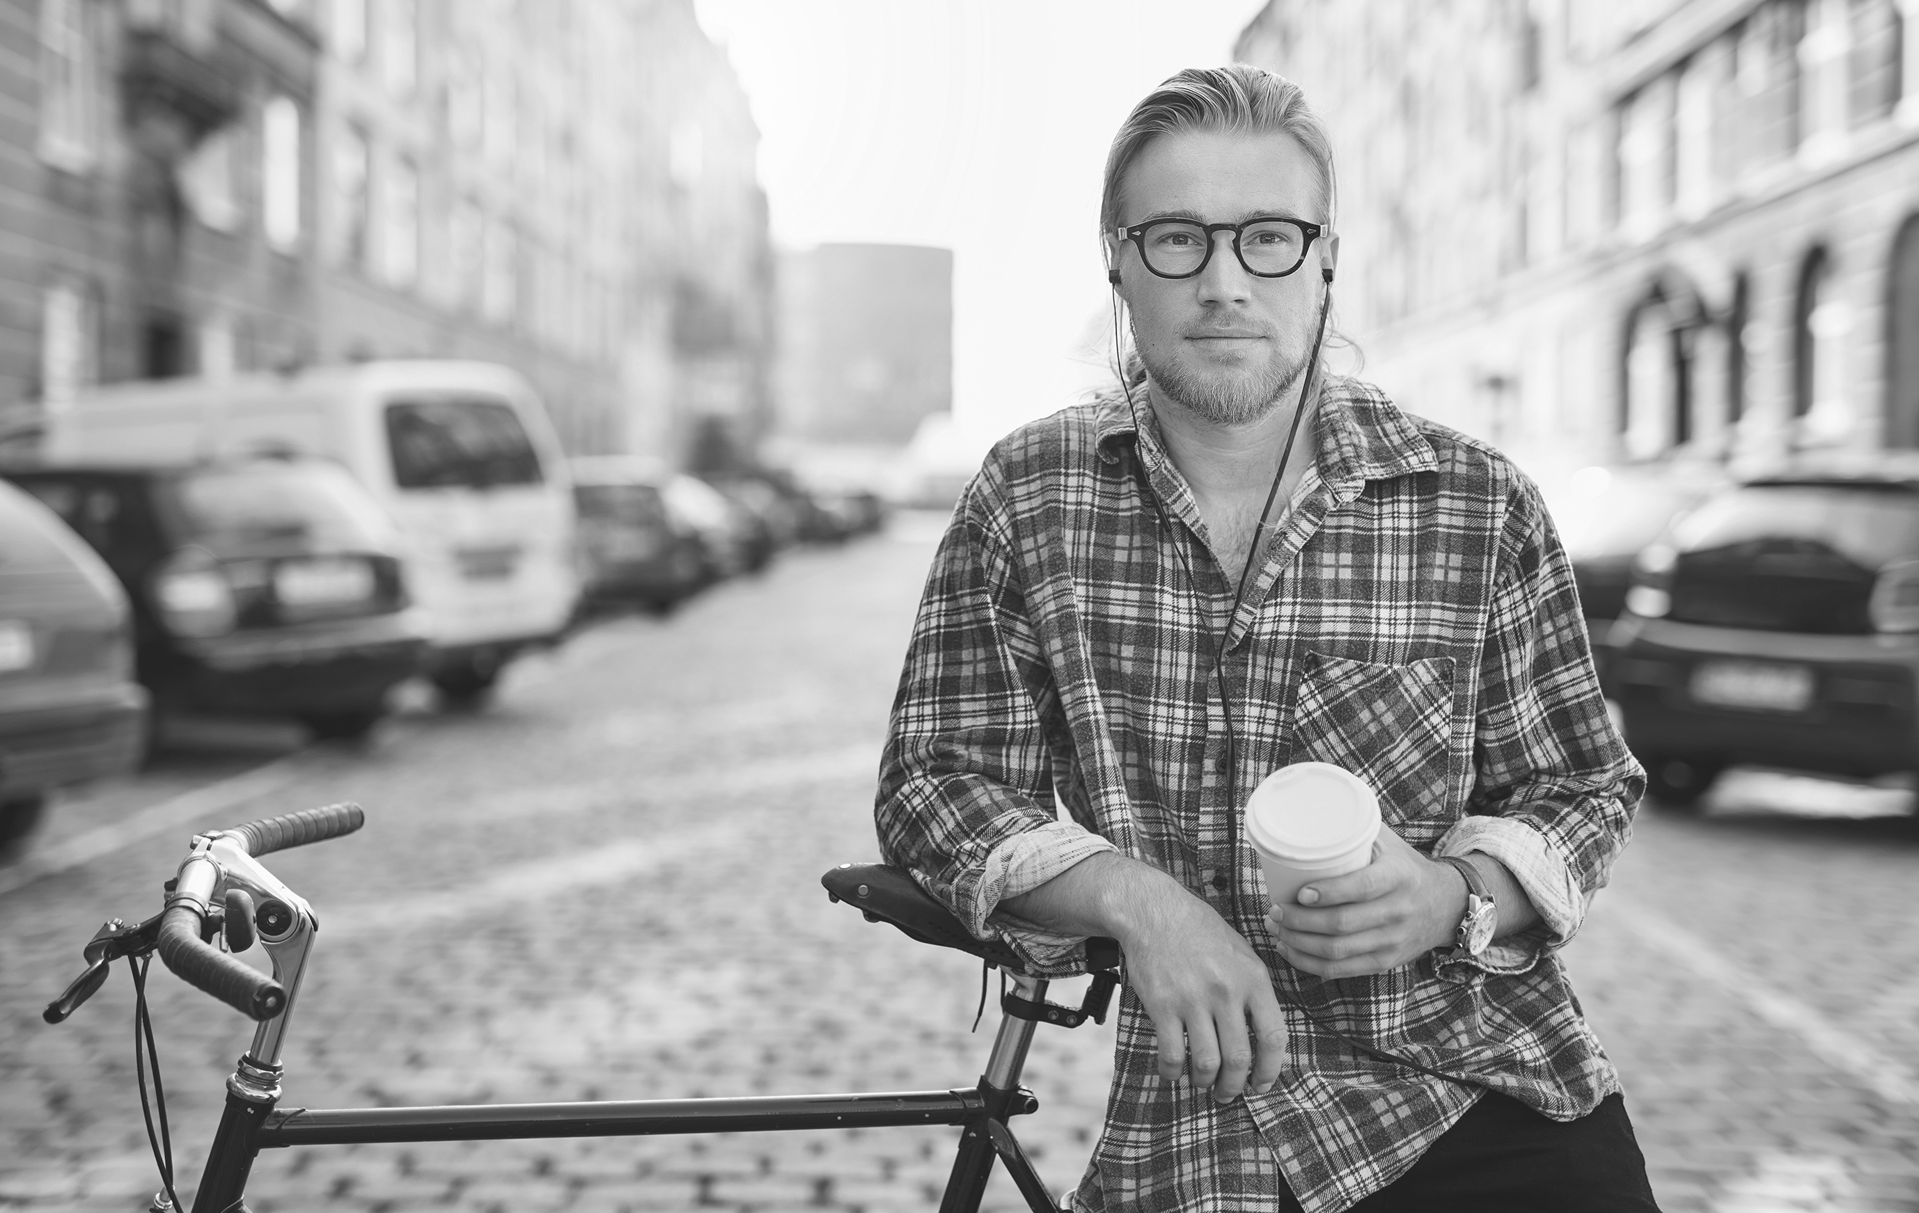


THANK YOU!

Slide 32
group discussion

Slide 33
group discussion questions:
How can we move from a cognitive/intellectual focused discipleship to a transformational experience?
What can you practically do to make discipleship a real experience in your own context (personal, family, church, job)?

