Slide 1

The Journey of Adolescence
Dr Nick Kross
Director of Youth Ministries, SPD.

Slide 2
Are you an adult??
How do you know??

Slide 3
The Task of: Individuation
What it looks like now..
Identity:
Who am I?
Do my Choices matter?
Autonomy:
It’s about Power (Agency)
Belonging:
Where do I fit in?

Slide 4




Systemic Abandonment

Slide 5
Timing and Duration
Puberty Culture
Pre 1900s 14.5 16
1980 13 18-20
Today 12 Mid 20s

Slide 6
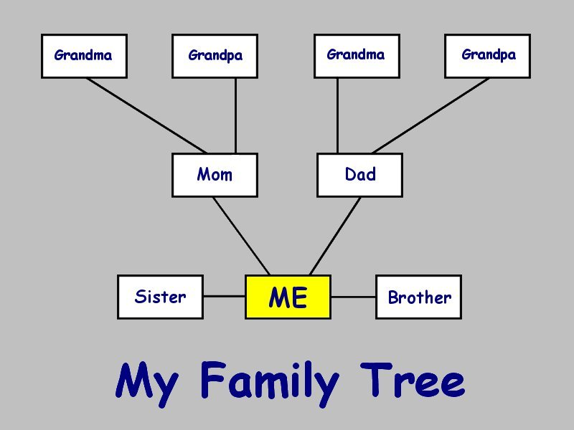

Slide 7
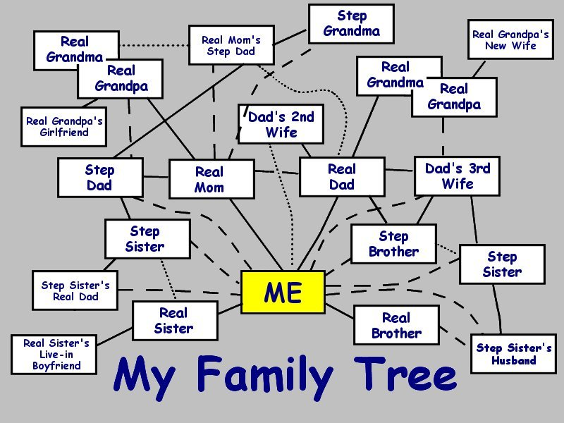

Slide 8
The situation for adolescents today
Skills needed for successful adulthood

Slide 9
The situation for adolescents today
Ongoing adult support and guidance offered

Slide 10
The situation for adolescents today
Skills needed
1980s
Adult guidance
and support

Slide 11
The situation for adolescents today
“…These two trends have created a serious problem in our country, indeed a crisis.”
Dr. James Comer, Yale
Carnegie Corporation’s Commission on Youth Development and Community Programs, 1989

Slide 12
Discipleship
Social Capital: Investing in Adolescents
Social Scaffolding: Skills Qualities they receive

Slide 13

Adolescents often have multiple candles burning.
School, Family, Church, Friends, Internet, Games, Sims, Facebook, Twitter, Vine, Instigram, Snapchat etc.
Note: They need to eventually
bring these multiples identities
together into one candle and
become resolved as one person.
Multiple Candles

Slide 14
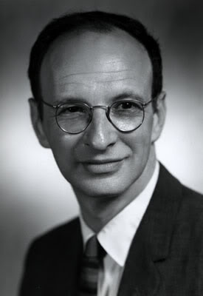
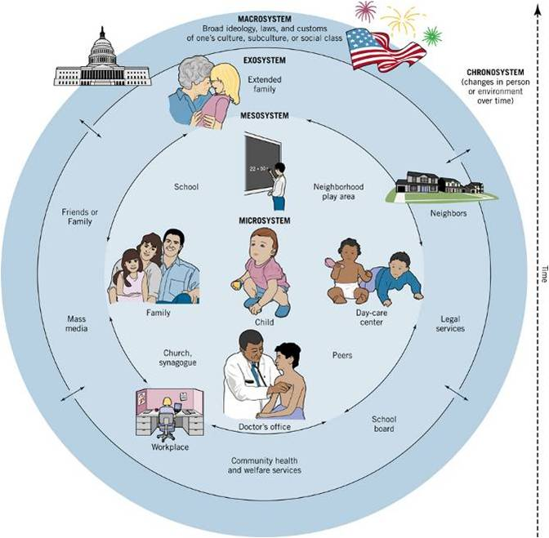
4 Spheres of adolescent influence
Urie Bronfenbrenner
Media/Ecology
  Non-parental non-committed adults/peers
Non-parental committed adults/peers
Loving Parents

Slide 15
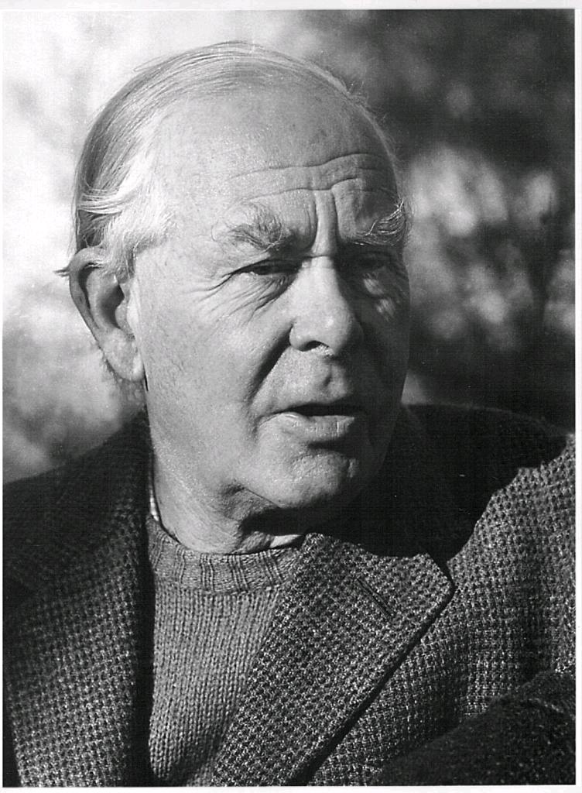
What an adolescent needs …
John Bowlby
Early Mid Late
11/12
14/15
19/21
Mid to late 20s
Paternal & Maternal Attachment
Maternal
& Paternal
Attachment
Trust
Communication
Closeness
Emerging
Adulthood
Family safety and stability
A Safe Haven

Slide 16
What you need as an adolescent …
Who’s going to help you through...
Early Mid Late
11/12
14/15
19/21
Mid to late 20s
Paternal Attachment
Maternal Attachment
Pathfinder
Youth
Leaders
Emerging
Adulthood
Extended Family
Family safety and stability
A Safe Haven

Slide 17
Fines, Loss of license etc.
Licenses, Speed limits
Quality Time
Hospitals
5-7 Mentors
Social Scaffolding
Life
Values
Social Capital
Adolescents
Pathfinders
Child Protection
Principles
Standards
Rules

Slide 18
Developing a Biblical Theology of Ministry to Adolescents
Primacy of Relationships & Mentoring
    Peer to Peer
    Adult to Youth
    Youth to Adult
Where both are led into a closer relationship with Christ
Every adolescent needs 5-7 mentors

Slide 19
Then Jesus called for the children and said to the disciples, "Let the children come to me. Don't stop them! For the Kingdom of God belongs to those who are like these children.” Lk 18:16

Slide 20
Adoption Model
As apostles of Christ we could have been a burden to you, but we were gentle among you, like a mother caring for her little children. We loved you so much that we were delighted to share with you not only the gospel of God but our lives as well, because you had become so dear to us.
1 Thes. 2:6-8
Unchurched youth
Church body

Slide 21
Adoption Model
For you know that we dealt with each of you as a father deals with his own children, encouraging, comforting and urging you to live lives worthy of God, who calls you into his kingdom and glory.
1 Thes. 2:11-12
Unchurched youth
Church body

Slide 22
The youth need more than a casual notice, more than an occasional word of encouragement. They need painstaking, prayerful, careful labor. He only whose heart is filled with love and sympathy will be able to reach those youth who are apparently careless and indifferent. Not all can be helped in the same way. God deals with each according to his temperament and character, and we must co-operate with Him. Often those whom we pass by with indifference, because we judge them from outward appearance, have in them the best material for workers, and will repay all the efforts bestowed on them. There must be more study given to the problem of how to deal with the youth, more earnest prayer for the wisdom that is needed in dealing with minds.
E G W, Gospel Workers. p208.

